Slide 1

Latent-Factors Based
Recommender Systems
Mining Massive Datasets
Carlos Castillo
Topic 18

Slide 2
Sources
Data Mining, The Textbook (2015) by Charu Aggarwal (Section 18.5) – slides by Lijun Zhang
Mining of Massive Datasets 2nd edition (2014) by Leskovec et al. (Chapter 9) - slides A, B

Slide 3
Key idea
Summarize the correlations across rows and columns in the form of lower dimensional vectors, or latent factors
These latent factors become hidden variables that encode the correlations in the data matrix in a concise way and can be used to make predictions
Estimation of the k-dimensional dominant latent factors is often possible even from incompletely specified data

Slide 4
Modeling
n users:
d items:
Approximate rating r_{ij} by
Approximate rating matrix D = [r_{ij}]_{n x d}

Slide 5
Singular Value Decomposition
SVD
Truncated SVD
Note: SVD is undefined for incomplete matrices

Slide 6
Matrix factorization
SVD is a special form of matrix factorization
Objective when D is fully observed
Objective when D is partially observed
  Ω is the set of observed cells

Slide 7
Non-negative, regularized matrix factorization
Matrix factorization
Objective:
  Ω is the set of observed cells in the matrix
  U ≥ 0, V ≥ 0

Slide 8
Example 1: grocery shopping

Slide 9
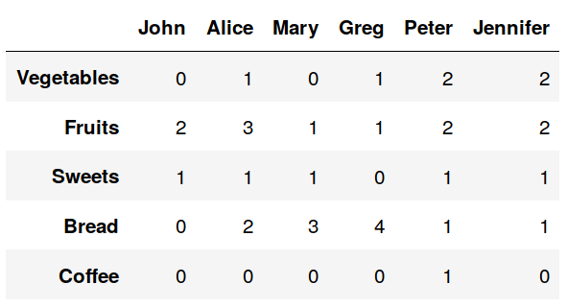
Example: grocery shopping
This purchase history indicates the number of time each person has purchased an item
For clarity we’re dealing with categories of items, but they can be the items themselves
This example (2018) by Piotr Gabrys

Slide 10
In Python
Python code
V = np.array(
[[0,1,0,1,2,2],
[2,3,1,1,2,2],
[1,1,1,0,1,1],
[0,2,3,4,1,1],
[0,0,0,0,1,0]])
V = pd.DataFrame(V, columns=['John', 'Alice', 'Mary', 'Greg', 'Peter', 'Jennifer'])
V.index = ['Vegetables', 'Fruits', 'Sweets', 'Bread', 'Coffee']
This example (2018) by Piotr Gabrys

Slide 11
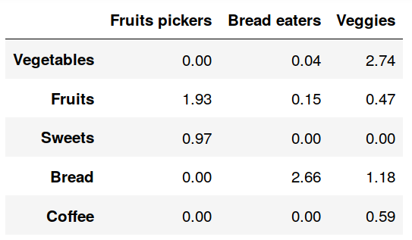
Matrix factorization (V ≃ WH)
Matrix W (items x factors) with possible names for each factor added for legibility
Python code
from sklearn.decomposition import NMF
nmf = NMF(3)
nmf.fit(V)
H = pd.DataFrame(np.round(nmf.components_,2), columns=V.columns)
H.index = ['Fruits pickers', 'Bread eaters', 'Veggies']
W = pd.DataFrame(np.round(nmf.transform(V),2), columns=H.index)
W.index = V.index
This example (2018) by Piotr Gabrys

Slide 12
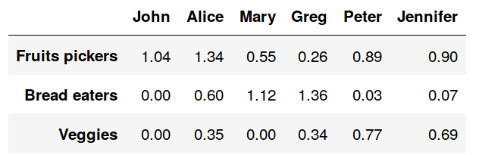
Matrix W (items x factors)
Possible names for each factor added for legibility
Matrix H (factors x people)
This example (2018) by Piotr Gabrys

Slide 13
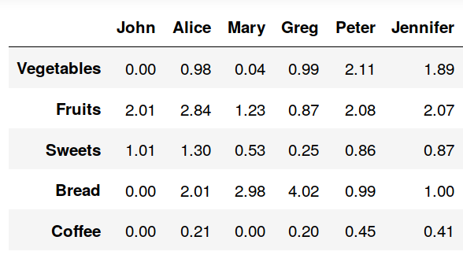
Reconstruction
Original matrix (V)
Reconstructed matrix (W H)
reconstructed = pd.DataFrame(np.round(np.dot(W,H),2), columns=V.columns)
reconstructed.index = V.index
This example (2018) by Piotr Gabrys

Slide 14
Recommendation
Original matrix (V)
Reconstructed matrix (W H)
If you were to recommend one product to someone, what would you recommend and to whom?
This example (2018) by Piotr Gabrys

Slide 15
Evaluation

Slide 16
Direct evaluation
Randomized controlled experiment
  Renamed A/B testing for … reasons
  People are split randomly in control/experimental
  Control group: receives one type of recommendation
  Experimental group: receives another type
Metrics such as CTR, retention, etc.
Requires infrastructure, users, policies

Slide 17
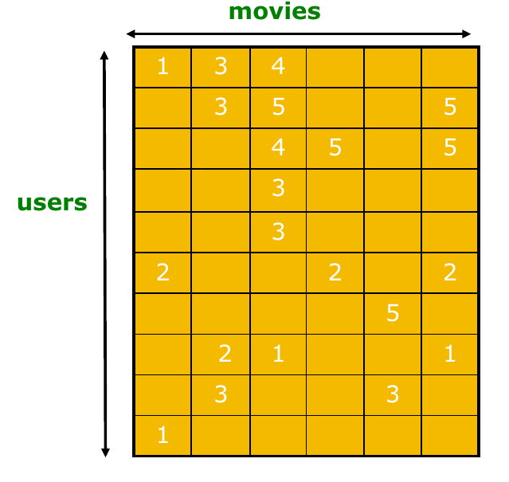
Evaluating with existing data
Mining of Massive Datasets 2nd edition (2014) by Leskovec et al. (Chapter 9) - slides A, B

Slide 18
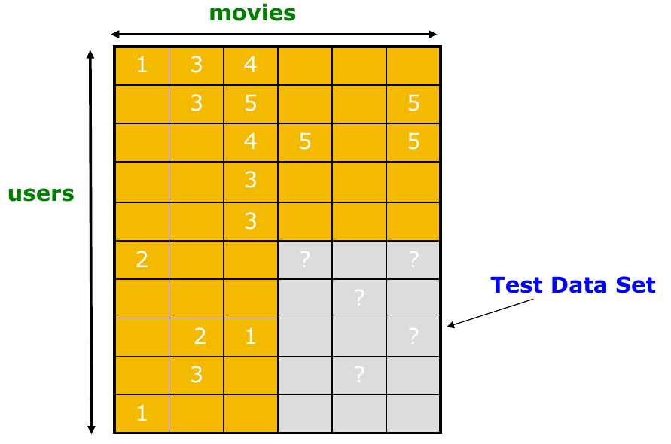
Evaluating with existing data
Mining of Massive Datasets 2nd edition (2014) by Leskovec et al. (Chapter 9) - slides A, B

Slide 19
Evaluation metrics
RMSE (root of mean of squared errors)
Precision @ k
  % of recommendations that are correct among those in the top k positions
Rank correlation
  Spearman’s correlation between system and user

Slide 20
Evaluating is hard
Accuracy is not all
We also want diversity
We want to be contextually sensitive
The order of predictions matters
RMSE might penalize a method that does well for high ratings but bad for others

Slide 21
Example 2: Netflix prize

Slide 22
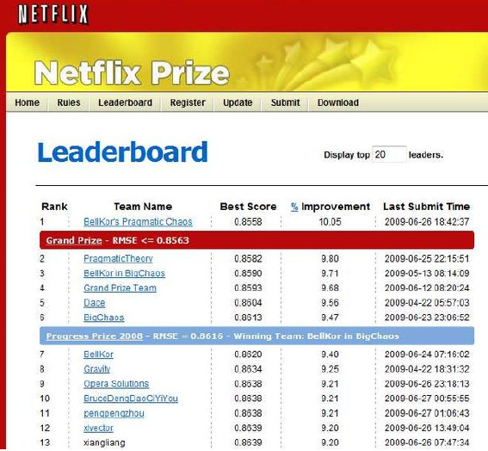
Example 2: Netflix prize (2009)
Netflix offered $1,000,000 to anyone beating their algorithm by 10% in RMSE
Provided 100M (user,movie) ratings for training
Held a testing set and allowed one guess/day on the testing set to create a leader board

Slide 23
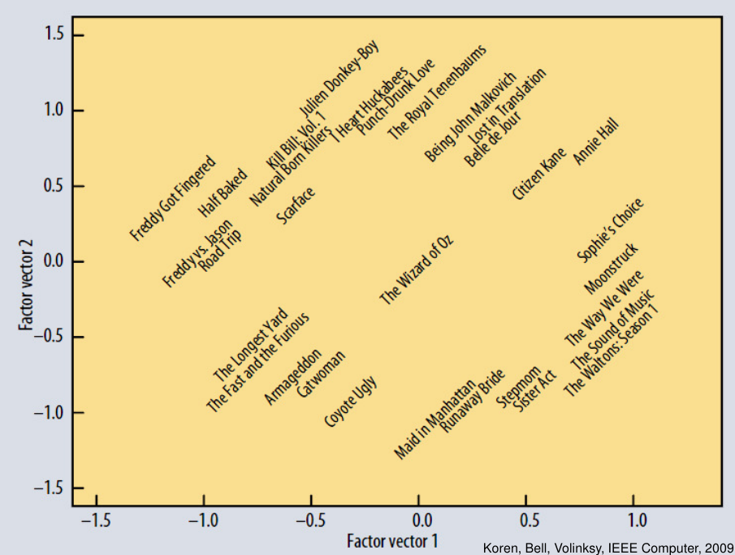
Latent factors
In latent factor space, similar movies are mapped to similar points

Slide 24
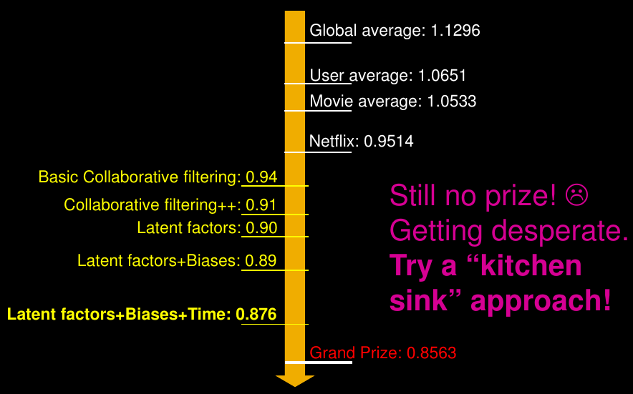
Shortly before deadline ...

Slide 25
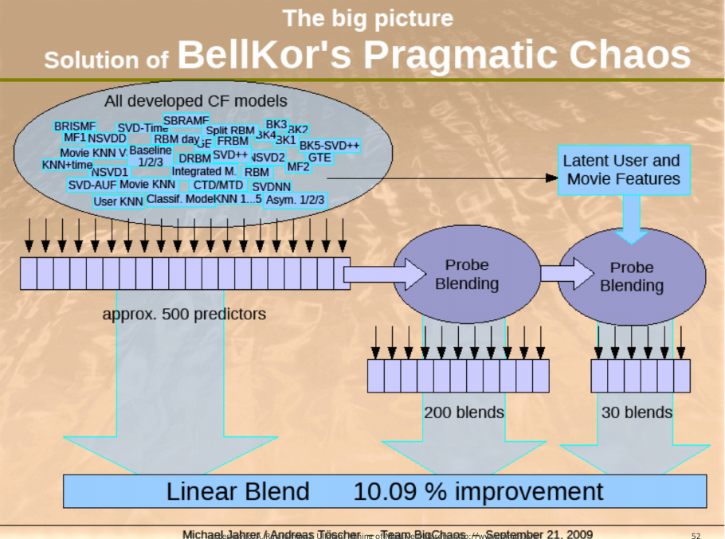

Slide 26
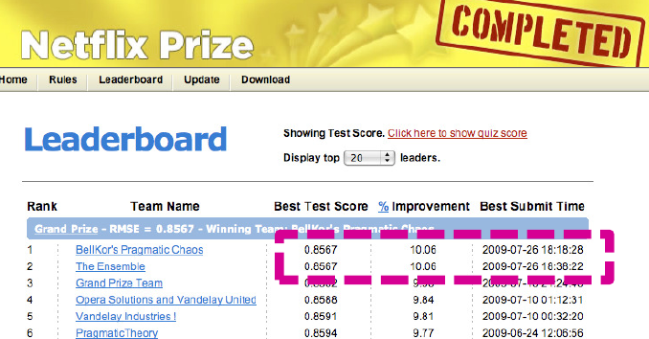
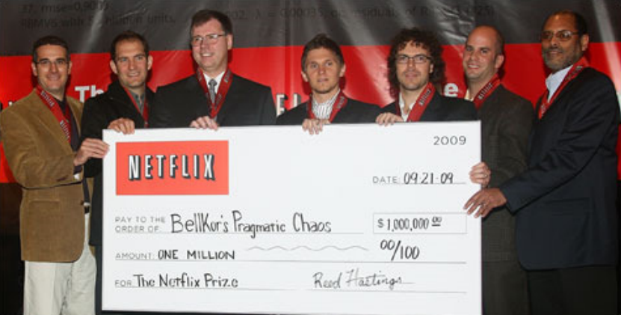
26 July 2009.- Bellkor team submits
40 minutes before the deadline,
“The Ensemble” team made of
a mix of other teams submitted
20 minutes before the deadline.
Bellkor team wins one million dollars

Slide 27
Summary

Slide 28
Things to remember
Interaction-based recommendations
  Latent factors based
Evaluation methods

Slide 29
Exercises for TT16-TT18
Mining of Massive Datasets 2nd edition (2014) by Leskovec et al. Note that some exercises cover advanced concepts:
  Exercises 9.2.8
  Exercises 9.3.4
  Exercises 9.4.6

