Slide 1

Association rules mining
Mining Massive Datasets
Carlos Castillo
Topic 06

Slide 2
Sources
Data Mining, The Textbook (2015) by Charu Aggarwal (Chapters 4, 5) – slides by Lijun Zhang
Mining of Massive Datasets 2nd edition (2014) by Leskovec et al. (Chapter 6) - slides
Data Mining Concepts and Techniques, 3rd edition (2011) by Han et al. (Chapter 6)
Introduction to Data Mining 2nd edition (2019) by Tan et al. (Chapters 5, 6) – slides ch5, slides ch6

Slide 3
Association rule
Let X, Y be two itemsets; the rule X⇒Y is an association rule of minimum support minsup and minimum confidence minconf if:
sup(X⇒Y) ≥ minsup
and
conf(X⇒Y) ≥ minconf

Slide 4
Association rule mining framework
In the first phase, all the frequent itemsets are generated at the minimum support of minsup
  The most difficult (computationally expensive) step
In the second phase, the association rules are generated from the frequent itemsets at the minimum confidence level of minconf
  Relatively straightforward

Slide 5
A straightforward implementation of the second phase
For each frequent itemset I // sup(I) ≥ minsup
  For each possible partition X, Y = I – X
    Check if conf(X⇒Y) ≥ minconf
Use the confidence monotonicity property (next slide) to reduce search space

Slide 6
Confidence monotonicity property
Let X_{S}, X_{L}, I be itemsets; assume X_{S} ⊂ X_{L} ⊂ I
Then:
Prove this, remember:

Slide 7
Confidence monotonicity property
Let X_{S}, X_{L}, I be itemsets; assume X_{S} ⊂ X_{L} ⊂ I

Slide 8
Brute-force itemset mining algorithms

Slide 9
Naïve approach
Generate all candidate itemsets (2^{|U|} of them)
  Not practical, U=1000 ⇒ more than 10³⁰⁰ itemsets
Calculate sup(I) for every itemset
Key observation
  If no k-itemsets are frequent
  No (k+1)-itemsets are frequent

Slide 10
Improved approach
Start with k=1
Generate all k-itemsets
Determine sup(I)
If no k-itemset has sup(I) ≥ minsup, stop
Otherwise, k ← k+1 and repeat

Slide 11
Improved approach is a significant improvement
Let l be the final value of k
For |U| = 1000, l=10, this is ≃ 10²³

Slide 12
Further improvements to brute-force method
Reducing the size of the explored search space (lattice) by pruning candidate itemsets (lattice nodes) using tricks, such as the downward closure property
Counting the support of each candidate more efficiently by pruning transactions that are known to be irrelevant for counting a candidate itemset
Using compact data structures to represent either candidates or transaction databases that support efficient counting

Slide 13
The Apriori Algorithm

Slide 14
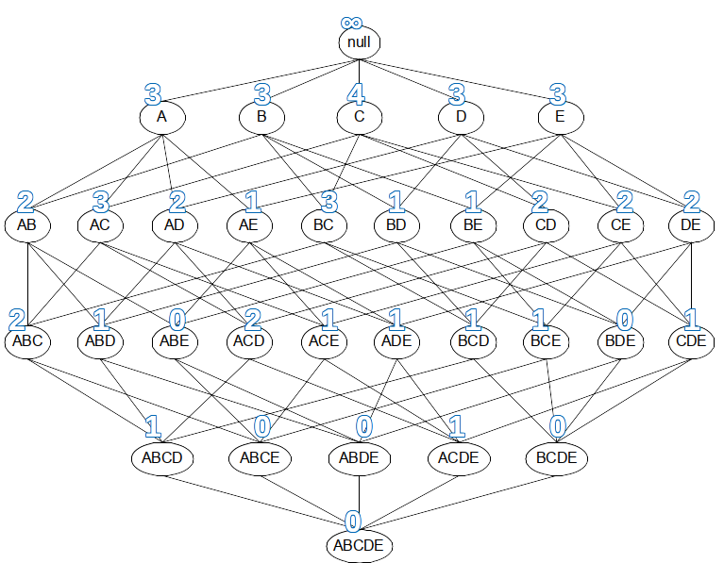
Apriori algorithm principle
Downward closure property: every subset of a frequent itemset is also frequent
Conversely, if an itemset has a subset that is not frequent, the itemset cannot be frequent
What are subsets in the lattice?

Slide 15
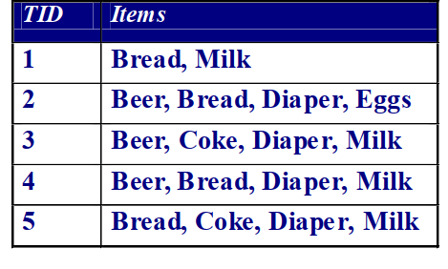
Example
Items (1-itemsets)
Item | Count
Bread | 4
Coke | 2 | X
Milk | 4
Beer | 3
Diaper | 4
Eggs | 1 | X
Minimum Support = 3
Introduction to Data Mining 2nd edition (2019) by Tan et al. (Chapters 5, 6) – slides ch5, slides ch6

Slide 16
Example
Items (1-itemsets)
Item | Count
Bread | 4
Coke | 2 | X
Milk | 4
Beer | 3
Diaper | 4
Eggs | 1 | X
Minimum Support = 3
Introduction to Data Mining 2nd edition (2019) by Tan et al. (Chapters 5, 6) – slides ch5, slides ch6

Slide 17
Example (cont.)
Items (1-itemsets)
Item | Count
Bread | 4
Coke | 2 | X
Milk | 4
Beer | 3
Diaper | 4
Eggs | 1 | X
Pairs (2-itemsets)
Item | Count
{Bread, Milk} | 3
{Beer, Bread} | 2 | X
{Bread, Diaper} | 3
{Beer, Milk} | 2 | X
{Diaper, Milk} | 3
{Beer, Diaper} | 3
Minimum Support = 3
Introduction to Data Mining 2nd edition (2019) by Tan et al. (Chapters 5, 6) – slides ch5, slides ch6

Slide 18
Example (cont.)
Items (1-itemsets)
Item | Count
Bread | 4
Coke | 2 | X
Milk | 4
Beer | 3
Diaper | 4
Eggs | 1 | X
Pairs (2-itemsets)
Item | Count
{Bread, Milk} | 3
{Beer, Bread} | 2 | X
{Bread, Diaper} | 3
{Beer, Milk} | 2 | X
{Diaper, Milk} | 3
{Beer, Diaper} | 3
Minimum Support = 3
Introduction to Data Mining 2nd edition (2019) by Tan et al. (Chapters 5, 6) – slides ch5, slides ch6

Slide 19
Example (cont.)
Items (1-itemsets)
Item | Count
Bread | 4
Coke | 2 | X
Milk | 4
Beer | 3
Diaper | 4
Eggs | 1 | X
Pairs (2-itemsets)
Item | Count
{Bread, Milk} | 3
{Beer, Bread} | 2 | X
{Bread, Diaper} | 3
{Beer, Milk} | 2 | X
{Diaper, Milk} | 3
{Beer, Diaper} | 3
Triplets (3-itemsets)
Item | Count
{Bread, Diaper, Milk} | 2 | X
{Beer, Bread, Diaper} | 2 | X
{Bread, Diaper, Milk} | 2 | X
{Beer, Bread, Milk} | 1 | X
Minimum Support = 3
Introduction to Data Mining 2nd edition (2019) by Tan et al. (Chapters 5, 6) – slides ch5, slides ch6

Slide 20
Example (cont.)
Items (1-itemsets)
Item | Count
Bread | 4
Coke | 2 | X
Milk | 4
Beer | 3
Diaper | 4
Eggs | 1 | X
Pairs (2-itemsets)
Item | Count
{Bread, Milk} | 3
{Beer, Bread} | 2 | X
{Bread, Diaper} | 3
{Beer, Milk} | 2 | X
{Diaper, Milk} | 3
{Beer, Diaper} | 3
Triplets (3-itemsets)
Item | Count
{Bread, Diaper, Milk} | 2 | X
{Beer, Bread, Diaper} | 2 | X
{Bread, Diaper, Milk} | 2 | X
{Beer, Bread, Milk} | 1 | X
Minimum Support = 3, found 8 frequent itemsets
Introduction to Data Mining 2nd edition (2019) by Tan et al. (Chapters 5, 6) – slides ch5, slides ch6

Slide 21
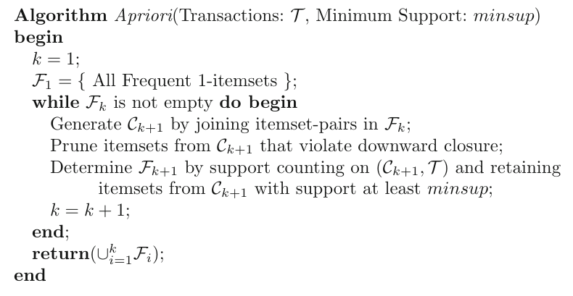
Pseudocode of Apriori
(1) Generation
(2) Pruning
(3) Support counting

Slide 22
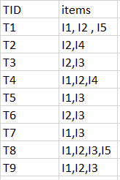
Try it!
Use the Apriori algorithm to obtain all rules of the form {a,b}→{c} having
minimum support = 2
and
confidence >= 50%
Note: to generate only rules of the form {a,b}→{c}, use only the itemsets of size 3

Slide 23
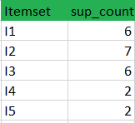
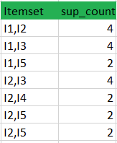

Answer
Example rules for itemset {I1, I2, I3}
[I1,I2]⇒[I3] //confidence = sup(I1,I2,I3)/sup(I1^I2) = 2/4*100=50%
[I1,I3]⇒[I2] //confidence = sup(I1,I2,I3)/sup(I1^I3) = 2/4*100=50%
[I2,I3]⇒[I1] //confidence = sup(I1,I2,I3)/sup(I2^I3) = 2/4*100=50%
[I1]⇒[I2,I3] //confidence = sup(I1,I2,I3)/sup(I1) = 2/6*100=33%
[I2]⇒[I1,I3] //confidence = sup(I1,I2,I3)/sup(I2) = 2/7*100=28%
[I3]⇒[I1,I2] //confidence = sup(I1,I2,I3)/sup(I3) = 2/6*100=33%
Itemset {l1,l2,l5} is done in an analogous manner.
Source: https://www.geeksforgeeks.org/apriori-algorithm/

Slide 24
Speeding up candidate generation

Slide 25
Level-wise pruning trick
Let F_{k} be the set of frequent k-itemsets
Let C_{k+1} be the set of (k+1)-candidates
I ∊ C_{k+1} is frequent only if all the k-subsets of I are frequent
Pruning
  Generate all the k-subsets of I
  If any one of them does not belong to F_{k}, then remove I

Slide 26
Candidates generation
A Naïve Approach
  Check all the possible combinations of frequent itemsets
An Example of the Naïve Approach
  itemsets: {abc} {bcd} {abd} {cde}
  {abc} + {bcd} = {abcd}
  {bcd} + {abd} = {abcd}
  {abd} + {cde} = {abcde}
  ….

Slide 27
Candidates generation (cont.)
Introduction of Ordering
  Items in U have a lexicographic ordering
  Itemsets can be order as strings
A Better Approach
  Order the frequent k-itemsets
  Merge two itemset if the first k-1 items of them are the same

Slide 28
Candidates generation (cont.)
Example
  k-itemsets: {abc} {abd} {bcd}
    {abc} + {abd} = {abcd}
k-itemsets: {abc} {acd} {bcd}
  No (k+1) -candidates
Early stop is possible
  Do not need to check {abc} +{bcd} after checking {abc} + {acd}
Do we miss {abcd}?
  No, due to the Downward Closure Property

Slide 29
Improving computation of support

Slide 30
Naïve support counting
Naïve counting:
  For each candidate I_{i} ∊ C_{k+1}
    For each transaction T_{j} in T
      Check whether I_{i} appears in T_{j}
Limitation
  Inefficient if both |C_{k+1}| and |T| are large

Slide 31
Support counting with a data structure
A Better Approach
  Organize the candidate patterns in C_{k+1} in a data structure
Use the data structure to accelerate counting
  Each transaction in T_{i} examined against the subset of candidates in C_{k+1} that might contain T_{i}

Slide 32
Data structured for support counting based on hashing
Naïve counting:
For each I_{i} ∊ C_{k+1}
For all T_{j} ∊ T
If I_{i} ⊆ T_{j}
Add to sup(I_{i})
Hashed counting:
For each T_{j} ∊ T
For I_{i} ∊ hashbucket(T_{j}, C_{k+1})
If I_{i} ⊆ T_{j}
Add to sup(I_{i})

Slide 33
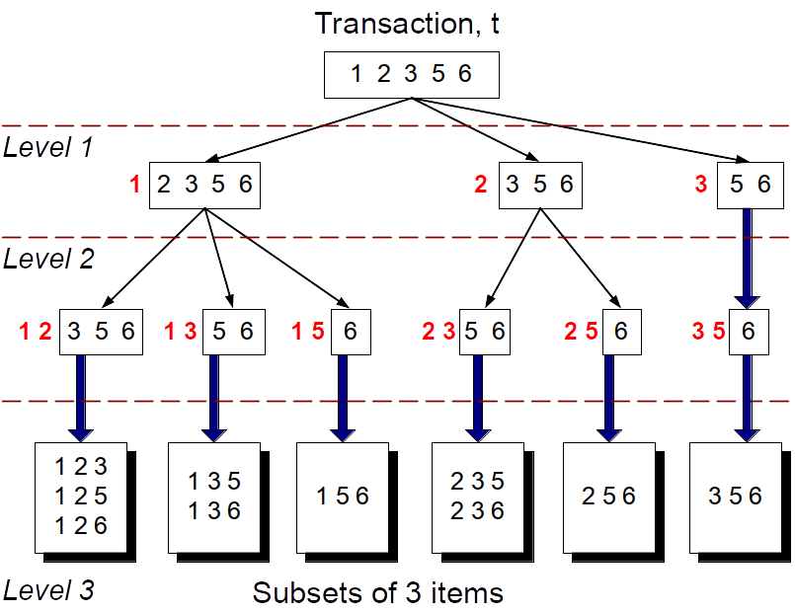
Which candidates are relevant?
Imagine 15 candidate
itemsets of length 3:
{1 4 5}, {1 2 4}, {4 5 7},
{1 2 5}, {4 5 8}, {1 5 9},
{1 3 6}, {2 3 4}, {5 6 7},
{3 4 5}, {3 5 6}, {3 5 7},
{6 8 9}, {3 6 7}, {3 6 8}
Now, suppose we look
for this transaction:
{1 2 3 5 6}
Here we depict only the candidates that appear in the transaction (10 out of 15)

Slide 34
Hash tree for itemsets in C_{k+1}
A tree with fixed degree r
Each itemset in C_{k+1} is stored in a leaf node
All internal nodes use a hash function to map items to one of the r branches (can be the same for all internal nodes)
All leaf nodes contain a lexicographically sorted list of up to max_leaf_size itemsets

Slide 35
Example hash tree r=3 max_leaf_size=3
Candidate itemsets
{1 4 5}, {1 2 4}, {4 5 7},
{1 2 5}, {4 5 8}, {1 5 9},
{1 3 6}, {2 3 4}, {5 6 7},
{3 4 5}, {3 5 6}, {3 5 7},
{6 8 9}, {3 6 7}, {3 6 8}
2 3 4
5 6 7
1 4 5
3 4 5
3 5 6
3 5 7
6 8 9
3 6 7
3 6 8
1 3 6
1 2 4
4 5 7
Hash function
1 2 5
4 5 8
1 5 9
3,6,9
1,4,7
Important:
itemsets are sorted!
2,5,8
This example from: Introduction to Data Mining 2nd edition (2019) by Tan et al. (Chapter 5) – slides ch5

Slide 36
Example hash tree (cont.)
Hash Function
Candidate Hash Tree
1,4,7
3,6,9
2,5,8
2 3 4
5 6 7
1 4 5
1 3 6
3 4 5
3 5 6
3 6 7
Hash on 1, 4 or 7
3 5 7
3 6 8
1 2 4
1 5 9
6 8 9
1 2 5
4 5 7
4 5 8

Slide 37
Example hash tree (cont.)
Hash Function
Candidate Hash Tree
1,4,7
3,6,9
2,5,8
2 3 4
5 6 7
1 4 5
1 3 6
3 4 5
3 5 6
3 6 7
Hash on 2, 5 or 8
3 5 7
3 6 8
1 2 4
1 5 9
6 8 9
1 2 5
4 5 7
4 5 8

Slide 38
Example hash tree (cont.)
Hash Function
Candidate Hash Tree
1,4,7
3,6,9
2,5,8
2 3 4
5 6 7
1 4 5
1 3 6
3 4 5
3 5 6
3 6 7
Hash on 3, 6 or 9
3 5 7
3 6 8
1 2 4
1 5 9
6 8 9
1 2 5
4 5 7
4 5 8

Slide 39
Checking which candidates might be in a transaction
1 2 3 5 6
transaction
Hash Function
1,4,7
3,6,9
2,5,8
2 3 4
5 6 7
1 4 5
1 3 6
3 4 5
3 5 6
3 6 7
3 5 7
3 6 8
1 2 4
1 5 9
6 8 9
1 2 5
4 5 7
4 5 8

Slide 40
Checking which candidates might be in a transaction
1 2 3 5 6
transaction
Hash Function
1 +
2 3 5 6
2 +
3 5 6
1,4,7
3,6,9
3 +
5 6
2,5,8
2 3 4
5 6 7
1 4 5
1 3 6
3 4 5
3 5 6
3 6 7
3 5 7
3 6 8
1 2 4
1 5 9
6 8 9
1 2 5
4 5 7
4 5 8

Slide 41
Checking which candidates might be in a transaction
1 2 3 5 6
transaction
Hash Function
1 +
2 3 5 6
2 +
3 5 6
1 2 +
3 5 6
1,4,7
3,6,9
3 +
5 6
2,5,8
1 3 +
5 6
2 3 4
1 5 +
6
5 6 7
1 4 5
1 3 6
3 4 5
3 5 6
3 6 7
3 5 7
3 6 8
1 2 4
1 5 9
6 8 9
1 2 5
4 5 7
4 5 8

Slide 42
Checking which candidates might be in a transaction
1 2 3 5 6
transaction
Hash Function
1 +
2 3 5 6
2 +
3 5 6
1 2 +
3 5 6
1,4,7
3,6,9
3 +
5 6
2,5,8
1 3 +
5 6
2 3 4
3 5 +
6
1 5 +
6
5 6 7
3 +
6
1 4 5
1 3 6
3 4 5
3 5 6
3 6 7
1 2 5 +
6
1 5 6
3 5 7
3 6 8
1 2 4
1 5 9
6 8 9
1 2 5
4 5 7
4 5 8
1 2 3 +
5 6

Slide 43
Checking which candidates might be in a transaction
1 2 3 5 6
transaction
Hash Function
1 +
2 3 5 6
2 +
3 5 6
1 2 +
3 5 6
1,4,7
3,6,9
3 +
5 6
2,5,8
1 3 +
5 6
2 3 4
Compare transaction against 11 out of 15 candidates
1 5 +
6
5 6 7
1 4 5
1 3 6
3 4 5
3 5 6
3 6 7
1 2 5 +
6
1 5 6
3 5 7
3 6 8
1 2 4
1 5 9
6 8 9
1 2 5
4 5 7
4 5 8
1 2 3 +
5 6

Slide 44
Try it! Use the hash tree to determine which candidates might be in this transaction
Hash Function
3 6 8 9
transaction
1,4,7
3,6,9
2,5,8
2 3 4
5 6 7
1 4 5
1 3 6
3 4 5
3 5 6
3 6 7
3 5 7
3 6 8
1 2 4
1 2 5
1 5 9
6 8 9
4 5 7
4 5 8

Slide 45
SOLUTION
Hash Function
3 6 8 9
transaction
8 +
9
3 +
6 8 9
1,4,7
3,6,9
6 +
8 9
2,5,8
3 6 +
8 9
6 8 +
9
3 8 +
9
2 3 4
5 6 7
1 4 5
1 3 6
3 4 5
3 5 6
3 6 7
3 5 7
3 6 8
Compare transaction against 8 out of 15 candidates
1 2 4
1 5 9
6 8 9
1 2 5
4 5 7
4 5 8

Slide 46
( = Relationship between prefixes)
transaction
Hash Function
3 6 8 9
8 +
9
3 +
6 8 9
1,4,7
3,6,9
6 +
8 9
2,5,8
3 6 +
8 9
6 8 +
9
3 8 +
9
2 3 4
5 6 7
1 4 5
1 3 6
3 4 5
3 5 6
3 6 7
3 5 7
3 6 8
Compare transaction against 8 out of 15 candidates
1 2 4
1 5 9
6 8 9
1 2 5
4 5 7
4 5 8

Slide 47
Enumeration-tree algorithms:
Lexicographic tree
There is a node in the tree for each frequent itemset
The root of the tree contains the null itemset
If I = {i₁, i₂, …, i_{k}} then the parent of I in the tree is {i₁, i₂, …, i_{k-1}}
Introduction to Data Mining 2nd edition (2019) by Tan et al. (Chapters 5, 6) – slides ch5, slides ch6

Slide 48
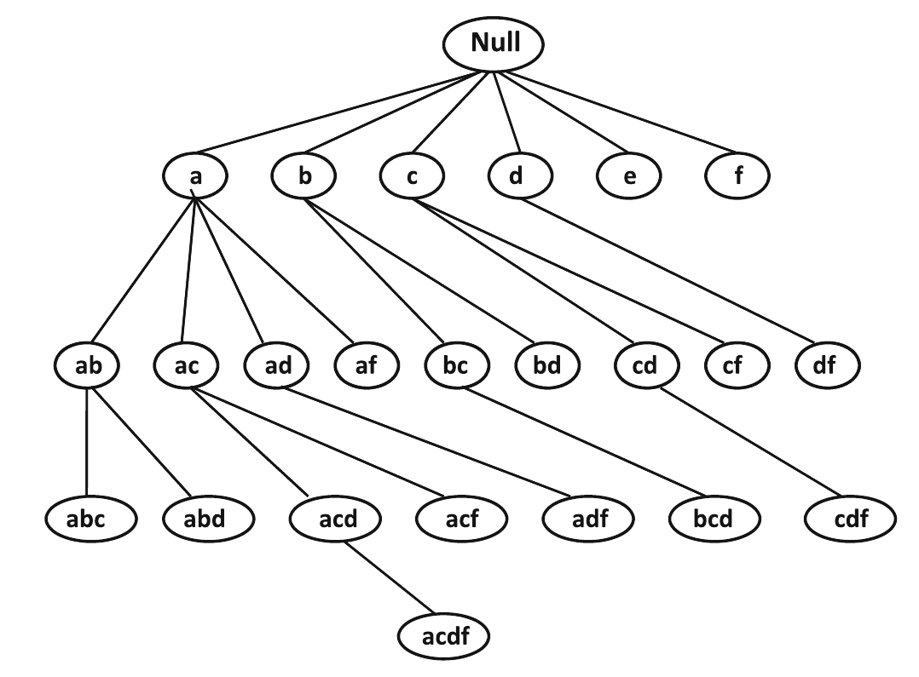
Example
Note that, unlike the lattice, a parent can only be extended with an item that is lexicographically larger

Slide 49
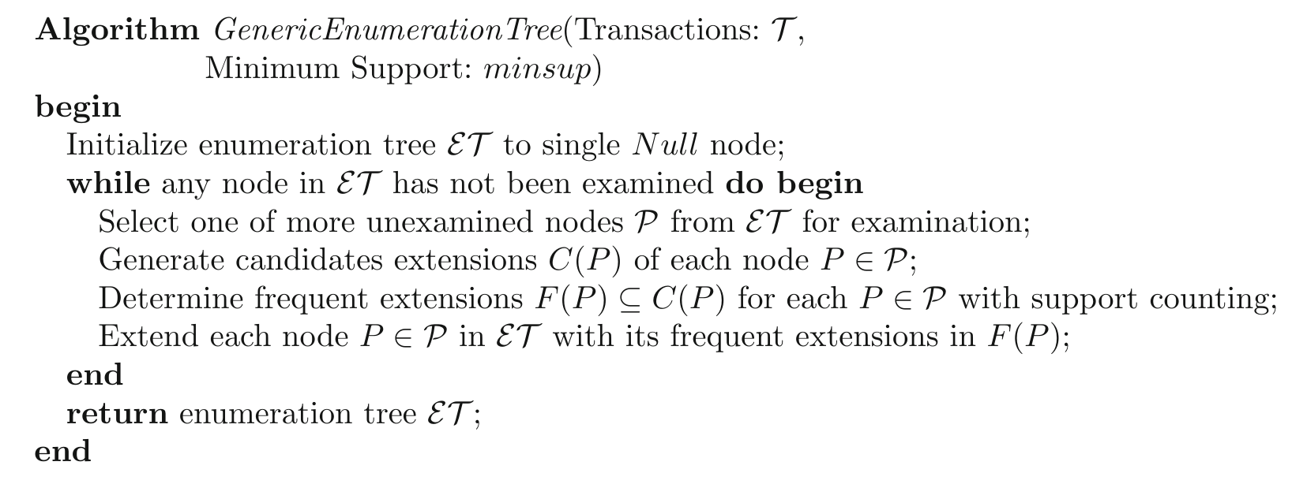
Enumeration tree algorithm

Slide 50
Enumeration-tree-based implementation of Apriori
Apriori constructs the enumeration tree in a breadth-first manner
Apriori generates candidate (k+1)-itemsets by merging two frequent k-itemsets of which the first k-1 items are the same ⇒ extension in the enumeration-tree

Slide 51
Summary

Slide 52
Things to remember
Support and confidence on a rule
Downward closure property
  every subset of a frequent itemset is also frequent
  hence, if an itemset X has a subset that is not frequent, X cannot be frequent
Methods for candidate generation, pruning
Algorithms for fast support computation

Slide 53
Exercises for this topic
Data Mining, The Textbook (2015) by Charu Aggarwal
  Exercises 4.9 → 9-10
Mining of Massive Datasets 2nd edition (2014) by Leskovec et al.
  Exercises 6.2.7 → 6.2.5 and 6.2.6
Introduction to Data Mining 2nd edition (2019) by Tan et al.
  Exercises 5.10 → 9-12

