Slide 1

Data streams
Mining Massive Datasets
Carlos Castillo
Topic 10

Slide 2
Sources
Mining of Massive Datasets (2014) by Leskovec et al. (chapter 4)
  Slides part 1, part 2
Tutorial: Mining Massive Data Streams (2019) by Michael Hahsler

Slide 3
What is a data stream?
A potentially infinite sequence of data points
  Each data point can be a tuple or vector
Examples:
  web click-stream data → who clicks on what
  computer network monitoring data
  telecommunication connection data
  readings from sensor nets
  stock quotes
Do not confuse with “streaming,” which
in vernacular typically means live video.

Slide 4
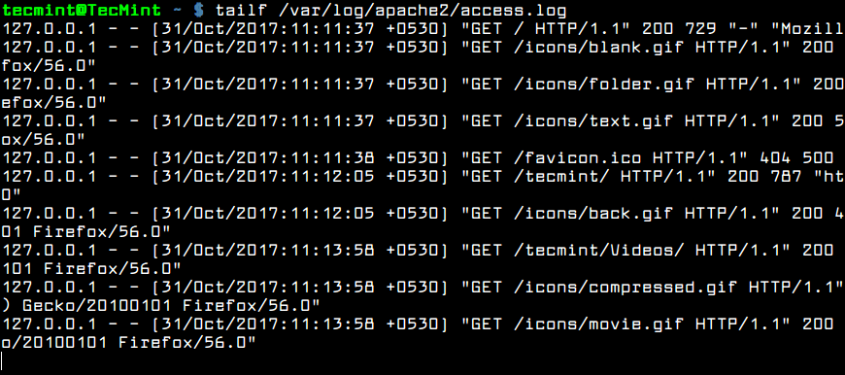
Example: Apache server log

Slide 5

Key properties of data streams
Unbounded size
  Data cannot be persisted on disk
  Only summaries can be stored
Transient
  Single pass over the data
  Sometimes real-time processing is needed
Dynamic
  May require incremental updates
  May require to forget old data
  Concepts “drift”
Temporal order is often important

Slide 6
Applications
Mining query streams
  A search engine wants to know what queries are more frequent today than yesterday
Mining click streams
  A newspaper wants to know when one of its pages starts getting an unusual number of hits per hour
Mining social network news feeds
  A social media platform wants to show trending topics

Slide 7
Applications (cont.)
Sensor Networks
  Many sensors feeding into a central controller
Telephone call records
  Data feeds into customer bills as well as settlements between telephone companies
IP packets monitored at a switch
  Gather information for optimal routing
  Detect denial-of-service attacks

Slide 8
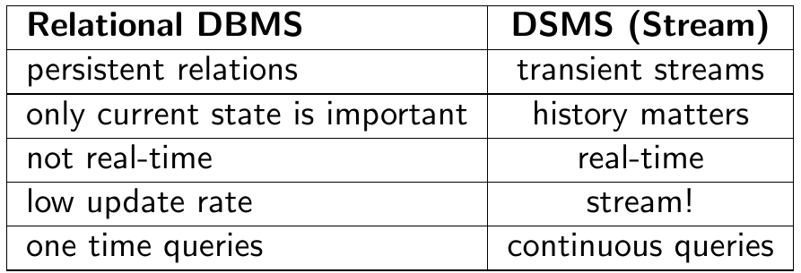
Why not simply use a relational DB?
Brian Babcock, Shivnath Babu, Mayur Datar, Rajeev Motwani, and Jennifer Widom (2002). Models and issues in data stream systems. In PODS ’02, pages 1–16, ACM Press.

Slide 9
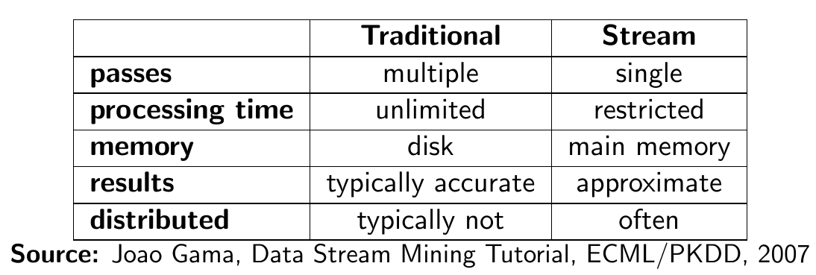
Why do we need new algorithms?

Slide 10
A generic stream-processing architecture
Ad-Hoc
Queries
Processor
. . . 1, 5, 2, 7, 0, 9, 3
. . . a, r, v, t, y, h, b
. . . 0, 0, 1, 0, 1, 1, 0
time
Standing
Queries
Output
Input streams
Each is stream is
composed of
elements/tuples
Limited
Working
Storage
Archival
Storage
J. Leskovec, A. Rajaraman, J. Ullman: Mining of Massive Datasets, http://www.mmds.org/

Slide 11
Load shedding

Slide 12
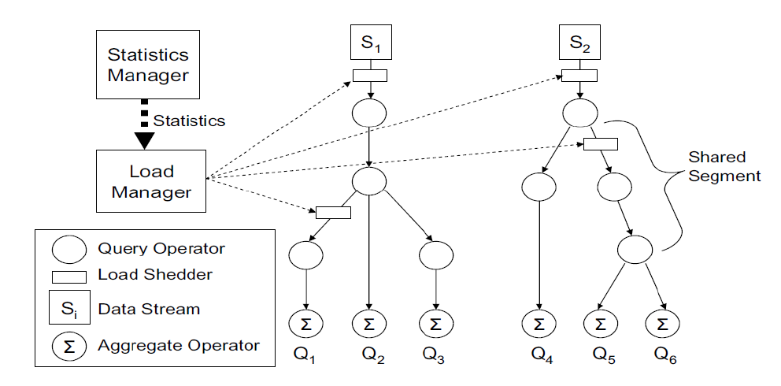
Too much data? Ignore some of it
Brian Babcock, Mayur Datar, and Rajeev Motwani. Load shedding techniques for data stream systems. In Proc. MPDS, 2003.

Slide 13
Sampling a fixed proportion

Slide 14
Sampling a fixed proportion
Example stream: <user, query, timestamp>
from a search engine query log
Suppose we have space to store 1/r of the stream
  E.g.: 1/10th, 1/100th, 1/1000th,
Naïve solution:
  Generate uniform random number in 0...(r-1)
    numpy.random.uniform(0,r)
  If the number is 0, keep the item

Slide 15
What can we do with this sample?
Approximate most frequent query
  Pick the most frequent in the sample
Approximate frequency of a query
  Multiply observed frequency by r
Do people ask query q?
  Approximate answer (with some prob. of error)

Slide 16
Try it!
We want to tell if we have seen item q
Suppose we have seen n items
Suppose we have sampled a fraction 1/r
Suppose item q appears with probability p(q)
What is the probability of a:
  False Positive? (Item q was not in the stream but we said it was)
  False Negative? (Item q was in the stream but we said it was not)

Slide 17
Answer
We want to tell if we have seen item q
Suppose we have seen n items
Suppose we have sampled a fraction 1/r
Suppose item q appears with probability p(q)
What is the probability of a:
  False Positive? ZERO. We cannot observe a query that isn’t.
  False Negative?

Slide 18
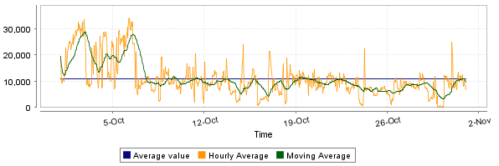
What can we do with this…? (cont.)
Approximate num. queries per minute
Peak frequency
  Multiply observed peak by r
https://steemit.com/steemsql/@arcange/steemsql-update-14-infrastructure-upgraded-for-better-performances

Slide 19
But there are questions we cannot answer well
What fraction of queries by an average search engine user are duplicates?
  Suppose each user issues x queries once and d queries twice (total of x+2d queries)
  Correct answer: d/(x+d)
Proposed solution: We keep 1/10th of the queries (r=10)
  Sample will contain x/10 of the singleton queries at least once
  Sample will contain 2d/10 of the duplicate queries at least once
  Sample will contain d/100 pairs of duplicates
    d/100 = 1/10 ∙ 1/10 ∙ d
  Of the d duplicates, 18d/100 will be seen once*
    18d/100 = ((1/10 ∙ 9/10)+(9/10 ∙ 1/10)) ∙ d
So the sample-based answer is
* Copy A is in the selected part, copy B in the unselected part, or viceversa

Slide 20
But there are questions we cannot answer well (cont.)
What fraction of queries by an average search engine user are duplicates?
  Suppose each user issues x queries once and d queries twice (total of x+2d queries)
  Correct answer: d/(x+d)
Proposed solution: We keep 1/10th of the queries (r=10)
  Sample will contain x/10 of the singleton queries at least once
  Sample will contain 2d/10 of the duplicate queries at least once
  Sample will contain d/100 pairs of duplicates
    d/100 = 1/10 ∙ 1/10 ∙ d
  Of the d duplicates, 18d/100 will be seen once
    18d/100 = ((1/10 ∙ 9/10)+(9/10 ∙ 1/10)) ∙ d
So the sample-based answer is
Observed duplicates
WRONG!
Observed singletons
Observed duplicates

Slide 21
How do we solve it?
We need to sample 1/r of users
and all of their queries
<user1, query, timestamp>
<user2, query, timestamp>
<user2, query, timestamp>
<user3, query, timestamp>
<user1, query, timestamp>
<user3, query, timestamp>
<user2, query, timestamp>
<user1, query, timestamp>
<user2, query, timestamp>
...
How do we do this?

Slide 22
How do we solve it?
We need to sample 1/r of users
and all of their queries
How do we do this?
  Hashing!
  Given <user, query, timestamp>
  Compute h(user) → 0, 1, …, (r-1)
  Keep tuple if hash value is 0
<user1, query, timestamp>
<user2, query, timestamp>
<user2, query, timestamp>
<user3, query, timestamp>
<user1, query, timestamp>
<user3, query, timestamp>
<user2, query, timestamp>
<user1, query, timestamp>
<user2, query, timestamp>
...

Slide 23
In general ...
To sample a fraction a/b of a stream by key
Compute h(key) → 0, 1, …, (b-1)
Keep if h(key) < a
0
1
...
b-1
a

Slide 24
Sampling a fixed-size sample

Slide 25
A fixed-size sample
We normally do not know the stream size
We just know how much storage space we have
Suppose we have storage space s and want to maintain a random sample S of size s=|S|
Requirement: after seeing n items, each of the n items should be in our sample with probability s/n
  No item should have an advantage or disadvantage

Slide 26
Bad solutions
Suppose stream = < a, f, e, b, g, r, u, … >
Requirement: after seeing n items, each of the n items should be in our sample with probability s/n
Suppose s=2
  Always keep first 2? No, because then p(a) = 1 ≠ 0 = p(e)
  Always keep last 2? No, because then p(a) = 0 ≠ 1 = p(u)
Sample some … which? Then evict some … which?

Slide 27
Reservoir sampling
(one of the most beautiful algorithms of this course)
Elements x₁, x₂, x₃, …, x_{i}, ...
Store all first s elements x₁, x₂, …, x_{s}
Suppose element x_{n} arrives
  With probability 1- s/n, ignore this element
  With probability s/n:
    Discard a random element from the reservoir
    Insert element x_{n} into the reservoir

Slide 28
Try it!
RESERVOIR SAMPLING
Store all first s elements x₁, x₂, …, x_{s}
When element x_{n} arrives
With probability 1- s/n, ignore
With probability s/n:
  Discard randomly from reservoir
  Insert element x_{n} into the reservoir
Suppose input is <a, b, c, ...>
Suppose s = 2
We have just processed element 3 = “c”
What is:
  Probability “a” is in the sample?
  Probability “b” is in the sample?
  Probability “c” is in the sample?
If you are done quickly, try one more element, “d”

Slide 29
Answer
Suppose input is <a, b, c, ...>, suppose s = 2
We have just processed element 3 = “c”
Probability “a” is in the sample after reading 3 elements?
Probability “b” is in the sample after reading 3 elements?
Probability “c” is in the sample after reading 3 elements?
You should also obtain

Slide 30
Proof by induction
Inductive hypothesis: after n elements seen
  each of them is sampled with probability s/n
Inductive step: element x_{n+1} arrives,
  what is the probability than an already-sampled element x_{i} stays in the sample?
x_{n+1} not sampled
x_{n+1} sampled
x_{i} not evicted

Slide 31

Proof by induction (cont.)
Tuple x_{n+1} is sampled with probability
Tuples x_{i} with i≤n
  Were in the sample with probability s/n
  Stay in the sample with probability n/(n+1)
  Hence, are in the sample with probability

Slide 32
Recency-biased reservoir sampling
Before we had p(i) = s/n
  Probability of element x_{i} to be included
  Reservoir of size s
  Stream so far of size n
Suppose we want a different p(i) ∝ f(i,n)
  Example: f(i,n) larger for more recent items
Data Mining, The Textbook (2015) by Charu Aggarwal (section 12.2.1.1. “Handling Concept Drift”)

Slide 33
Recency-biased reservoir sampling (cont.)
Suppose we want
Parameter is a decay factor and
Algorithm: reservoir starts empty
  At time n, it is full
  x_{n+1} arrives and is inserted with probability
  If x_{n+1} is inserted, remove from reservoir a random element with probability
See proof in: Aggarwal, C. (2006). On biased reservoir sampling in the presence of stream evolution. Proc. VLDB
The longer an item is in the reservoir, the more likely is this item to be evicted.

Slide 34
Bloom filters

Slide 35
Filtering a data stream
Suppose we have a large set S of keys
We want to filter a stream <key, data> to let pass only the elements for which key ∊ S
Example: key is an e-mail address, we have a total of |S|=10⁹ allowed e-mail addresses
Naïve solution?

Slide 36
Filtering a data stream
Suppose we have a large set S of keys
We want to filter a stream <key, data> to let pass only the elements for which key ∊ S
Example: key is an e-mail address, we have a total of |S|=10⁹ allowed e-mail addresses
Naïve solution? Hash table won’t work, too big!

Slide 37
Bloom Filter (1-bit case)
Given a set of keys S
Create a bit array B[] of n bits
  Initialize to all 0s
Pick a hash function h with range [0,n)
  For each member of s∈ S
    Hash to one of n buckets
    Set that bit to 1, i.e., B[h(s)] ← 1
For each element a of the stream
  Output a if and only if B[h(a)] == 1
Bloom filter creation
Stream processing

Slide 38
Bloom Filter is an approximate filter
Can it output an element with a key not in S?
Can it not output an element with a key in S?

Slide 39
Bloom Filter is an approximate filter
Can it output an element with a key not in S?
Yes, due to hash collisions h(x)=h(y) when x≠y
Can it not output an element with a key in S?
No, because h(x) is always the same for x
Bloom filters are permissive (not strict)

Slide 40
Bloom filter
A bloom filter is:
  An array of n bits, initialized as 0
  A collection of hash functions h₁, h₂, …, h_{k}
  A set S of m key values
The purpose of the bloom filter is to allow all stream items whose key is in S

Slide 41

Bloom filter initialization
For all positions i in [0, n-1]
  B[i] ← 0
For all keys K in S:
For every hash function h₁, h₂, …, h_{k}
B[h_{i}(K)] ← 1

Slide 42
Bloom filter usage
For each input element <key, data>
allow ← TRUE
For every hash function h₁, h₂, …, h_{k}
allow ← allow ∧ B[h_{i}(K)] == 1
output element if allow == TRUE

Slide 43
Characteristics of Bloom Filters
Are lax (not strict) and let some items pass
  May require a second-level check to make filter strict, for instance store output on disk files and then check against hash tables (slower)
Implementations can be very fast
  E.g., use hardware words for the bit table

Slide 44
Preliminaries for the analysis: targets and darts
Suppose we throw y darts at x targets
  All darts will hit one of the targets
After throwing the darts, how many distinct targets can we expect to hit at least once?
  Prob. that a given dart will not hit a given target is (x-1)/x = 1-1/x
  Prob. none of the y darts will hit a given target is (1-1/x)^{y} = (1-1/x)^{x(y/x)}
  Using (1-ε)^{1/ε} ≃ 1/e for small ε
  Prob. none of the y darts will hit a given target is (1/e)^{y/x}

Slide 45
Analysis of the 1-bit Bloom Filter
Each element of S is a dart |S|=y
Each bit in the array is a target n=x
Suppose y=|S|=10⁹ (1 G) and x=n=8 x 10⁹ (8 GB)
Prob. that a given bit is NOT set to 1 (dart does not hit the target) is (1/e)^{y/x} = (1/e)^{1/8}
Prob. bit is set to 1 is 1 – (1/e)^{1/8} = 0.1175
  About 12% of bits are set to one in the Bloom Filter
  this is also the false-hit probability of this method

Slide 46
General case
|S|=m keys, array has n bits
k hash functions
Targets x=n, darts y=km
Probability that a bit remains 0 is e^{-km/n}
Example:
  We can pick k=n/m to obtain collision probability 1/e = 37%

Slide 47
Analysis of a 2-bit Bloom Filter
Suppose |S|=10⁹ (1 G) and n=8 x 10⁹ (8 GB)
Suppose we use two hash functions
Prob. that a given bit is NOT set to 1 (dart does not hit the target) is (1/e)^{y/x} = (1/e)^{1/4}
Prob. a bit is set to 1 is 1 – (1/e)^{1/4}
Prob. two bits are set to 1 is (1 – (1/e)^{1/4})² = 0.0493
We have a false hit probability of about 5% with two hash functions, while the probability was about 12% with only one

Slide 48
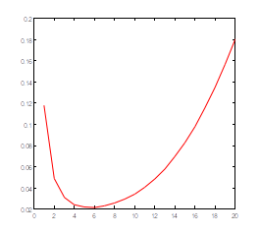
How many hash functions to use?
Too few: test is too unspecific. Too many: table becomes too crowded.
m = 1 billion, n = 8 billion
  k = 1: (1 – e^{-1/8}) = 0.1175
  k = 2: (1 – e^{-1/4})² = 0.0493
What happens as we
keep increasing k?
  “Optimal” value of k: n/m ln(2)
  In our case: Optimal k = 8 ln(2) = 5.54 ≈ 6
  Error at k = 6: (1 – e^{-1/6})² = 0.0235
False positive prob.
Number of hash functions, k

Slide 49
Probabilistic counting

Slide 50
Motivating example how many neighbors?
Let n(u,h) be the number of nodes reachable through a path of length up to h from node u
Naïve method
  Maintain a set for each node u, initialize S(u) = {u}
  Repeat h times:
  Answer n(u,h) = |S(u)|

Slide 51
What is the problem with this method?
Let n(u,h) be the number of nodes reachable through a path of length up to h from node u
Naïve method
  Maintain a set for each node u, initialize S(u) = {u}
  Repeat h times:
  Answer n(u,h) = |S(u)|

Slide 52
Let’s look at each node
We will receive a stream of items
  Our neighbors at distance <= h
  Repeated many times because of loops
We want to use a small amount of memory
We don’t care which items are in the stream
We just want to know how many are distinct

Slide 53


Counting fishes with pebbles
Normally, to count with pebbles, you add one pebble every time you see an event
How do you extend this method to count up to 1000 fishes with 10 pebbles?
Assume you have access to a random number generator but not to an abacus for … reasons

Slide 54
Answer
How to count up to 1000 fishes with 10 pebbles?
Every time you see a fish:
  generate a random integer between 1 and 100
  Add one pebble if that number is 1 (or any fixed value)
Return 100 x number of pebbles as an approximation

Slide 55
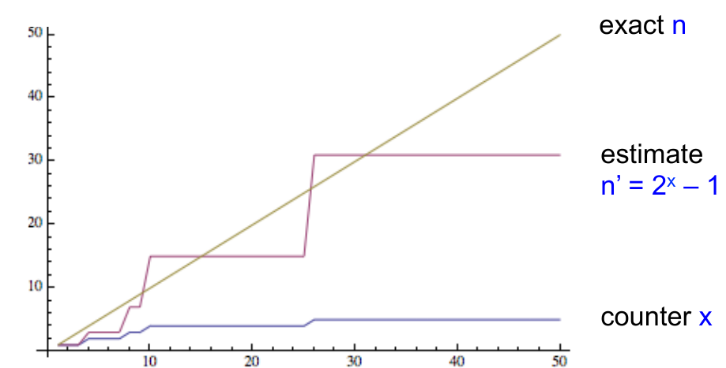
Morris’ probabilistic counting (1977)
x ← 0
For each of the n events:
  x ← x + 1 with probability (1/2)^{x}
Return estimate n’ = 2^{x}+1
Counter x needs only log₂(n) bits
Source: Slides by Nick Duffield

Slide 56
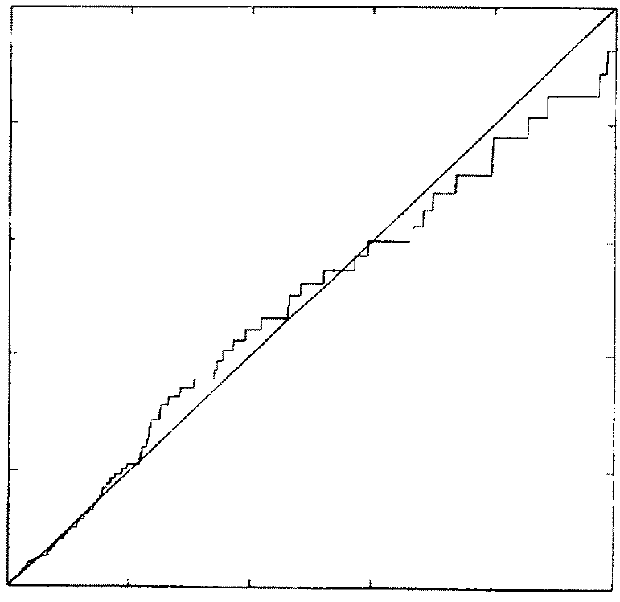
n (actual value)
Simulation results by Flajolet (1985)
n’ (approximation)

Slide 57
Morris’ algorithm provides an unbiased estimator
Init x=0, let p_{x} = 2^{-x}, estimate n’ = 2^{x} - 1
n = 1
  before: x = 0 p₀ = 1;
  prob. 1: x → 1
  estimate n’ = 2¹ – 1 = 1 = n
n = 2
  before: x = 1; p₁ = 1⁄2
  prob. 1⁄2: x stays at 1; n’ = 2¹ – 1 = 1
  prob. 1⁄2: x → 2. n’ = 2² -1 = 3
  E[n’] = 1⁄2 x 1 + 1⁄2 x 3 = 2 = n
Source: Slides by Nick Duffield

Slide 58
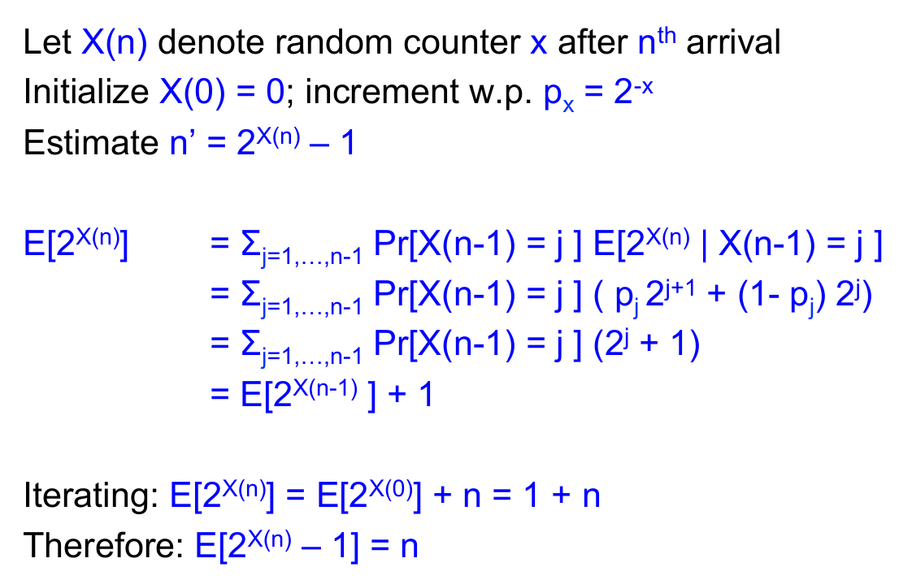
Morris’ algorithm provides an unbiased estimator (cont.)
Source: Slides by Nick Duffield

Slide 59
Flajolet-Martin algorithm for counting distinct elements
For every element u in the stream, compute hash h(u)
Let r(u) be the number of trailing zeros in hash value
  Example: if h(u) = 001011101000 then r(u) = 3
Maintain R = max r(u) seen so far
Output 2^{R} as an estimator of the number of distinct elements seen so far

Slide 60
Flajolet-Martin algorithm
(intuitive, hand-waving explanation)
Let r(u) be the number of trailing zeros in hash value, keep R = max r(u), output 2^{R} as estimate
Repeated items don’t change our estimates because their hashes are equal
About ½ of distinct items hash to *******0
  To actually see a *******0, we expect to wait until seeing 2 distinct items
About ¼ of distinct items hash to ******00
  To actually see a ******00, we expect to wait until seeing 4 items
…
If we actually saw a hash value of ***000...0 (having R trailing zeros) then on expectation we saw 2^{R} different items
J. Leskovec, A. Rajaraman, J. Ullman: Mining of Massive Datasets, http://www.mmds.org/

Slide 61
Flajolet-Martin, correctness proof
Let m be the number of distinct elements
Let z(r) be the probability of finding a tail of r zeroes
We will prove that
  z(r) → 1 if m ≫ 2^{r}
  z(r) → 0 if m ≪ 2^{r}
Hence 2^{r} should be around m
J. Leskovec, A. Rajaraman, J. Ullman: Mining of Massive Datasets, http://www.mmds.org/

Slide 62
Flajolet-Martin, correctness proof (cont.)
Probability a hash value ends in r zeroes = (1/2)^{r}
  Assuming h(u) produces values at random
  Prob. random binary ends in r zeroes = (1/2)^{r}
Probability of seeing m distinct elements and NOT seeing a tail of r zeroes = (1 – (½)^{r})^{m}
J. Leskovec, A. Rajaraman, J. Ullman: Mining of Massive Datasets, http://www.mmds.org/

Slide 63
Flajolet-Martin, correctness proof (cont.)
Probability of seeing m distinct elements and NOT seeing a tail of r zeroes = (1 – (½)^{r})^{m}
Remember (1-ε)^{1/ε} ≃ 1/e for small ε
Hence
J. Leskovec, A. Rajaraman, J. Ullman: Mining of Massive Datasets, http://www.mmds.org/

Slide 64
Flajolet-Martin, correctness proof (cont.)
Probability of seeing m distinct elements and NOT seeing a tail of r zeroes
If m ≫ 2^{r}, this tends to 0
  We almost certainly will see a tail of r zeroes
If m ≪ 2^{r}, this tends to 1
  We almost certainly will not see a tail of r zeroes
Hence, 2^{r} should be around m
J. Leskovec, A. Rajaraman, J. Ullman: Mining of Massive Datasets, http://www.mmds.org/

Slide 65
Flajolet-Martin: increasing precision
Idea: repeat many times or compute in parallel for multiple hash functions
How to combine?
  Average? E[2^{r}] is infinite, extreme values will skew the number excessively
  Median? 2^{r} is always a power of 2
Solution: group hash functions, take median of values obtained in each group, then average across groups

Slide 66
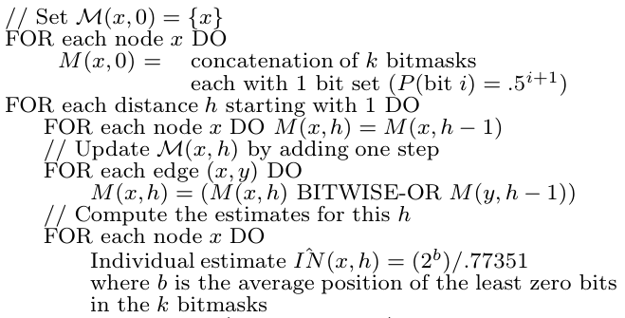
Let’s go back to counting neighbors
Naïve method:
Maintain a set for each node u, initialize S(u) = {u}
Repeat h times:
Answer n(u,h) = |S(u)|
ANF method:
Palmer, C. R., Gibbons, P. B., & Faloutsos, C. (2002, July). ANF: A fast and scalable tool for data mining in massive graphs. In Proc. KDD.

Slide 67
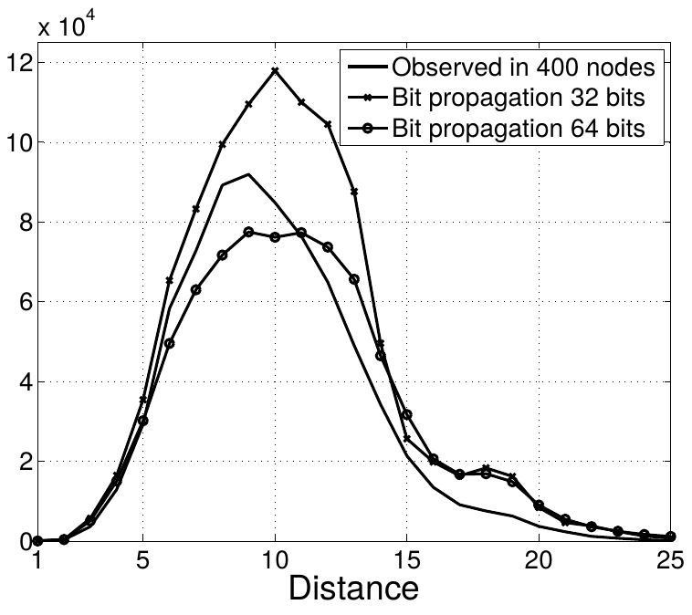
Example of another variant of the same type of algorithm
More repetitions of the algorithm yield better precision
Becchetti, Luca, Carlos Castillo, Debora Donato, Stefano Leonardi, and Ricardo Baeza-Yates. "Using rank propagation and probabilistic counting for link-based spam detection." In Proc. of WebKDD, 2006.

Slide 68
Estimating moments

Slide 69
Moments of order k
If a stream has A distinct elements, and each element has frequency m_{i}
The k^{th} order moment of the stream is
The 0th order moment is the number of distinct elements in the stream
The 1st order moment is the length of the stream

Slide 70
Moments of order k (cont.)
The k^{th} order moment of the stream is
The 2nd order moment is also known as the “surprise number” of a stream (large values = more uneven distribution)
m_{i} | i=1 | i=2 | i=3 | i=4 | i=5 | i=6 | i=7 | i=8 | i=9 | i=10 | i=11 | 2nd moment
Seq1 | 10 | 9 | 9 | 9 | 9 | 9 | 9 | 9 | 9 | 9 | 9 | 910
Seq2 | 90 | 1 | 1 | 1 | 1 | 1 | 1 | 1 | 1 | 1 | 1 | 8110

Slide 71
Method for second moment
Assume (for now) that we know n, the length of the stream
We will sample s positions
For each sample we will have X.element and X.count
We sample s random positions in the stream
  X.element = element in that position, X.count ← 1
  When we see X.element again, X.count ← X.count + 1
Estimate second moment as n(2 × X.count - 1)
Alon, N., Matias, Y., & Szegedy, M. (1999). The space complexity of approximating the frequency moments. Journal of Computer and system sciences, 58(1), 137-147.

Slide 72
Method for second moment (cont.)
Example: a,b,c,b,d,a,c,d,a,b,d,c,a,a,b
  m_{a} = 5, m_{b} = 4, m_{c} = 3, m_{d} = 3
  second moment = 5²+4²+3²+3² = 59
Suppose we sample s=3 variables X₁, X₂, X₃
Suppose we pick the 3rd, 8th, and 13th position at random
X₁.element=c, X₂.element=d, X₃.element=a
X₁.count=3, X₂.count=2, X₃.count=2 (we count forwards only!)
Estimate n(2 × X.count – 1), first estimate = 15(6-1) = 75,
second estimate 15(4-1) = 45, third estimate 15(4-1) = 45,
average of estimates = 55≃59
Alon, N., Matias, Y., & Szegedy, M. (1999). The space complexity of approximating the frequency moments. Journal of Computer and system sciences, 58(1), 137-147.

Slide 73
Method for second moment (cont.)
Example: a,b,c,b,d,a,c,d,a,b,d,c,a,a,b
Suppose we pick the 3rd, 8th, and 13th position at random
X₁.element=c, X₂.element=d, X₃.element=a
X₁.count=3, X₂.count=2, X₃.count=2
Alon, N., Matias, Y., & Szegedy, M. (1999). The space complexity of approximating the frequency moments. Journal of Computer and system sciences, 58(1), 137-147.

Slide 74
Why this method works?
Let e(i) be the element in position i of the stream
Let c(i) be the number of times e(i) appears in positions i, i+1, i+2, …, n
Example: a,b,c,b,d,a,c,d,a,b,d,c,a,a,b
  c(6) = ?

Slide 75
Why this method works?
Let e(i) be the element in position i of the stream
Let c(i) be the number of times e(i) appears in positions i, i+1, i+2, …, n
Example: a,b,c,b,d,a,c,d,a,b,d,c,a,a,b
  c(6) = 4
(remember: we count forwards only!)

Slide 76
Why this method works? (cont.)
c(i) is the number of times e(i) appears in positions i, i+1, i+2, …, n
E[n (2 × X.count – 1)] is the average of
n (2 c(i) – 1) over all positions i=1...n

Slide 77
Why this method works? (cont.)
Now focus on element a that appears m_{a} times in the stream
  The last time a appears this term is 2c(i) – 1 = 2x1-1 = 1
  Just before that, 2c(i)-1 = 2x2-1 = 3
  …
  Until 2m_{a} – 1 for the first time a appears
Hence

Slide 78
For higher order moments
(v = X.count)
For second order moment
  We use n(2v-1) = n(v² – (v-1)²)
For third order moment
  We use n(3v² – 3v + 1) = n(v³ – (v-1)³)
For k^{th} order moment
  We use n(v^{k} - (v-1)^{k})

Slide 79
For infinite streams
Use a reservoir sampling strategy
If we want s samples
  Pick the first s elements of the stream setting X_{i}.element ← e(i) and X_{i}.count ← 1 for i=1...s
  When element n+1 arrives
    Pick X_{n+1}.element with probability s/(n+1), evicting one of the existing elements at random and setting X.count ← 1
As before, probability of an element is s/n

Slide 80
Summary

Slide 81
Things to remember
Reservoir sampling
Bloom filter
Probabilistic counting algorithms:
  Morris
  Flajolet-Martin
k^{th} order moments of a stream

Slide 82
Exercises for this topic
Mining of Massive Datasets (2014) by Leskovec et al.
  Exercises 4.2.5
  Exercises 4.3.4
  Exercises 4.4.5
  Exercises 4.5.6

