Slide 1

Data Preparation:
Reduction and Transformation
Mining Massive Datasets
Prof. Carlos Castillo
Topic 05

Slide 2
Main Sources
Data Mining, The Textbook (2015) by Charu Aggarwal (Chapter 2) + slides by Lijun Zhang
Introduction to Data Mining 2nd edition (2019) by Tan et al. (Chapter 2)
Data Mining Concepts and Techniques, 3rd edition (2011) by Han et al. (Chapter 3)

Slide 3
Data reduction and transformation
Sampling
  ≃ “Less rows”
Dimensionality Reduction or Feature Selection
  ≃ “Less columns”

Slide 4
Why reduce/transform data?
The Advantages
  Reduce space complexity
  Reduce time complexity
  Reduce noise
  Reveal hidden structures
    E.g., manifold learning
The Disadvantages
  Information loss

Slide 5
Sampling for static data
Uniform random sampling
  with/without replacement
Biased sampling
  e.g., emphasize recent items
Stratified sampling
  Partition data in strata, sample in each stratum

Slide 6
Sampling example
There are 10000 people which contain 100 millionaires
Uniform random sample of 100 people
  In expectation, one millionaire will be sampled
  There is ≃ 37% chance no millionaires are sampled, why?
Stratified Sampling
  Unbiased Sampling 1 from 100 millionaires
  Unbiased Sampling 99 from remaining

Slide 7
Sampling from data streams
The setting
  Data arrive sequentially
  We want sample of them uniformly
  There is a reservoir that can hold k data points
The algorithm: reservoir sampling
  The first k data points are kept
  Insert the n-th data point with probability k/n
  Drop one of the existing data points uniformly at random
  More on this in the sequence mining lecture ...

Slide 8
Reducing data dimensionality
Note: PCA/SVD covered well in other courses, won’t be part of our exam

Slide 9
Feature selection
Unsupervised Feature Selection
  Using the performance of unsupervised learning (e.g, clustering) to guide the selection
Supervised Feature Selection
  Using the performance of supervised learning (e.g., classification) to guide the selection

Slide 10
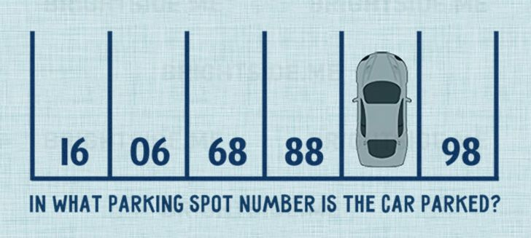
An axis rotation may help
Source: Centauro Blog (2017)

Slide 11
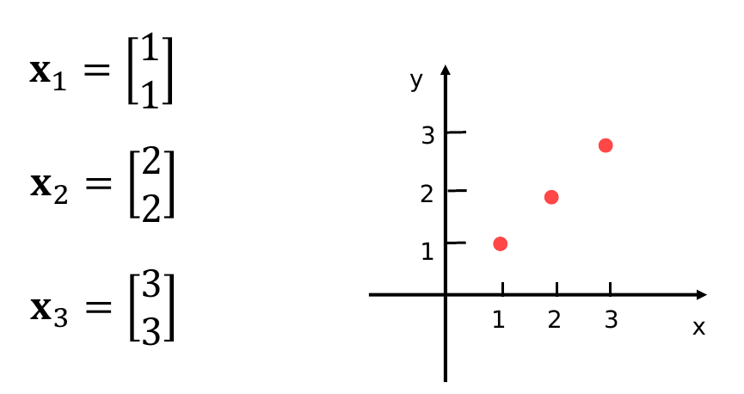
Dimensionality reduction with axis rotation (perfect case)
Motivation: three points in a line in two-dimensional space

Slide 12
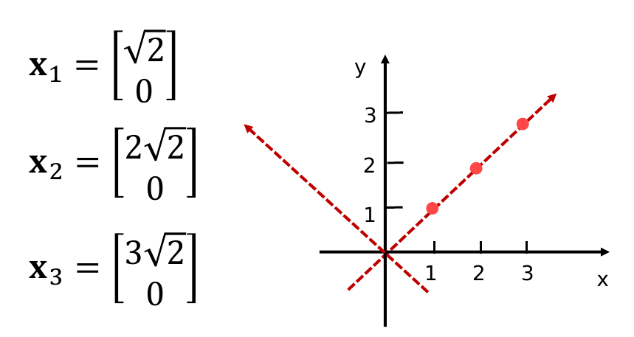
Dimensionality reduction with axis rotation (perfect case, cont.)
Coordinates after axes rotation

Slide 13
Dimensionality reduction with axis rotation (perfect case, cont.)
Coordinates after axes rotation
Drop second coordinate, no information is lost.
2D data reduced to 1D data

Slide 14
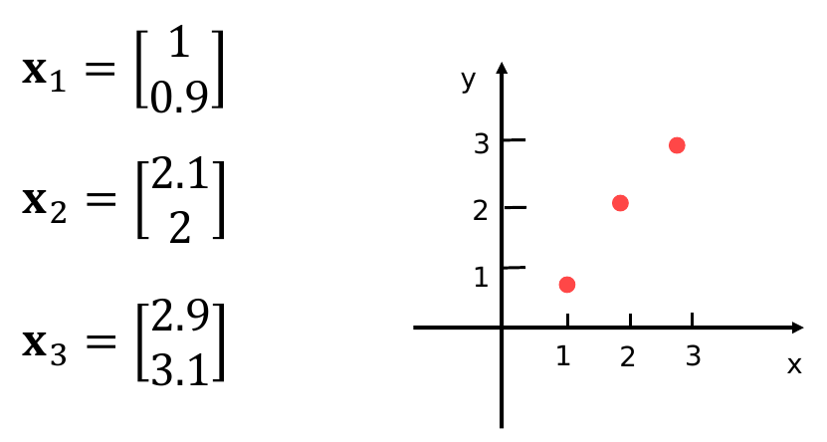
Dimensionality reduction with axis rotation (noisy case)
Suppose points don’t lie exactly on a line

Slide 15
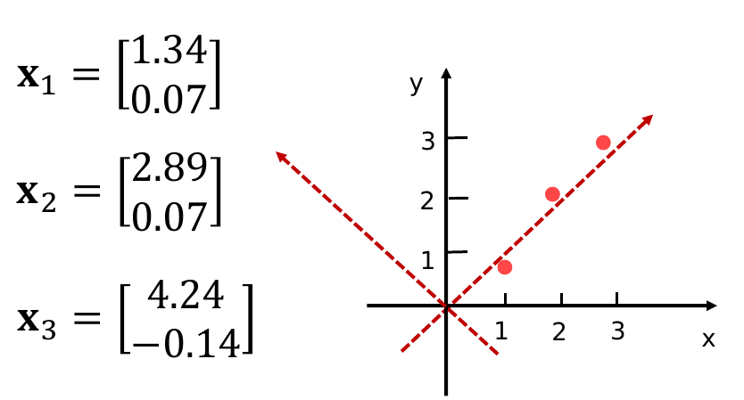
Dimensionality reduction with axis rotation (noisy case, cont.)
Suppose points don’t lie exactly on a line

Slide 16
Dimensionality reduction with axis rotation (noisy case, cont.)
Suppose points don’t lie exactly on a line
Drop second coordinate, some information is lost.
2D data reduced to 1D data

Slide 17
How does this work in reality?
Change of axes removes correlations and reduces dimensionality
Techniques
  Principal Component Analysis (PCA)
  Singular-Value Decomposition (SVD)
  (Seen elsewhere: not in the exams on this subject,
  the next slides are just here for completeness)

Slide 18
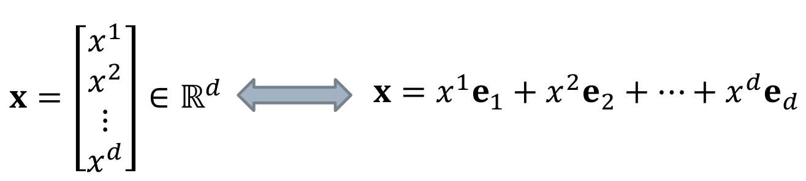
Axis rotation - formulation
Points are usually described with respect to the standard basis

Slide 19
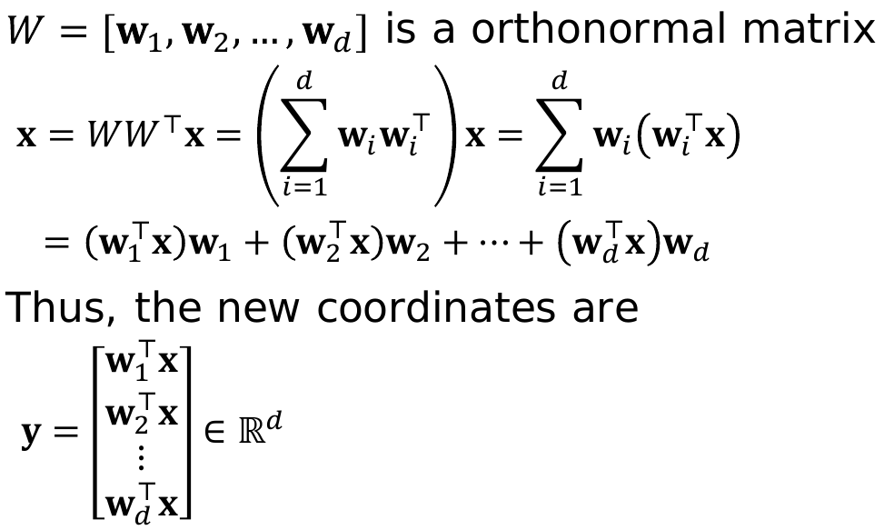
Axis rotation – formulation (cont.)
We will determine new coordinates under basis W:
Vector x has n dimensions, but
vector y has d≤n dimensions

Slide 20
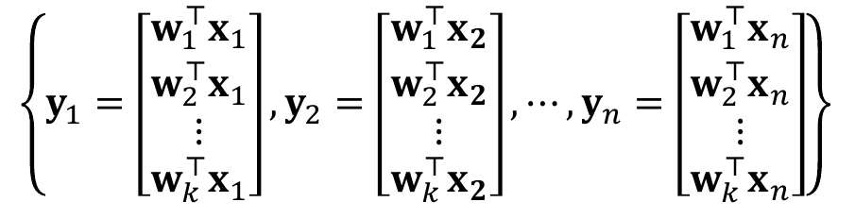
PCA formulation: optimization
Find new basis { w₁, w₂, …, w_{k} }, with k ≤ d such that the variance of this set is maximized:

Slide 21
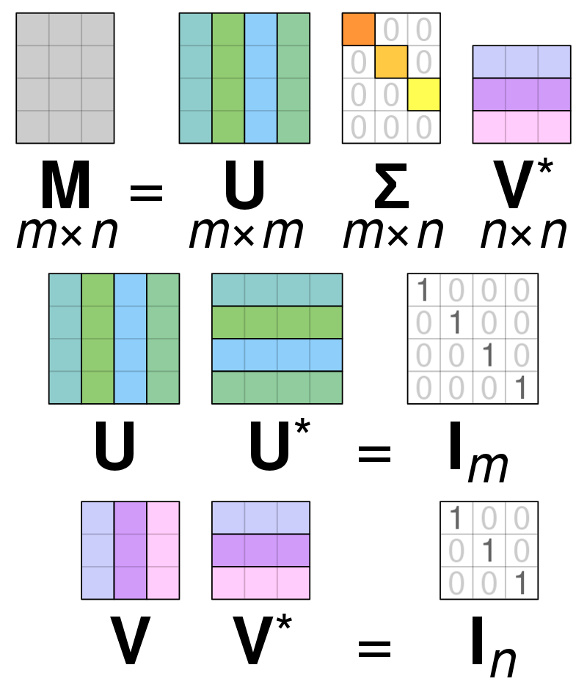
SVD formulation
U and V are rotation matrices; Σ is a scaling matrix
The rotated data is obtained by multiplying U^{T}X
X = U Σ V*
d x n d x d d x n n x n
U U* = I_{d}
V V* = I_{n}

Slide 22
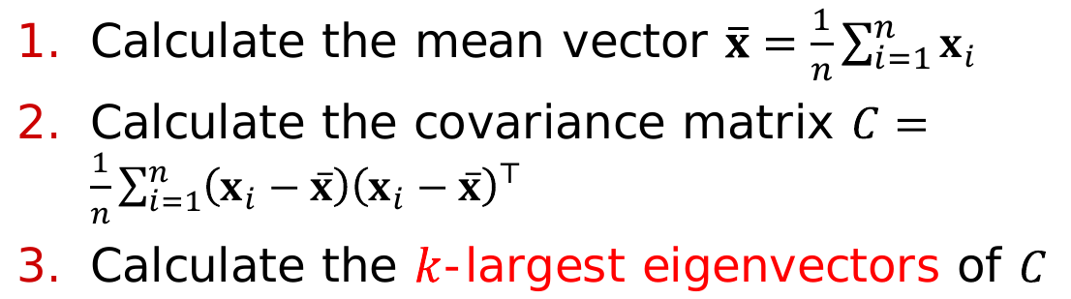
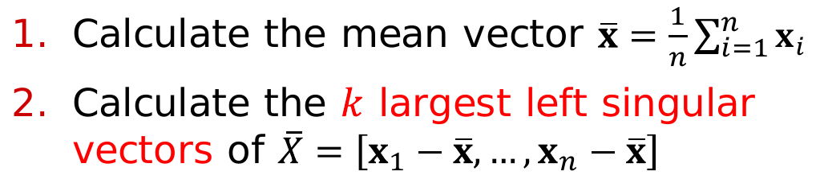
Algorithms for PCA and SVD
PCA
SVD

Slide 23
Summary

Slide 24
Things to remember
Data sampling methods
Why would we want to reduce dimensionality?
What are the main techniques for doing so

Slide 25
Exercises for TT03-TT05
Exercises 3.7 of Data Mining Concepts and Techniques, 3rd edition (2011) by Han et al.
Exercises 2.6 of Introduction to Data Mining, Second Edition (2019) by Tan et al.
  Mostly the first exercises, say 1-6

