Slide 1

Recommender systems
Mining Massive Datasets
Carlos Castillo
Topic 08

Slide 2
Sources
Data Mining, The Textbook (2015) by Charu Aggarwal (Section 18.5) – slides by Lijun Zhang
Mining of Massive Datasets 2nd edition (2014) by Leskovec et al. (Chapter 9) - slides A, B

Slide 3


YouTube's algorithm cares as much about Spanish trap as your professor, but manages to produce reasonable recommendations. How?

Slide 4
Recommender systems (purchase)
Given data from user buying behaviors
  User profiles, interests, browsing behavior, buying behavior, and ratings about various items
Leverage such data to make recommendations to customers about possible buying interests

Slide 5
Recommender systems (general)
Given data from user interests
  User profiles, interests, browsing behavior, item interaction behavior, ratings about various items
Leverage such data to make recommendations to users about further interesting items

Slide 6






Slide 7
Utility matrix
For n users and d items, there is a matrix D of utility values
  The utility value for a user-item pair could correspond to either the buying behavior or the ratings of the user for the item
  Typically, a small subset of the utility values are known

Slide 8
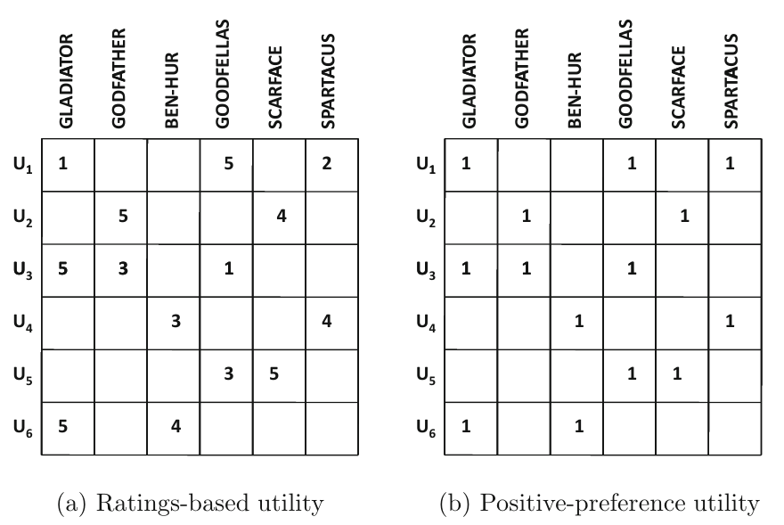
Utility matrix (ratings-based, positive preference)

Slide 9
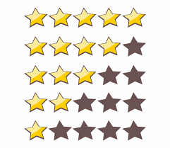


Types of utility
Explicit: we ask users to rate items
Implicit: we take watching/consuming/buying behavior as a positive signal, skip/hide as negative

Slide 10
Sources for a recommendation
Content-based recommendation
  Users and items are associated with features
  Features are matched to infer interest
Interaction-based recommendations
  Leverage user preferences in the form of ratings or other behavior
  Recommend through similarity or latent factors

Slide 11
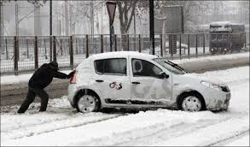
The “cold start”problem
New items have no ratings
and
New users have no history
Photo: Torque News

Slide 12
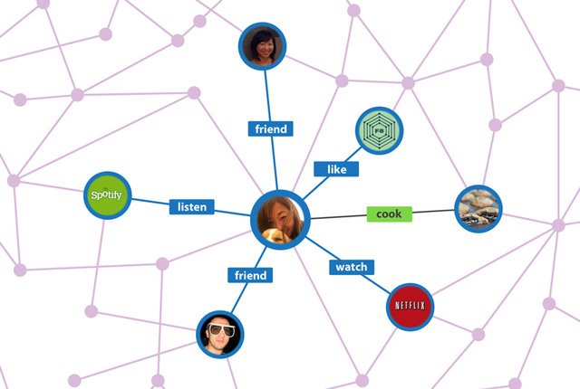

1.
“Side information” can help alleviate cold start

Slide 13

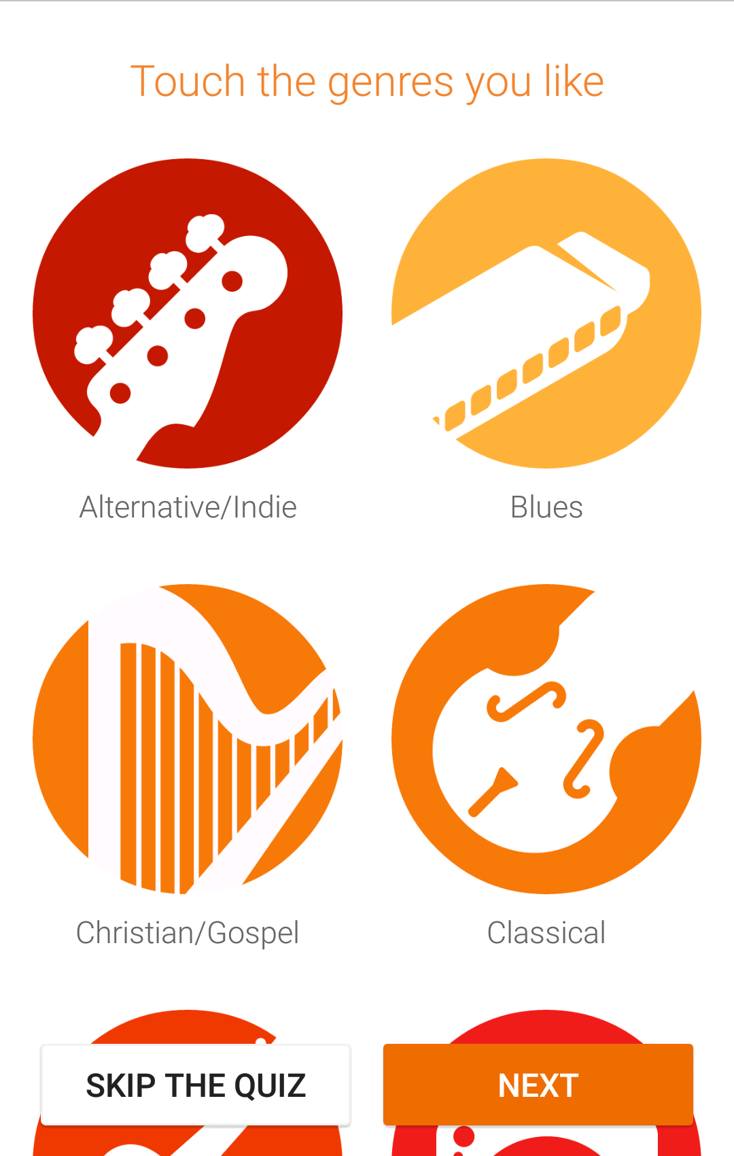
2.
“On-boarding” users can help to alleviate cold start

Slide 14
Content-based recommendations

Slide 15
General idea of content-based recommendations
Movies: recommend other movies with same director, actor, genre, as viewed ones
Product: recommend other products in same category, brand, color, as purchased ones

Slide 16

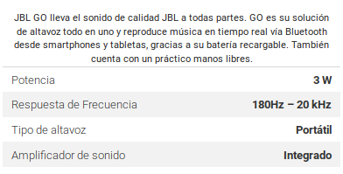
Creating a recommendation
User is associated with some documents that describe his/her interests
  Specified demographic profile
  Specified interests at registration time
  Descriptions of the items bought
Items are also associated with semi-structured descriptions

Slide 17
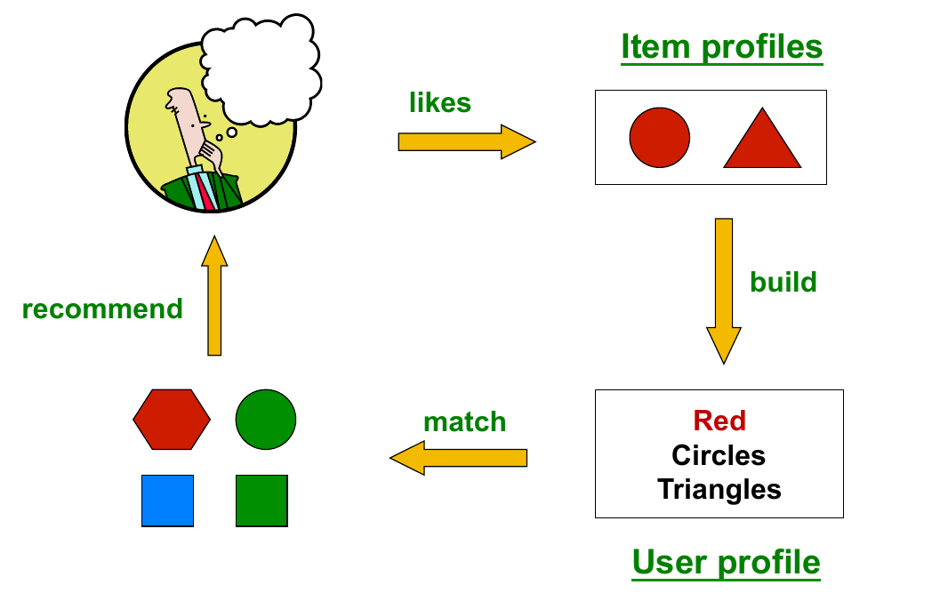
Creating a recommendation (cont.)
Mining of Massive Datasets 2nd edition (2014) by Leskovec et al. (Chapter 9) - slides A, B

Slide 18
Possible recommendation methods
If no utility matrix is available
  k-nearest neighbor approach
    Find the top-k items that are closest to the user (when items and users can be represented in the same space, e.g., dating apps)
  The cosine similarity with tf-idf can be used
If a utility matrix is available
  Classification-based approach: training documents are those for which the user has specified utility, labels are utility values
  Regression-based approach in the case of ratings
Limitations: depends on the quality of the features

Slide 19
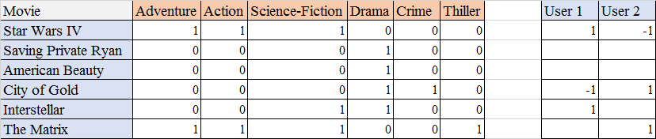
Example: regression-based approach for content-based recommendation
...
We would do two regressions: one for the ratings of user 1 and another for user 2.
How many rated movies would we need, as a minimum, to be able to do this?

Slide 20
Pros and Cons of content-based recommendations
Pros:
  No cold-start problem if no utility needed
  Able to recommend to users with very particular tastes
  Able to recommend new and obscure items
  Able to provide explanations that are easily understandable

Slide 21
Pros and Cons of content-based recommendations
Cons:
  Finding the correct features might be hard
  Recommending for new users still challenging if user features are different from item features
  Overspecialization/”bubble”: might reinforce user interests
  Does not exploit ratings of other users!

Slide 22
Interaction-based recommendations

Slide 23
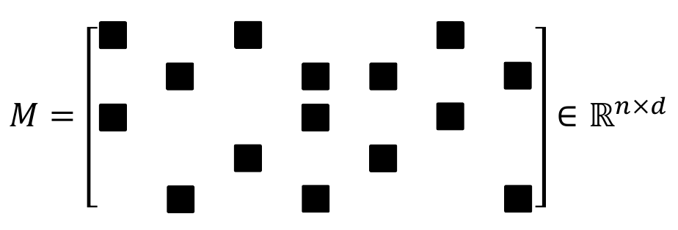
Missing-value estimation/completion
The matrix is extremely large and sparse
Only black squares have non-zero values.

Slide 24
Types of algorithms
Neighborhood-Based Methods
  User-Based or Item-Based Similarity with Ratings
Graph-Based Methods
Clustering Methods
  Adapting k-Means Clustering or Adapting Co-Clustering
Latent Factor Models
  Matrix Factorization, e.g., Singular Value Decomposition

Slide 25
User-based similarity with ratings
Let Iu,v be the common ratings between two users
Similarity: Pearson correlation coefficient
Note: averages are taken over all elements, not only ones in common

Slide 26
User-based similarity with ratings (cont.)
Score of recommendation
Note: for efficiency one can take only the most similar users

Slide 27
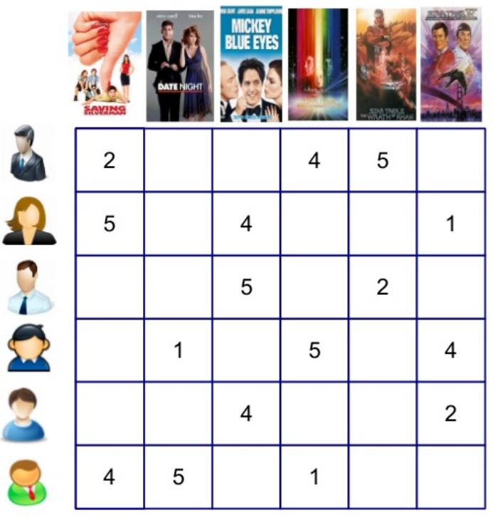
Try it!
Compute avg(v) for all users
Compute sim(u,v) for all users for which there is some intersection with u
Compute score(u,i) for all items that u has not seen yet
u
Exercise from ML for Recommender Systems tutorial by Alex Karatzoglou, 2015.

Slide 28
avg(v)
sim(u,v)
3.67
Undefined
3.33
0.87
3.50
1.00
3.33
-1.00
u
3.51
3.81
2.42
2.48
3.00
sim(u,v)
3.33
Undefined
Exercise from ML for Recommender Systems tutorial by Alex Karatzoglou, 2015.

Slide 29
You can do the same with items!
Item-based similarities with ratings
Item-based recommendations

Slide 30
Try it!
i
Compute avg(j) for all items
Compute sim(i,j) for all items for which there is some intersection with i
Compute score(u,i) for all users who have not seen i yet
Exercise from ML for Recommender Systems tutorial by Alex Karatzoglou, 2015.

Slide 31
i
Compute avg(j) for all items
Compute sim(i,j) for all items for which there is some intersection with i
Compute score(u,i) for all users who have not seen i yet
2.94
2.48
1.12
avg(j) 3.66 3 4.33 3.33 3.5 2.33
sim(i,j) -1 1 0.86 1 NULL
Exercise from ML for Recommender Systems tutorial by Alex Karatzoglou, 2015.

Slide 32
Summary

Slide 33
Things to remember
...

