Slide 1

Outlier Detection:
Probabilistic / Clustering-Based
Mining Massive Datasets
Prof. Carlos Castillo — https://chato.cl/teach

Slide 2
Sources
Data Mining, The Textbook (2015) by Charu Aggarwal (chapter 8) – slides by Lijun Zhang

Slide 3
Probabilistic methods

Slide 4
Related to probabilistic model-based clustering
Assume data is generated from a mixture-based generative model
Learn the parameters of the model from data
  EM algorithm
Evaluate the probability of each data point being generated by the model
  Points with low values are outliers

Slide 5
Mixture-based generative model
Data is generated by a mixture of k distributions with probability distributions
G₁, …, G_{k}
Each point X is generated as follows:
  Select a mixture component with probability α_{i}
    Suppose it’s component r
  Sample a data point from distribution G_{r}

Slide 6
Learning parameters from data
Probability of generating a point

Slide 7
Learning parameters from data
Probability of generating a point
Probability of generating a dataset
Learning: maximize log likelihood

Slide 8
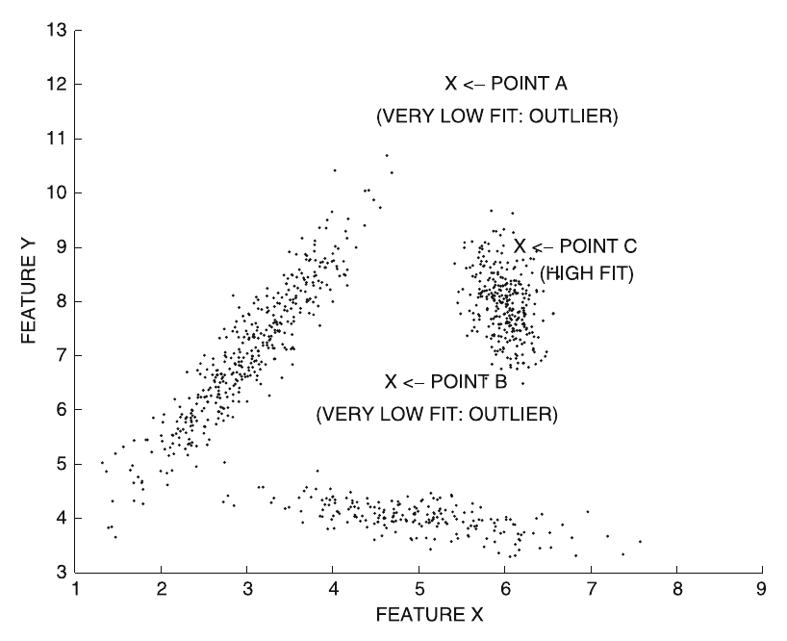
Identifying an outlier
Outlier score:

Slide 9
Clustering-based methods

Slide 10
Clustering for outlier analysis
Clustering associate points to similar points
Points either clearly belong to a cluster or are outliers
Some clustering algorithms also detect outliers
  Examples: DBSCAN, DENCLUE

Slide 11
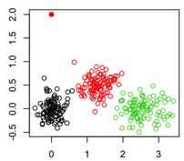
Simple method
Outlier
Cluster data, associating each point to a centroid, e.g., using k-means
Outlier score = distance of point to its centroid

Slide 12


Exercise: outliers through clustering
Spreadsheet does k-means to cluster the electric scooter database
Re-run with a new initial clustering
Do you see any interesting pattern in the final clustering assignment?
Find outliers according to the method from the previous slide
Spreadsheet links: https://upfbarcelona.padlet.org/chato/hogch321o6pws1fd

Slide 13
Improved method
Cluster data
Outlier score = local Mahalanobis distance with respect to center of cluster r
is the mean of the cluster r
is the covariance matrix of cluster r

Slide 14
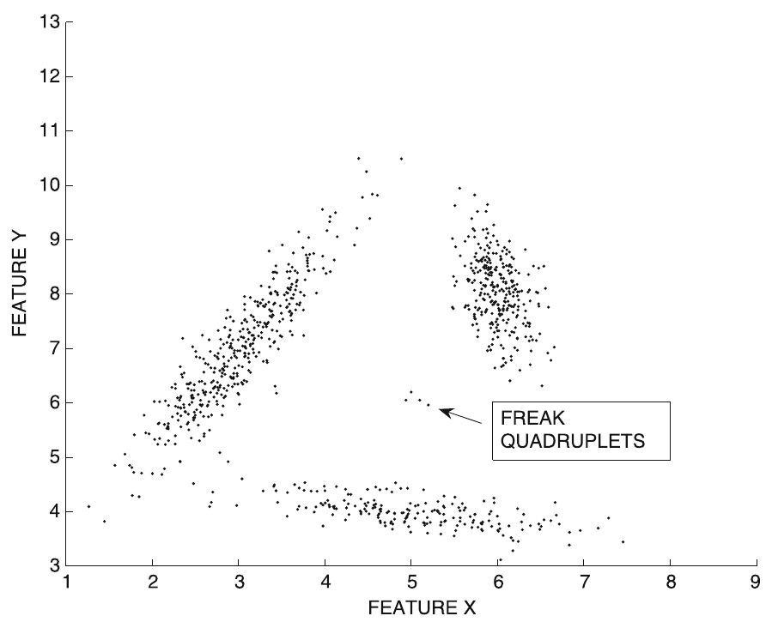
Improved method (cont.)
Remove tiny
clusters

Slide 15
Summary

Slide 16
Things to remember
Probabilistic methods
Clustering-based methods

Slide 17
Exercises for TT19-TT21
Data Mining, The Textbook (2015) by Charu Aggarwal
  Exercises 8.11 → all except 10, 15, 16, 17

