Slide 1

Association Rules
Mining Massive Datasets
Prof. Carlos Castillo — https://chato.cl/teach

Slide 2
Sources
Data Mining, The Textbook (2015) by Charu Aggarwal (Chapters 4, 5) – slides by Lijun Zhang
Mining of Massive Datasets 2nd edition (2014) by Leskovec et al. (Chapter 6) - slides
Data Mining Concepts and Techniques, 3rd edition (2011) by Han et al. (Chapter 6)
Introduction to Data Mining 2nd edition (2019) by Tan et al. (Chapters 5, 6) – slides ch5, slides ch6

Slide 3
What is a rule
A rule is of the form X⇒Y
  X and Y are itemsets
X is the antecedent, Y is the consequent
The confidence of the rule is:

Slide 4
Confidence of a rule
The confidence of the rule X ⇒ Y is:
This is the conditional probability of X U Y occurring in a transaction, given that X occurs in the transaction

Slide 5
Confidence of a rule (cont.)
tid | Set of items
1 | Bread, Jam, Juice
2 | Tofu, Juice, Tomatoes
3 | Bread, Strawberries, Tofu, Juice
4 | Tofu, Juice, Tomatoes
5 | Strawberries, Juice, Tomatoes

Slide 6
Confidence of a rule (cont.)
tid | Set of items
1 | Bread, Jam, Juice
2 | Tofu, Juice, Tomatoes
3 | Bread, Strawberries, Tofu, Juice
4 | Tofu, Juice, Tomatoes
5 | Strawberries, Juice, Tomatoes

Slide 7
Lift of a rule
The lift of the rule X ⇒ Y is:
This is the ratio between the observed support and the expected support if X and Y were independent

Slide 8
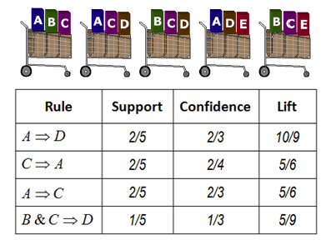
Exercise
Answer in
Nearpod draw-it
Code to be given in class
https://www.saedsayad.com/association_rules.htm

Slide 10
Answers
https://www.saedsayad.com/association_rules.htm

Slide 11
Association rule (minsup, minconf)
Let X, Y be two itemsets; the rule X⇒Y is an association rule of minimum support minsup and minimum confidence minconf if:
sup(X⇒Y) ≥ minsup
and
conf(X⇒Y) ≥ minconf

Slide 12
Summary

Slide 13
Things to remember
Association rule of minsup and minconf
The concepts of confidence and lift

Slide 14
Exercises for TT11-TT12
Data Mining, The Textbook (2015) by Charu Aggarwal
  Exercises 4.9 → 1-3, 5, 7-8
  Exercises 5.7 → 1-5
Mining of Massive Datasets 2nd edition (2014) by Leskovec et al.
  Exercises 6.1.5 → 6.1.1-6.1.7
Introduction to Data Mining 2nd edition (2019) by Tan et al.
  Exercises 5.10 → 2-7

