Slide 1

Data Preparation:
Integration and Cleaning
Mining Massive Datasets
Prof. Carlos Castillo — https://chato.cl/teach

Slide 2
Main Sources
Data Mining, The Textbook (2015) by Charu Aggarwal (Chapter 2) + slides by Lijun Zhang
Introduction to Data Mining 2nd edition (2019) by Tan et al. (Chapter 2)
Data Mining Concepts and Techniques, 3rd edition (2011) by Han et al. (Chapter 3)

Slide 3
Data integration

Slide 4
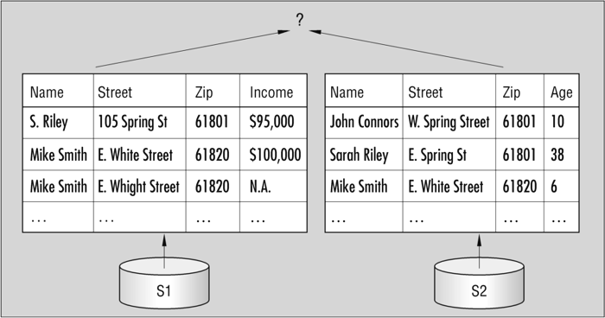
Data integration is not easy
Lu et al. 2013

Slide 5
Data integration is not easy
Lu et al. 2013

Slide 6
Data integration is not easy
Lu et al. 2013

Slide 7
Data integration aspects
Remember: difference between
DB schema and DB state
Schema integration
  Bring different schemata together
  Equal concepts should be represented with equal types
Object matching / Entity identification
  Equal entities should be equally identified across datasets (unless re-identification forbidden by policy)

Slide 8
Data integration aspects (cont.)
Redundancy analysis
  Sometimes data needs to be integrated because different sets are row-incomplete
  Sometimes those sets don’t form a partition ⇒ there will be repeated entities to be removed
Resolution of value conflicts
  Same entity, different attribute values

Slide 9
Data cleaning

Slide 10
Why data cleaning?
Data collection technologies are inaccurate
  Sensors
  Optical character recognition
  Speech-to-text data
Privacy reasons
Manual errors
Data collection is expensive and inaccurate

Slide 11
What is data cleaning?
It is a process by which data records are
modified or deleted
until each record passes
data validity criteria

Slide 12
Data validity criteria (1)
Mandatory constraints: certain columns cannot be empty.
Data-type constraints: values in a column must be of a particular datatype
Range constraints: numbers or dates should fall within a certain range
Regular expression patterns: e.g., phone numbers [0-9]{9}

Slide 13
Data validity criteria (2)
Unique constraints: a field, or a combination of fields, must be unique
Set-membership constraints: values in a column come from a set of discrete values or codes
Foreign-key constraints: set membership constraint where valid values in a column are defined in a column of another table that contains unique values

Slide 14
Data validity criteria (3)
Cross-field validation: certain conditions that utilize multiple fields must hold, e.g.:
  percentages add up to 1.0 or to 100
  discounted price lower or equal to regular price
  date of expiration after date of manufacturing

Slide 15
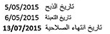
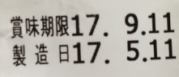
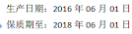
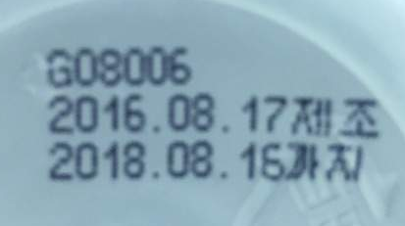
Data validity criteria (3 cont.)
You see this in a package … how do you decide whether the product is expired or not?

Slide 16
Handling missing entries
Why is a value missing?
Missing Completely at Random (MCAR)
  Missingness of a value is independent of observable attributes
Missing at Random (MAR)
  Missingness has statistical dependencies with an observable attribute
  We can fill in values based on other attributes, but this
  is likely to introduce a bias in the analysis
Missing Not at Random (MNAR)
  Missingness depends deterministically on an observable attribute
  In general this is informative, non-ignorable missingness
In general, it is not possible to know which one is the case just by looking at the data

Slide 17
Handling missing entries: options
Delete the data record containing missing entries
Estimate or Impute the Missing Values
  Additional errors may be introduced
  Good under certain conditions (e.g., Matrix Completion)
Some algorithms can work with missing data

Slide 18

Exercise
Handling missing data (specify your assumptions)
5% of student records at a university have no “civil status” (single, married, ...)
  Drop records? Impute value, how?
5% of smokers in a study of the effects of tobacco on health had no year of birth
  Drop records? Impute value, how?
5% of records of sales of a company have zip code but no province
  Drop records? Impute value, how?
Temperature sensor at weather station was failing at random intervals during one day, total downtime 6 hours, max continuous downtime 15 minutes
  Drop that day? Impute values, how?
Same sensor failed during one night, downtime 6 hours continuous
  Drop that day? Impute values, how?
Pin board: https://upfbarcelona.padlet.org/chato/mgu47ssu5hxlxej8

Slide 19
Possible answers
(correctness depends on assumptions)
5% of student records at a university have no “civil status” (single, married, ...)
  Undergrads? Impute as “single” unless there is a “spouse” field or similar
5% of smokers in a study of the effects of tobacco on health had no year of birth
  Drop, but check if there is something systematic in distribution of other values for them
5% of records of sales of a company have zip code but no province
  Get a zip code to province table, complete the missing data
Temperature sensor at weather station was failing at random intervals during one day, total downtime 6 hours, max continuous downtime 15 minutes
  Impute by interpolating
Same sensor failed during one night, downtime 6 hours continuous
  Drop day, interpolation may be inaccurate

Slide 20
Handling Incorrect and
Inconsistent Entries
Inconsistency detection
  E.g., full name and abbreviation don’t match
Domain knowledge
  Human age cannot reach to 800 (yet?)
Data-centric methods
  Outlier detection

Slide 21
Scaling and normalization
Features have different scales
  Age versus Salary
Standardization (“z-scoring”)
  Mean 0 and stdev 1
Min-Max Scaling
  Map to [0,1]
  Sensitive to noise

Slide 22
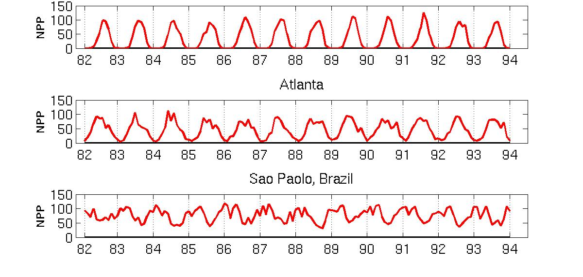
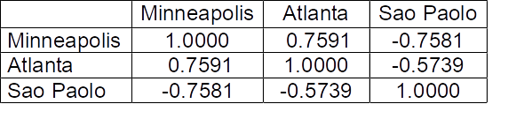
Example: seasonal standardization
Minneapolis
Net Primary Production (NPP) is a measure of plant growth used by ecosystem scientists.
Introduction to Data Mining 2nd edition (2019) by Tan et al. (Chapter 2)

Slide 23
Example: seasonal standardization
Minneapolis
Net Primary Production (NPP) is a measure of plant growth used by ecosystem scientists.
Introduction to Data Mining 2nd edition (2019) by Tan et al. (Chapter 2)
Spurious correlations between time series

Slide 24
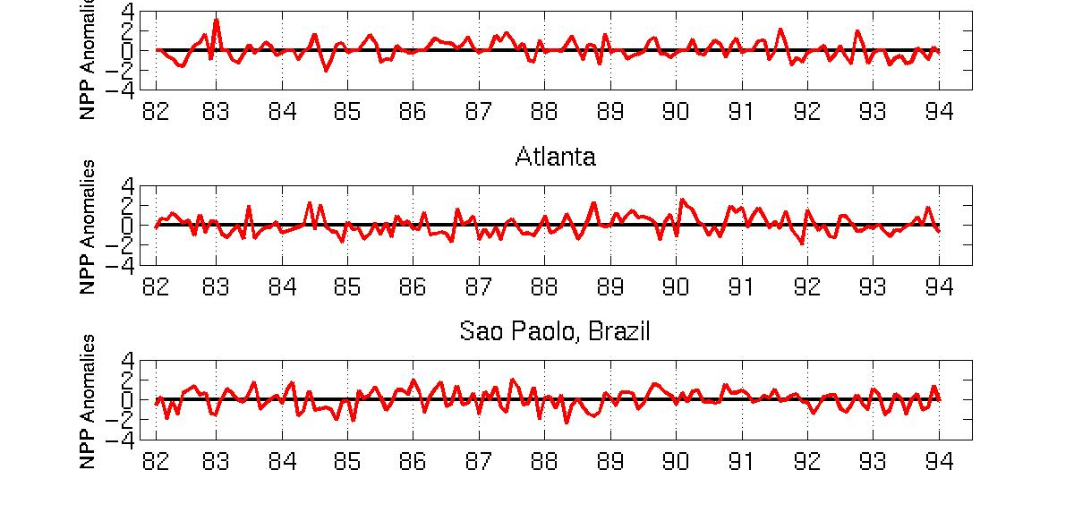
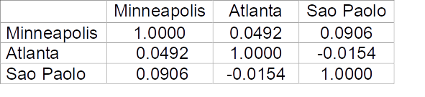
Example: seasonal standardization
Minneapolis
Normalized using monthly Z Score:
Subtract off monthly mean and divide by monthly standard deviation
Introduction to Data Mining 2nd edition (2019) by Tan et al. (Chapter 2)
Adjusted correlations between time series

Slide 25
Summary

Slide 26
Things to remember
Data cleaning
  Specially: when and how to impute missing values

Slide 27
Exercises for TT03-TT05
Exercises 3.7 of Data Mining Concepts and Techniques, 3rd edition (2011) by Han et al.
Exercises 2.6 of Introduction to Data Mining, Second Edition (2019) by Tan et al.
  Mostly the first exercises, say 1-6

