Slide 1

Data, Methods, Scenarios
Mining Massive Datasets
Prof. Carlos Castillo
Topic 02

Slide 2
Main Sources
Data Mining, The Textbook (2015) by Charu Aggarwal (Chapter 1) + slides by Lijun Zhang
Mining of Massive Datasets, 2nd edition (2014) by Leskovec et al. (Chapter 1)
Data Mining Concepts and Techniques, 3rd edition (2011) by Han et al. (Chapters 1-2)

Slide 3
Contents
Types of data
Types of problem
Example scenarios
Major challenges

Slide 4
Data types

Slide 5
Nondependency / Dependency
Nondependency oriented data can be structured so items are separate
  Relational data, text data
Dependency oriented data includes relationships between items
  Graphs, time series

Slide 6
Mixed attribute data
Most attributes we will deal with are numerical, they quantify something
Sometimes attributes are categorical
  Categorical
    Example: elephant, tiger, moose, ...
  Binary (two categories)
    Example: present, absent
  Ordinal (two or more categories that can be naturally sorted)
    Example: low, medium, high
Real-world datasets include both types

Slide 7
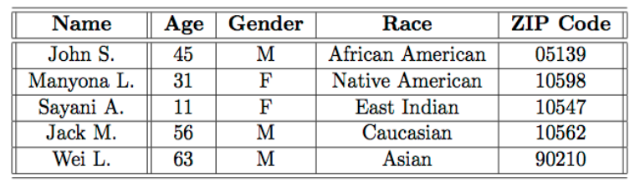
Binary attributes, sets, dummy vars.
Every binary attribute can be used as a marker of belonging to a set and viceversa
One-hot encoding: every categorical attribute taking one of k values can be encoded as k “dummy” binary attributes

Slide 8
Question
Suppose you encode race and gender using one-hot encoding. How many columns will your new dataset have?

Slide 9
Answer: 10 columns
Columns Name, Age, Gender_M, Gender_F, Race_AA, Race_NA, Race_EI, Race_C, Race_A, Zip Code

Slide 10
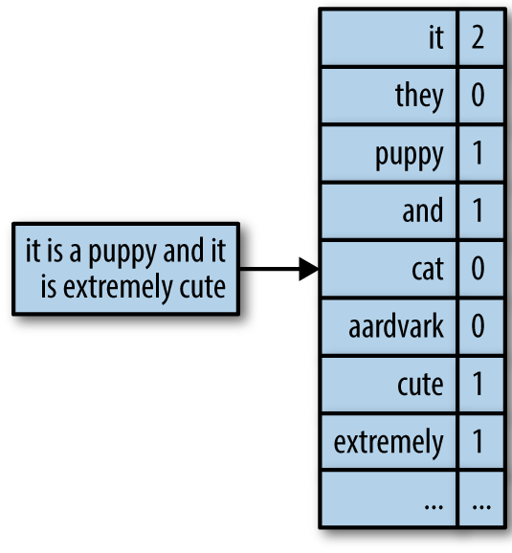
Textual data
Text be represented as:
  As a string
  As a set of binary variables, one for each word in the dictionary, with value True iff the word belongs to the text (the “bag-of-words” model)
  As a set of numerical variables indicating number of occurrences (the “vector space” model)
http://uc-r.github.io/creating-text-features

Slide 11
Time series data
Contextual attributes
  Timestamps, sequence number, …
Behavioral attributes
  Readings of a sensor, value of the variable, …
Multivariate time series data has multiple behavioral attributes

Slide 12
Spatial data
Two (lat/long) or three (lat/long/elevation) spatial attributes
Represented by images
Remote sensing data

Slide 13
Spatiotemporal data
Spatial and temporal attributes are contextual
  Example: sea surface temperature
Temporal attribute is contextual, spatial attribute is behavioral
  Example: trajectories

Slide 14
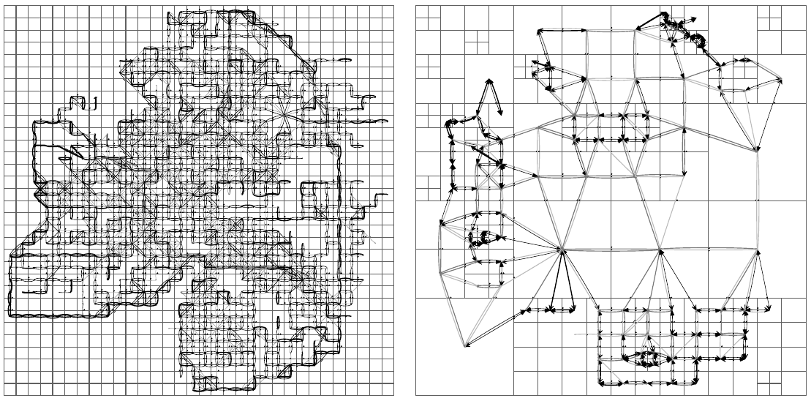
Example: trajectory data aggregation
Bonchi, F., Castillo, C., Donato, D., & Gionis, A. (2009). Taxonomy-driven lumping for sequence mining.
Data Mining and Knowledge Discovery, 19(2), 227-244.

Slide 15
Problem types

Slide 16
Data mining methods try to find relationships
Between columns
  Find associations, correlations, …
  If there is one key column: classification, prediction, ...
Between rows
  Find clusters
  Detect outliers

Slide 17
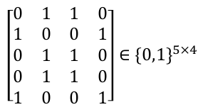
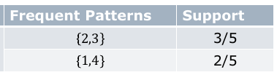
Example:
Association pattern mining
Sparse binary databases representing, e.g., items a person is interested in
The relative frequency of a pattern is its support
https://cs.nju.edu.cn/zlj/Course/DM_15.html

Slide 18
Association pattern mining (cont.)
Given a binary n × d data matrix D,
  determine all subsets of columns such that all the values in these columns take on the value True for at least a fraction min_support of the rows in the matrix.
The relative frequency of a pattern is referred to as its support

Slide 19
Association pattern mining (cont.)
The confidence of a rule A→B is
  support(A U B) / support(A)
Example:
  { Chips, Olives } → { Beer }

Slide 20
Exercise
The confidence of a rule A→B is
  support(A U B) / support(A)
Suppose
  10 people buy only Chips and Beer
  20 people buy only Chips and Olives
  30 people buy only Olives and Beer
  40 people buy all three: Chips, Olives, and Beer.
What is the confidence of the rule
{ Chips, Olives } → { Beer } ?
Answer in Nearpod Collaborate
https://nearpod.com/student/
Code to be given during class

Slide 21
Answer
The confidence of a rule A→B is: support(A U B) / support(A)
Suppose
  10 people buy only Chips and Beer
  20 people buy only Chips and Olives
  30 people buy only Olives and Beer
  40 people buy all three: Chips, Olives, and Beer.
Confidence of the rule { Chips, Olives } → { Beer } ?
support({Chip, Olives, Beer} / support({Chip, Olives}) = 40 / (40+20) = 2/3

Slide 22
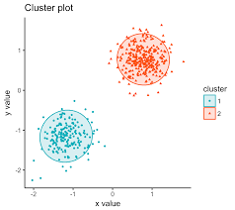
Clustering
Partition records/rows in a way that
  elements in the same partition are similar
  elements in different partitions are different
But what does it mean to be similar? How many sets? Can a record/row belong to two sets? To zero sets? ...
Applications:
  Segmentation, summarization, …
  Sometimes a step in a larger DM algorithm
Image credit: http://www.sthda.com/english/articles/tag/pam-clustering/

Slide 23
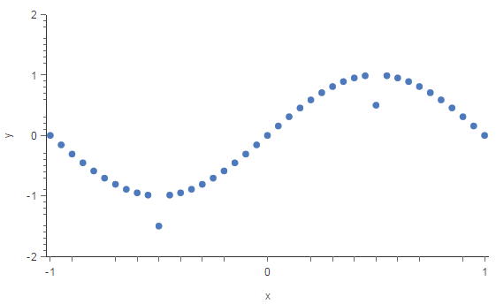
Outlier detection
Given a database, find
records/rows that are different
from the rest of the database
But what does it mean to be different? How many can be different? How different should they be?
Applications:
  Intrusion detection, credit card fraud, interesting sensor events, medical diagnosis, ...
Image credits: https://www.kdnuggets.com/2017/01/3-methods-deal-outliers.html

Slide 24
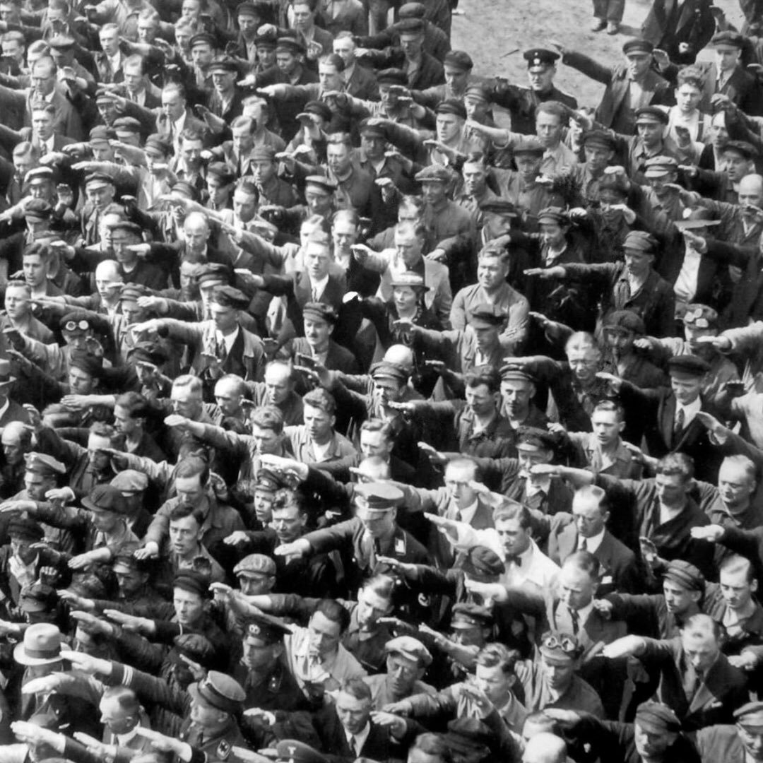
Outlier detection (cont.)
August Landmesser in 1936

Slide 25
Data classification
When data has a special feature known as a class label
A model can learn from previous data to associate a record/row to a class label
Applications:
  Too many to list here :-)

Slide 26
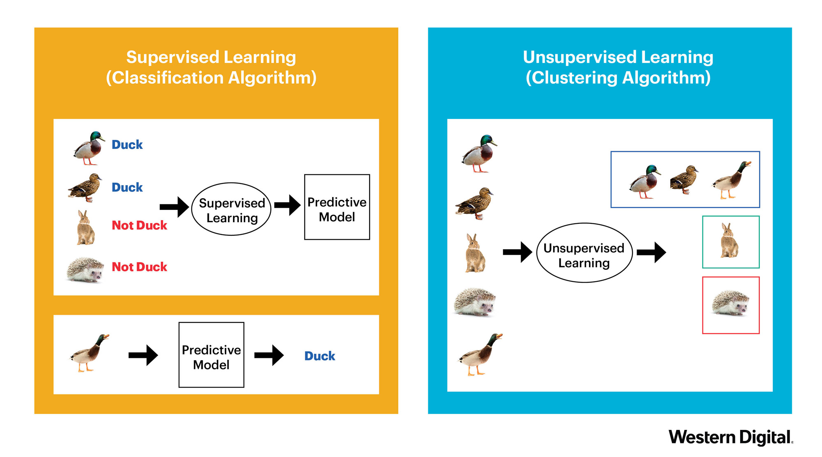
https://blog.westerndigital.com/machine-learning-pipeline-object-storage/

Slide 27
Tasks with complex data types
Frequent temporal patterns
Time series motifs
Graph motifs
Trajectory clusters
Collective classification
...

Slide 28
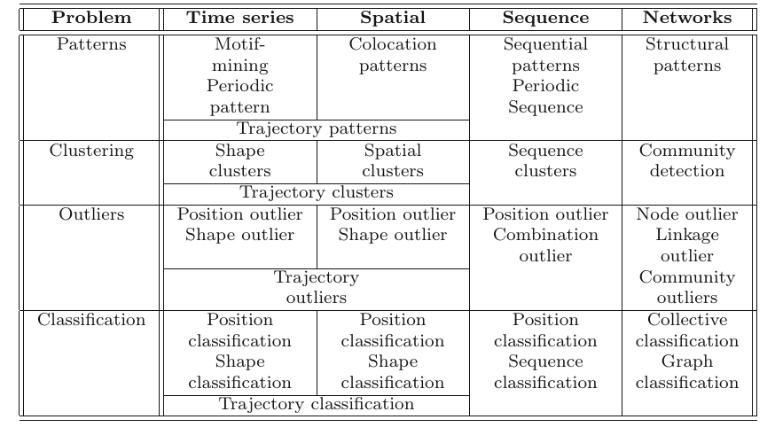
Data types x Prototypical problems
Data Mining, The Textbook (2015) by Charu Aggarwal

Slide 29
Example scenarios

Slide 30
Example scenario 1
Place products in a store to maximize co-purchases of items frequently bought together
  Input data: baskets
  Output: similar pairs
  Algorithm: frequent pattern mining

Slide 31
Example scenario 2
Recommend movies to users in a video-on-demand platform
  Input data: viewing history
  Output: recommendations for a user
  Simple algorithm: k nearest neighbors

Slide 32
Example scenario 3
Help diagnose if an electrocardiogram is associated to a health problem
  Input data: time series, possibly multi-dimensional
  Output: binary label or risk score
  Algorithms: outlier detection or classification

Slide 33
Example scenario 4
Help a sysadmin determine if an intruder is trying or has accessed the network
  Input data: time series of event records
  Output: binary label or risk score
  Algorithms: event detection

Slide 34
Are these data mining tasks?
Dividing the customers of a company by gender
Finding credit card scammers among customers of a company
Computing the total sales of a company
Sorting a student database by student identification number
Predicting the future stock price of a company using past records
Determine when a complex machine needs to be repaired
Extracting the frequencies of a sound wave
Answer in Nearpod Time to Climb
https://nearpod.com/student/
Code to be given during class

Slide 35
Answers
Dividing the customers of a company by gender
Finding credit card scammers among customers of a company
Computing the total sales of a company
Sorting a student database by student identification number
Predicting the future stock price of a company using past records
Determine when a complex machine needs to be repaired
Extracting the frequencies of a sound wave

Slide 36
Major challenges

Slide 37
Methodological challenges
Mining new kinds of knowledge
Mining multidimensional data
Fully utilizing the expertise of domain experts who know the data better
Handling uncertainty, noise, incompleteness

Slide 38
User interaction challenges
Allowing users to ask the questions that matter to them
Performing interactive mining
Presenting and visualizing data mining results

Slide 39
Efficiency and scalability
Data cannot be stored in a single machine
  Processing time of an algorithm might be exponential in input … or even polynomial, even with small degree: a process can become unreasonably slow very quickly
  Streaming algorithms
  Parallel/distributed mining algorithms

Slide 40
Diversity of database types
Real databases are a complex mixture of very rich and diverse data types
Mining dynamic, networked, global data repositories
  Integrating from complementary sources

Slide 41

Data mining can be harmful
Social impacts of data mining
  Who wins? And more importantly, who loses?
Privacy-preserving data mining
  Avoid invisible, pervasive, invasive data mining

Slide 42
Summary

Slide 43
Things to remember
Types of data
Types of data mining methods
Prototypical data mining scenarios
Typical challenges of data mining

Slide 44
Exercises for this topic
Section 1.9 of Data Mining, The Textbook (2015) by Charu Aggarwal
Exercises 1.7 of Introduction to Data Mining, Second Edition (2019) by Tan et al.

