Slide 1

Itemsets
Mining Massive Datasets
Prof. Carlos Castillo
Topic 11

Slide 2
Sources
Data Mining, The Textbook (2015) by Charu Aggarwal (Chapters 4, 5) – slides by Lijun Zhang
Mining of Massive Datasets 2nd edition (2014) by Leskovec et al. (Chapter 6) - slides
Data Mining Concepts and Techniques, 3rd edition (2011) by Han et al. (Chapter 6)
Introduction to Data Mining 2nd edition (2019) by Tan et al. (Chapters 5, 6) – slides ch5, slides ch6

Slide 3
Market Basket Analysis
Understand customers
  Purchasing habits, sensitivity to price, promotions
Understand products
  Co-purchases, fast/slow movers
Take action: promotions, store layout, …
https://paginas.fe.up.pt/~ec/files_1112/week_04_Association.pdf

Slide 4
Transactions contain items, which can be grouped into itemsets
Transactions
  Sets of items bought by customers
The Goal
  Determine associations between groups of items bought by customers
Quantification of the Level of Association
  Frequencies of sets of items
The Discovered Sets of Items
  Large itemsets, frequent itemsets, or frequent patterns

Slide 5
“Transaction” is a general concept
Items | Transactions
Groceries | Grocery cart
University courses | Transcript of courses taken
Guests | Party
Movies | Actor
Symptoms | Patient
Streamed songs | Streaming subscriber
Words | Document
Liked photos | Instagram account
https://web.stanford.edu/class/cs102/lecturenotes/DataMining.pdf

Slide 6
Applications
Supermarket Data
  Target marketing, shelf placement
Text Mining
  Identifying co-occurring terms
Generalization to Dependency-oriented Data Types
  Web log analysis, software bug detection
Other Major Data Mining Problems
  Clustering, classification, and outlier analysis

Slide 7
Association rules
Generated from frequent itemsets
Formulation X⇒Y
  {Soy latte} ⇒ {Brown Sugar}
  {Kale, Quinoa} ⇒ {Almond milk}
Applications
  Promotion
  Shelf placement
Conditional Probability

Slide 8
Association rule mining
U is a set of d items
T is a set of n transactions T₁, T₂, …, T_{n}
with T_{i} ⊆ U
Itemset: a set of items
k-itemset: a set of k items
  How many different k-itemsets exist? 2^{k}

Slide 9
Binary representation of a transaction
tid | Set of items | Binary representation
1 | Bread, Jam, Juice | 110010
2 | Tofu, Juice, Tomatoes | 000111
3 | Bread, Strawberries, Tofu, Juice | 101110
4 | Tofu, Juice, Tomatoes | 000111
5 | Strawberries, Juice, Tomatoes | 001011

Slide 10
Definitions
Support of itemset I, written sup(I):
  the fraction of transactions in the database
  T = {T₁ … T_{n}} that contain I as a subset.
Frequent itemset mining with support minsup:
  Given a set of transactions T = {T₁, …, T_{n}},
  where T_{i} ⊆ U,
  find all itemsets I_{j} such that sup(I_{j}) ≥ minsup

Slide 11
Example
tid | Set of items | Binary representation
1 | Bread, Jam, Juice | 110010
2 | Tofu, Juice, Tomatoes | 000111
3 | Bread, Strawberries, Tofu, Juice | 101110
4 | Tofu, Juice, Tomatoes | 000111
5 | Strawberries, Juice, Tomatoes | 001011
sup({Bread, Juice}) = 2/5 = 0.4
sup({Strawberries, Tomatoes}) = 1/5 = 0.2
If minsup=0.3, {Bread, Juice} is a frequent itemset

Slide 12
Exercise: compute support
TID | Items
100 | 1 3 4
200 | 2 3 5
300 | 1 2 3 5
400 | 2 5
Write the support of every 2-itemset or
3-itemset occurring
in this database
Indicate which are frequent itemsets if minsup = 1/2
Answer in
Google spreadsheet

Slide 13
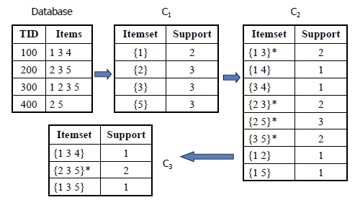
Note: in this slide “support” is an absolute value (number of occurrences)
while in this course in general “support” will be a fraction or probability.
In this case, divide by 4 (number of transactions) to obtain a fraction or probability.
Source: https://www.saedsayad.com/association_rules.htm

Slide 14
Properties
The smaller minsup is, the larger the number of frequent itemsets
Support monotonicity property:
if J ⊆ I, sup(J) ≥ sup(I) WHY?

Slide 15
Properties
The smaller minsup is, the larger the number of frequent itemsets
Support monotonicity property:
if J ⊆ I, sup(J) ≥ sup(I)
Fundamental observation for the proof:
  if I is contained in a transaction, J is contained in the same transaction!

Slide 16
Properties
The smaller minsup is, the larger the number of frequent itemsets
Support monotonicity property:
if J ⊆ I, sup(J) ≥ sup(I)
Confusingly, some authors refer to this as the support anti-monotonicity property
Downward closure property: every subset of a frequent itemset is also frequent

Slide 17
Closed itemset
An itemset is closed if all itemsets containing it are (strictly) less frequent
tid | Set of items
1 | Bread, Jam, Juice
2 | Tofu, Juice, Tomatoes
3 | Bread, Strawberries, Tofu, Juice
4 | Tofu, Juice, Tomatoes
5 | Strawberries, Juice, Tomatoes
Find a closed itemset in this set of transactions

Slide 18
Closed itemset
An itemset is closed if all itemsets containing it are less frequent
tid | Set of items
1 | Bread, Jam, Juice
2 | Tofu, Juice, Tomatoes
3 | Bread, Strawberries, Tofu, Juice
4 | Tofu, Juice, Tomatoes
5 | Strawberries, Juice, Tomatoes
Example closed itemset: {Bread, Juice}
sup({Bread, Juice}) = 2
  sup({Bread, Juice, Jam}) = 1
  sup({Bread, Juice, Strawberries}) = 1
  sup({Bread, Juice, Tofu}) = 1

Slide 19
Maximal itemset
An itemset is maximal if
- it is closed and
- it has support ≥ minsup
tid | Set of items
1 | Bread, Jam, Juice
2 | Tofu, Juice, Tomatoes
3 | Bread, Strawberries, Tofu, Juice
4 | Tofu, Juice, Tomatoes
5 | Strawberries, Juice, Tomatoes
Answer in
Nearpod collaborate
Exercise
Find three maximal frequent itemsets at minsup=0.4
Tip: first find all frequent itemsets at minsup=0.4

Slide 20
Maximal itemset
An itemset is maximal if
- it is closed and
- it has support ≥ minsup
tid | Set of items
1 | Bread, Jam, Juice
2 | Tofu, Juice, Tomatoes
3 | Bread, Strawberries, Tofu, Juice
4 | Tofu, Juice, Tomatoes
5 | Strawberries, Juice, Tomatoes
Maximal frequent patterns at minsup=0.4
{Bread, Juice}, {Strawberries, Juice}, {Tofu, Juice, Tomatoes}
Frequent patterns at minsup=0.4
  The total number is 11 (?)
  All of them are subsets of maximal frequent patterns

Slide 21
Maximal itemset
An itemset is maximal if
- it is closed and
- it has support ≥ minsup
tid | Set of items
1 | Bread, Jam, Juice
2 | Tofu, Juice, Tomatoes
3 | Bread, Strawberries, Tofu, Juice
4 | Tofu, Juice, Tomatoes
5 | Strawberries, Juice, Tomatoes
Maximal itemsets
{Bread, Juice}, {Strawberries, Juice}, {Tofu, Juice, Tomatoes}
… are condensed representations of frequent patterns, but do not retain information about the support of their subsets.

Slide 22
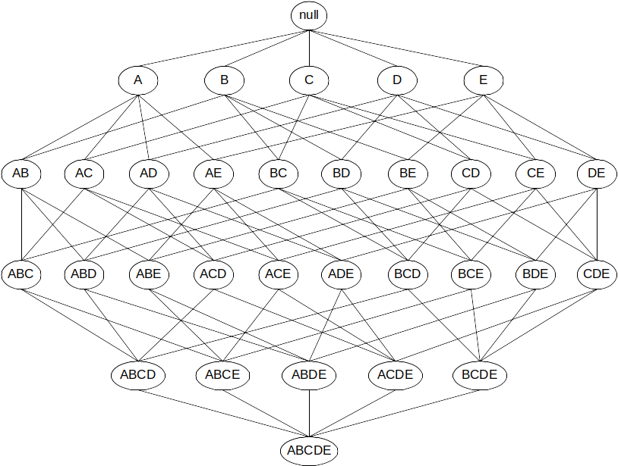
The itemset lattice
2^{|U|} nodes representing search space

Slide 23
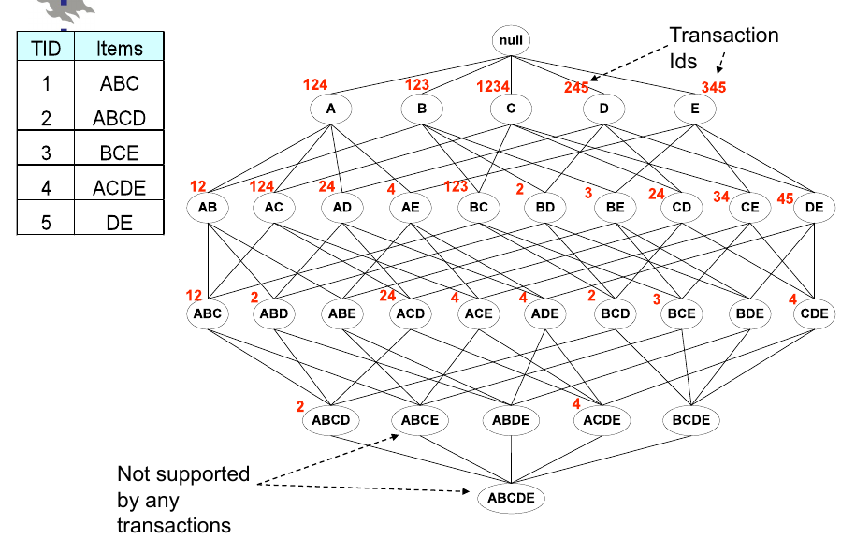
[Source]

Slide 24
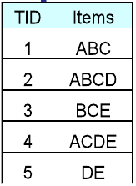
∞
Support of each itemset
3 3 4 3 3
2 3 2 1 3 1 1 2 2 2
2 1 0 2 1 1 1 1 0 1
1 0 0 1 0
0

Slide 25
∞
minsup = 1
3 3 4 3 3
2 3 2 1 3 1 1 2 2 2
2 1 0 2 1 1 1 1 0 1
1 0 0 1 0
0

Slide 26
∞
minsup = 2
3 3 4 3 3
2 3 2 1 3 1 1 2 2 2
2 1 0 2 1 1 1 1 0 1
1 0 0 1 0
0

Slide 27
∞
minsup = 3
3 3 4 3 3
2 3 2 1 3 1 1 2 2 2
2 1 0 2 1 1 1 1 0 1
1 0 0 1 0
0

Slide 28
∞
minsup = 4
3 3 4 3 3
2 3 2 1 3 1 1 2 2 2
2 1 0 2 1 1 1 1 0 1
1 0 0 1 0
0

Slide 29
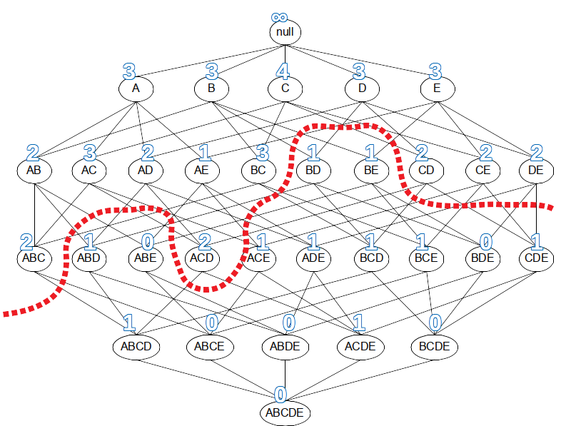
The border is a graph cut and ...
All itemsets above the
border are frequent
All itemsets below the
border are not frequent
All maximal frequent
itemsets are adjacent to the border
Any border respects the downward
closure property

Slide 30
Summary

Slide 31
Things to remember
Itemset, k-itemset, transaction
Support, confidence, lift
Maximal and closed itemsets

Slide 32
Exercises for TT11-TT12
Data Mining, The Textbook (2015) by Charu Aggarwal
  Exercises 4.9 → 1-3, 5, 7-8
  Exercises 5.7 → 1-5
Mining of Massive Datasets 2nd edition (2014) by Leskovec et al.
  Exercises 6.1.5 → 6.1.1-6.1.7
Introduction to Data Mining 2nd edition (2019) by Tan et al.
  Exercises 5.10 → 2-7

