Slide 1

Outlier Detection: Probabilistic and
Density-Based Methods
Mining Massive Datasets
Prof. Carlos Castillo
Topic 20

Slide 2
Sources
Data Mining, The Textbook (2015) by Charu Aggarwal (chapter 8) – slides by Lijun Zhang

Slide 3
Probabilistic methods

Slide 4
Related to probabilistic model-based clustering
Assume data is generated from a mixture-based generative model
Learn the parameters of the model from data
  EM algorithm
Evaluate the probability of each data point being generated by the model
  Points with low values are outliers

Slide 5
Mixture-based generative model
Data is generated by a mixture of k distributions with probability distributions
G₁, …, G_{k}
Each point X is generated as follows:
  Select a mixture component with probability α_{i}
    Suppose it’s component r
  Sample a data point from distribution G_{r}

Slide 6
Learning parameters from data
Probability of generating a point

Slide 7
Learning parameters from data
Probability of generating a point
Probability of generating a dataset
Learning: min log loss

Slide 8
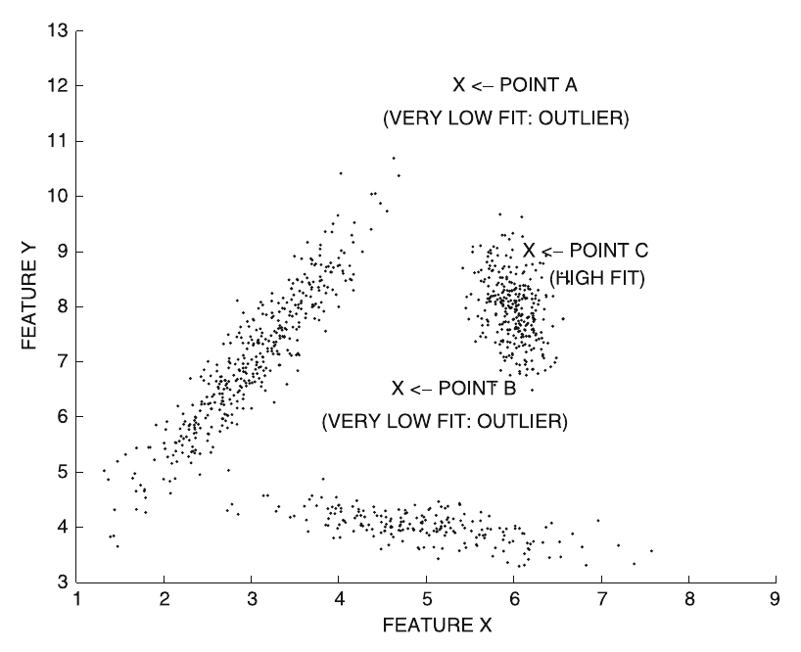
Identifying an outlier
Outlier score:

Slide 9
Clustering-based methods

Slide 10
Clustering for outlier analysis
Clustering associate points to similar points
Points either clearly belong to a cluster or are outliers
Some clustering algorithms also detect outliers
  Examples: DBSCAN, DENCLUE

Slide 11
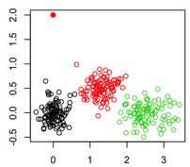
Simple method
Outlier
Cluster data, associating each point to a centroid, e.g., using k-means
Outlier score = distance of point to its centroid

Slide 12
Improved method
Cluster data
Outlier score = local Mahalanobis distance with respect to center of cluster r
is the mean of the cluster r
is the covariance matrix of cluster r

Slide 13
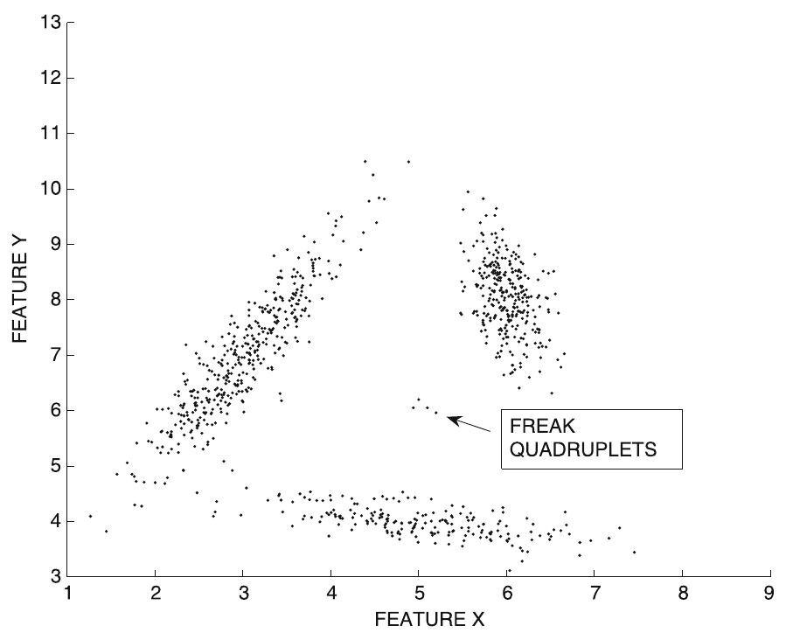
Improved method (cont.)
Remove tiny
clusters

Slide 14
Density-based methods

Slide 15
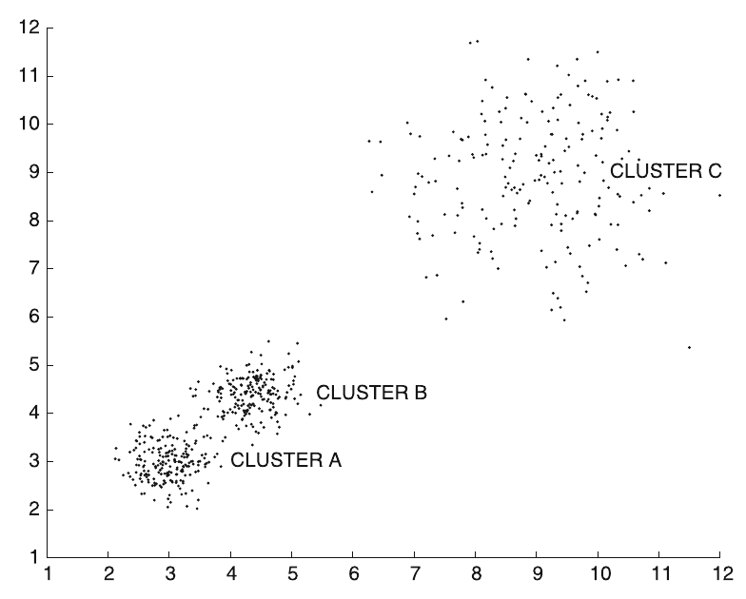
Density-based methods
Key idea:
find sparse regions in the data
Limitation:
cannot handle variations of density

Slide 16
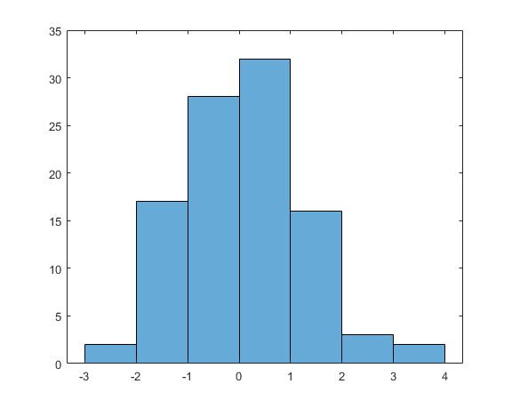
Histogram- and grid-based methods
Histogram-based method:
Put data into bins
Outlier score: num – 1,
where num is the number of
items in the same bin
Clear outliers are alone or almost alone in a bin

Slide 17
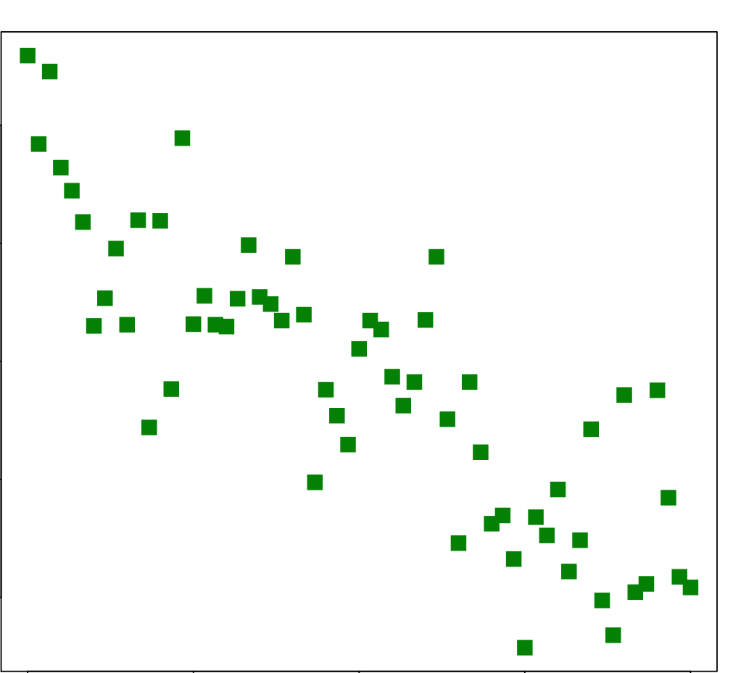

Histogram- and grid-based methods
Grid-based method
Put data into a grid
Outlier score: num – 1,
where num is the number of
items in the same cell
Clear outliers are alone or almost alone in a cell

Slide 18
Problems with grid-based methods
How to choose the grid size?
Grid size should be chosen
considering data density,
but density might vary
across regions
If dimensionality is high, then
most cells will be empty

Slide 19
Kernel-based methods
Given n points
K_{h} is a function peaking at X_{i} with bandwidth h
For instance, a Gaussian kernel:

Slide 20
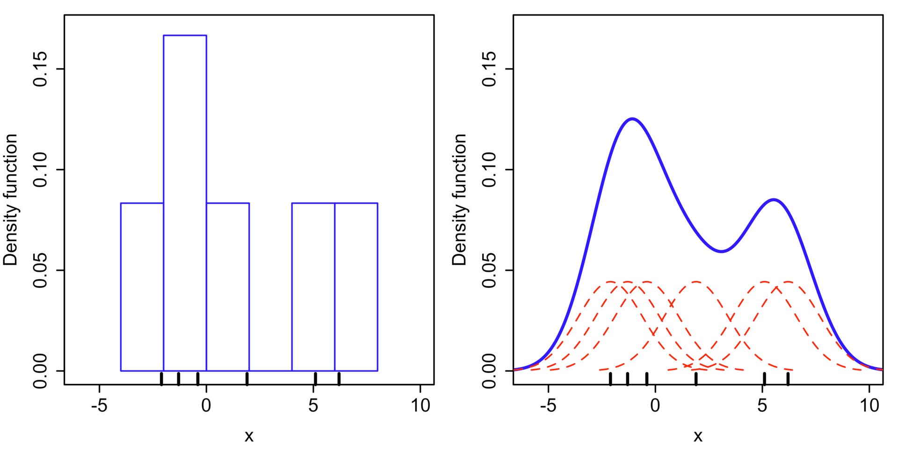
Kernel-based methods (cont.)
Example with a Gaussian kernel
  X = < -2.1, -1.3, -0.4, 1.9, 5.1, 6.2 >
Each K_{h} in red
f = sum of K_{h} in blue
Histogram
Kernel density est.
[Wikipedia: Kernel density estimation]

Slide 21
Information-theoretic models
Describe “ABABABABABABABABABABABABABABABABAB”
  “AB” 17 times
Describe “ABABACABABABABABABABABABABABABABAB”
  Minimum description length increased
Information-theoretic models: learn a model, then look at increases in model size due to a data point

Slide 22
Summary

Slide 23
Things to remember
Probabilistic methods
Clustering-based methods
Density-based methods

Slide 24
Exercises for TT19-TT21
Data Mining, The Textbook (2015) by Charu Aggarwal
  Exercises 8.11 → all except 10, 15, 16, 17

