Slide 1

Data Streams:
Bloom Filters
Mining Massive Datasets
Prof. Carlos Castillo
Topic 24

Slide 2
Sources
Mining of Massive Datasets (2014) by Leskovec et al. (chapter 4)
  Slides part 1, part 2
Tutorial: Mining Massive Data Streams (2019) by Michael Hahsler

Slide 3
Bloom filters

Slide 4
Filtering a data stream
Suppose we have a large set S of keys
We want to filter a stream <key, data> to let pass only the elements for which key ∊ S
Example: key is an e-mail address, we have a total of |S|=10⁹ allowed e-mail addresses
Naïve solution?

Slide 5
Filtering a data stream
Suppose we have a large set S of keys
We want to filter a stream <key, data> to let pass only the elements for which key ∊ S
Example: key is an e-mail address, we have a total of |S|=10⁹ allowed e-mail addresses
Naïve solution? Hash table won’t work, too big!

Slide 6
Bloom Filter (1-bit case)
Given a set of keys S
Create a bit array B[] of n bits
  Initialize to all 0s
Pick a hash function h with range [0,n)
  For each member of s∈ S
    Hash to one of n buckets
    Set that bit to 1, i.e., B[h(s)] ← 1
For each element a of the stream
  Output a if and only if B[h(a)] == 1
Bloom filter creation
Stream processing

Slide 7
Bloom Filter is an approximate filter
Can it output an element with a key not in S?
Can it not output an element with a key in S?

Slide 8
Bloom Filter is an approximate filter
Can it output an element with a key not in S?
Yes, due to hash collisions h(x)=h(y) when x≠y
Can it not output an element with a key in S?
No, because h(x) is always the same for x
Bloom filters are permissive (not strict)

Slide 9
Bloom filter
A bloom filter is:
  An array of n bits, initialized as 0
  A collection of hash functions h₁, h₂, …, h_{k}
  A set S of m key values
The purpose of the bloom filter is to allow all stream items whose key is in S

Slide 10

Bloom filter initialization
For all positions i in [0, n-1]
  B[i] ← 0
For all keys K in S:
For every hash function h₁, h₂, …, h_{k}
B[h_{i}(K)] ← 1

Slide 11
Bloom filter usage
For each input element <key, data>
allow ← TRUE
For every hash function h₁, h₂, …, h_{k}
allow ← allow ∧ B[h_{i}(K)] == 1
output element if allow == TRUE

Slide 12
Characteristics of Bloom Filters
Are lax (not strict) and let some items pass
  May require a second-level check to make filter strict, for instance store output on disk files and then check against hash tables (slower)
Implementations can be very fast
  E.g., use hardware words for the bit table

Slide 13
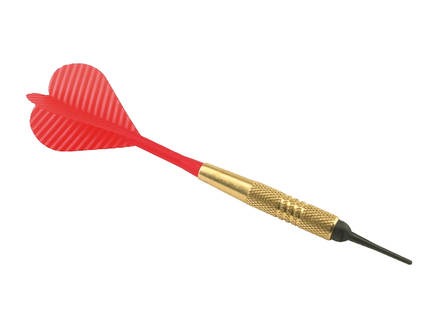

Preliminaries for the analysis: targets and darts
Suppose we throw y darts at x targets
  All darts will hit one of the targets
y=4 darts
x=4 targets

Slide 14
Preliminaries for the analysis: targets and darts
How many distinct targets can we expect to hit at least once?
  Prob. that a given dart will hit a specific target is 1/x
  Prob. that a given dart will not hit a specific target is 1-1/x
  Prob. none of the y darts will hit a specific target is (1-1/x)^{y} = (1-1/x)^{x(y/x)}
  Using that (1-ε)^{1/ε} ≃ 1/e for small ε
  If x is large, 1/x is small, and prob. that none of the y darts will hit a specific target is (1/e)^{y/x}
y=4 darts
x=4 targets

Slide 15
Analysis of the 1-bit Bloom Filter
Each element of the signature S is a dart |S|=y
Each bit in the array is a target n=x
Suppose y=|S|=10⁹ (1 G) and x=n=8 x 10⁹ (8 G)
Prob. that a given bit is not set to 1 (dart does not hit the target) is
(1/e)^{y/x} = (1/e)^{1/8}
Prob. that a given bit is set to 1 is 1 – (1/e)^{1/8} = 0.1175
Expected number of bits that is set to 1 = 11.75% x 8GB
  About 12% of bits are set to one in this Bloom Filter
  this is also the false-hit probability in this case

Slide 16
General case
|S|=m keys, array has n bits
k hash functions
Targets x=n, darts y=km
Probability that a bit remains 0 is (1/e)^{km/n =} e^{-km/n}
Example:
  We can pick k=n/m to obtain collision probability 1/e = 37%

Slide 17
Analysis of a 2-bit Bloom Filter
Suppose |S|=10⁹ (1 G) and n=8 x 10⁹ (8 GB)
Suppose we use two hash functions
Prob. that a given bit is NOT set to 1 (dart does not hit the target) is (1/e)^{y/x} = (1/e)^{1/4}
Prob. a bit is set to 1 is 1 – (1/e)^{1/4}
Prob. two bits are set to 1 is (1 – (1/e)^{1/4})² = 0.0493
We have a false hit probability of about 5% with two hash functions, while the probability was about 12% with only one

Slide 18
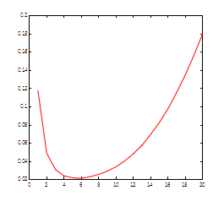
How many hash functions to use?
Too few: test is too unspecific. Too many: table becomes too crowded.
m = 1 billion, n = 8 billion
  k = 1: (1 – e^{-1/8}) = 0.1175
  k = 2: (1 – e^{-1/4})² = 0.0493
What happens as we
keep increasing k?
  “Optimal” value of k: n/m ln(2)
  In our case: Optimal k = 8 ln(2) = 5.54 ≈ 6
  Error at k = 6: (1 – e^{-1/6})² = 0.0235
False positive prob.
Number of hash functions, k

Slide 19
Summary

Slide 20
Things to remember
How to initialize a Bloom filter
How to use a Bloom filter
Proofs for 1-bit, 2-bit case

Slide 21
Exercises for TT22-T26
Mining of Massive Datasets (2014) by Leskovec et al.
  Exercises 4.2.5
  Exercises 4.3.4
  Exercises 4.4.5
  Exercises 4.5.6

