Slide 1

Basket Analysis
Mining Massive Datasets
Carlos Castillo
Topic 05

Slide 2
Sources
Data Mining, The Textbook (2015) by Charu Aggarwal (Chapters 4, 5) – slides by Lijun Zhang
Mining of Massive Datasets 2nd edition (2014) by Leskovec et al. (Chapter 6) - slides
Data Mining Concepts and Techniques, 3rd edition (2011) by Han et al. (Chapter 6)
Introduction to Data Mining 2nd edition (2019) by Tan et al. (Chapters 5, 6) – slides ch5, slides ch6

Slide 3
Introduction
Transactions
  Sets of items bought by customers
The Goal
  Determine associations between groups of items bought by customers
Quantification of the Level of Association
  Frequencies of sets of items
The Discovered Sets of Items
  Large itemsets, frequent itemsets, or frequent patterns

Slide 4
“Transaction” is a general concept
Items | Transactions
Groceries | Grocery cart
University courses | Virtual shopping cart
Guests | Party
Movies | Actor
Symptoms | Patient
Menu items | Restaurant customer
Words | Document
Liked photos | Instagram account
https://web.stanford.edu/class/cs102/lecturenotes/DataMining.pdf

Slide 5
Applications
Supermarket Data
  Target marketing, shelf placement
Text Mining
  Identifying co-occurring terms
Generalization to Dependency-oriented Data Types
  Web log analysis, software bug detection
Other Major Data Mining Problems
  Clustering, classification, and outlier analysis

Slide 6
Association rules
Generated from frequent itemsets
Formulation X⇒Y
  {Soy latte} ⇒ {Brown Sugar}
  {Kale, Quinoa} ⇒ {Almond milk}
Applications
  Promotion
  Shelf placement
Conditional Probability

Slide 7
Association rule mining
U is a set of d items
T is a set of n transactions T₁, T₂, …, T_{n}
with T_{i} ⊆ U
Itemset: a set of items
k-itemset: a set of k items
  How many different k-itemsets exist? 2^{k}

Slide 8
Binary representation of a transaction
tid | Set of items | Binary representation
1 | Bread, Jam, Juice | 110010
2 | Tofu, Juice, Tomatoes | 000111
3 | Bread, Strawberries, Tofu, Juice | 101110
4 | Tofu, Juice, Tomatoes | 000111
5 | Strawberries, Juice, Tomatoes | 001011

Slide 9
Definitions
Support of itemset I, written sup(I):
  the fraction of transactions in the database
  T = {T₁ … T_{n}} that contain I as a subset.
Frequent itemset mining with support minsup:
  Given a set of transactions T = {T₁, …, T_{n}}, where T_{i} ⊆ U, find all itemsets I_{j} such that sup(I_{j}) ≥ minsup

Slide 10
Example
tid | Set of items | Binary representation
1 | Bread, Jam, Juice | 110010
2 | Tofu, Juice, Tomatoes | 000111
3 | Bread, Strawberries, Tofu, Juice | 101110
4 | Tofu, Juice, Tomatoes | 000111
5 | Strawberries, Juice, Tomatoes | 001011
sup({Bread, Juice}) = 2/5 = 0.4
sup({Strawberries, Tomatoes}) = 1/5 = 0.2
If minsup=0.3, {Bread, Juice} is a frequent itemset

Slide 11
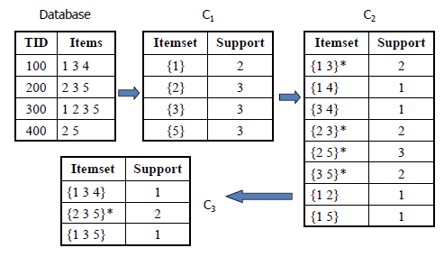
Try it!
Write the support of every itemset of size 2 or 3 occurring in this database
Indicate which are frequent itemsets if minsup = 1/2

Slide 12
Note: in this slide “support” is an absolute value (number of occurrences) while in this course in general “support” will be a fraction or probability.
Source: https://www.saedsayad.com/association_rules.htm

Slide 13
Properties
The smaller minsup is, the larger the number of frequent itemsets
Support monotonicity property:
if J ⊆ I, sup(J) ≥ sup(I) WHY?

Slide 14
Properties
The smaller minsup is, the larger the number of frequent itemsets
Support monotonicity property:
if J ⊆ I, sup(J) ≥ sup(I)
Fundamental observation for the proof:
  if I is contained in a transaction, J is contained in the same transaction!

Slide 15
Properties
The smaller minsup is, the larger the number of frequent itemsets
Support monotonicity property:
if J ⊆ I, sup(J) ≥ sup(I)
Confusingly, some authors refer to this as the support anti-monotonicity property
Downward closure property: every subset of a frequent itemset is also frequent

Slide 16
Maximal frequent itemset
A frequent itemset is maximal at a given minimum support level minsup, if it is frequent, and no superset of it is frequent
tid | Set of items
1 | Bread, Jam, Juice
2 | Tofu, Juice, Tomatoes
3 | Bread, Strawberries, Tofu, Juice
4 | Tofu, Juice, Tomatoes
5 | Strawberries, Juice, Tomatoes
Maximal frequent patterns at minsup=0.3
{Bread, Juice}, {Strawberries, Juice}, {Tofu, Juice, Tomatoes}
Frequent patterns at minsup=0.3
  The total number is 11
  All of them are subsets of maximal frequent patterns

Slide 17
Maximal frequent itemset
A frequent itemset is maximal at a given minimum support level minsup, if it is frequent, and no superset of it is frequent
tid | Set of items
1 | Bread, Jam, Juice
2 | Tofu, Juice, Tomatoes
3 | Bread, Strawberries, Tofu, Juice
4 | Tofu, Juice, Tomatoes
5 | Strawberries, Juice, Tomatoes
Maximal patterns ...
{Bread, Juice}, {Strawberries, Juice}, {Tofu, Juice, Tomatoes}
… are condensed representations of frequent patterns, but do not retain information about the support of their subsets.

Slide 18
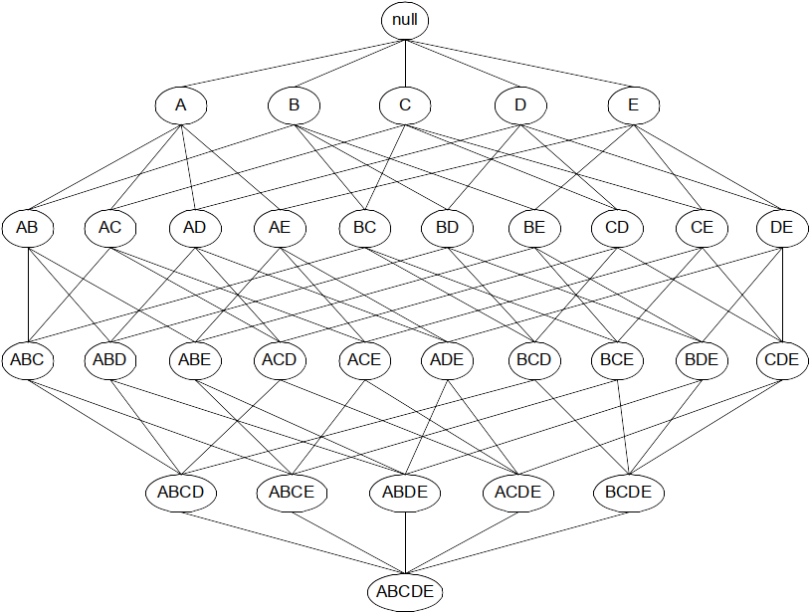
The itemset lattice
2^{|U|} nodes representing search space

Slide 19
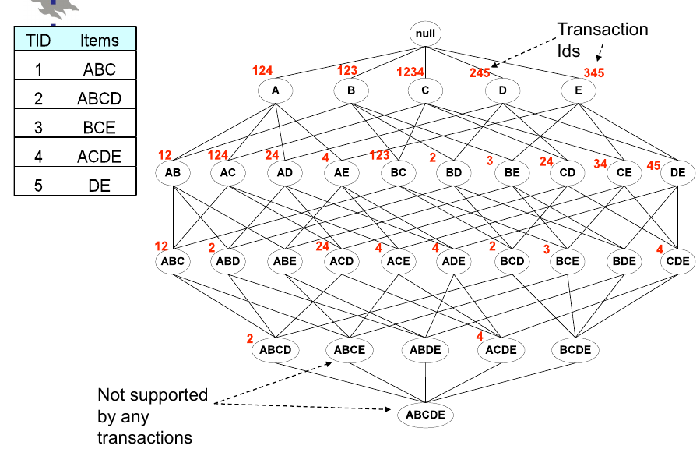
[Source]

Slide 20
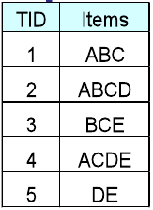
∞
Support of each itemset
3 3 4 3 3
2 3 2 1 3 1 1 2 2 2
2 1 0 2 1 1 1 1 0 1
1 0 0 1 0
0

Slide 21
∞
minsup = 1
3 3 4 3 3
2 3 2 1 3 1 1 2 2 2
2 1 0 2 1 1 1 1 0 1
1 0 0 1 0
0

Slide 22
∞
minsup = 2
3 3 4 3 3
2 3 2 1 3 1 1 2 2 2
2 1 0 2 1 1 1 1 0 1
1 0 0 1 0
0

Slide 23
∞
minsup = 3
3 3 4 3 3
2 3 2 1 3 1 1 2 2 2
2 1 0 2 1 1 1 1 0 1
1 0 0 1 0
0

Slide 24
∞
minsup = 4
3 3 4 3 3
2 3 2 1 3 1 1 2 2 2
2 1 0 2 1 1 1 1 0 1
1 0 0 1 0
0

Slide 25
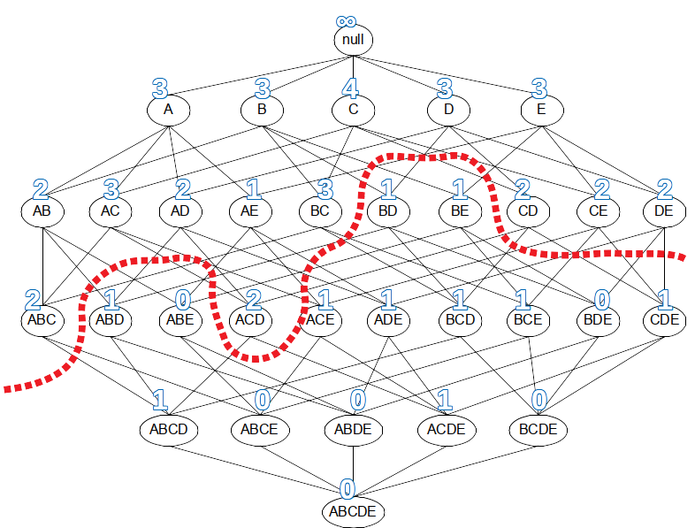
The border is a graph cut and ...
All itemsets above the
border are frequent
All itemsets below the
border are not frequent
All maximal frequent
itemsets are adjacent to the border
Any border respects the downward
closure property

Slide 26
Association Rule Generation

Slide 27
What is a rule
A rule is of the form X⇒Y
  X and Y are itemsets
X is the antecedent, Y is the consequent
The confidence of the rule is:

Slide 28
Confidence of a rule
The confidence of the rule X ⇒ Y is:
This is the conditional probability of X U Y occurring in a transaction, given that X occurs in the transaction

Slide 29
Confidence of a rule (cont.)
tid | Set of items
1 | Bread, Jam, Juice
2 | Tofu, Juice, Tomatoes
3 | Bread, Strawberries, Tofu, Juice
4 | Tofu, Juice, Tomatoes
5 | Strawberries, Juice, Tomatoes

Slide 30
Confidence of a rule (cont.)
tid | Set of items
1 | Bread, Jam, Juice
2 | Tofu, Juice, Tomatoes
3 | Bread, Strawberries, Tofu, Juice
4 | Tofu, Juice, Tomatoes
5 | Strawberries, Juice, Tomatoes

Slide 31
Association rule
Let X, Y be two itemsets; the rule X⇒Y is an association rule of minimum support minsup and minimum confidence minconf if:
sup(X⇒Y) ≥ minsup
and
conf(X⇒Y) ≥ minconf

Slide 32
Association rule mining framework
In the first phase, all the frequent itemsets are generated at the minimum support of minsup
  The most difficult (computationally expensive) step
In the second phase, the association rules are generated from the frequent itemsets at the minimum confidence level of minconf
  Relatively straightforward

Slide 33
A straightforward implementation of the second phase
For each frequent itemset I // sup(I) ≥ minsup
  For each possible partition X, Y = I – X
    Check if conf(X⇒Y) ≥ minconf
Use the confidence monotonicity property (next slide) to reduce search space

Slide 34
Confidence monotonicity property
Let X_{S}, X_{L}, I be itemsets; assume X_{S} ⊂ X_{L} ⊂ I
Then:
Prove this, remember:

Slide 35
Confidence monotonicity property
Let X_{S}, X_{L}, I be itemsets; assume X_{S} ⊂ X_{L} ⊂ I

Slide 36
Brute-force itemset mining algorithms

Slide 37
Naïve approach
Generate all candidate itemsets (2^{|U|} of them)
  Not practical, U=1000 ⇒ more than 10³⁰⁰ itemsets
Calculate sup(I) for every itemset
Key observation
  If no k-itemsets are frequent
  No (k+1)-itemsets are frequent

Slide 38
Improved approach
Start with k=1
Generate all k-itemsets
Determine sup(I)
If no k-itemset has sup(I) ≥ minsup, stop
Otherwise, k ← k+1 and repeat

Slide 39
Improved approach is a significant improvement
Let l be the final value of k
For |U| = 1000, l=10, this is ≃ 10²³

Slide 40
Further improvements to brute-force method
Reducing the size of the explored search space (lattice) by pruning candidate itemsets (lattice nodes) using tricks, such as the downward closure property
Counting the support of each candidate more efficiently by pruning transactions that are known to be irrelevant for counting a candidate itemset
Using compact data structures to represent either candidates or transaction databases that support efficient counting

Slide 41
The Apriori Algorithm

Slide 42
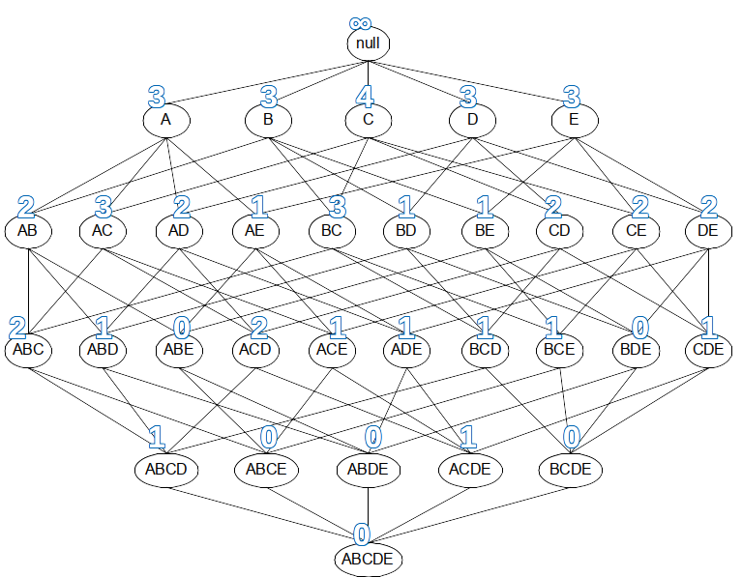
Apriori algorithm principle
Downward closure property: every subset of a frequent itemset is also frequent
Conversely, if an itemset has a subset that is not frequent, the itemset cannot be frequent
What are subsets in the lattice?

Slide 43
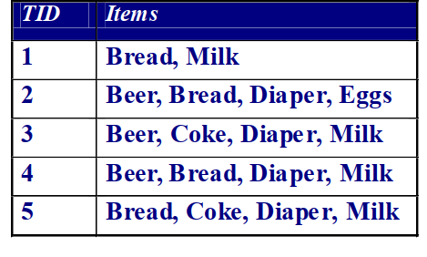
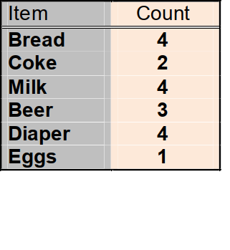
Example
Items (1-itemsets)
Minimum Support = 3
Introduction to Data Mining 2nd edition (2019) by Tan et al. (Chapters 5, 6) – slides ch5, slides ch6

Slide 44
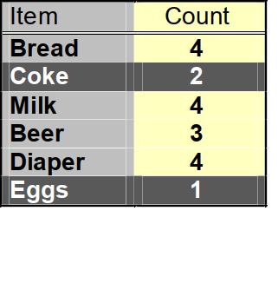
Example (cont.)
Items (1-itemsets)
x
x
Minimum Support = 3
Introduction to Data Mining 2nd edition (2019) by Tan et al. (Chapters 5, 6) – slides ch5, slides ch6

Slide 45
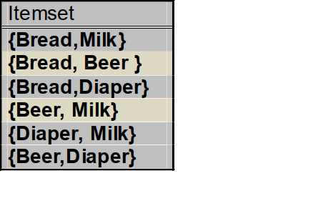
Example (cont.)
Items (1-itemsets)
Pairs (2-itemsets)
x
No need to generate
candidates involving Coke or Eggs!
x
Minimum Support = 3
Introduction to Data Mining 2nd edition (2019) by Tan et al. (Chapters 5, 6) – slides ch5, slides ch6

Slide 46
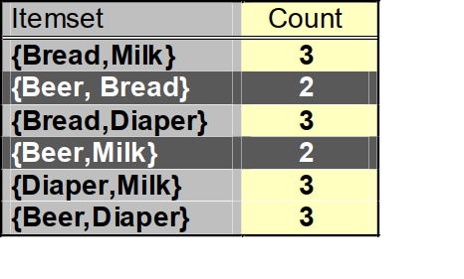
Example (cont.)
Items (1-itemsets)
Pairs (2-itemsets)
x
x
Minimum Support = 3
Introduction to Data Mining 2nd edition (2019) by Tan et al. (Chapters 5, 6) – slides ch5, slides ch6

Slide 47
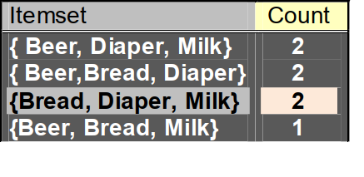
Example (cont.)
Items (1-itemsets)
Pairs (2-itemsets)
x
x
x
x
Triplets (3-itemsets)
Minimum Support = 3
Introduction to Data Mining 2nd edition (2019) by Tan et al. (Chapters 5, 6) – slides ch5, slides ch6

Slide 48
Example (cont.)
Items (1-itemsets)
Pairs (2-itemsets)
x
x
x
x
Triplets (3-itemsets)
x
Minimum Support = 3: found 8 itemsets
Introduction to Data Mining 2nd edition (2019) by Tan et al. (Chapters 5, 6) – slides ch5, slides ch6

Slide 49
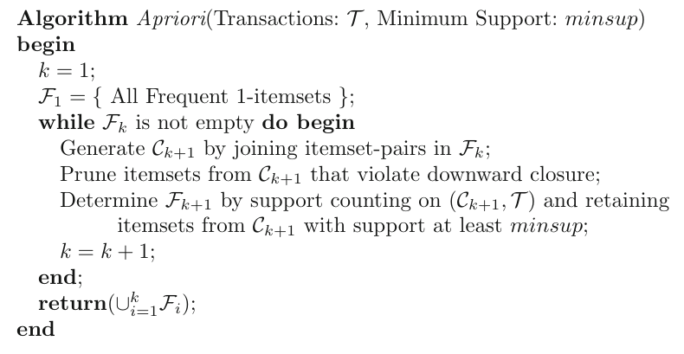
Pseudocode of Apriori
(1) Generation
(2) Pruning
(3) Support counting

Slide 50
Candidates generation
A Naïve Approach
  Check all the possible combinations of frequent itemsets
An Example of the Naïve Approach
  itemsets: {abc} {bcd} {abd} {cde}
  {abc} + {bcd} = {abcd}
  {bcd} + {abd} = {abcd}
  {abd} + {cde} = {abcde}
  ….

Slide 51
Candidates generation (cont.)
Introduction of Ordering
  Items in U have a lexicographic ordering
  Itemsets can be order as strings
A Better Approach
  Order the frequent k-itemsets
  Merge two itemset if the first k-1 items of them are the same

Slide 52
Candidates generation (cont.)
Example
  k-itemsets: {abc} {abd} {bcd}
    {abc} + {abd} = {abcd}
k-itemsets: {abc} {acd} {bcd}
  No (k+1) -candidates
Early stop is possible
  Donot need to check {abc} +{bcd} after checking {abc} + {acd}
Do we miss {abcd}?
  No, due to the Downward Closure Property

Slide 53
Level-wise pruning trick
Let F_{k} be the set of frequent k-itemsets
Let C_{k+1} be the set of (k+1)-candidates
I ∊ C_{k+1} is frequent only if all the k-subsets of I are frequent
Pruning
  Generate all the k-subsets of I
  If any one of them does not belong to F_{k}, then remove I

Slide 54
Support counting (1)

Slide 55
SLIDE 30 of
Tan et al. and following (hash)
Introduction to Data Mining 2nd edition (2019) by Tan et al. (Chapters 5, 6) – slides ch5, slides ch6

