Slide 1

Mining time series data
Mining Massive Datasets
Carlos Castillo
Topic 11

Slide 2
Sources
Data Mining, The Textbook (2015) by Charu Aggarwal (chapter 14)
Introduction to Time Series Mining (2006) tutorial by Keogh Eamonn [alt. link]
Time Series Data Mining (2006) slides by Hung Son Nguyen

Slide 3
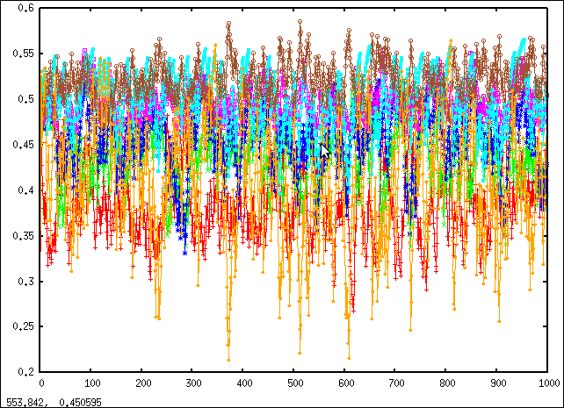
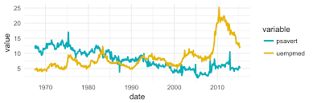
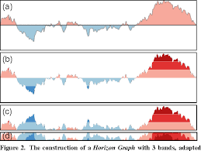
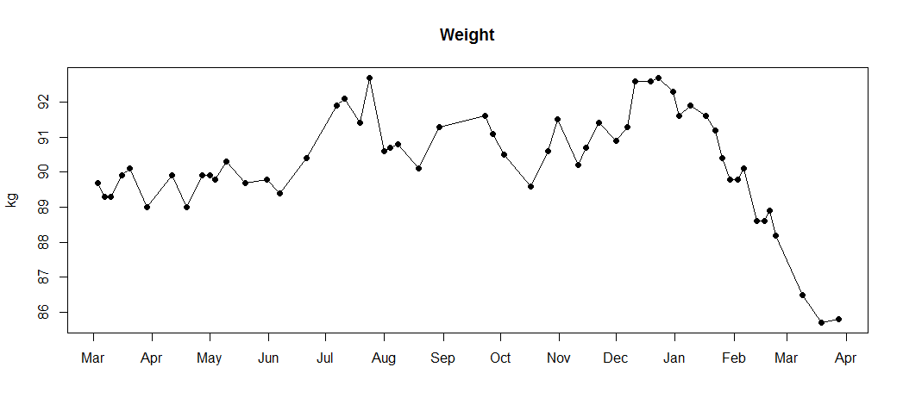
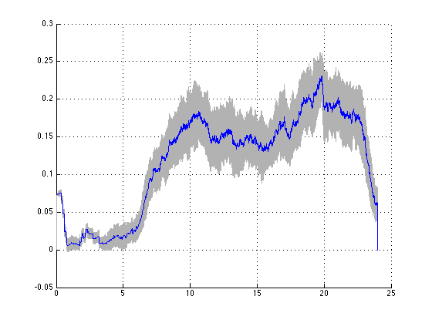
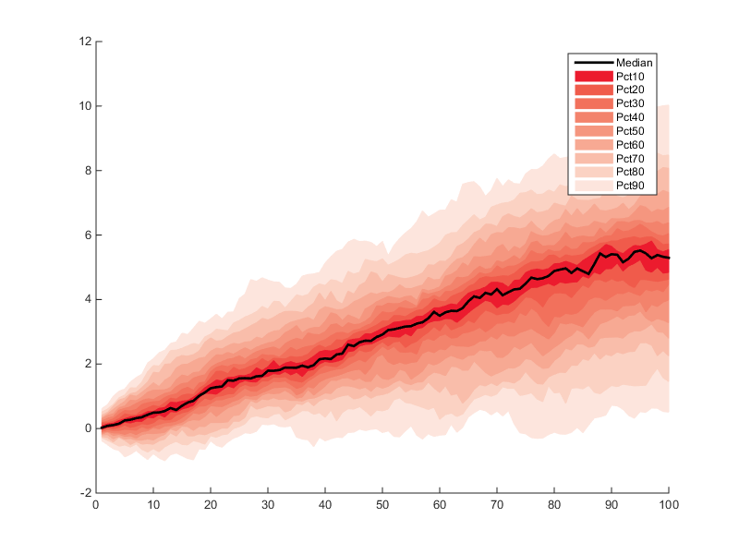
Why do we mine time series? Examples

Slide 4
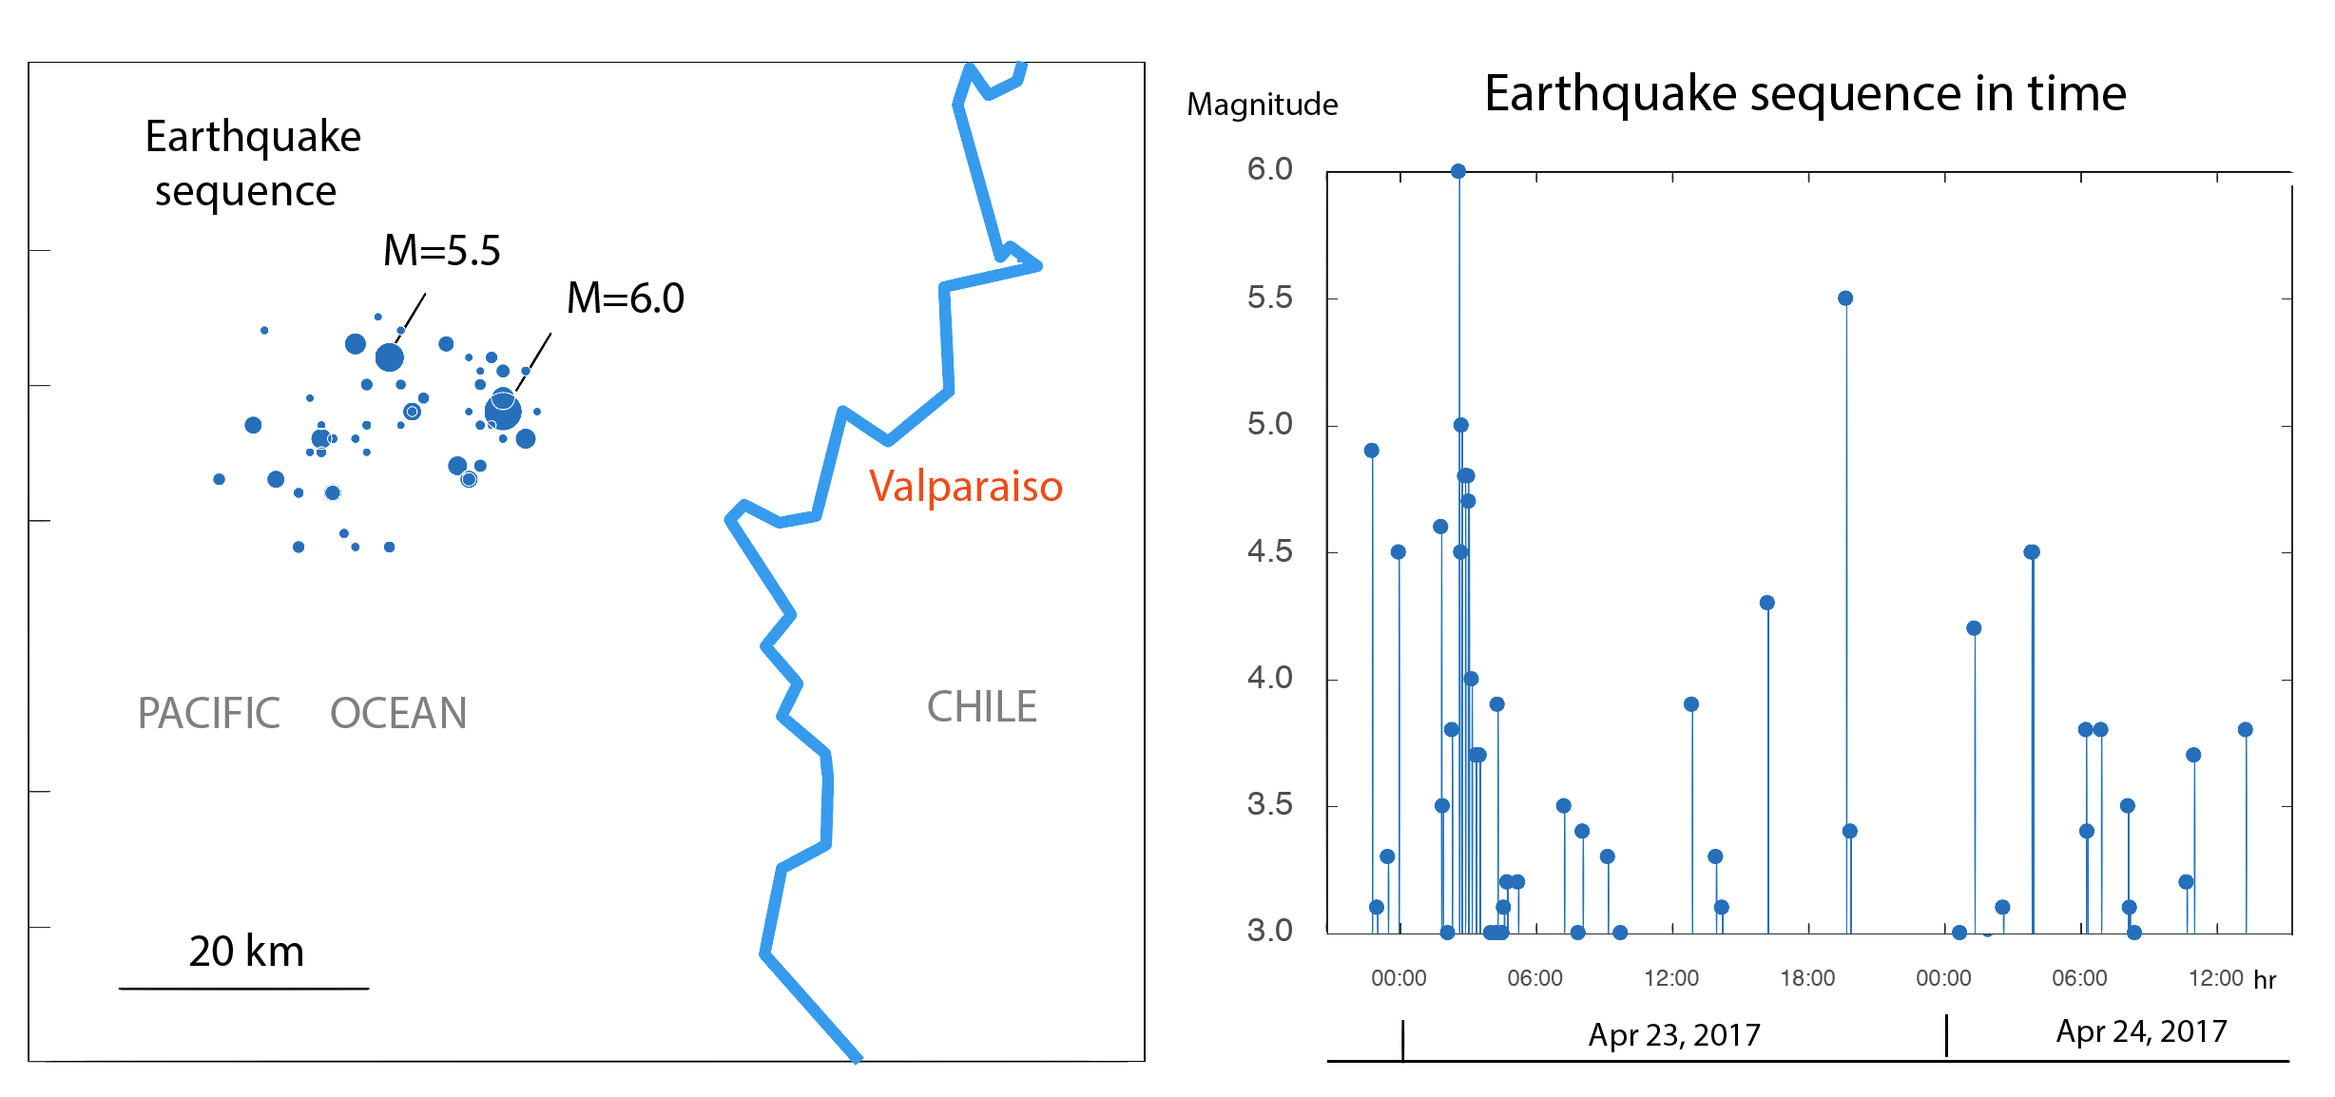
Seismic data
Observations = earthquakes
Goal: characterize when peeks occur

Slide 5
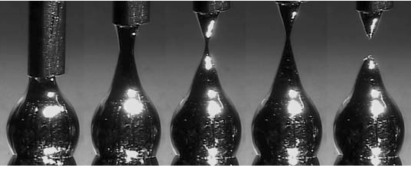
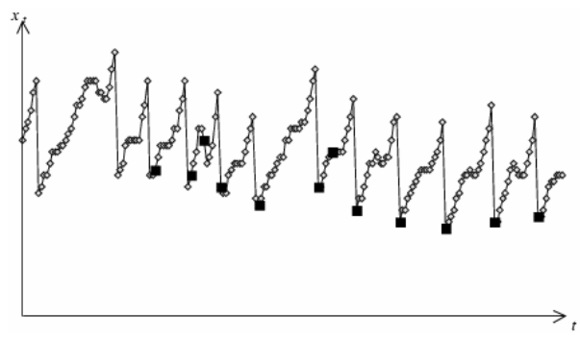
Liquid metal droplets
= length of hot metal droplet
= droplet release
  (chaotic, noisy)
Goal: prediction of release
Time Series Data Mining (2006) slides by Hung Son Nguyen

Slide 6
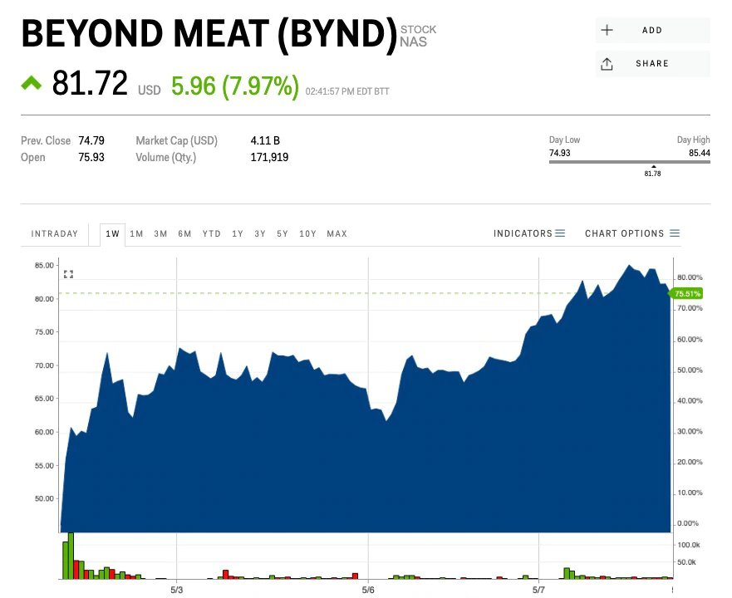
Stock prices
Price
Volume traded
Goal: find hidden patterns providing an advantage

Slide 7
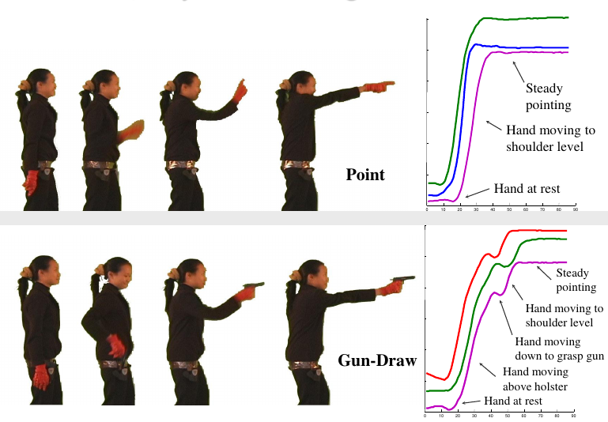
Video data / gestures
Series of angles of articulations in the body
Temporal patterns can reveal gestures
Introduction to Time Series Mining (2006) tutorial by Keogh Eamonn [alt. link]

Slide 8
Applications
Clustering
Classification
Motif discovery
Event detection
...
All require a reasonable definition of the similarity between two time series
All can be done in real-time or retrospectively

Slide 9
Context vs Behavior
Contextual attribute(s)
  x(i) = t_{i} = timestamp is the typical one
  Sometimes other attributes providing context
Behavioral attribute(s)
  y^{j}(i) = temperature, angle, price, sensor reading, …
  j ∊ 1 … d

Slide 10
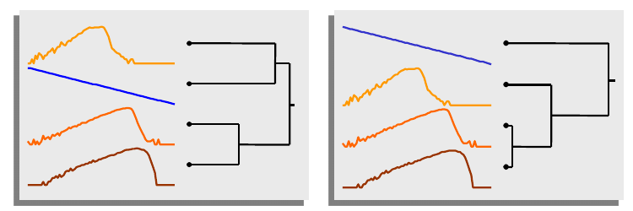
What are the difficulties?
High sampling rate of many series over extended periods of time means ...
  Tons of data
  Things are bound to fail at several points
  (missing data, noisy data)
Subjectivity
Introduction to Time Series Mining (2006) tutorial by Keogh Eamonn [alt. link]

Slide 11
Preparing a time series

Slide 12
Notation: multivariate time series
Length n, timestamps t₁, t₂, …, t_{n}
Values at time t_{i} : (y_{i}¹, y_{i}², …, y_{i}^{d})
If series is univariate we drop the superscript

Slide 13
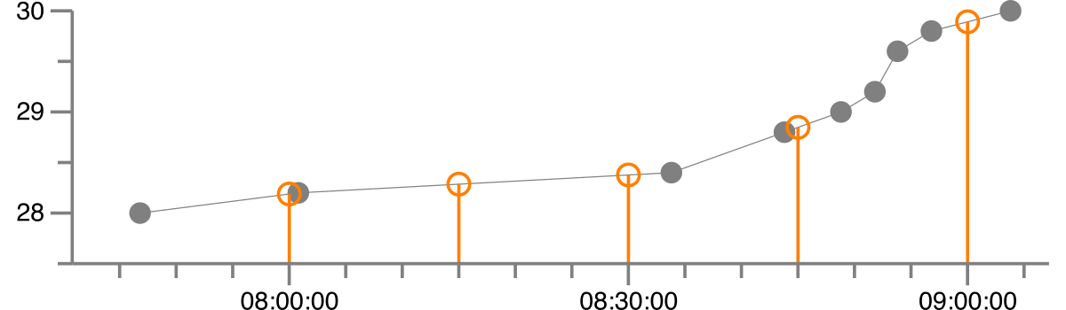
Missing values: linear interpolation
Let t_{i} < t_{x} < t_{j}
Example: make an irregular series regular

Slide 14
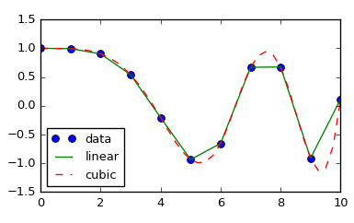
Missing values: splines
Cubic polynomials between y_{i}, y_{i+1} that have the same slope at those points as the original curve.
http://lagrange.univ-lyon1.fr/docs/scipy/0.17.1/tutorial/interpolate.html

Slide 15
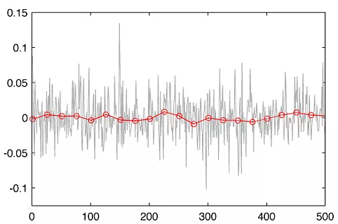
Noise removal: binning
Replace series by average of values in bins (subsequences) of length k
— original series
— binning with k=25
http://www.quantatrisk.com/2013/03/22/rebinning-of-financial-time-series/

Slide 16
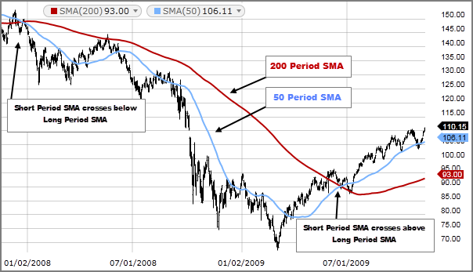
Noise removal: moving average smoothing
Equivalent to overlapping bins
Larger k leads to smoother series, but losses more
information
Use smaller k for first k-1 items
k=200
k=50
original
https://www.fidelity.com/learning-center/trading-investing/technical-analysis/technical-indicator-guide/sma

Slide 17
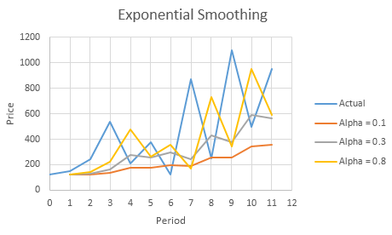
Noise removal: exponential smoothing
Combine previously
smoothed point with
current point
Recursively substituting
Which y’ has the
larger alpha?

Slide 18
Noise removal: exponential smoothing
Combine previously
smoothed point with
current point
Recursively substituting

Slide 19
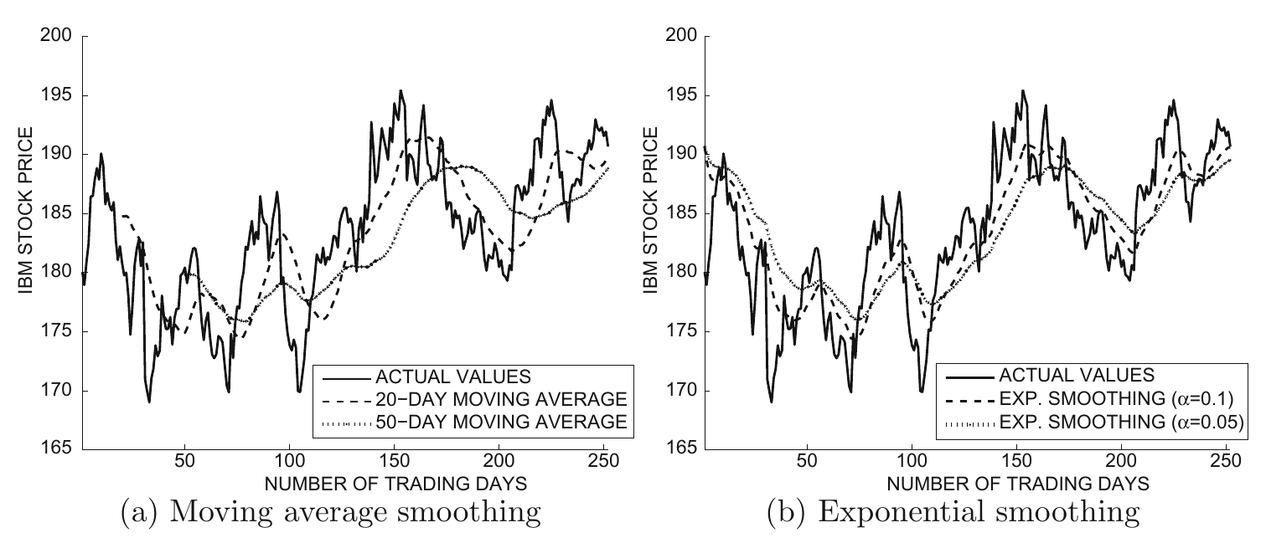
Moving average vs exponential smoothing

Slide 20
Try it!
Given the following series:
y_{t}’: moving average with k=3
y_{t}’’: exponential average with alpha=0.5
t | 1 | 2 | 3 | 4 | 5 | 6 | 7 | 8 | 9 | 10
y_{t} | 2 | 4 | 12 | 3 | 1 | -2 | 0 | 15 | 3 | 2
y_{t}’
y_{t}’’

Slide 21
Answer
Given the following series:
y_{t}’: moving average with k=3
y_{t}’’: exponential average with alpha=0.5
t | 1 | 2 | 3 | 4 | 5 | 6 | 7 | 8 | 9 | 10
y_{t} | 2 | 4 | 12 | 3 | 1 | -2 | 0 | 15 | 3 | 2
y_{t}’ | 2 | 3 | 6 | 6 | 5 | 0.33 | -0.33 | 4.33 | 6 | 7
y_{t}’’ | 2 | 3 | 7.5 | 4.75 | 2.88 | 0.44 | 0.22 | 7.61 | 5.30 | 4.15

Slide 22

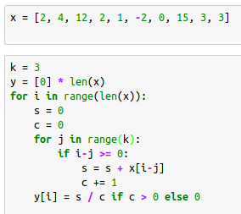
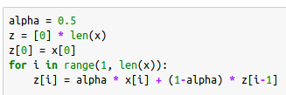
Answer (code)

Slide 23
Using Euclidean distance on time series

Slide 24
Euclidean distance for time series
Euclidean distance between series y and z
Sensitive to noise (see previous slides on how to fix this)
Sensitive to different offsets, amplitudes, and trends
numpy.linalg.norm(y-z)
Slides on this section from: Introduction to Time Series Mining (2006) tutorial by Keogh Eamonn [alt. link]

Slide 25
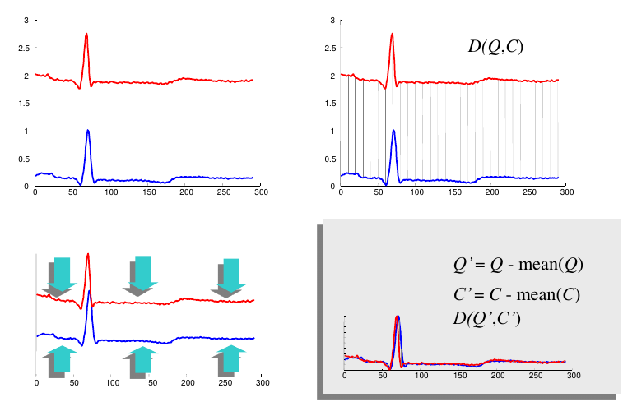
Offset translation: subtract the mean
d(y,z)
Series look different
series y
series z
Series look similar
y’ = y – avg(y)
z’ = z - avg(z)

Slide 26
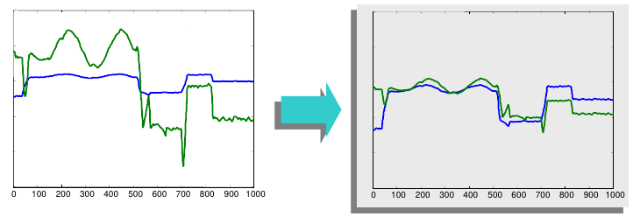
Amplitude scaling: normalize
d(y,z)
d(y’,z’)
— y
— z
— y’
— z’
Standardization
Range-based normalization

Slide 27
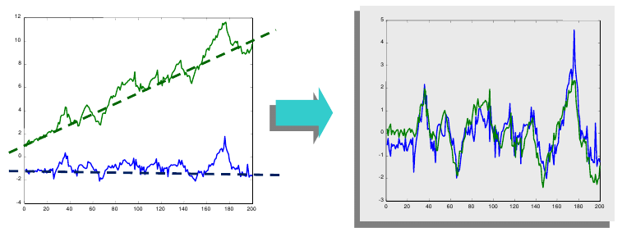
Trend removal: remove linear trend
d(y,z)
d(y’,z’)
— y
— z
— y’
— z’
1. Find best straight line fitting data
2. Subtract that line from the data

Slide 28
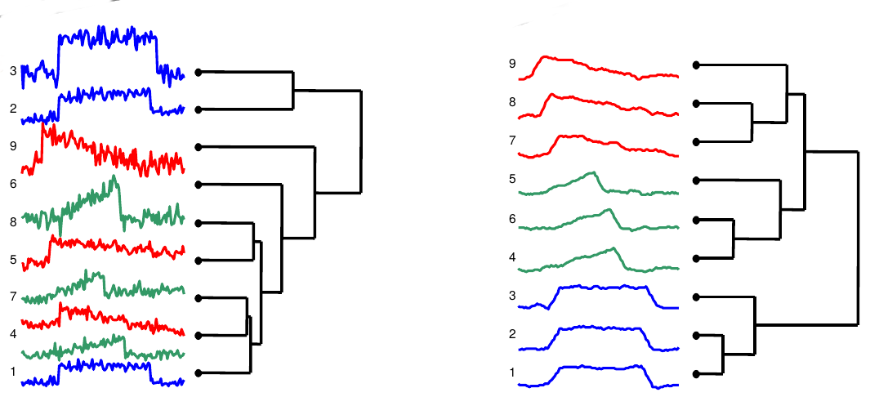
Example: clustering of time series after using smoothing, offset translation, amplitude scaling, and trend removal
Clustering using euclidean distance on original series
Clustering using euclidean distance on processed series

Slide 29
Dynamic time warping

Slide 30
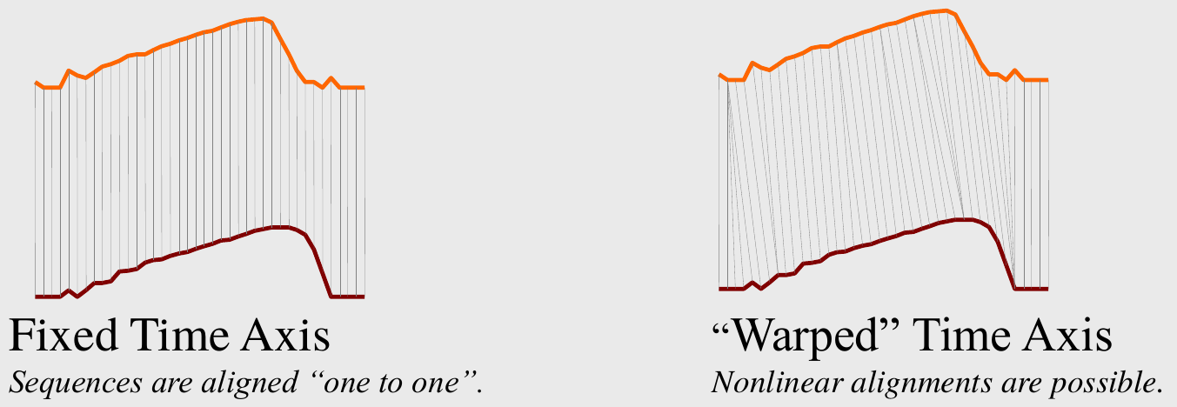
Dynamic time warping
Slides on this section from: Introduction to Time Series Mining (2006) tutorial by Keogh Eamonn [alt. link]

Slide 31
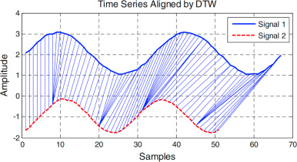
Dynamic time warping example
Image credits: Lu et al. 2016

Slide 32
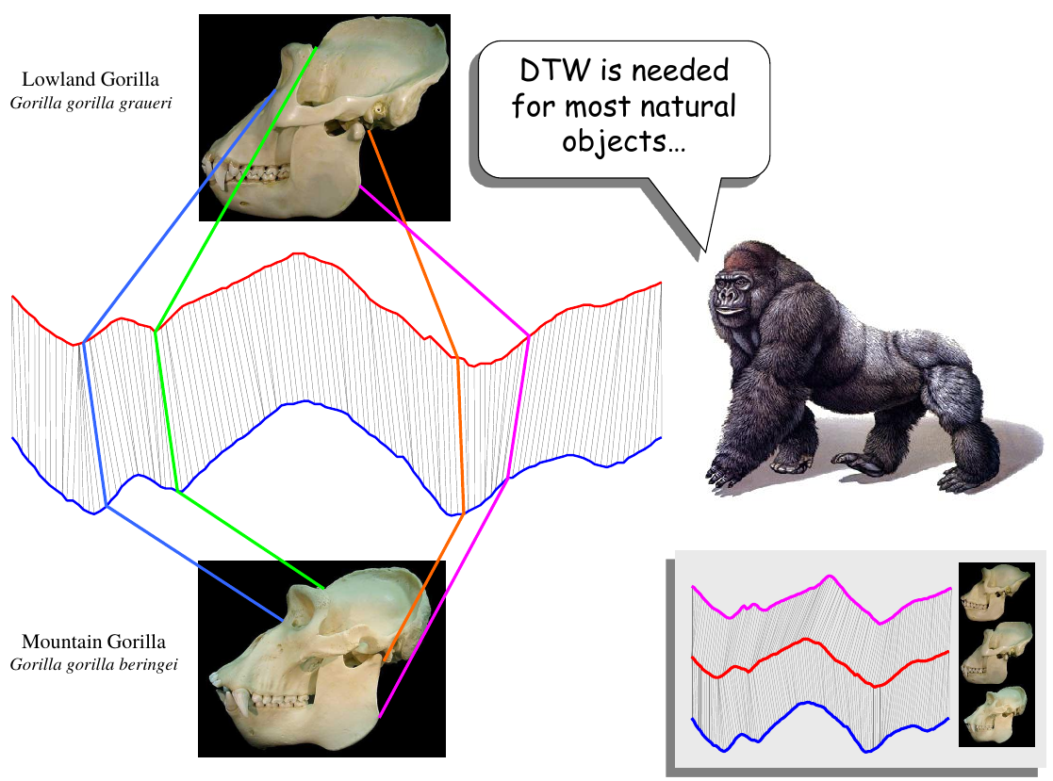

Slide 33
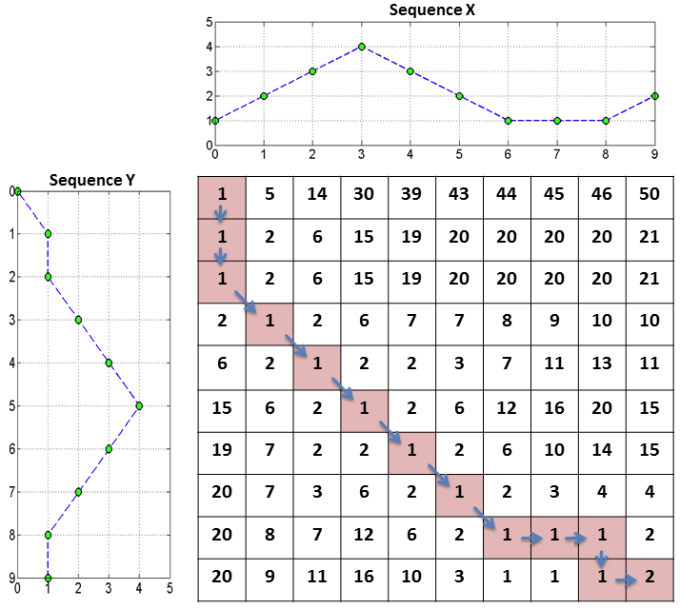
Computing DTW(X,Y)
Create a matrix M of size |X|×|Y|
Fill-in the matrix using dynamic programming
1 | 5 | 14 | 30
1 | 2 | 6 | 15
[Source]

Slide 34
Computing DTW(X,Y) (cont.)
Create a matrix M of size |X|×|Y|
Fill-in the matrix using dynamic programming
Find lighter path
Cell (a,b) in path ⇒ points a,b should be aligned
[Source]

Slide 35
Try it!
Compute the DTW for these two series
t | 1 | 2 | 3 | 4 | 5 | 6
Y_{t} | 2 | 5 | 2 | 5 | 3 | --
X_{t} | 0 | 3 | 6 | 0 | 6 | 1
Ko et al. 2008

Slide 36
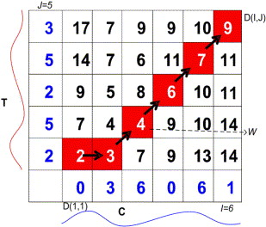
Answer
Y
X
Ko et al. 2008

Slide 37
Faster DTW through size reduction
How to avoid having a large matrix?
Use less points
  Sub-sample from original series
  Bin the original series
If sampling was done, after doing DTW:
  Interpolate warpings for intermediate points

Slide 38
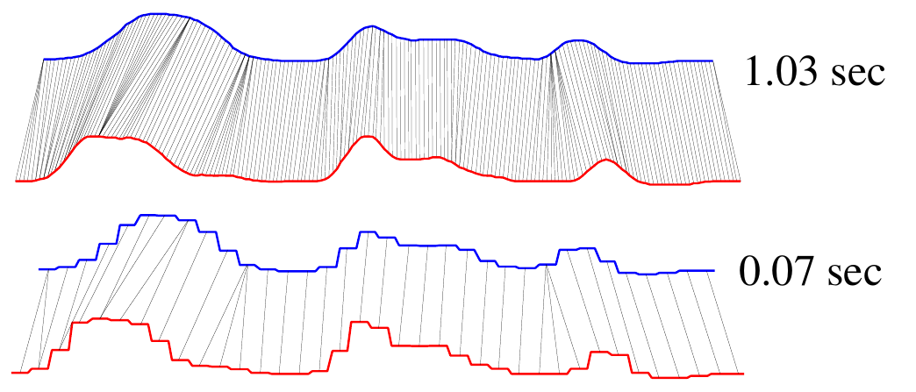
Example: faster DTW through sub-sampling

Slide 39
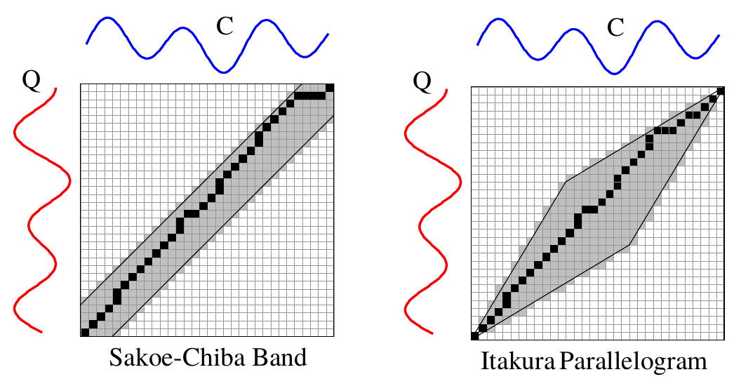
How to avoid pathological warpings?
Assume original series cannot be so far apart from each other, using domain knowledge

Slide 40
Forecasting
(AR, MA, ARMA, ARIMA, ...)

Slide 41
Stationary vs Non-Stationary processes
Stationary process
  Parameters do not change over time
  E.g., White noise has zero mean, fixed variance, and zero covariance between y_{t} and y_{t+L} for any lag L
Non-stationary process
  Parameters change over time
  E.g., price of oil, height of a child, glucose level of a patient, ...

Slide 42
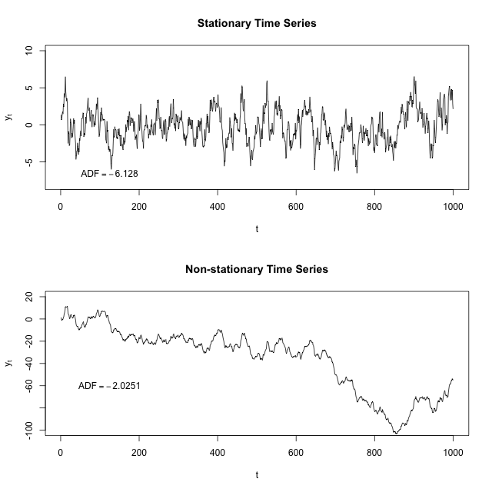
Stationary process
Non-stationary process
By Protonk at English Wikipedia, CC BY-SA 3.0
https://commons.wikimedia.org/w/index.php?curid=41600857

Slide 43
Strictly stationary time series
A strictly stationary time series is one in which the distribution of values in any time interval [a,b] is identical to that in [a+L, b+L] for any value of time shift (lag) L
In this case, current parameters (e.g., mean) are good predictors of future parameters

Slide 44
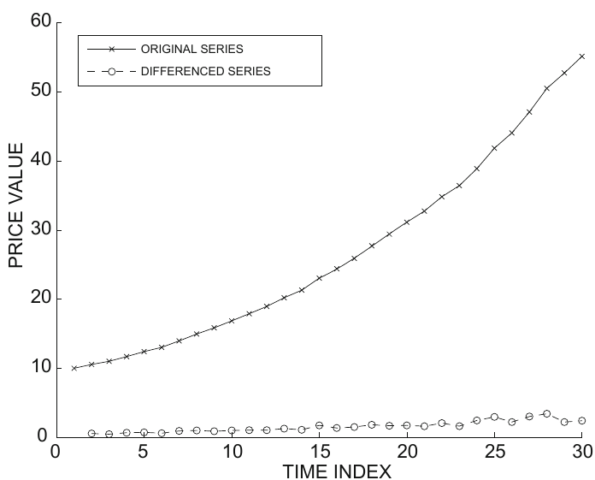
Differencing
First order differencing
In this first example, if the original series is superlinear, the differenced series is stationary or non-stationary?

Slide 45
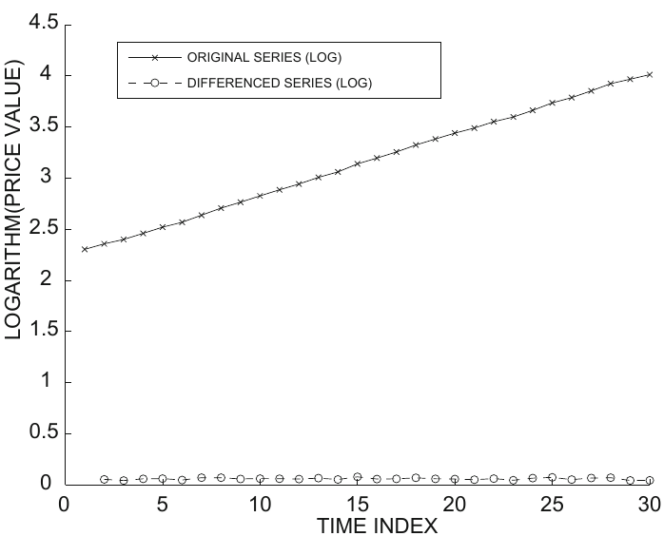
Differencing (cont.)
First order differencing
In this second example, where the series is linear, the differenced series is stationary or non-stationary?

Slide 46
Other differencing operations
Second-order differencing
Seasonal differencing (m = 24 hours, 7 days, …)
If you find a differencing that yields a stationary series, the forecasting problem is basically solved.

Slide 47
Autoregressive model AR(p)
Autocorrelation lines in [-1,1]
High absolute values ⇒ predictability
Autoregressive model of order p, AR(p):

Slide 48
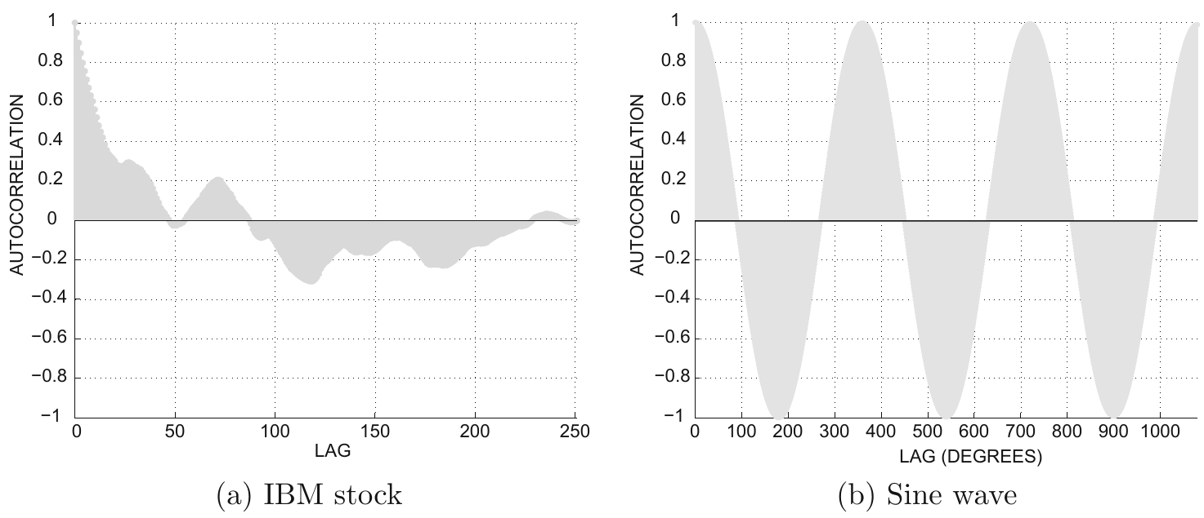
How to decide p? Autocorrelation plots
What is a reasonable range for p in these cases?

Slide 49
Finding coefficients and evaluating
Each data point is a
training element
Coefficients found by least-squares regression
Best models have R² → 1

Slide 50
Moving average model MA(q)
Focus on the variations (shocks) of the model, i.e., places where change was unexpected
AR(p) model:
MA(q) model:

Slide 51
Autoregressive moving average model ARMA(p,q)
Combines both the autoregressive and the moving average model
Select small p, q, to avoid overfitting

Slide 52
Autoregressive integrated moving average model ARIMA(p,q)
Combines both the autoregressive and the moving average model on differenced series
Note: this is an ARIMA(p,1,q) model as we’re using first order differencing

Slide 53
Event detection
(a simple framework)

Slide 54
Event: an important occurrence
Earthquake or
aftershock
Droplet
release
Sudden
price change
Time Series Data Mining (2006) slides by Hung Son Nguyen

Slide 55
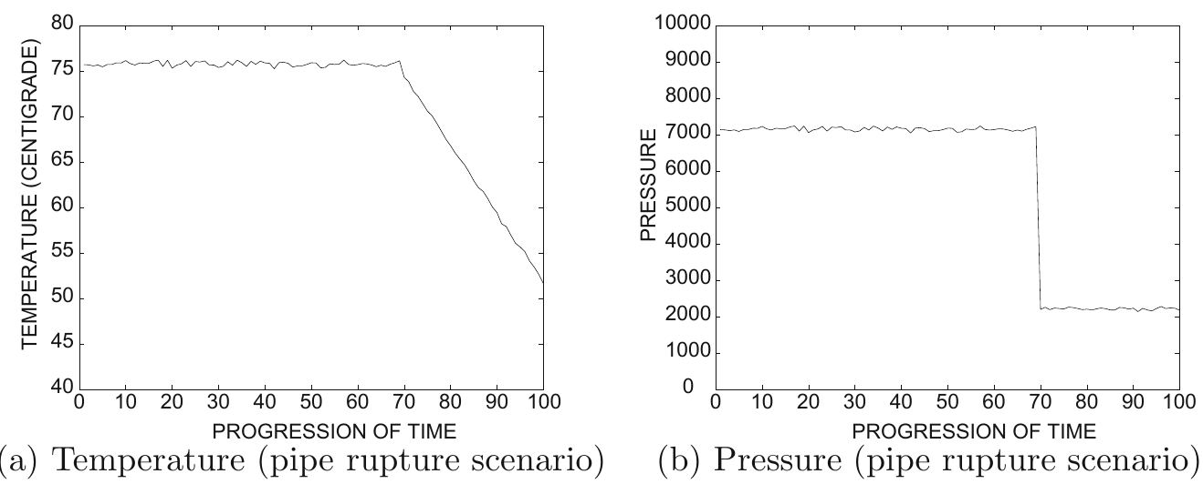
Example: pipe rupture

Slide 56
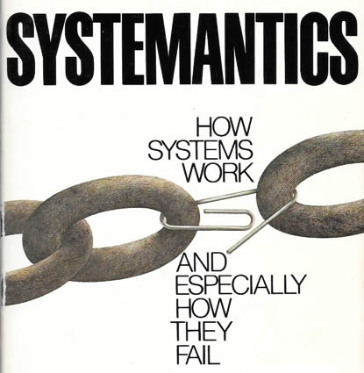
(… but what if sensors fail? …
“Systems in general work poorly or not at all”
“In complex systems, malfunction and even total non-function may not be detectable for long periods, if ever”
Gall, John. Systemantics: the underground text of systems lore:
how systems really work and especially how they fail. Ann Arbor, MI, 1975.

Slide 57
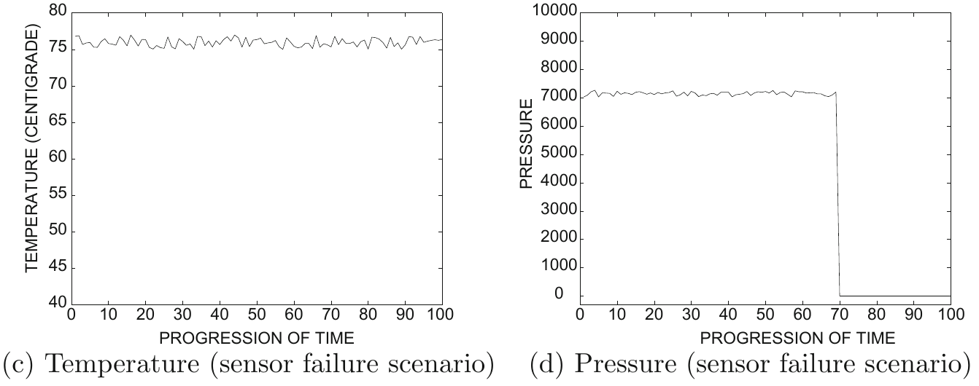
… can we detect failure? …)

Slide 58
A general scheme for event detection in multivariate time series
Let T₁, T₂, …, T_{r} be times at which an event has been observed in the past
(Offline) Learn coefficients α₁, α₂, …, α_{d} to distinguish between event times and non-event times
(Online) Observe series and determine deviation of every stream i at timestamp t as z_{t}^{i}
(Online) Compute composite alarm level

Slide 59
Learning discrimination coefficients α₁ , α₂ , … , α_{d}
Average alarm level for events
Average alarm level for non-events
(we assume most points are non-events)

Slide 60
Learning discrimination coefficients α₁ , α₂ , … , α_{d} (cont.)
For events
For non-events
Maximize
subject to
Use any off-the-shelf iterative
optimization solver

Slide 61
Summary

Slide 62
Things to remember
Series preparation
  Interpolation
  Smoothing
Dynamic time warping
Time series forecasting
Event detection

Slide 63
Exercises for this topic
Data Mining, The Textbook (2015) by Charu Aggarwal
  Exercises 14.10 → 1-6

