Slide 1

Outlier detection
Mining Massive Datasets
Carlos Castillo
Topic 09

Slide 2
Sources
Data Mining, The Textbook (2015) by Charu Aggarwal (chapter 8) – slides by Lijun Zhang

Slide 3
What is an outlier?
Informally, “An outlier is an observation which deviates so much from the other observations as to arouse suspicions that it was generated by a different mechanism.”
  Clustering seeks to group points that are similar
  Outlier detection seeks points that are different from the remaining data

Slide 4
Some applications
Data cleaning
  Remove noise in data
Credit card fraud
  Unusual patterns of credit card activity
Network intrusion detection
  Unusual records/changes in network traffic

Slide 5
Outlier detection methods
Key idea
  Create a model of normal patterns
  Outliers are data points that do not naturally fit within this normal model
  The “outlierness” of a data point is quantified by a outlier score
Outputs of Outlier Detection Algorithms
  Real-valued outlier score
  Binary label (outlier / not outlier)

Slide 6
Extreme values analysis

Slide 7
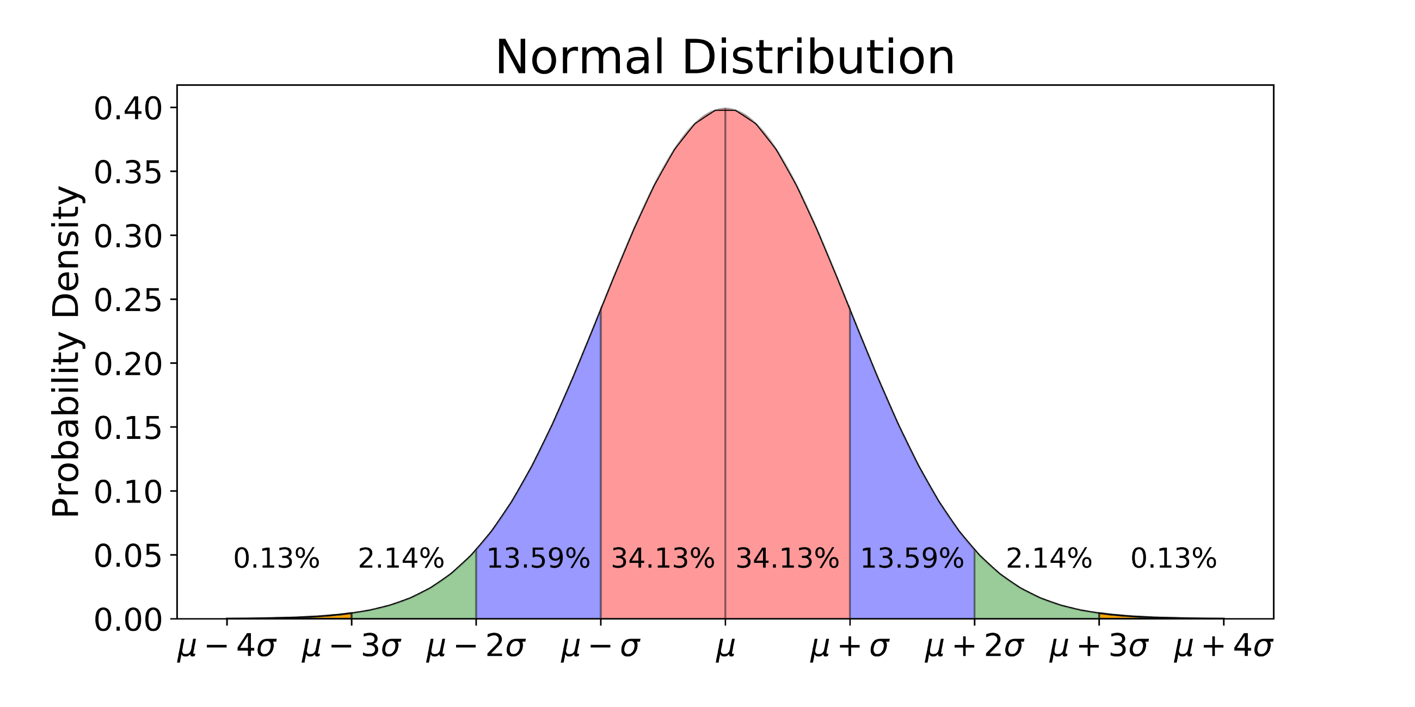
Extreme value analysis:
Statistical Tails

Slide 8
Extreme value analysis (cont.)
All extreme values
are outliers
Outliers may not be
extreme values
  {1,3,3,3,50,97,97,100}
  1 and 100 are extreme values
  50 is an outlier but no an extreme value

Slide 9
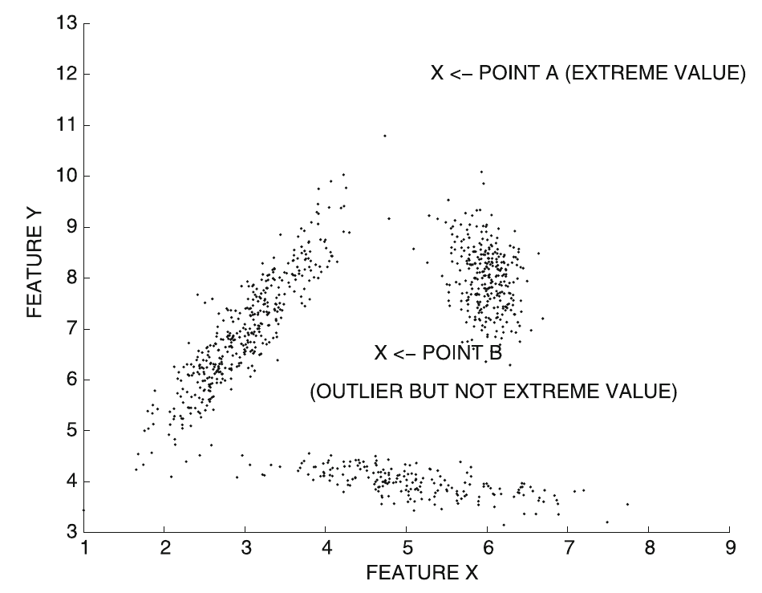
Extreme value analysis (cont.)
Point A is an extreme value (hence, an outlier)
Point B is an outlier but not an extreme value

Slide 10
Univariate extreme value analysis
Statistical tail confidence test
  Let density be f_{X}(x)
  Tails are extreme regions s.t. f_{X}(x) ≤ θ

Slide 11
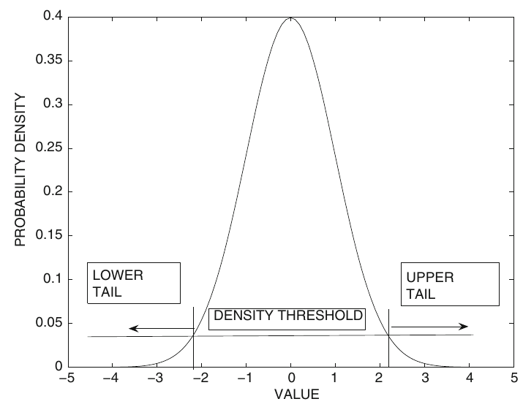
Univariate extreme value analysis (cont.)
Let density be f_{X}(x); tails are extreme regions s.t. f_{X}(x) ≤ θ
Symmetric distribution
  Two symmetric tails
  Areas inside tails represent cumulative distribution

Slide 12
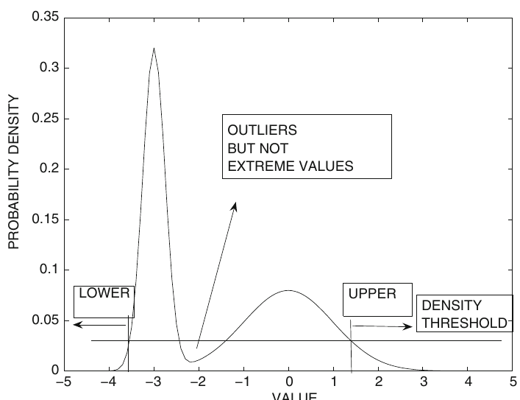
Univariate extreme value analysis (cont.)
Let density be f_{X}(x); tails are extreme regions s.t. f_{X}(x) ≤ θ
Asymmetric distribution
  Areas in two tails are different
  Regions in the interior are not tails

Slide 13
Standardization for univariate outlier analysis
Normal distribution assumed
Parameters
  From prior knowledge
  Estimated from data

Slide 14
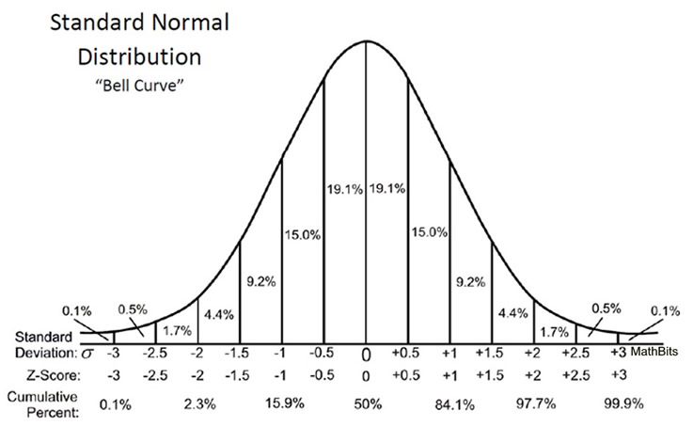
Standardization for univariate outlier analysis (cont.)
z-value
Follows normal distribution with mean 0 and standard deviation 1
  Large z-value: upper tail
  Small z-value: lower tail

Slide 15
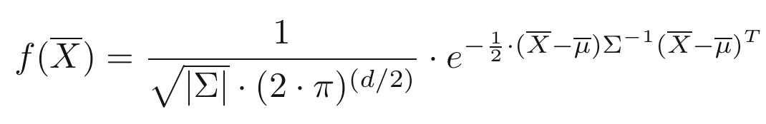
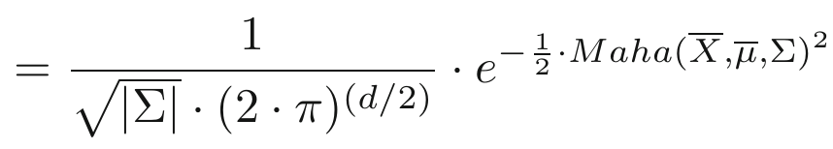
Multivariate extreme values
Multivariate Gaussian distribution in d dimensions
Maha(X, μ, Σ) is the Mahalanobis distance
|Σ| is the determinant of the covariances matrix

Slide 16
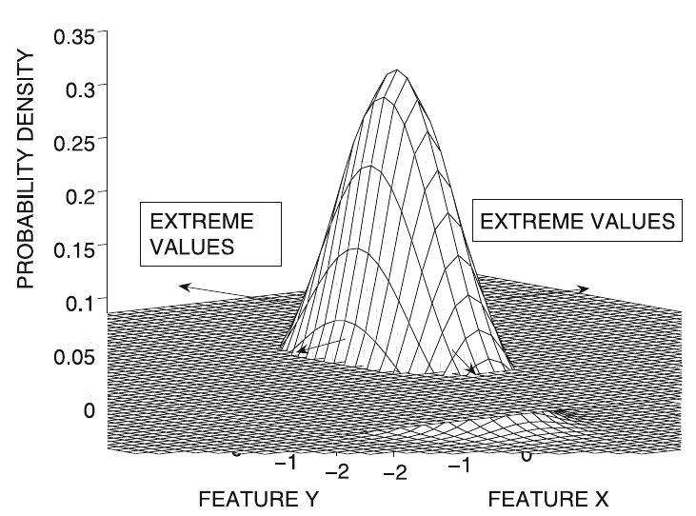
Multivariate extreme values (cont.)
Extreme value score of X
  Maha(X, μ, Σ)
  Mahalanobis distance to
  the mean of the data
  Larger values imply
  more extreme behavior

Slide 17
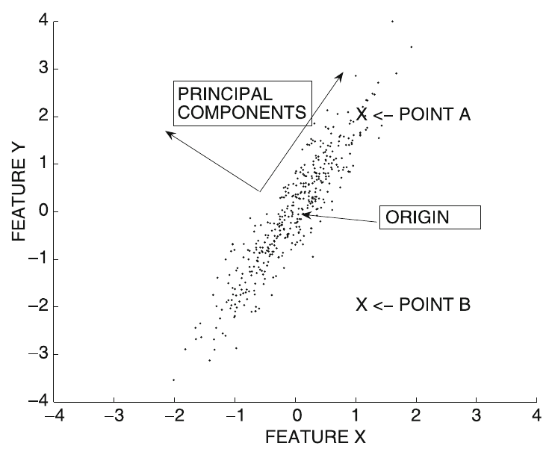
Multivariate extreme values (cont.)
Extreme value score of X
  Maha(X, μ, Σ)
  Mahalanobis distance to
  the mean of the data
  Larger values imply
  more extreme behavior
  The Mahalanobis distance is the Euclidean distance in a transformed (axes-rotated) data set after dividing each of the transformed coordinate values by the standard deviation along its direction

Slide 18
Depth-based methods

Slide 19
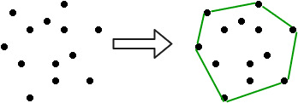
Key concept: convex hull
The convex hull of a set C is the set of
all convex combinations of points in C

Slide 20
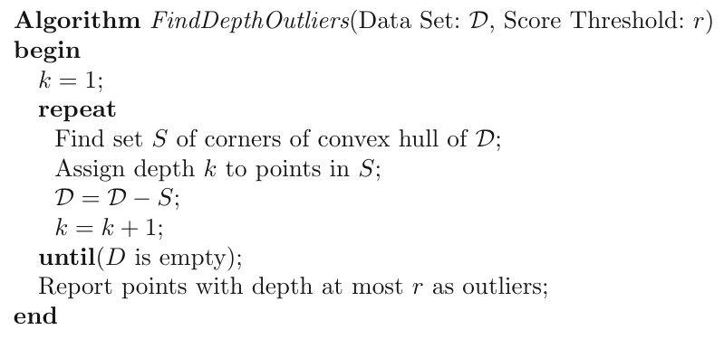
Algorithm

Slide 21
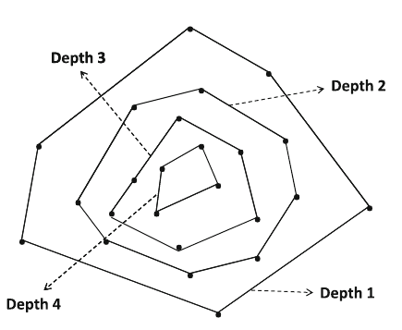
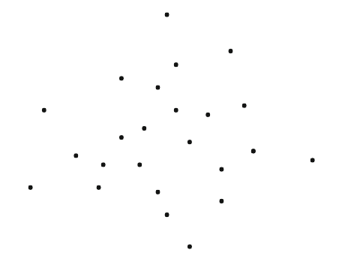
Explanation: peeling layers

Slide 22
Limitations of this method
How many outliers?
No normalization
Computational complexity increases significantly with dimensionality
Many data points are indistinguishable

Slide 23
Probabilistic methods

Slide 24
Related to probabilistic model-based clustering
Assume data is generated from a mixture-based generative model
Learn the parameters of the model from data
  EM algorithm
Evaluate the probability of each data point being generated by the model
  Points with low values are outliers

Slide 25
Mixture-based generative model
Data is generated by a mixture of k distributions with probability distributions
G₁, …, G_{k}
Each point X is generated as follows:
  Select a mixture component with probability α_{i}
  Suppose it’s component r
  Generate a data point from G_{r}

Slide 26
Learning parameters from data
Probability of generating a point

Slide 27
Learning parameters from data
Probability of generating a point
Probability of generating a dataset
Learning: min log loss

Slide 28
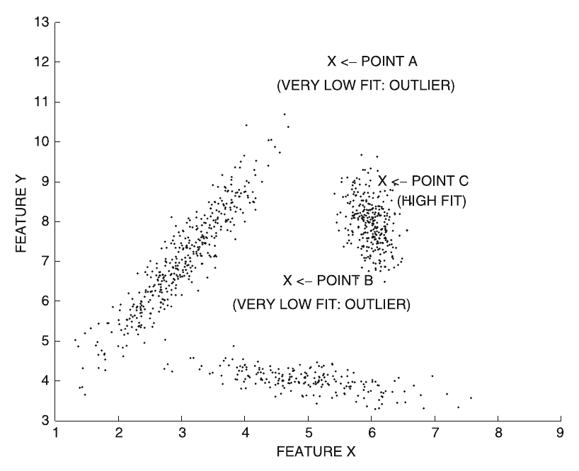
Identifying an outlier
Outlier score:

Slide 29
Clustering-based methods

Slide 30
Clustering for outlier analysis
Clustering associate points to similar points
Points either belong to a cluster or are outliers
Some clustering algorithms also detect outliers
  Examples: DBSCAN, DENCLUE

Slide 31
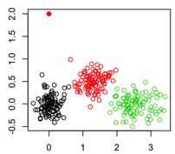
Simple method
Outlier
Cluster data, associating each point to a centroid, e.g., using k-means
Outlier score = distance of point to its centroid

Slide 32
Improved method
Cluster data
Outlier score = local Mahalanobis distance with respect to center of cluster r
is the mean of the cluster r
is the covariance matrix of cluster r

Slide 33
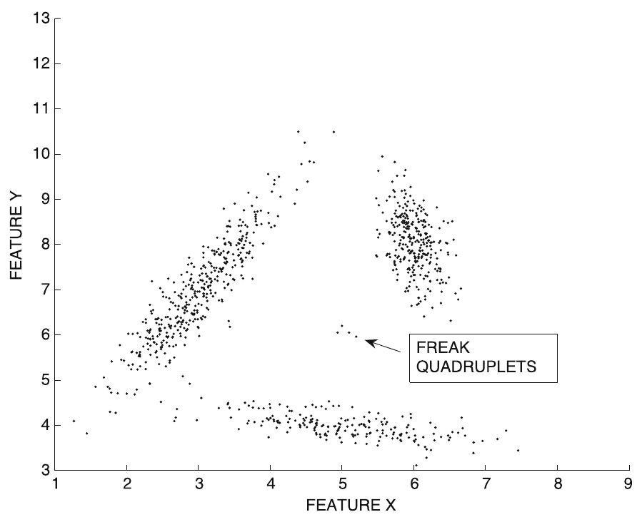
Improved method (cont.)
Remove tiny
clusters

Slide 34
Distance-based methods

Slide 35
Instance-specific definition
The distance-based outlier score of an object O is its distance to its k^{th} nearest neighbor
In this example of a
small group of 4
outliers, we can set
k > 3

Slide 36
Problem: computational cost
The distance-based outlier score of an object O is its distance to its k^{th} nearest neighbor
In principle this requires O(n²) computations!
  Index structure:
  useful only for cases of low data dimensionality
  Pruning tricks:
  useful when only top-r outliers are needed

Slide 37
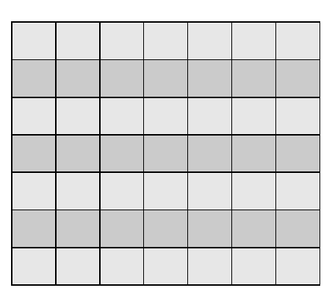
Problem: computational cost
The distance-based outlier score of an object O is its distance to its k^{th} nearest neighbor
In principle this requires:
  O(n²) computations for evaluating the n x n distance matrix
  O(n²) computations for finding the r smallest values on each row
n
n
Distance to k^{th} nearest neighbor

Slide 38
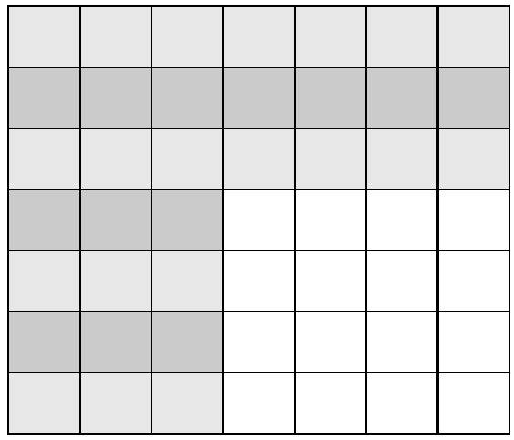
Pruning method: sampling
Evaluate s x n distances
For points
1...s we are OK
For points (s+1)...n we know only upper bounds
s
n

Slide 39
Pruning method: sampling (cont.)
From points
1...s we already know the r “winners”
(r≤s nodes with the larger distance to their k^{th} nearest neighbor)
Any point having
V_{k} < L_{s} cannot be among the top r outliers
s
n

Slide 40
Pruning method: sampling (cont.)
From points
1...s we already know the r “winners”
(r≤s nodes with the larger distance to their k^{th} nearest neighbor)
Any point having
V_{k} < L_{s} cannot be among the top r outliers
s
n

Slide 41
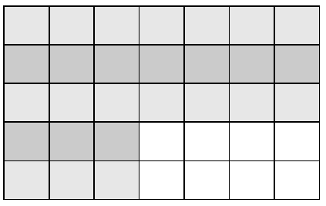
Pruning method: sampling (cont.)
Remove points
having
Update L_{r} keeping
r largest values, and
stop computing for a
row if one already finds
k nearest neighbors in that row that are all below distance L_{r}
s
n

Slide 42
Local outlier factor

Slide 43
Local Outlier Factor (LOF)
Let V_{k}(X) be the distance of X to its k-nearest neighbor
Reachability distance

Slide 44
Local Outlier Factor (LOF) (cont.)
V_{k}(X): distance of X to its k-nearest neighbor
Reachability distance
Not symmetric
Equal to simple distance for long distances
Smoothed by V_{k}(X)
for short distances
X
Y

Slide 45
Local Outlier Factor (LOF) (cont.)
Reachability distance
Average reachability distance
L_{k}(X) is the set of points within distance V_{k}(X) of X (might be more than k due to ties)

Slide 46
Local Outlier Factor (LOF) (cont.)
Local outlier factor Outlier score
Large for outliers, close to 1 for others

Slide 47
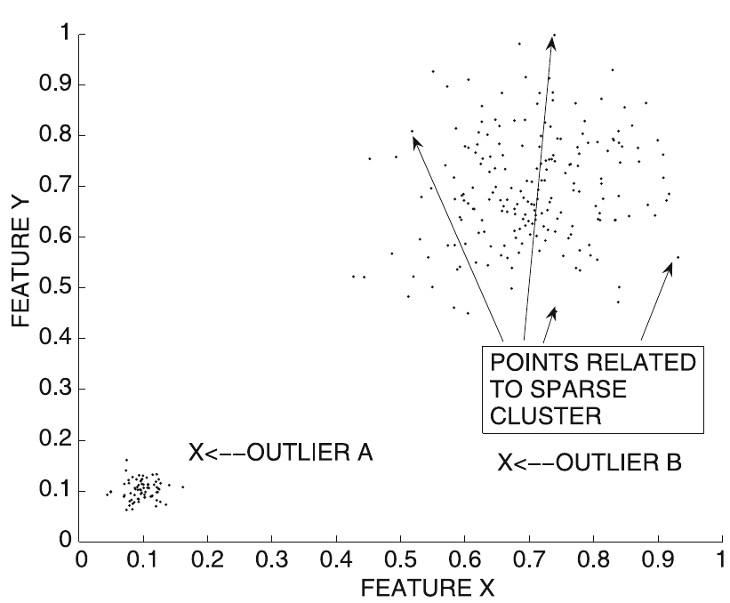
Local Outlier Factor (LOF) (cont.)
Local outlier factor
LOF values for points inside a cluster are close to one if cluster is homogeneous
LOF values much higher for outliers: they are computed in terms of average distances of near-by clusters

Slide 48
Density-based methods

Slide 49
Continue … slide 51

Slide 50
Outlier validity

Slide 51
Continue …

Slide 52
Summary

Slide 53
Things to remember
Extreme value analysis
  Univariate, multivariate, depth based
Clustering-based methods
Distance-based methods
Density-based methods
Outlier validity

