Slide 1

Recommender Systems
Mining Massive Datasets
Prof. Carlos Castillo
Topic 16

Slide 2
Sources
Data Mining, The Textbook (2015) by Charu Aggarwal (Section 18.5) – slides by Lijun Zhang
Mining of Massive Datasets 2nd edition (2014) by Leskovec et al. (Chapter 9) - slides A, B

Slide 3


YouTube's algorithm cares as much about trap as your professor, but manages to produce reasonable recommendations. How?

Slide 4
Recommender systems (purchase)
Given data from user buying behaviors
  User profiles, interests, browsing behavior, buying behavior, and ratings about various items
Leverage such data to make recommendations to customers about possible buying interests

Slide 5
Recommender systems (general)
Given data from user interests
  User profiles, interests, browsing behavior, item interaction behavior, ratings about various items
Leverage such data to make recommendations to users about further interesting items

Slide 6






Slide 7
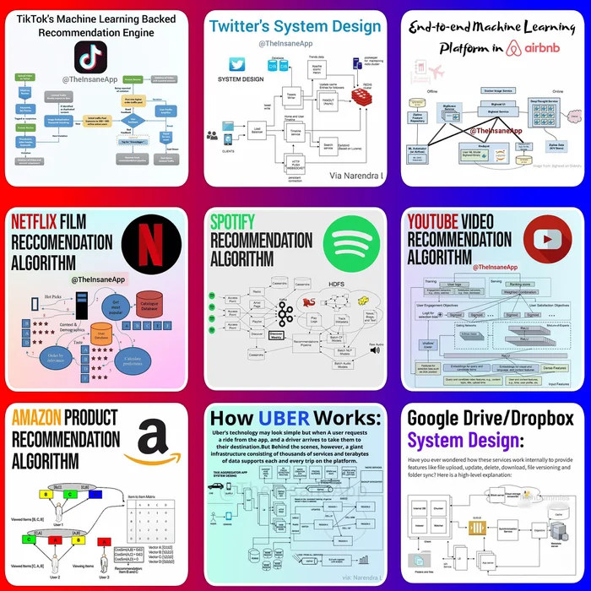
Large scale engines for recommendation:
are composed of
multiple layers,
use online and
offline (batch) models,
include complex
data pipelines to move behavioral and content signals around.
Source: The Insane App
March 2021

Slide 8
Utility matrix
For n users and d items, there is a matrix D of utility values
  The utility value for a user-item pair could correspond, e.g., to buying behavior or ratings of the user for the item
  Typically, a small subset of the utility values are known

Slide 9
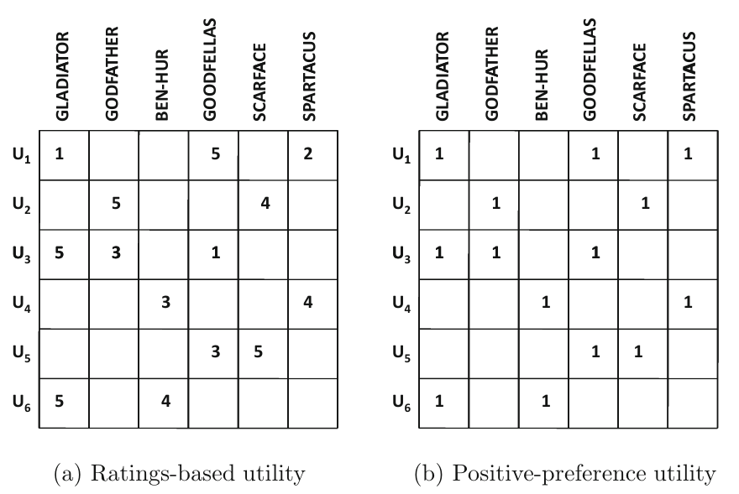
Utility matrix (ratings-based, positive preference)

Slide 10



Types of utility
Explicit: we ask users to rate items
Implicit: we take watching/consuming/buying behavior as a positive signal, skip/hide as negative

Slide 11
Sources for a recommendation
Content-based recommendation
  Users and items are associated with features
  Features are matched to infer interest
Interaction-based recommendations
  Leverage user preferences in the form of ratings or other behavior
  Recommend through similarity or latent factors

Slide 12
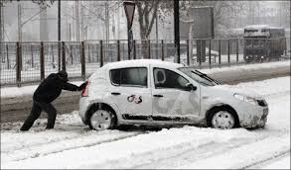
New items have no ratings
and
New users have no history
Photo: Torque News

Slide 13
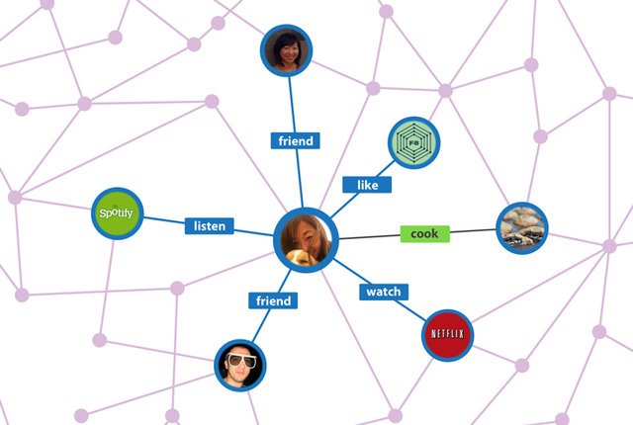

Solution 1. “Side information”

Slide 14
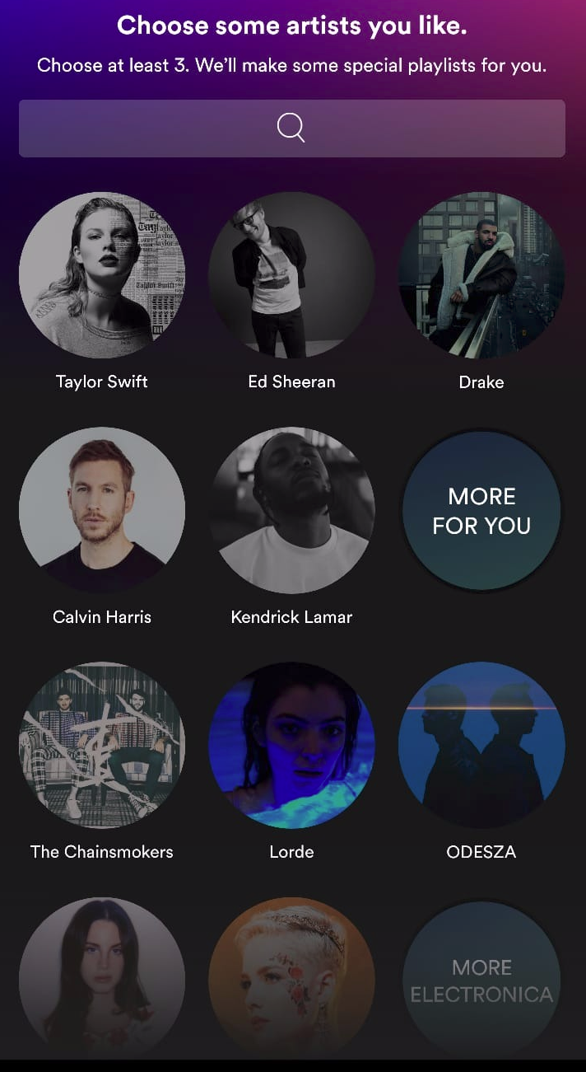
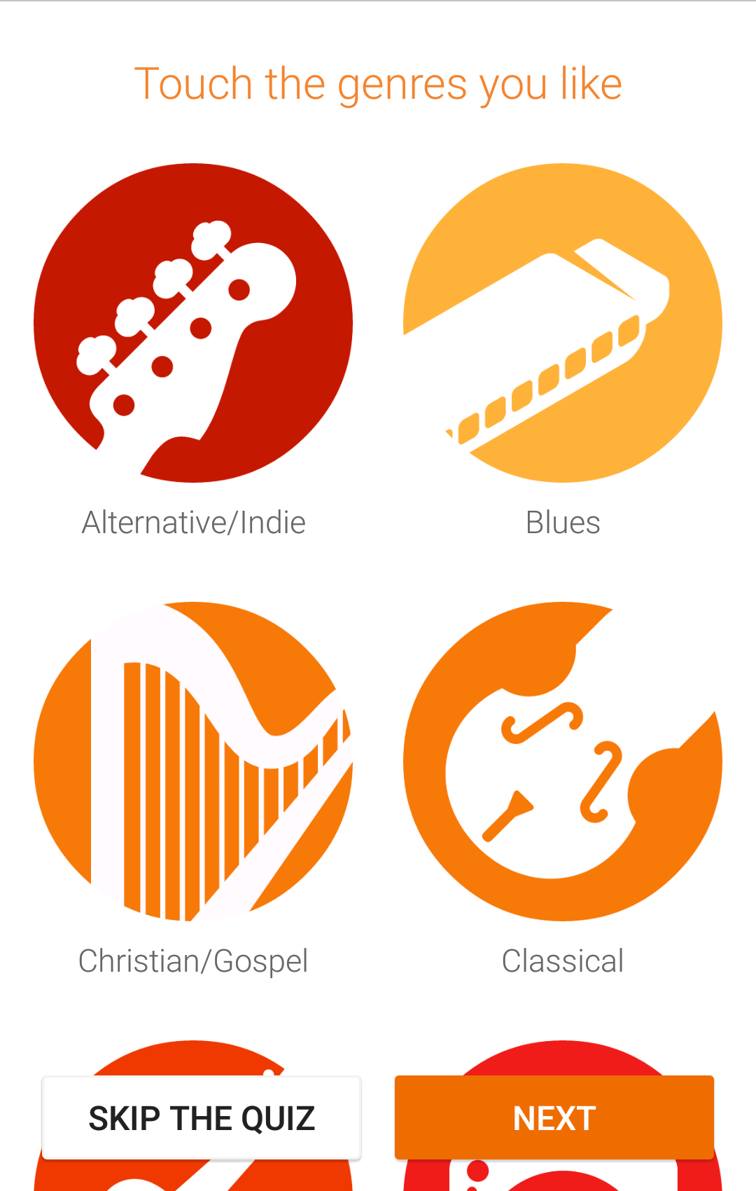
Solution 2.
“On-boarding” users

Slide 15
Content-based recommendations

Slide 16
General idea of content-based recommendations
Movies: recommend other movies with same director, actor, genre, as viewed ones
Products: recommend other products in same category, brand, color, as purchased ones

Slide 17

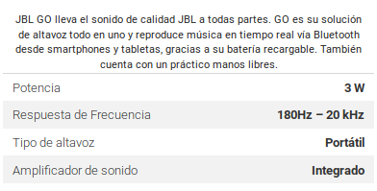
Creating a recommendation
User is associated with some documents that describe his/her interests
  Specified demographic profile
  Specified interests at registration time
  Descriptions of the items bought
Items are also associated with semi-structured descriptions

Slide 18
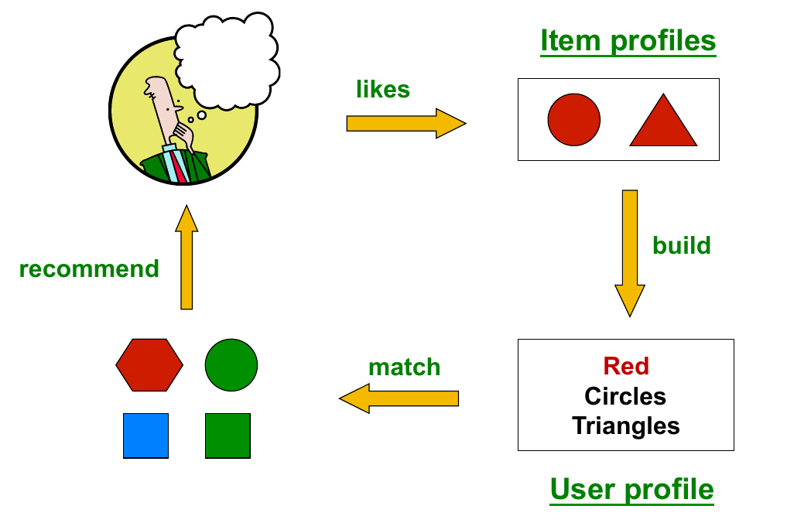
Creating a recommendation (cont.)
Mining of Massive Datasets 2nd edition (2014) by Leskovec et al. (Chapter 9) - slides A, B

Slide 19
Possible recommendation methods
If no utility matrix is available
  k-nearest neighbor approach
    Find the top-k items that are closest to the user (when items and users can be represented in the same space, e.g., dating apps)
  The cosine similarity with tf-idf can be used
If a utility matrix is available
  Classification-based approach: training documents are those for which the user has specified utility, labels are utility values
  Regression-based approach in the case of ratings
Limitations: depends on the quality of the features

Slide 20
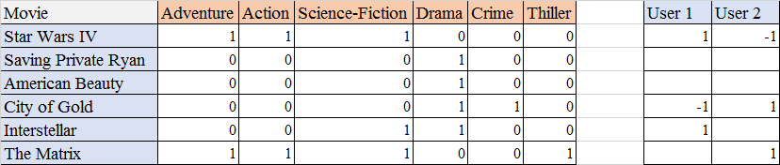
Example: regression-based approach for content-based recommendation
...
We would do two regressions: one for the ratings of user 1 and another for user 2.
(We can also do this for groups of users, e.g., by city and age)
How many rated movies would we need, as a minimum, to be able to do this?

Slide 21

Exercise: single user recommendation
Database of ~100 electric scooters, of which 12 have been rated on a scale 1-5
We have done linear regression on:
  price [$], battery capacity [Wh], range [km]
Which would be your top-3 recommended scooter among the remaining ones?
Answer in
Google Spreadsheet

Slide 22
Pros and Cons of content-based recommendations
Pros:
  No cold-start problem if no utility needed
  Able to recommend to users with very particular tastes
  Able to recommend new and obscure items
  Able to provide explanations that are easily understandable

Slide 23
Pros and Cons of content-based recommendations
Cons:
  Finding the correct features might be hard
  Recommending for new users still challenging if user features are different from item features
  Overspecialization/”bubble”: might reinforce user interests
  Does not exploit ratings of other users!

Slide 24
Summary

Slide 25
Things to remember
Content-based recommendations

Slide 26
Exercises for TT16-TT18
Mining of Massive Datasets 2nd edition (2014) by Leskovec et al. Note that some exercises cover advanced concepts:
  Exercises 9.2.8
  Exercises 9.3.4
  Exercises 9.4.6

