Slide 1

Association Rules Mining:
Reducing Running Time
Mining Massive Datasets
Prof. Carlos Castillo — https://chato.cl/teach

Slide 2
Sources
Data Mining, The Textbook (2015) by Charu Aggarwal (Chapters 4, 5) – slides by Lijun Zhang
Mining of Massive Datasets 2nd edition (2014) by Leskovec et al. (Chapter 6) - slides
Data Mining Concepts and Techniques, 3rd edition (2011) by Han et al. (Chapter 6)
Introduction to Data Mining 2nd edition (2019) by Tan et al. (Chapters 5, 6) – slides ch5, slides ch6

Slide 3
Speeding up candidate generation

Slide 4
Speeding-up candidate generation: level-wise pruning trick
Let F_{k} be the set of frequent k-itemsets [we know they are frequent]
Let C_{k+1} be the set of (k+1)-candidates [we do not know their frequency]
I ∊ C_{k+1} is frequent only if all the k-subsets of I are frequent
Pruning
  Generate all the k-subsets of I
  If any one of them does not belong to F_{k}, then remove I

Slide 5
Candidates generation
A Naïve Approach
  Check all the possible combinations of frequent itemsets
An Example of the Naïve Approach
  itemsets: {abc} {bcd} {abd} {cde}
  {abc} + {bcd} = {abcd}
  {bcd} + {abd} = {abcd}
  {abd} + {cde} = {abcde}
  ….

Slide 6
Candidates generation (cont.)
Introduction of ordering
  Items in U can be sorted in lexicographic ordering
  Items in each itemset can be sorted in lexicographic ordering
  Itemsets can be ordered as strings
The improved approach:
  Order the frequent k-itemsets
  Merge two itemsets if and only if the first k-1 items of them are equal

Slide 7
Candidates generation (cont.)
Example 1:
  k-itemsets: {abc} {abd} {acd} {bcd}
  (k+1)-itemsets: {abc} + {abd} = {abcd}
  No other pair shares a prefix of size k-1, no need to check other combinations
Example 2:
  k-itemsets: {abc} {acd} {bcd}
  No (k+1) -candidates
  Did we miss {abcd}?
    No, due to the Downward Closure Property: every subset of a frequent itemset is also frequent, and {abd} is not frequent
Note: We are writing {xyz} to mean the set {x, y, z}

Slide 8
Improving computation of support

Slide 9
Naïve support counting
Naïve counting:
  For each candidate I_{i} ∊ C_{k+1}
    For each transaction T_{j} in T
      Check whether I_{i} appears in T_{j}
This is very slow if both |C_{k+1}| and |T| are large

Slide 10
Support counting with a data structure
A Better Approach
  Organize the candidate patterns in C_{k+1} in a data structure
Use the data structure to accelerate counting
  Each transaction in T_{i} examined against the subset of candidates in C_{k+1} that might contain T_{i}

Slide 11
Support counting based on hashing
Naïve counting:
For each I_{i} ∊ C_{k+1}
For all T_{j} ∊ T
If I_{i} ⊆ T_{j}
Add to sup(I_{i})
Hashed counting:
For each T_{j} ∊ T
For I_{i} ∊ hashbucket(T_{j}, C_{k+1})
If I_{i} ⊆ T_{j}
Add to sup(I_{i})

Slide 12
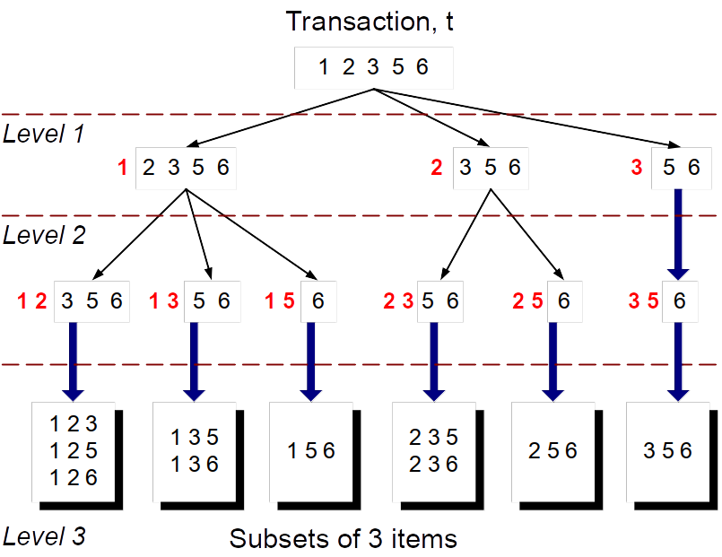
Which candidates are relevant?
Imagine 15 candidates
itemsets of length 3:
{1 4 5}, {1 2 4}, {4 5 7},
{1 2 5}, {4 5 8}, {1 5 9},
{1 3 6}, {2 3 4}, {5 6 7},
{3 4 5}, {3 5 6}, {3 5 7},
{6 8 9}, {3 6 7}, {3 6 8}
Now, suppose we look
for this transaction:
{1 2 3 5 6}
Here we depict only the candidates that appear in the transaction (10 out of 15)

Slide 13
Hash tree for itemsets in C_{k+1}
A tree with fixed degree r
Each itemset in C_{k+1} is stored in a leaf node
All internal nodes use a hash function to map items to one of the r branches (can be the same for all internal nodes)
All leaf nodes contain a lexicographically sorted list of up to max_leaf_size itemsets

Slide 14
Example hash tree r=3 max_leaf_size=3
Candidate itemsets
{1 4 5}, {1 2 4}, {4 5 7},
{1 2 5}, {4 5 8}, {1 5 9},
{1 3 6}, {2 3 4}, {5 6 7},
{3 4 5}, {3 5 6}, {3 5 7},
{6 8 9}, {3 6 7}, {3 6 8}
2 3 4
5 6 7
1 4 5
3 4 5
3 5 6
3 5 7
6 8 9
3 6 7
3 6 8
1 3 6
1 2 4
4 5 7
Hash function
1 2 5
4 5 8
1 5 9
3,6,9
1,4,7
Important:
itemsets are sorted!
2,5,8
This example from: Introduction to Data Mining 2nd edition (2019) by Tan et al. (Chapter 5) – slides ch5

Slide 15
Example hash tree (cont.)
Hash Function
Candidate Hash Tree
1,4,7
3,6,9
2,5,8
2 3 4
5 6 7
1 4 5
1 3 6
3 4 5
3 5 6
3 6 7
Hash on 1, 4 or 7
3 5 7
3 6 8
1 2 4
1 5 9
6 8 9
1 2 5
4 5 7
4 5 8

Slide 16
Example hash tree (cont.)
Hash Function
Candidate Hash Tree
1,4,7
3,6,9
2,5,8
2 3 4
5 6 7
1 4 5
1 3 6
3 4 5
3 5 6
3 6 7
Hash on 2, 5 or 8
3 5 7
3 6 8
1 2 4
1 5 9
6 8 9
1 2 5
4 5 7
4 5 8

Slide 17
Example hash tree (cont.)
Hash Function
Candidate Hash Tree
1,4,7
3,6,9
2,5,8
2 3 4
5 6 7
1 4 5
1 3 6
3 4 5
3 5 6
3 6 7
Hash on 3, 6 or 9
3 5 7
3 6 8
1 2 4
1 5 9
6 8 9
1 2 5
4 5 7
4 5 8

Slide 18
Checking which candidates might be in a transaction
1 2 3 5 6
transaction
Hash Function
1,4,7
3,6,9
2,5,8
2 3 4
5 6 7
1 4 5
1 3 6
3 4 5
3 5 6
3 6 7
3 5 7
3 6 8
1 2 4
1 5 9
6 8 9
1 2 5
4 5 7
4 5 8

Slide 19
Checking which candidates might be in a transaction
1 2 3 5 6
transaction
Hash Function
1 +
2 3 5 6
2 +
3 5 6
1,4,7
3,6,9
3 +
5 6
2,5,8
2 3 4
5 6 7
1 4 5
1 3 6
3 4 5
3 5 6
3 6 7
3 5 7
3 6 8
1 2 4
1 5 9
6 8 9
1 2 5
4 5 7
4 5 8

Slide 20
Checking which candidates might be in a transaction
1 2 3 5 6
transaction
Hash Function
1 +
2 3 5 6
2 +
3 5 6
1 2 +
3 5 6
1,4,7
3,6,9
3 +
5 6
2,5,8
1 3 +
5 6
2 3 4
1 5 +
6
5 6 7
1 4 5
1 3 6
3 4 5
3 5 6
3 6 7
3 5 7
3 6 8
1 2 4
1 5 9
6 8 9
1 2 5
4 5 7
4 5 8

Slide 21
Checking which candidates might be in a transaction
1 2 3 5 6
transaction
Hash Function
1 +
2 3 5 6
2 +
3 5 6
1 2 +
3 5 6
1,4,7
3,6,9
3 +
5 6
2,5,8
1 3 +
5 6
2 3 4
3 5 +
6
1 5 +
6
5 6 7
3 +
6
1 4 5
1 3 6
3 4 5
3 5 6
3 6 7
1 2 5 +
6
1 5 6
3 5 7
3 6 8
1 2 4
1 5 9
6 8 9
1 2 5
4 5 7
4 5 8
1 2 3 +
5 6

Slide 22
Checking which candidates might be in a transaction
1 2 3 5 6
transaction
Hash Function
1 +
2 3 5 6
2 +
3 5 6
1 2 +
3 5 6
1,4,7
3,6,9
3 +
5 6
2,5,8
1 3 +
5 6
2 3 4
Compare transaction against 11 out of 15 candidates
1 5 +
6
5 6 7
1 4 5
1 3 6
3 4 5
3 5 6
3 6 7
1 2 5 +
6
1 5 6
3 5 7
3 6 8
1 2 4
1 5 9
6 8 9
1 2 5
4 5 7
4 5 8
1 2 3 +
5 6

Slide 23
Exercise: Use the hash tree to determine which candidates might be in this transaction
Hash Function
3 6 8 9
transaction
1,4,7
3,6,9
2,5,8
2 3 4
5 6 7
1 4 5
1 3 6
3 4 5
3 5 6
3 6 7
3 5 7
3 6 8
1 2 4
1 2 5
1 5 9
6 8 9
4 5 7
4 5 8

Slide 24
Hash Function
3 6 8 9
transaction
1,4,7
3,6,9
2,5,8
2 3 4
5 6 7
1 4 5
1 3 6
3 4 5
3 5 6
3 6 7
3 5 7
3 6 8
1 2 4
1 2 5
1 5 9
6 8 9
4 5 7
4 5 8

Slide 25
SOLUTION
Hash Function
3 6 8 9
transaction
8 +
9
3 +
6 8 9
1,4,7
3,6,9
6 +
8 9
2,5,8
3 6 +
8 9
6 8 +
9
3 8 +
9
2 3 4
5 6 7
1 4 5
1 3 6
3 4 5
3 5 6
3 6 7
3 5 7
3 6 8
Compare transaction against 8 out of 15 candidates
1 2 4
1 5 9
6 8 9
1 2 5
4 5 7
4 5 8

Slide 26
( = Relationship between prefixes)
transaction
Hash Function
3 6 8 9
8 +
9
3 +
6 8 9
1,4,7
3,6,9
6 +
8 9
2,5,8
3 6 +
8 9
6 8 +
9
3 8 +
9
2 3 4
5 6 7
1 4 5
1 3 6
3 4 5
3 5 6
3 6 7
3 5 7
3 6 8
Compare transaction against 8 out of 15 candidates
1 2 4
1 5 9
6 8 9
1 2 5
4 5 7
4 5 8

Slide 27
Improved algorithm for frequent itemsets
C₁ ← singletons, lexicographically sorted
F₁ ← elements in C₁ with support ≥ minsup, obtained by direct counting
k ← 1
While F_{k} is not empty
  Generate C_{k+1} by merging elements in F_{k} sharing a prefix of size k-1
  Remove from C_{k+1} elements that do not have all of their subsets in F_{k}
  Create hash tree for C_{k+1}
  Pass all transactions in T by the hash tree to compute support for elements of C_{k+1}
  F_{k+1} ← elements in C_{k+1} with support ≥ minsup, lexicographically sorted
Return the union of F₁, F₂, …, F_{k}

Slide 28
Summary

Slide 29
Things to remember
Lexicographic candidate generation
Level pruning
Hash-tree method

Slide 30
Exercises for this topic
Data Mining, The Textbook (2015) by Charu Aggarwal
  Exercises 4.9 → 9-10
Mining of Massive Datasets 2nd edition (2014) by Leskovec et al.
  Exercises 6.2.7 → 6.2.5 and 6.2.6
Introduction to Data Mining 2nd edition (2019) by Tan et al.
  Exercises 5.10 → 9-12

Slide 31

Additional contents
(not included in exams)

Slide 32
Enumeration-tree algorithms:
Lexicographic tree
There is a node in the tree for each frequent itemset
The root of the tree contains the null itemset
If I = {i₁, i₂, …, i_{k}} then the parent of I in the tree is {i₁, i₂, …, i_{k-1}}
Introduction to Data Mining 2nd edition (2019) by Tan et al. (Chapters 5, 6) – slides ch5, slides ch6

Slide 33
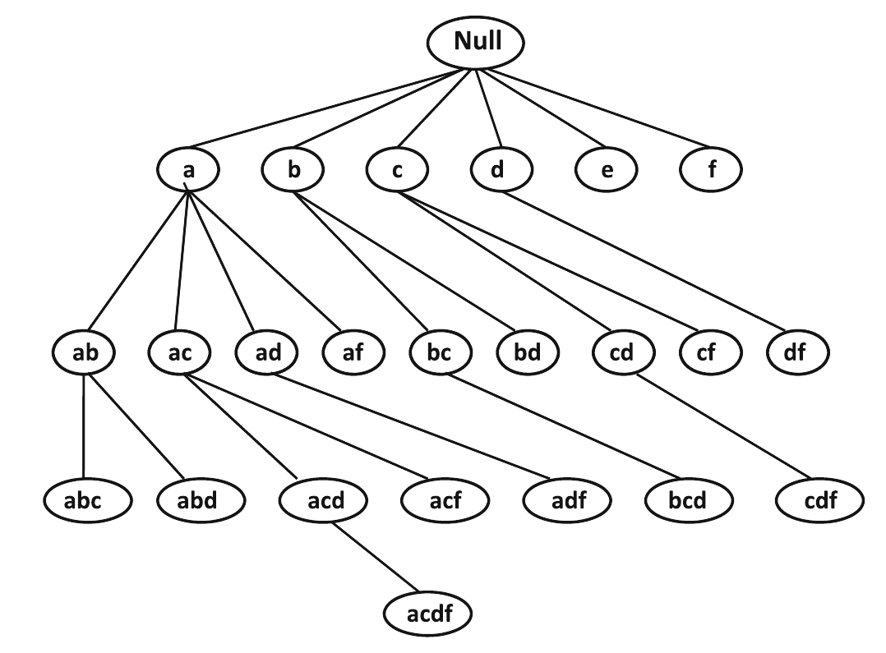
Example
Note that, unlike the lattice, a parent can only be extended with an item that is lexicographically larger

Slide 34
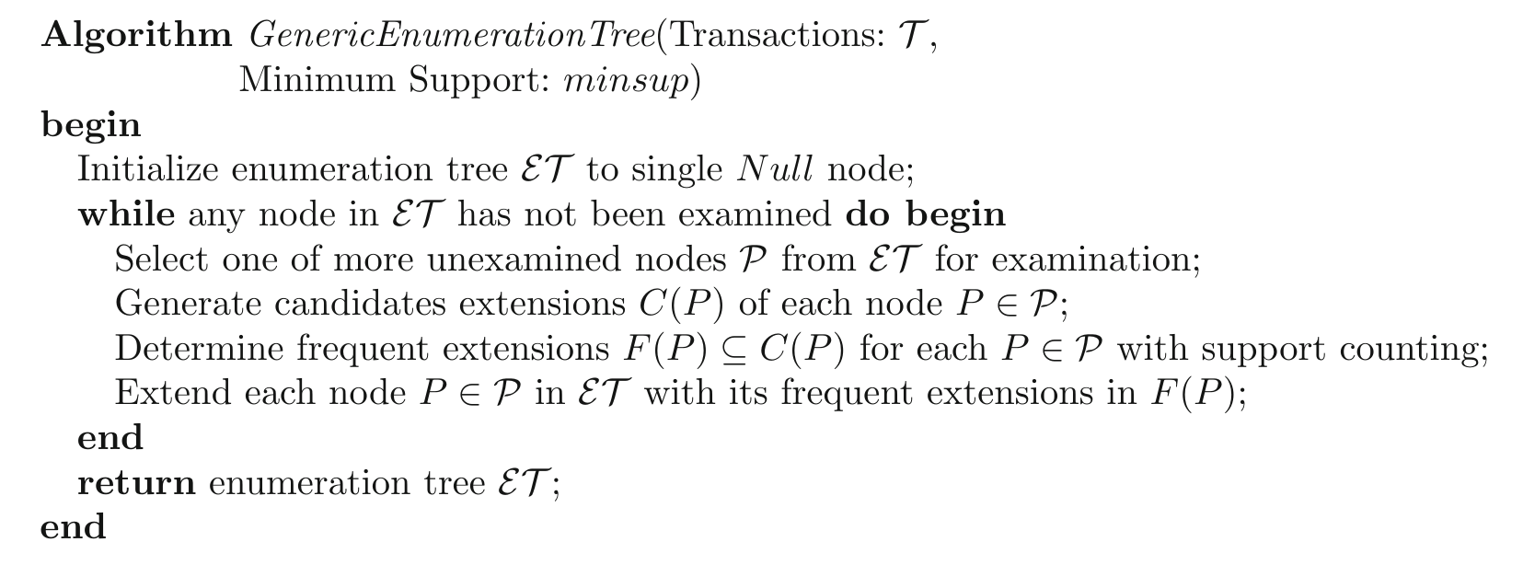
Enumeration tree algorithm

Slide 35
Enumeration-tree-based implementation of Apriori
Apriori constructs the enumeration tree in a breadth-first manner
Apriori generates candidate (k+1)-itemsets by merging two frequent k-itemsets of which the first k-1 items are the same ⇒ extension in the enumeration-tree

