Slide 1

Interaction-Based
Recommender Systems
Mining Massive Datasets
Prof. Carlos Castillo
Topic 17

Slide 2
Sources
Data Mining, The Textbook (2015) by Charu Aggarwal (Section 18.5) – slides by Lijun Zhang
Mining of Massive Datasets 2nd edition (2014) by Leskovec et al. (Chapter 9) - slides A, B

Slide 3
Interaction-based recommendations

Slide 4
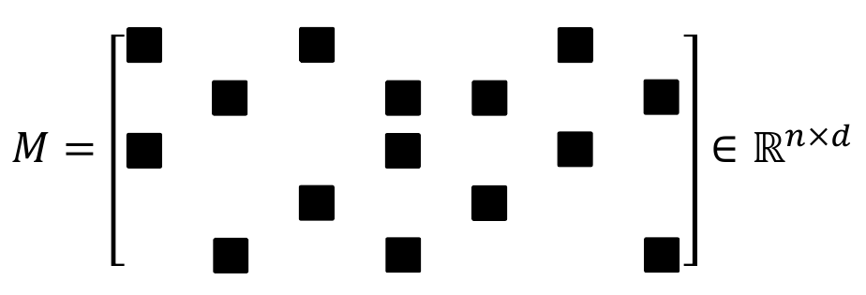
Missing-value estimation/completion
The matrix is extremely large and sparse
Only black squares have non-zero values.

Slide 5
Types of algorithms
Neighborhood-Based Methods
  User-Based or Item-Based Similarity with Ratings
Graph-Based Methods
Clustering Methods
  Adapting k-Means Clustering or Adapting Co-Clustering
Latent Factor Models
  Matrix Factorization, e.g., Singular Value Decomposition

Slide 6
User-based similarity with ratings
Let Iu,v be common ratings between two users
Similarity: Pearson correlation coefficient
Note: averages are taken over all elements, not only ones in common

Slide 7
User-based similarity with ratings (cont.)
Score of recommendation
Note: for efficiency one can take only the most similar users

Slide 8
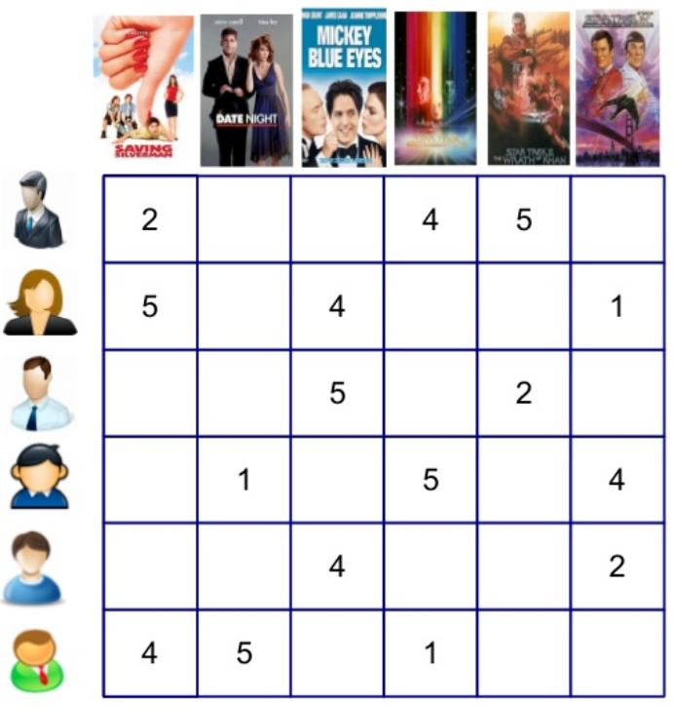
Exercise
Answer in
Google Spreadsheet
In the spreadsheet, complete all yellow cells:
The computation of sim(u,v)
The rating of all the movies that user u has not seen yet
Which movie is recommended?
u
Exercise from ML for Recommender Systems tutorial by Alex Karatzoglou, 2015.

Slide 9
Answer
avg(v)
sim(u,v)
3.67
NULL
3.33
0.87
3.50
1.00
3.33
-1.00
u
3.51
3.81
2.42
2.48
3.00
3.33
NULL
Exercise from ML for Recommender Systems tutorial by Alex Karatzoglou, 2015.

Slide 10
You can do the same with items!
Item-based similarities with ratings
Item-based recommendations

Slide 11
(Do it at home)
Compute avg(j) for all items
Compute sim(i,j) for all items for which there is some intersection with i
Compute score(u,i) for all users who have not seen i yet
i
Exercise from ML for Recommender Systems tutorial by Alex Karatzoglou, 2015.

Slide 12
i
2.94
2.48
1.12
avg(j) 3.66 3 4.33 3.33 3.5 2.33
sim(i,j) -1 -1 0.86 1 NULL
Exercise from ML for Recommender Systems tutorial by Alex Karatzoglou, 2015.

Slide 13
Note
There are many ways of computing user-based similarity and item-based similarity
There are many ways of using these to generate recommendations
The method we have described is aware of the bias of users, in the sense of some users being more positive/negative than others in general

Slide 14
Graph- and clustering-based methods

Slide 15
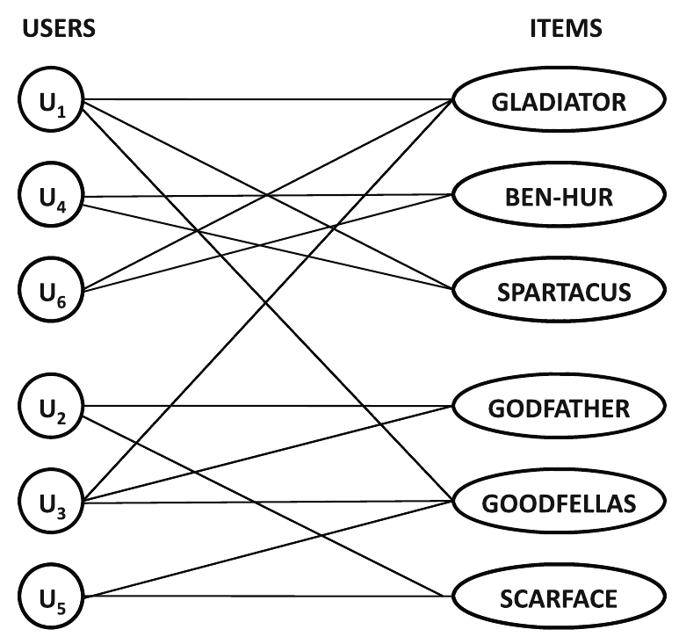
Graph-based methods
Bipartite user-item graph with nodes Nu U Ni
Nu users
Nu items
Non-zero utility ⇒ edge

Slide 16
Graph-based methods (cont.)
Use graph-based methods
  Random walk with restart to a user or item
  SimRank
Low “random jump” probability might favor popular items

Slide 17
Graph-based methods (cont.)
Signed networks can be used
  Remember we must interpret ratings with respect to user and item averages
  Below average rating ⇒ -
  Above average rating ⇒ +
Positive link prediction problem

Slide 18
Clustering methods
Motivations
  Reduce computational cost
  To some extent address data sparsity
Results of clustering
  Clusters of users for user-user similarity recs.
  Clusters of items for item-item similarity recs.

Slide 19
Clustering methods (cont.)
User-user recommendation approach
  Cluster users into groups
  For any user u, compute average normalized rating for each item i the user has not seen
  Report these ratings for (u,i)
Same with item-item recommendations
Neighborhoods will be smaller

Slide 20
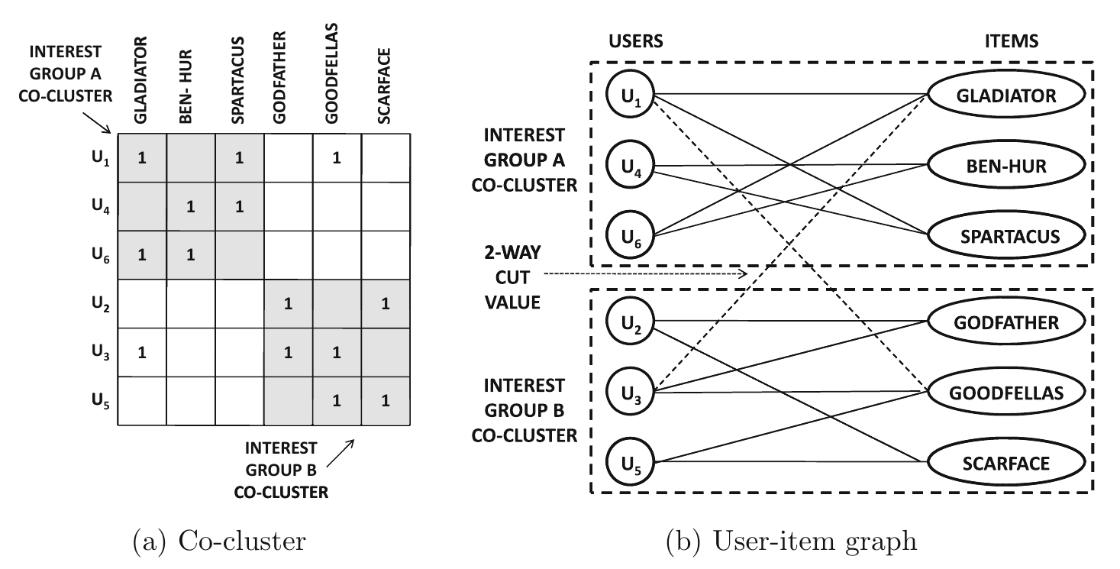
Co-Clustering Approach

Slide 21
Summary

Slide 22
Things to remember
Interaction-based recommendations
  User-based
  Item-based

Slide 23
Exercises for TT16-TT18
Mining of Massive Datasets 2nd edition (2014) by Leskovec et al. Note that some exercises cover advanced concepts:
  Exercises 9.2.8
  Exercises 9.3.4
  Exercises 9.4.6

