Slide 1

Similarity:
Beyond Numerical Data
Mining Massive Datasets
Prof. Carlos Castillo
Topic 07

Slide 2
Main Sources
Data Mining, The Textbook (2015) by Charu Aggarwal (Chapter 3) + slides by Lijun Zhang
Data Mining Concepts and Techniques, 3rd edition (2011) by Han et al. (Section 2.4)
Introduction to Data Mining 2nd edition (2019) by Tan et al. (Chapter 2)
Mining of Massive Datasets 2nd edition (2014) by Leskovec et al. (Chapter 3)

Slide 3
Categorical and mixed data

Slide 4
Simple similarity for categorical data
Given
Compute similarity as
Simple coordinate-wise similarity

Slide 5
Weighing feature values by how rare they are
Compute similarity as
Inverse occurrence frequency
p_{i}(z) is the probability that feature i takes value z
Goodall measure

Slide 6
Mixture of quantitative and categorical data
Given
Where c denotes the subset of categorical data and n the subset of numerical data
In general λ is difficult to set, and additionally we should have variables with similar variances or normalize by variance

Slide 7
Binary and set data

Slide 8
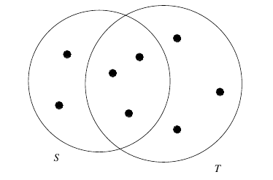
Jaccard coefficient
Example: J(S,T) = 3/8

Slide 9
Binary variables can be set as set inclusion variables
If X=(x₁, …, x_{d}) is such that x_{i} = 1, this can be seen as element X belonging to set i
Alternatively, X can be seen as S_{X} the set of all variables i such that x_{i} = 1
Extended Jaccard coefficient (Tanimoto)

Slide 10
Exercise
Answer in Nearpod open-ended question
Code to be given in class
Compute Tanimoto and Jaccard* coefficient between:
  (0, 2, 1, 0, 3)
  (1, 2, 0, 0, 0)
* For the Jaccard coefficient, binarize the vectors

Slide 11
Answer
Compute Tanimoto and Jaccard coefficient between:
  (0, 2, 1, 0, 3)
  (1, 2, 0, 0, 0)
Tanimoto: 4/(14+5-4) = 4/15 ≃ 0.2666
Jaccard: 1/4 = 0.25

Slide 12
Similarity != Distance
When using Jaccard:
  The similarity between an object and itself is 1.0
  The distance between an object and itself is 0.0
Hence:
  Jaccard similarity = Jaccard_coefficient
  Jaccard distance = 1 - Jaccard_coefficient

Slide 13
Text data

Slide 14
Text documents as vectors:
L_{p} norms
As Quantitative Multidimensional Data
  Bag of words model
  They are very sparse
  L_{p} norm does not work well
  Long documents have long distance
Dimensionality Reduction (A Possible Solution)
  Latent Semantic Analysis (equivalent to SVD)
  L_{p} norm in the new space

Slide 15
Text documents as vectors: angles
What we care about is the relative frequency of terms
Freq. of term 2
X
Y
θ
Freq. of term 1
However, some terms are very common and others are very rare …

Slide 16
Text documents as vectors: tf-idf weighting (idf)
Skipped in 2021
  Global inverse document frequency of term t
  Where n_{t} is the number of documents where term t appears, n is the total number of documents
Typical variation (in Okapi BM25):

Slide 17
Text documents as vectors: tf-idf weighting (tf)
Skipped in 2021
tf(x_{i})
  Frequency in a document of term x_{i}
  Log frequency, square root of frequency, or similar to reduce the impact of terms of very high frequency

Slide 18
Text documents as vectors: tf-idf weighting (cont.)
Skipped in 2021
h(x_{i}) = tf(x_{i}) x idf(x_{i})
Or Tanimoto-like:

Slide 19
Continuous time series data
Skipped in 2021

Slide 20
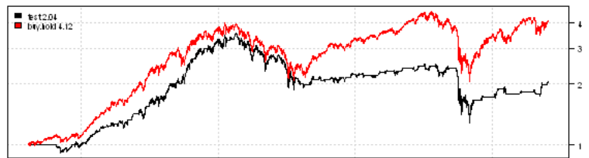
Misalignment between series
Skipped in 2021
Behavioral attributes
  Scaling (range is larger or narrower)
  Translation (series is shifted up or down)
Contextual attribute (typically, time)
  Scaling (time is stretched or compressed)
  Translation or shift (starting time changes)
Matches might not be contiguous (noisy segments)

Slide 21
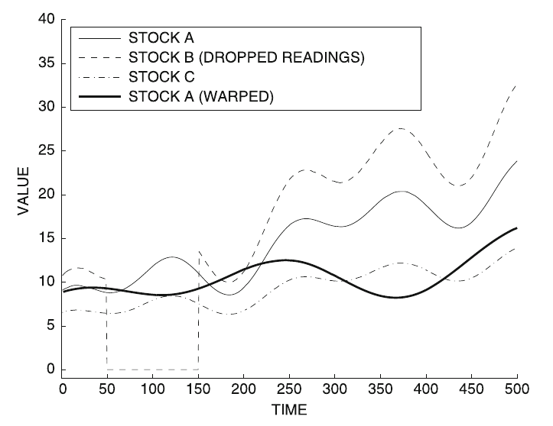
Example of scaling, translation, noise
Skipped in 2021
More on this
later in the course,
in the
sequence mining topic
Data Mining, The Textbook (2015) by Charu Aggarwal (Chapter 3). Warping means stretching or compressing time.

Slide 22
Discrete sequence data
Skipped in 2021

Slide 23
Discrete sequences can be treated as strings
Skipped in 2021
Compute edit distance
Compute longest common sub-sequence
In genetic sequences, use
PAM (Point Accepted Mutation) matrices
  Indicate rarity (cost) of replacement

Slide 24
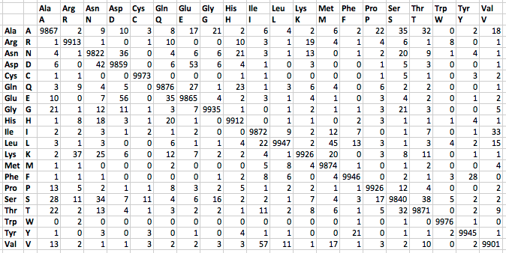
Example PAM matrix
Skipped in 2021

Slide 25
Graph data
Skipped in 2021

Slide 26
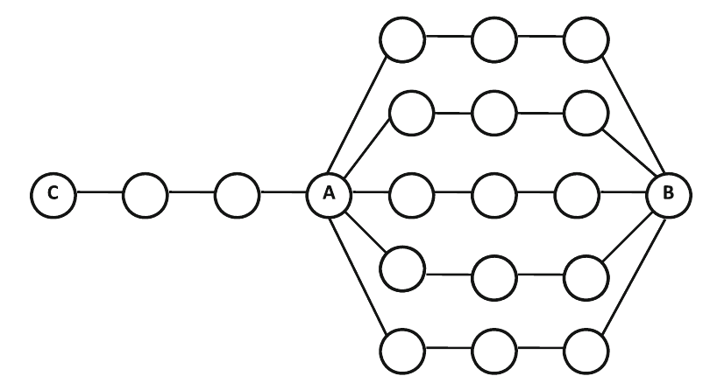
Distance/similarity in graph data
Skipped in 2021
Comparing A-B and A-C?
  A-B should be closer
  A-C should be closer
  Both should be equal

Slide 27
Distance/similarity in graph data
Skipped in 2021
Distance-Based Measure
  Shortest-path on the graph
  Dijkstra algorithm
Random Walk-Based Similarity
  (e.g. personalized PageRank)
  Accounts for multiplicity in paths during similarity computation
Under random walk similarity, A-B are closer than A-C

Slide 28
Supervised similarity functions

Slide 29
Learning a distance function through supervised ML
Suppose you have data from experts, annotators, or user feedback:
Learn a distance f(O_{i}, O_{j}, θ): UxU → [0,1]

Slide 30
Summary

Slide 31
Things to remember
For similarity/distance computation, there are different solutions for different data types

Slide 32
Exercises for this topic
Data Mining, The Textbook (2015) by Charu Aggarwal
  Exercises 3.9 on similarity measures
Introduction to Data Mining 2nd edition (2019) by Tan et al.
  Exercises 2.6 → 14-28
Mining of Massive Datasets 2nd edition (2014) by Leskovec et al.
  Exercises 3.5.7 on distance measures
Data Mining Concepts and Techniques, 3rd ed. (2011) by Han et al.
  Exercises 2.6 → 2.5-2.8

