Slide 1

Data Streams:
Introduction
Mining Massive Datasets
Prof. Carlos Castillo — https://chato.cl/teach

Slide 2
Sources
Mining of Massive Datasets (2014) by Leskovec et al. (chapter 4)
  Slides part 1, part 2
Tutorial: Mining Massive Data Streams (2019) by Michael Hahsler

Slide 3
What is a data stream?
A potentially infinite sequence of data points
  Each data point can be a tuple or vector
Examples:
  web click-stream data → who clicks on what
  computer network monitoring data
  telecommunication connection data
  readings from sensor nets
  stock quotes
Do not confuse with “streaming,” which typically means watching a video while it is being downloaded.

Slide 4
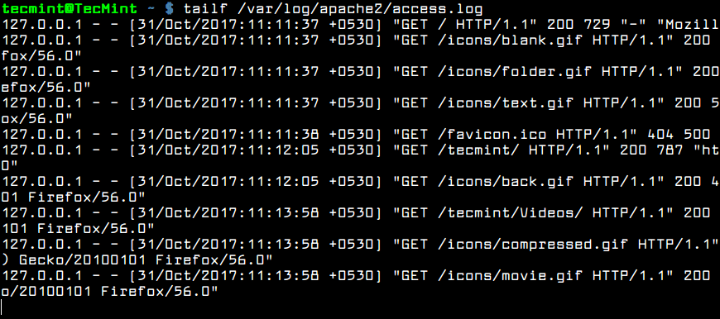
Example: web server log

Slide 5

Key properties of data streams
Unbounded size
  Data cannot be persisted on disk
  Only summaries can be stored
Transient
  Single pass over the data
  Sometimes real-time processing is needed
Dynamic
  May require incremental updates
  May require to forget old data
  Concepts “drift”
Temporal order is often important

Slide 6
Applications
Mining query streams
  A search engine wants to know what queries are more frequent today than yesterday
Mining click streams
  A newspaper wants to know when one of its pages starts getting an unusual number of hits per hour
Mining social network news feeds
  A social media platform wants to show trending topics

Slide 7
Applications (cont.)
Sensor Networks
  Many sensors feeding into a central controller
Telephone call records
  Data feeds into customer bills as well as settlements between telephone companies
IP packets monitored at a switch
  Gather information for optimal routing
  Detect denial-of-service attacks

Slide 8
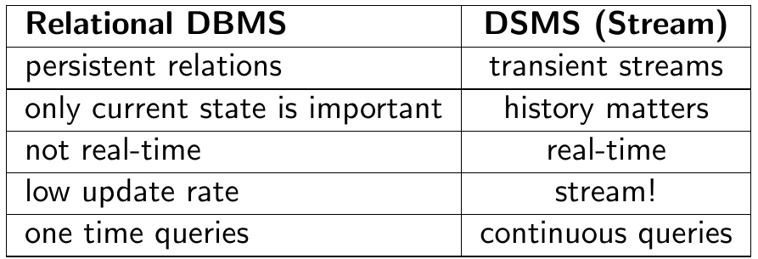
Why not simply use a relational DB?
Brian Babcock, Shivnath Babu, Mayur Datar, Rajeev Motwani, and Jennifer Widom (2002). Models and issues in data stream systems. In PODS ’02, pages 1–16, ACM Press.

Slide 9
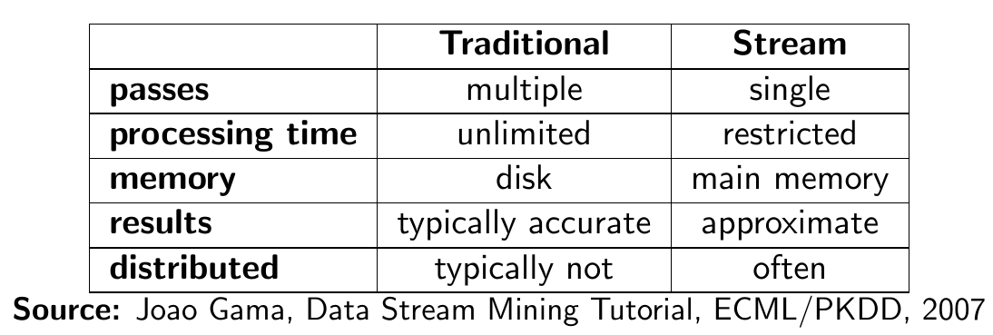
Why do we need new algorithms?

Slide 10
A generic stream-processing architecture
Ad-Hoc
Queries
Processor
. . . 1, 5, 2, 7, 0, 9, 3
. . . a, r, v, t, y, h, b
. . . 0, 0, 1, 0, 1, 1, 0
time
Standing
Queries
Output
Input streams
Each is stream is
composed of
elements/tuples
Limited
Working
Storage
Archival
Storage
J. Leskovec, A. Rajaraman, J. Ullman: Mining of Massive Datasets, http://www.mmds.org/

Slide 11
Load shedding

Slide 12
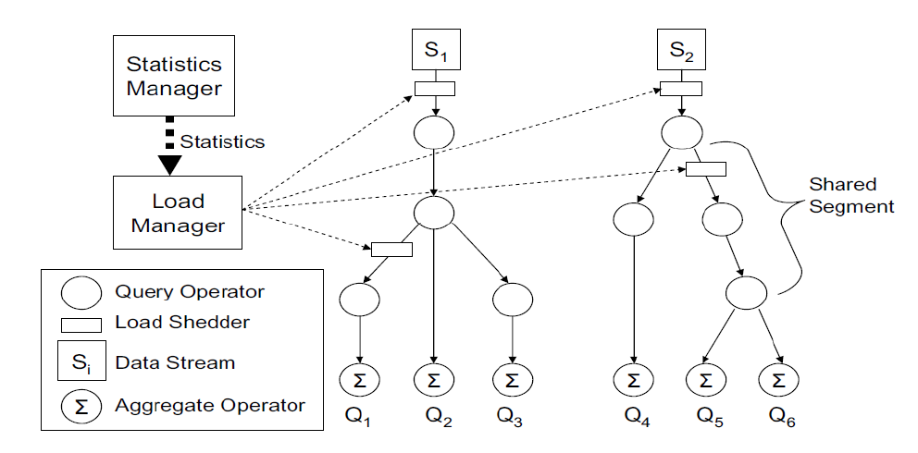
Too much data? Ignore some of it
Brian Babcock, Mayur Datar, and Rajeev Motwani. Load shedding techniques for data stream systems. In Proc. MPDS, 2003.

Slide 13
Sampling a fixed proportion

Slide 14
Sampling a fixed proportion
Example stream: <user, query, timestamp>
from a search engine query log
Suppose we have space to store 1/r of the stream
  E.g.: 1/10th, 1/100th, 1/1000th,
Naïve solution:
  Generate uniform random number in 0...(r-1)
    numpy.random.uniform(0,r)
  If the number is 0, keep the item

Slide 15
What can we do with this sample?
Approximate most frequent query
  Pick the most frequent in the sample
Approximate frequency of a query
  Multiply observed frequency by r
Do people ask query q?
  Approximate answer (with some prob. of error)

Slide 16
Exercise: sampling at a fixed rate
We want to tell if we have seen item q
Suppose we have seen n items
Suppose we have sampled a fraction 1/r
Suppose item q appears with probability p(q)
Can we observe a ...
  False Positive? (Item q was not in the stream but we said it was)
  False Negative? (Item q was in the stream but we said it was not)

Slide 17
Answer
We want to tell if we have seen item q
Suppose we have seen n items
Suppose we have sampled a fraction 1/r
Suppose item q appears with probability p(q)
Can we observe a ...
  False Positive? NO. We cannot observe an item that is not.
  False Negative? YES. We can miss an item that is there.

Slide 18
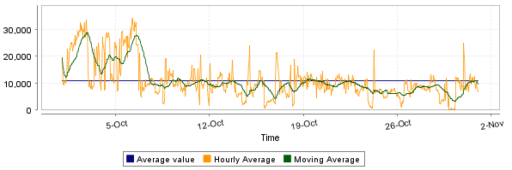
What can we do with this…? (cont.)
Approximate num. queries per minute
Peak frequency
  Multiply observed peak by r
https://steemit.com/steemsql/@arcange/steemsql-update-14-infrastructure-upgraded-for-better-performances

Slide 19
There are questions we cannot answer with this sampling method
What fraction of queries by an average search engine user are duplicates?
  Suppose each user issues x queries once and d queries twice (total of x+2d queries)
  Correct answer: d/(x+d)
Proposed solution: We keep 1/10th of the queries (r=10)
  Sample will contain x/10 of the singleton queries at least once
  Sample will contain 2d/10 of the duplicate queries at least once
  Sample will contain d/100 pairs of duplicates
    d/100 = 1/10 ∙ 1/10 ∙ d
  Of the d duplicates, 18d/100 will be seen once*
    18d/100 = ((1/10 ∙ 9/10)+(9/10 ∙ 1/10)) ∙ d
So the sample-based answer is
* Copy A is in the selected part, copy B in the unselected part, or viceversa

Slide 20
There are questions we cannot answer with this sampling method (cont.)
What fraction of queries by an average search engine user are duplicates?
  Suppose each user issues x queries once and d queries twice (total of x+2d queries)
  Correct answer: d/(x+d)
Proposed solution: We keep 1/10th of the queries (r=10)
  Sample will contain x/10 of the singleton queries at least once
  Sample will contain 2d/10 of the duplicate queries at least once
  Sample will contain d/100 pairs of duplicates
    d/100 = 1/10 ∙ 1/10 ∙ d
  Of the d duplicates, 18d/100 will be seen once*
    18d/100 = ((1/10 ∙ 9/10)+(9/10 ∙ 1/10)) ∙ d
So the sample-based answer is
Observed duplicates
WRONG!
Observed singletons
Observed duplicates

Slide 21
Sampling tuples at random by one attribute
Suppose we need to sample 1/r of users and all of their actions
<user1, action, timestamp>
<user2, action, timestamp>
<user2, action, timestamp>
<user3, action, timestamp>
<user1, action, timestamp>
<user3, action, timestamp>
<user2, action, timestamp>
<user1, action, timestamp>
<user2, action, timestamp>
...
How do we do this?

Slide 22
How do we solve it?
<user1, action, timestamp>
<user2, action, timestamp>
<user2, action, timestamp>
<user3, action, timestamp>
<user1, action, timestamp>
<user3, action, timestamp>
<user2, action, timestamp>
<user1, action, timestamp>
<user2, action, timestamp>
...
We need to sample 1/r of users
and all of their actions
How do we do this?
  Hashing!
  Given <user, action, timestamp>
  Compute h(user) → 0, 1, …, (r-1)
  Keep tuple if hash value is 0

Slide 23
In general ...
To sample a fraction a/b of a stream by key
Compute h(key) → 0, 1, …, (b-1)
Keep if h(key) < a
0
1
...
b-1
a

Slide 24
Summary

Slide 25
Things to remember
What is a data stream
How to sample a fixed percentage of values grouped by a key, using hashing

Slide 26
Exercises for TT22-T26
Mining of Massive Datasets (2014) by Leskovec et al.
  Exercises 4.2.5
  Exercises 4.3.4
  Exercises 4.4.5
  Exercises 4.5.6

