Slide 1

Similarity:
Numerical Data
Mining Massive Datasets
Carlos Castillo
Topic 06

Slide 2
Main Sources
Data Mining, The Textbook (2015) by Charu Aggarwal (Chapter 3) + slides by Lijun Zhang
Data Mining Concepts and Techniques, 3rd edition (2011) by Han et al. (Section 2.4)
Introduction to Data Mining 2nd edition (2019) by Tan et al. (Chapter 2)
Mining of Massive Datasets 2nd edition (2014) by Leskovec et al. (Chapter 3)

Slide 3
Example: scene completion
Mining of Massive Datasets 2nd edition (2014) by Leskovec et al. (Chapter 3)

Slide 4


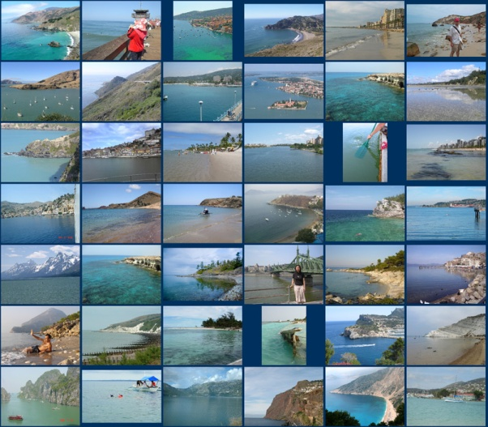

Scene completion problem
[Hays and Efros, SIGGRAPH 2007]

Slide 5

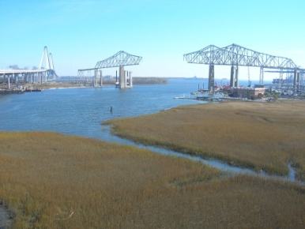
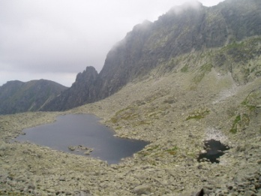

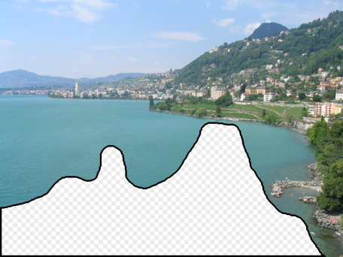
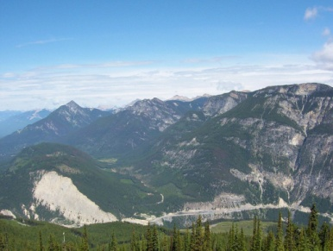
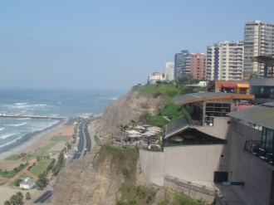
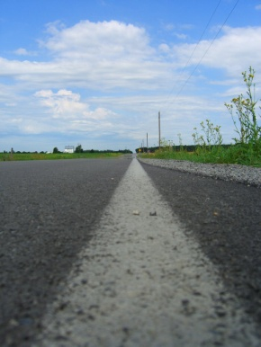
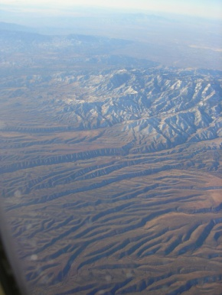

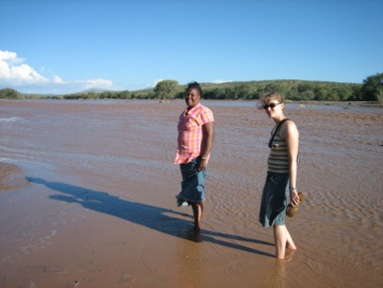
10 closest items in a collection of 20K images

Slide 6
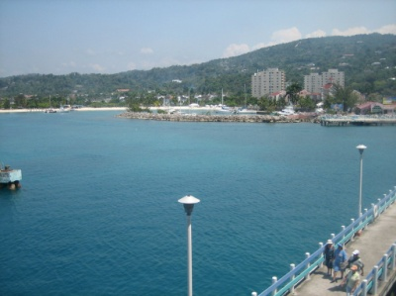

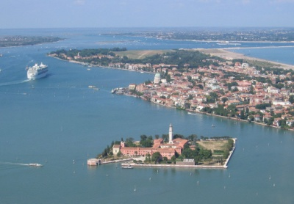





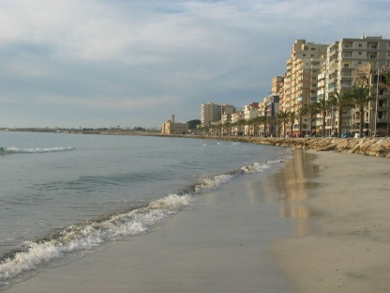

10 closest items in a collection of 2M images

Slide 7
Computing similarity

Slide 8
Computing similarity is important
Many problems can be expressed as finding “similar” sets:
  Find near-neighbors in high-dimensional space
Examples:
  Pages with similar words
    For duplicate detection or for classification by topic
  Customers who purchased similar products
    Products with similar customer sets
  Images with similar features
  Users who visited similar websites

Slide 9
Similarity computation task
Given two objects u and v, determine the value of:
  similarity(u,v) and distance(u,v)
  (Often one is defined in terms of the other)
Similar objects should have
large similarity and small distance
Dissimilar objects should have
small similarity and large distance
Closed-form functions (e.g., euclidean distance) or algorithm

Slide 10
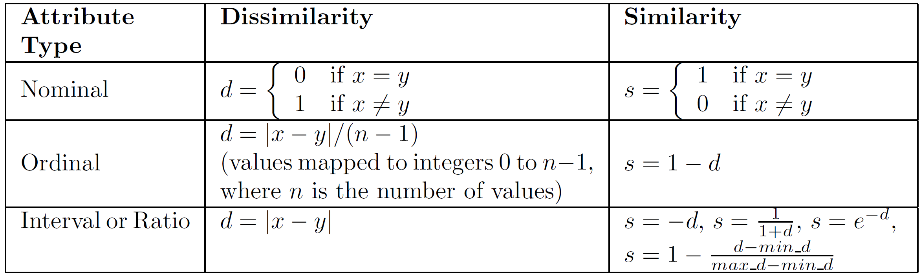
Simple single-attribute similarity
Introduction to Data Mining 2nd edition (2019) by Tan et al. (Chapter 2)

Slide 11
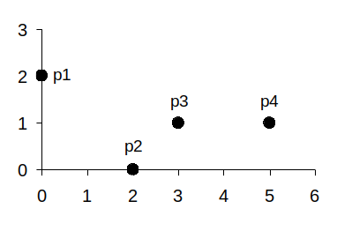


Euclidean distance: L₂ norm
Introduction to Data Mining 2nd edition (2019) by Tan et al. (Chapter 2)

Slide 13
L_{p} norm, p ≥ 1
p=1 : Manhattan norm
  Sum of absolute values
p=2: Euclidean norm
  Square root of sum of squares
  Rotation-invariant
p=∞ : Infinity norm
  Largest absolute value

Slide 14
Exercise: compute Lp distance
Given vectors
  u = (22, 1, 42, 10)
  v = (20, 0, 36, 8)
Compute:
  L₁ distance
  L₂ distance
  L∞ distance
Answer in Nearpod Collaborate
Code to be given in class

Slide 15

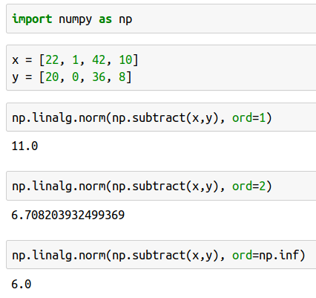
Answer
Compute L₁, L₂, L∞
norm between:
  (22, 1, 42, 10)
  (20, 0, 36, 8)

Slide 16
Generalized L_{p} norm, p ≥ 1
Useful when some
features are more
important than others
E.g., in credit scoring,
salary is more important than gender
a_{i} are domain-specific non-negative coefficients

Slide 17
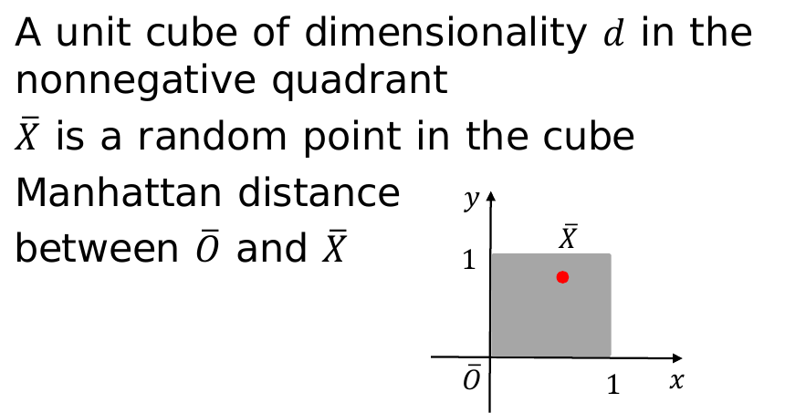
When the dimensionality is high, all points are at similar L_{p} distances from each other
Example:

Slide 18
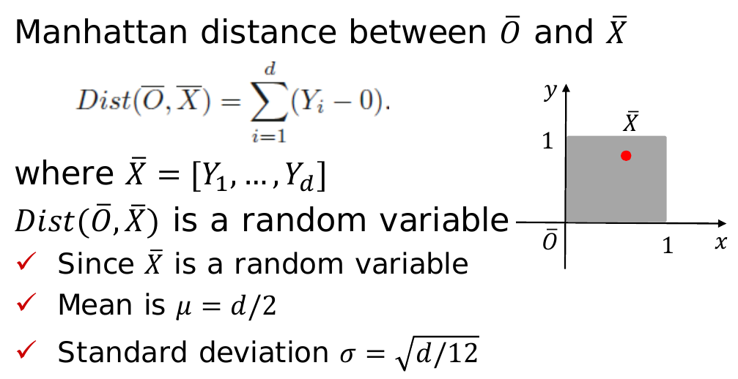
Example (cont.):

Slide 19
Applying Chebyshev’s inequality:

Slide 20
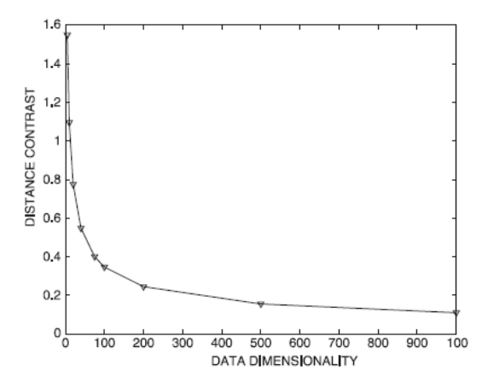
Applying Chebyshev’s inequality:

Slide 21
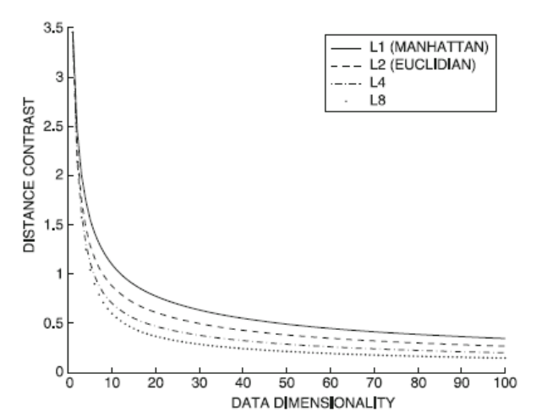
Irrelevant features
Many features are probably irrelevant for your purposes, specially
in high-dimensional data
L_{p} norm suffers from irrelevant features
Contrast worsens
for large p

Slide 22
Match-based similarity
Idea: to compute similarity(u,v) ignore dimensions in which they are “too far apart”
Discretize each dimension into k_{d} equi-depth buckets
For two objects u, v, determine the dimensions in which they map to the same bucket
Compute L_{p} norm on those dimensions only

Slide 23
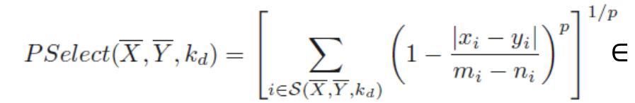
Match-based similarity (cont.)
S(X, Y, k_{d}) is the set of features for which
X and Y map to the same bucket
m_{i}, n_{i} are the max and min value of that bucket
k_{d} ∝ d achieves a constant level of contrast in high dimensions for certain data distributions

Slide 24
Distances and orientation

Slide 25
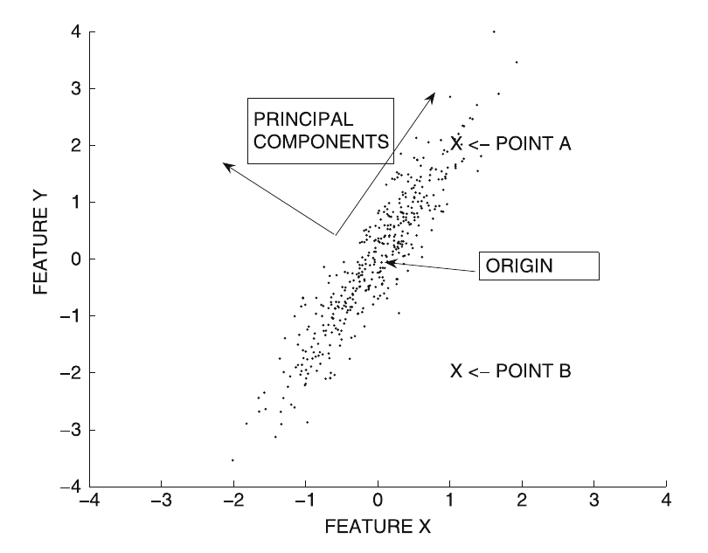
Useful distances, in general, depend on data distributions
Points A and B are equidistant from the origin
However, point A should be considered closer to the origin than point B (think of a perfectly circular cloud of points)

Slide 26
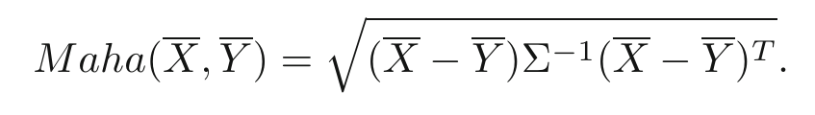
Useful distances, in general, depend on data distributions (cont.)
The Mahalanobis distance, with Σ covariance matrix
is equivalent to applying PCA, dividing each coordinate by the standard deviation of that feature, and computing Euclidean distance

Slide 27
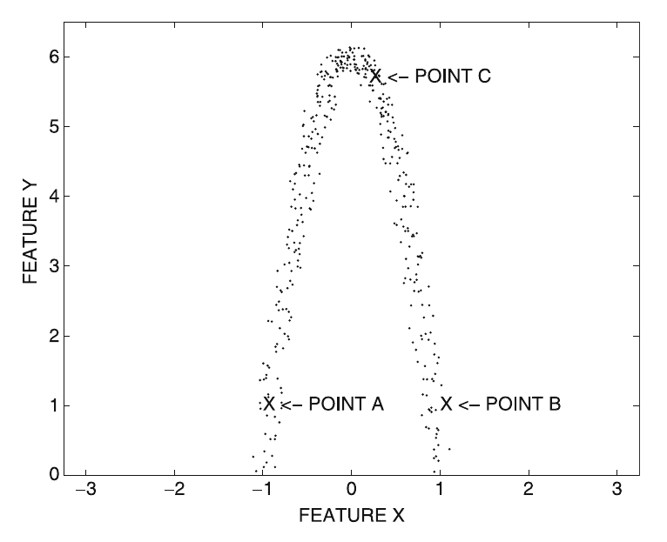
Non-linear distributions
Which point would you consider as closer to A?
(Blackboard collaborate poll)

Slide 28
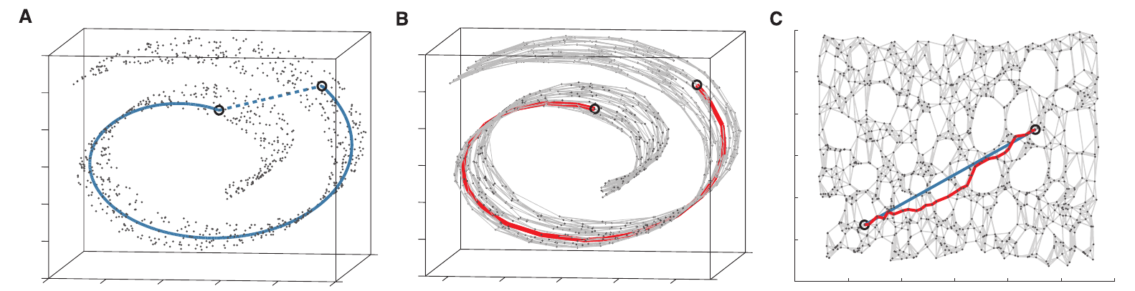
ISOMAP (general idea)
Original data Nearest neighbors graph Graph projection
Tenenbaum, Joshua B., Vin De Silva, and John C. Langford. "A global geometric framework for nonlinear dimensionality reduction." Science 2000.

Slide 29
ISOMAP (1/3)
The first step is to connect each point to its k nearest neighbors (here k=7)
Tenenbaum, Joshua B., Vin De Silva, and John C. Langford. "A global geometric framework for nonlinear dimensionality reduction." Science 2000.

Slide 30
ISOMAP (2/3)
Now, shortest path or geodesic distances can be computed on the graph
(red color)
Tenenbaum, Joshua B., Vin De Silva, and John C. Langford. "A global geometric framework for nonlinear dimensionality reduction." Science 2000.

Slide 31
ISOMAP (3/3)
It is, however, more effective to project the graph and compute Euclidean distances in the projected graph (blue color)
Tenenbaum, Joshua B., Vin De Silva, and John C. Langford. "A global geometric framework for nonlinear dimensionality reduction." Science 2000.

Slide 32
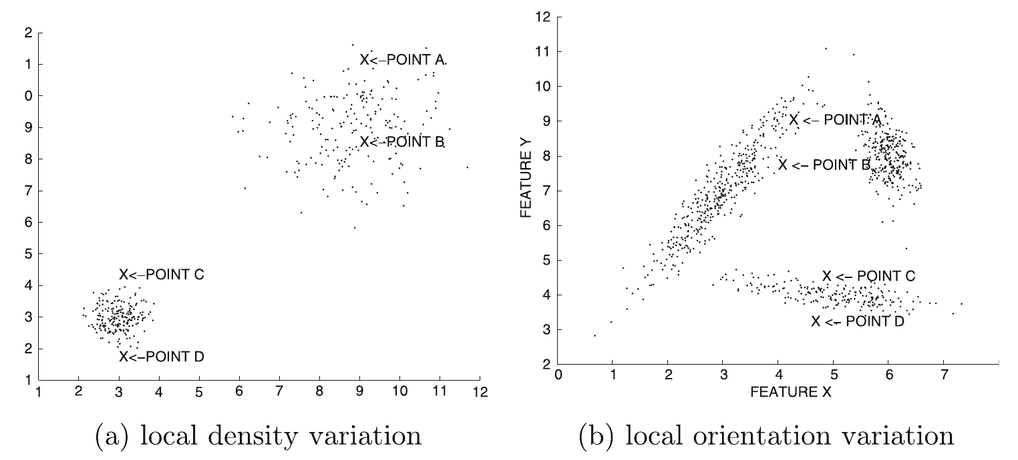
Local variations
Which distance should be larger? A-B or C-D?
Which distance should be larger? A-B or C-D?
(Blackboard collaborate poll)

Slide 33
(Answer: in both cases
C-D should be larger than A-B)

Slide 34
Solution for local variations
Partition the data into a set of local regions
  (Nontrivial, which distance to use?)
For any pair of objects, determine the most relevant region for the pair
If they belong to the same region
  Compute the pairwise distances using the local statistics of that region
  E.g., local Mahalanobis distance
If they belong to different regions
  Global statistics or averaged statistics

Slide 35
Summary

Slide 36
Things to remember
Distance/similarity is a key component of many data mining algorithms
Sensitive to dimensionality, global/local nature of data distribution

Slide 37
Exercises for TT06-TT07
Data Mining, The Textbook (2015) by Charu Aggarwal
  Exercises 3.9 on similarity measures
Introduction to Data Mining 2nd edition (2019) by Tan et al.
  Exercises 2.6 → 14-28
Mining of Massive Datasets 2nd edition (2014) by Leskovec et al.
  Exercises 3.5.7 on distance measures
Data Mining Concepts and Techniques, 3rd ed. (2011) by Han et al.
  Exercises 2.6 → 2.5-2.8

