Slide 1

Data Preparation:
Data Types
Mining Massive Datasets
Prof. Carlos Castillo
Topic 03

Slide 2
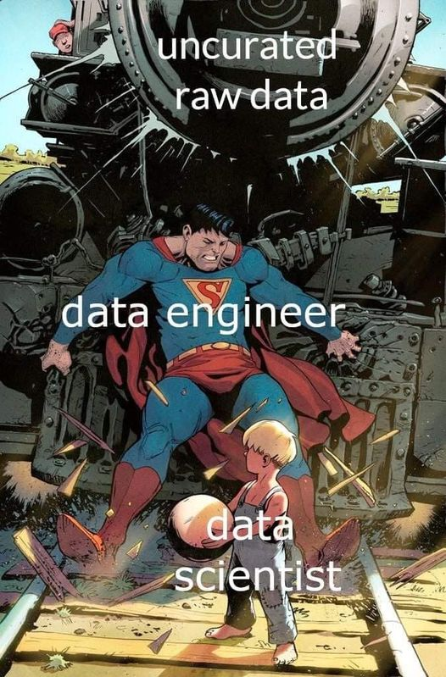

Slide 3
Main Sources
Data Mining, The Textbook (2015) by Charu Aggarwal (Chapter 2) + slides by Lijun Zhang
Introduction to Data Mining 2nd edition (2019) by Tan et al. (Chapter 2)
Data Mining Concepts and Techniques, 3rd edition (2011) by Han et al. (Chapter 3)

Slide 4

Success depends upon previous preparation, and without such preparation there is sure to be failure – Confucius

Slide 5
Typical datasets
Records / Matrices
Documents
Transactions
Graphs
Temporal / Sequences
Spatial

Slide 6
Data preparation
Feature Extraction and Portability
  Extract relevant elements for our analysis
  Convert heterogeneous data types
Data Cleaning
  Deal with missing, erroneous, and inconsistent data
Data Integration
  Bring different data sources into a common framework
Data Reduction, Selection, and Transformation
  Done for both efficiency and effectiveness

Slide 7
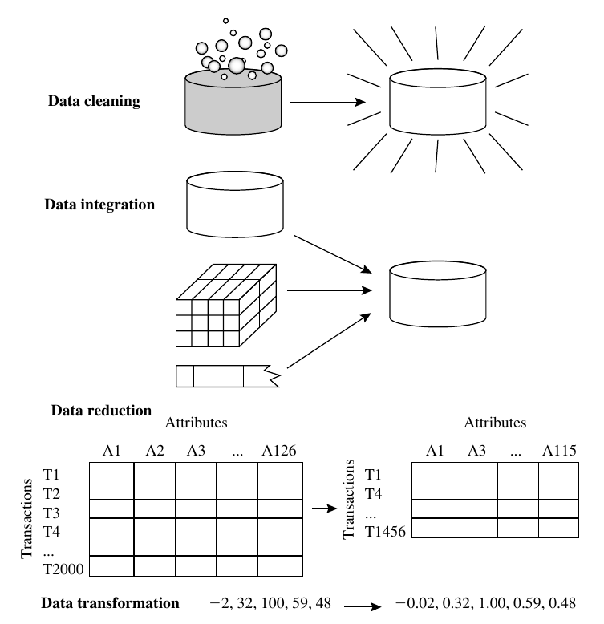
Data Mining Concepts and Techniques, 3rd edition (2011) by Han et al. (page 87)

Slide 8
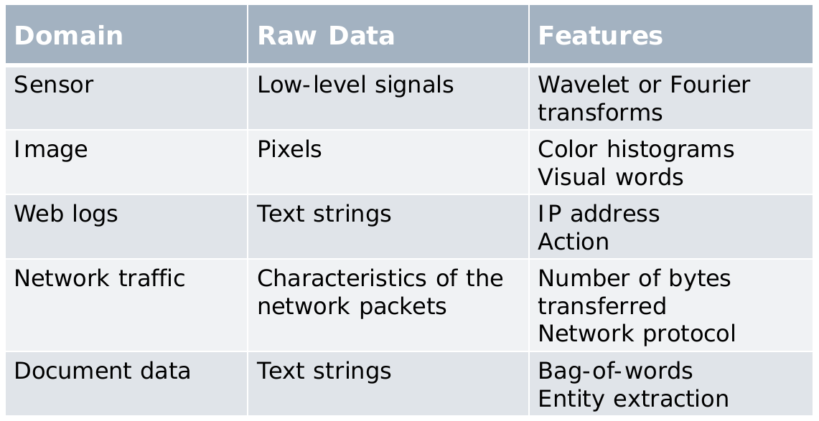
Feature extraction examples
This is both a skill and an art that the analyst develops over the years.

Slide 9
Data type conversions

Slide 10
Data type conversions
Data is often heterogeneous
  A demographic data set may contain both numeric and mixed attributes
Possible solution
  Designing an algorithm for an arbitrary combination of data types
    Time-consuming and sometimes impractical
Converting between various data types
  Using off-the-shelf tools for processing

Slide 11
Data type conversions (cont.)
Some ways of converting between data types
Source data type | Destination data type | Methods
Numeric | Categorical | Discretization
Categorical | Numeric | Binarization
Text | Numeric | Latent Semantic Analysis (LSA)
Time series | Discrete sequence | Symbolic Aggregate Approximation (SAX)
Time series | Numeric multidimensional | Discrete Wavelet Transform (DWT), Discrete Fourier Transform (DFT)
Discrete sequence | Numeric multidimensional
Spatial | Numeric multidimensional | 2-d DWT
Graphs | Numeric multidimensional | Multidimensional Scaling (MDS), spectral
Any type | Graphs | Similarity graph (restricted applicability)

Slide 12
Numerical Categorical

Slide 13
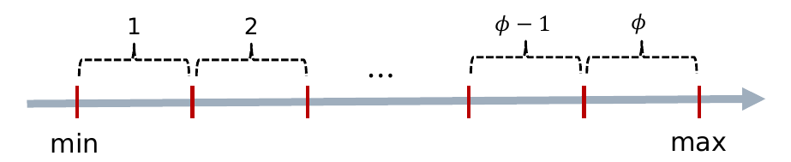
Numerical to categorical: discretization
Divide the range for the numerical variable into Φ different ranges

Slide 14
Numerical to categorical: discretization (cont.)
Equi-width ranges (l_{i} – r_{i} is constant)
Equi-log ranges (log r_{i} – log l_{i} is constant)
Equi-depth ranges (num. items in [l_{i}, r_{i}] constant)

Slide 15
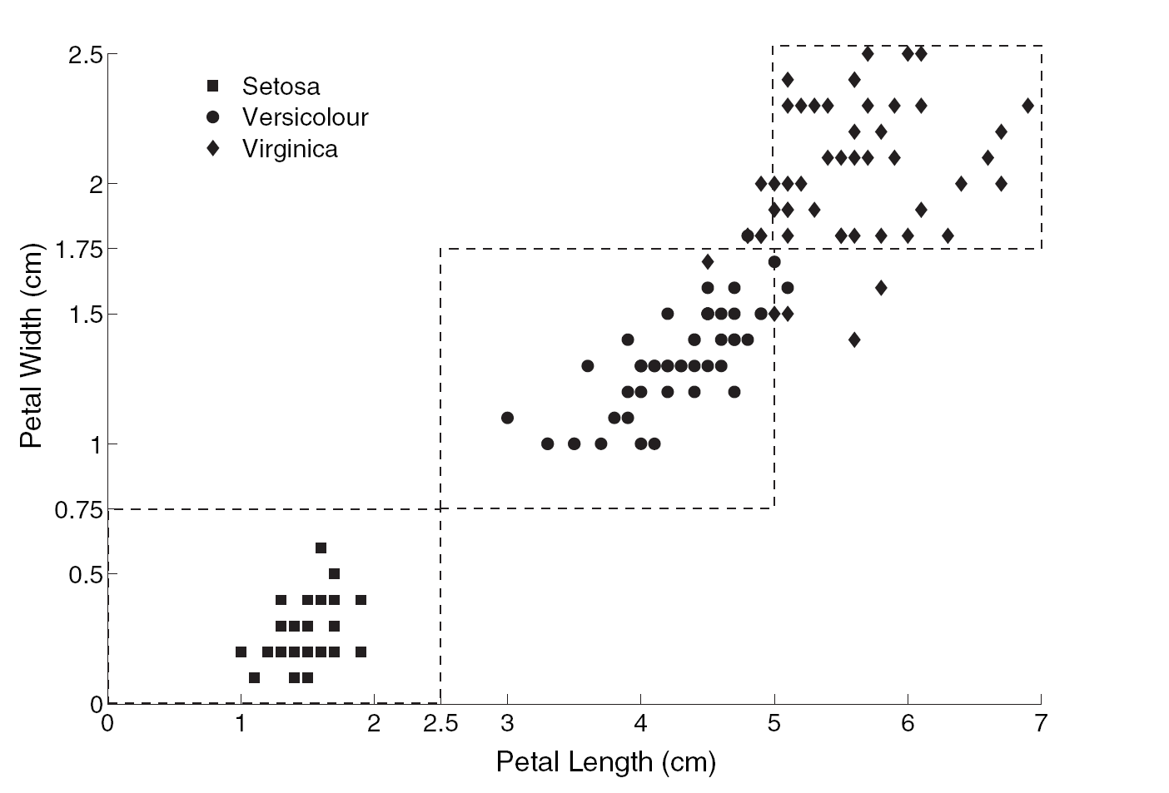

Example discretization in IRIS dataset
Continuous variables are converted to three possible values per feature: small, medium, large

Slide 16
Exercise
Answer in
Google Spreadsheet
(Link in Aula Global)
Person | Salary
a | 34,000
b | 49,000
c | 53,000
d | 54,000
e | 32,000
f | 44,000
g | 41,000
h | 37,000
i | 48,000
Given this database
Create two categorical (ordinal) attributes
  Salary bin (equi width) with salary binned into equi-width categories
  Salary bin (equi depth) with salary binned into equi-depth categories
Values: low, medium, high

Slide 17
Answer
Person | Salary | Salary_EW | Salary_ED
a | 34,000 | low | low
b | 49,000 | medium | high
c | 53,000 | high | high
d | 54,000 | high | high
e | 32,000 | low | low
f | 44,000 | medium | medium
g | 41,000 | medium | medium
h | 37,000 | low | low
i | 48,000 | medium | medium
In the equi-width, each bin goes from a × 10,000 to (a+1) × 10,000
In the equi-depth, each bin has 3 elements.

Slide 18
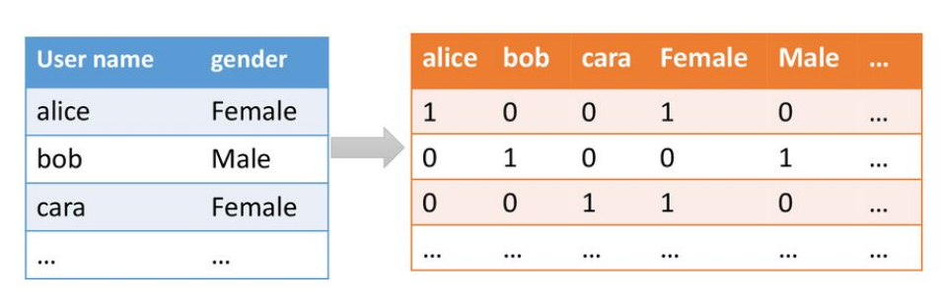
Categorical to numerical: binarization (one-hot encoding)
One categorical value with K categories
⇒ indicator vector with K binary variables
https://slideplayer.com/slide/14461691/

Slide 19
Series and sequences

Slide 20
Time series to discrete sequence
Symbolic aggregate approximation (SAX)
  Window-based averaging
    Evaluate the average value in each window
  Value-based discretization
    Discretize the average value by equi-depth intervals
How to ensure equi-depth without seeing the entire series?
  Assume certain distribution, such as Gaussian
  Estimate the distribution

Slide 21
Time series to numeric data
Discrete Wavelet Transform (DWT)
Discrete Fourier transform (DFT)
(Seen elsewhere, e.g., signal processing)

Slide 22
Discrete sequence to numeric
Discrete sequence to a set of (binary) time series
  ACACACTGTGACTG (4 Symbols)
  10101000001000 (A)
  01010100000100 (C)
  00000010100010 (T)
  00000001010001 (G)
Map each of these time series into a multidimensional vector
Features from the different series are combined

Slide 23
Graphs Numerical

Slide 24
Convert any data type to a graph
Determine distance d(u,v) between all pairs of elements (u,v)
All elements with d(u,v)≤θ are connected

Slide 25
Graphs to numerical
Graph embeddings
  Each node is converted into a point in a low-dimensional space
  Nearby nodes in the low-dimensional space are connected by short paths in the graph
We might see more on this on the
spectral graph clustering topic,
possibly (if we get to that topic)

Slide 26
Summary

Slide 27
Things to remember
Converting across data types

Slide 28
Exercises for TT03-TT05
Exercises 3.7 of Data Mining Concepts and Techniques, 3rd edition (2011) by Han et al.
Exercises 2.6 of Introduction to Data Mining, Second Edition (2019) by Tan et al.
  Mostly the first exercises, say 1-6

