Slide 1

Similarity
Mining Massive Datasets
Carlos Castillo
Topic 03

Slide 2
Main Sources
Data Mining, The Textbook (2015) by Charu Aggarwal (Chapter 3) + slides by Lijun Zhang
Data Mining Concepts and Techniques, 3rd edition (2011) by Han et al. (Section 2.4)
Introduction to Data Mining 2nd edition (2019) by Tan et al. (Chapter 2)
Mining of Massive Datasets 2nd edition (2014) by Leskovec et al. (Chapter 3)

Slide 3
Similarity computation task
Given two objects u and v, determine the value of:
  similarity(u,v) and distance(u,v)
  (Often one is defined in terms of the other)
Similar objects should have
large similarity and small distance
Dissimilar objects should have
small similarity and large distance
Closed-form functions (e.g., euclidean distance) or algorithm

Slide 4
Multi-dimensional data

Slide 5
L_{p} norm, p ≥ 1
p=1 : Manhattan norm
  Sum of absolute values
p=2: Euclidean norm
  Square root of sum of squares
  Rotation-invariant
p=∞ : Infinity norm
  Largest absolute value

Slide 6
Generalized L_{p} norm, p ≥ 1
Useful when some
features are more
important than others
E.g., in credit scoring,
salary is more important than gender
a_{i} are domain-specific non-negative coefficients

Slide 7
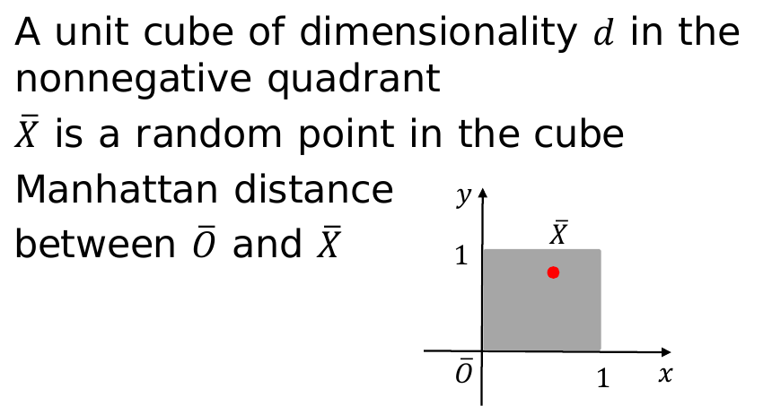
When the dimensionality is high, all points are at similar L_{p} distances from each other
Example:

Slide 8
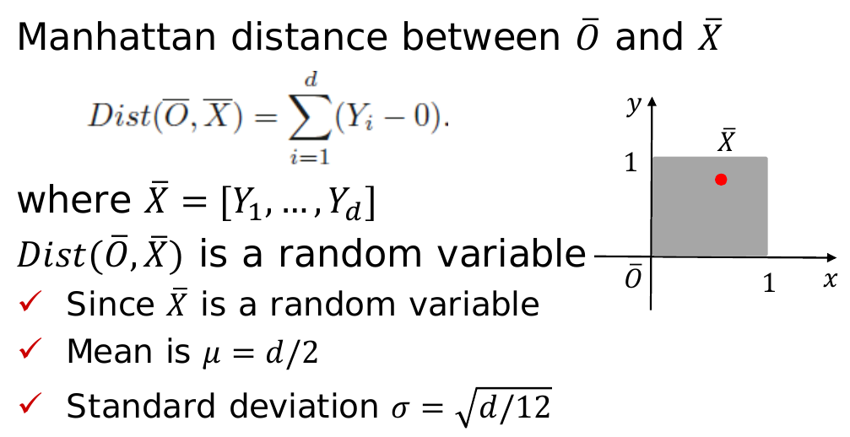
Example (cont.):

Slide 9
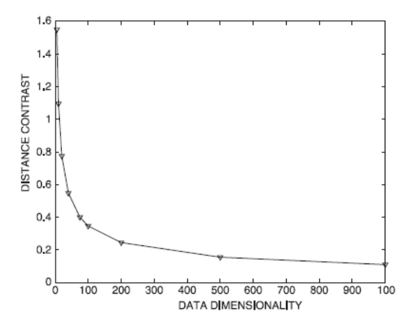
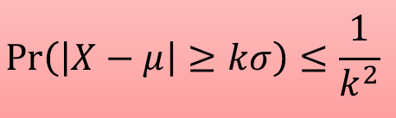
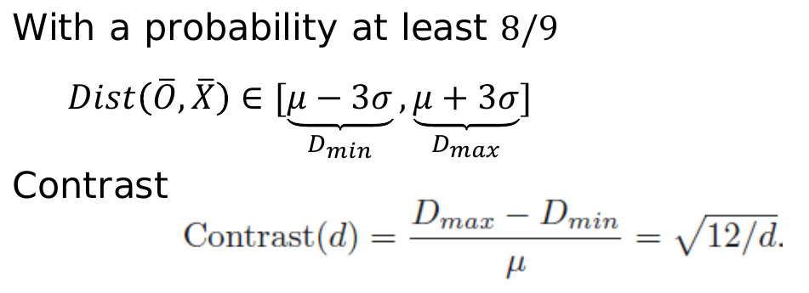
Applying Chebyshev’s
inequality

Slide 10
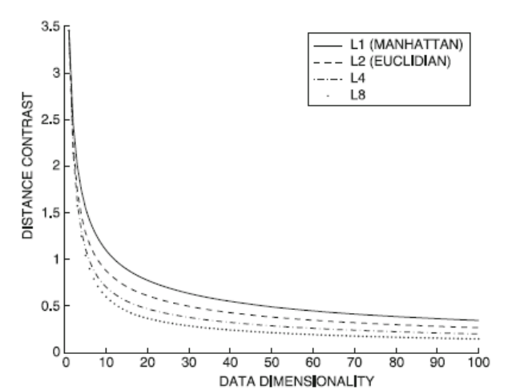
Irrelevant features
Many features are probably irrelevant for your purposes, specially
in high-dimensional data
L_{p} norm suffers from irrelevant features
Contrast worsens
for large p

Slide 11
Match-based similarity
Idea: to compute similarity(u,v) ignore dimensions in which they are “too far apart”
First, discretize each dimension into k_{d} equi-depth buckets
Second, for two objects u, v, determine the dimensions in which they map to the same bucket
Third, compute L_{p} norm on those dimensions only

Slide 12
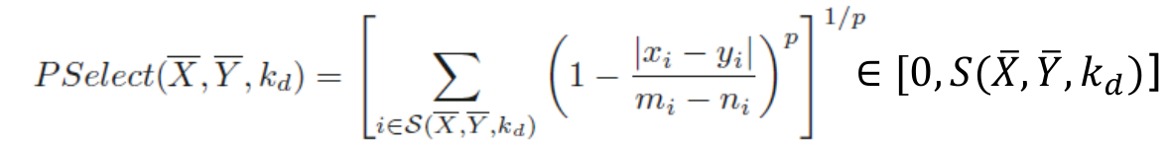
Match-based similarity (cont.)
S(X, Y, k_{d}) is the set of features for which
X and Y map to the same bucket
m_{i}, n_{i} are the max and min value of that bucket
kd propto d achieves a constant level of contrast in high dimensions for certain data distributions

Slide 13
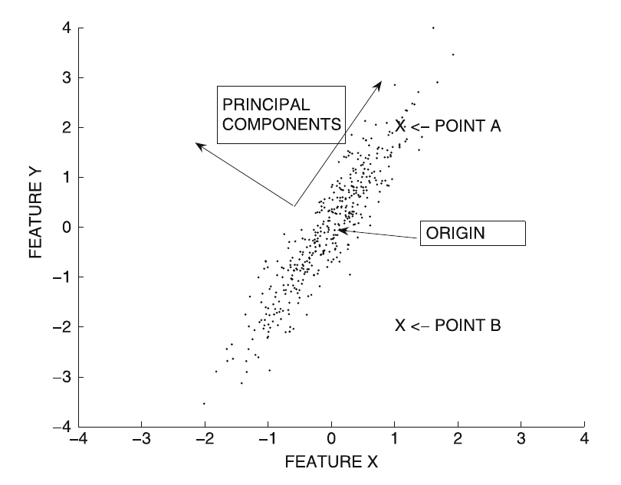
Useful distances, in general, depend on data distributions
Points A and B are equidistant from the origin
However, point A should be closer to the origin than point B (think of a perfectly circular cloud of points)

Slide 14
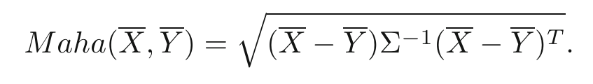
Useful distances, in general, depend on data distributions (cont.)
The Mahalanobis distance, with Σ covariance matrix
is equivalent to applying PCA, dividing each coordinate by the standard deviation of that feature, and computing Euclidean distance

Slide 15
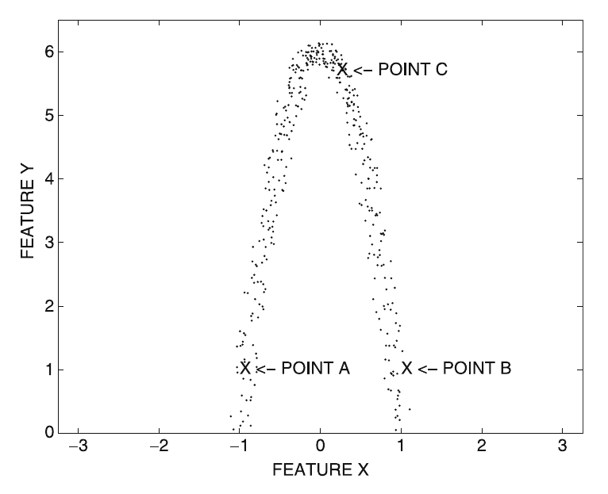
Non-linear distributions
Which point is closer to A?

Slide 16
(continue with crashed session)
ISOMAP from - A global geometric framework for nonlinear dimensionality reduction science 2000 (use their image)
Local density variations

