Slide 1

Streaming
Mining Massive Datasets
Carlos Castillo
Topic 10

Slide 2
Sources
Mining of Massive Datasets (2014) by Leskovec et al. (chapter 4) – slides part 1, part 2
Data Mining, The Textbook (2015) by Charu Aggarwal (chapter 12)
Tutorial: Mining Massive Data Streams (2019) by Michael Hahsler

Slide 3
What is a data stream?
An ordered and potentially infinite sequence of data points
  Each data point can be a tuple or vector
Examples:
  web click-stream data
  computer network monitoring data
  telecommunication connection data
  readings from sensor nets
  stock quotes

Slide 4
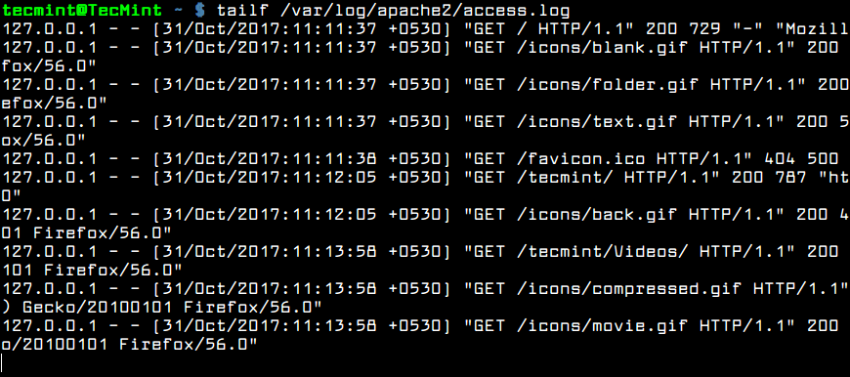
Example: Apache server log

Slide 5

Key properties of data streams
Unbounded size
  Data cannot be persisted on disk
  Only summaries can be stored
Transient
  Single pass over the data
  Real-time processing
Dynamic
  May require incremental updates
  May require to forget old data
  Concepts “drift”
Temporal order may be important

Slide 6
Applications
Mining query streams
  A search engine wants to know what queries are more frequent today than yesterday
Mining click streams
  A newspaper wants to know which of its pages are getting an unusual number of hits in the past hour
Mining social network news feeds
  A social media platform wants to show trending topics

Slide 7
Applications (cont.)
Sensor Networks
  Many sensors feeding into a central controller
Telephone call records
  Data feeds into customer bills as well as settlements between telephone companies
IP packets monitored at a switch
  Gather information for optimal routing
  Detect denial-of-service attacks

Slide 9
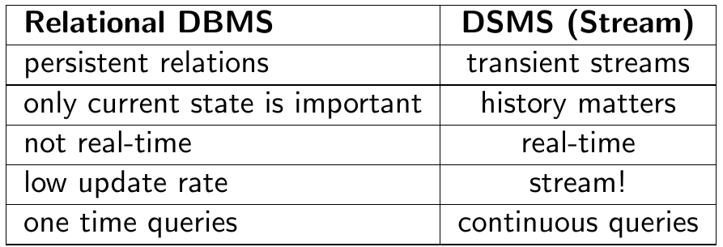
Why not use a relational DB?
Brian Babcock, Shivnath Babu, Mayur Datar, Rajeev Motwani, and Jennifer Widom (2002). Models and issues in data stream systems. In PODS ’02, pages 1–16, ACM Press.

Slide 10
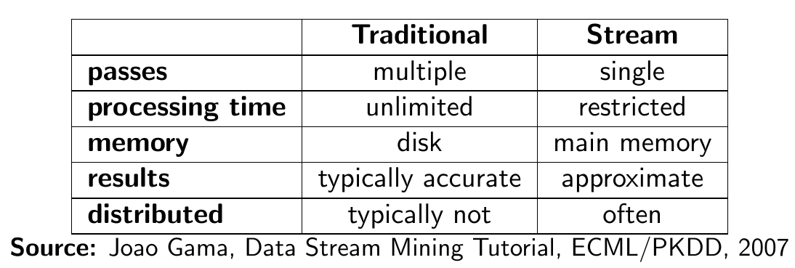
Why do we need new algorithms?

Slide 11
Generic stream-processing architecture
Ad-Hoc
Queries
Processor
. . . 1, 5, 2, 7, 0, 9, 3
. . . a, r, v, t, y, h, b
. . . 0, 0, 1, 0, 1, 1, 0
time
Streams Entering.
Each is stream is
composed of
elements/tuples
Standing
Queries
Output
Limited
Working
Storage
Archival
Storage
J. Leskovec, A. Rajaraman, J. Ullman: Mining of Massive Datasets, http://www.mmds.org/

Slide 12
Load shedding

Slide 13
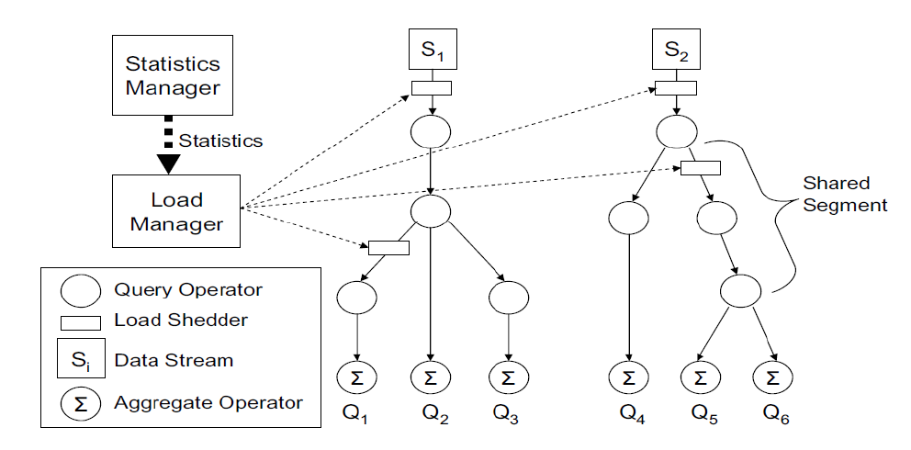
Too much data? Ignore some of it
Brian Babcock, Mayur Datar, and Rajeev Motwani. Load shedding techniques for data stream systems. In Proc. MPDS, 2003.

Slide 14
Sampling a fixed proportion

Slide 15
Sampling a fixed proportion
Example stream: <user, query, timestamp>
from a search engine query log
Suppose we have space to store 1/10th, 1/100th, 1/1000th, 1/r of the stream
Naïve solution:
  Generate uniform random number in 0...(r-1)
    numpy.random.uniform(0,r)
  If the number is 0, keep the item

Slide 16
What can we do with this sample?
Approximate most frequent query
  Pick the most frequent in the sample
Approximate frequency of a query
  Multiply observed frequency by r
Do people ask query q?
  Approximate answer (with some prob. of error)

Slide 17
Try it!
We want to tell if we have seen query q
Suppose we have seen n items
Suppose we have sampled a fraction 1/r
Suppose query q appears with probability p(q)
What is the probability of a:
  False Positive?
  False Negative?

Slide 18
Answer
We want to tell if we have seen query q
Suppose we have seen n items
Suppose we have sampled a fraction 1/r
Suppose query q appears with probability p(q)
What is the probability of a:
  False Positive? ZERO. We cannot observe a query that isn’t.
  False Negative?

Slide 19
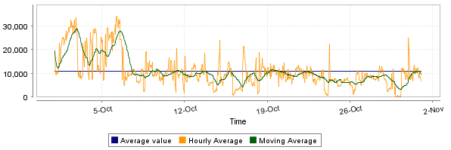
What can we do with this…? (cont.)
Approximate num. queries per minute
Peak frequency
  Multiply observed peak by r
https://steemit.com/steemsql/@arcange/steemsql-update-14-infrastructure-upgraded-for-better-performances

Slide 20
But ...
What fraction of queries by an average search engine user are duplicates?
  Suppose each user issues x queries once and d queries twice (total of x+2d queries)
  Correct answer: d/(x+d)
Proposed solution: We keep 10% of the queries (r=10)
  Sample will contain x/10 of the singleton queries and 2d/10 of the duplicate queries at least once
  But only d/100 pairs of duplicates
    d/100 = 1/10 ∙ 1/10 ∙ d
  Of d “duplicates” 18d/100 appear exactly once
    18d/100 = ((1/10 ∙ 9/10)+(9/10 ∙ 1/10)) ∙ d
So the sample-based answer is

Slide 21
But ...
What fraction of queries by an average search engine user are duplicates?
  Suppose each user issues x queries once and d queries twice (total of x+2d queries)
  Correct answer: d/(x+d)
Proposed solution: We keep 10% of the queries (r=10)
  Sample will contain x/10 of the singleton queries and 2d/10 of the duplicate queries at least once
  But only d/100 pairs of duplicates
    d/100 = 1/10 ∙ 1/10 ∙ d
  Of d “duplicates” 18d/100 appear exactly once
    18d/100 = ((1/10 ∙ 9/10)+(9/10 ∙ 1/10)) ∙ d
So the sample-based answer is
Observed duplicates
WRONG!
Observed singletons
Observed duplicates

Slide 22
How do we solve it?
We need to sample by user
We want to sample all queries by 1/r of users
How do we do this?

Slide 23
How do we solve it?
We need to sample by user
We want to sample all queries by 1/r of users
How do we do this?
  Hashing!
  Given <user, query, timestamp>
  Compute h(user) → 0, 1, …, (r-1)
  Keep tuple if hash value is 0

Slide 24
In general ...
To sample a fraction a/b of a stream by key
Compute h(key) → 0, 1, …, (b-1)
Keep if h(key) < a
0
1
...
b-1
a

Slide 25
Sampling a fixed-size sample

Slide 26
A fixed-size sample
We normally do not know the stream size
We only know how much storage we have
Suppose we have storage space s and want to maintain a random sample S of size s=|S|
Requirement: after seeing n items, each of the n items should be in our sample with probability s/n
  No item should have an advantage or disadvantage

Slide 27
Bad solutions
Suppose stream = < a, f, e, b, g, r, u, … >
Requirement: after seeing n items, each of the n items should be in our sample with probability s/n
Suppose s=2
  Sample first 2? No, because then p(a) = 1 ≠ 0 = p(e)
  Sample last 2? No, because then p(a) = 0 ≠ 1 = p(u)
Sample some … which? Then evict some … which?

Slide 28
Reservoir sampling
Elements x₁, x₂, x₃, …, x_{i}, ...
Store all first s elements x₁, x₂, …, x_{s}
Suppose element x_{n} arrives
  With probability 1- s/n, ignore this element
  With probability s/n:
    Discard a random element from the reservoir
    Insert element x_{n} into the reservoir

Slide 29
Try it!
Suppose input is <a, b, c, ...>
Suppose s = 2
We have just processed element 3 = “c”
What is:
  Probability “a” is in the sample?
  Probability “b” is in the sample?
  Probability “c” is in the sample?

Slide 30
Answer
Suppose input is <a, b, c, ...>, suppose s = 2
We have just processed element 3 = “c”
Probability “a” is in the sample?
Probability “b” is in the sample?
Probability “c” is in the sample?

Slide 31
Summary

Slide 32
Things to remember
Extreme value analysis
  Univariate, multivariate, depth based
Clustering-based methods
Distance-based methods
Density-based methods
Outlier validity

