Slide 1

K-Cores
Introduction to Network Science
Carlos Castillo
Topic 21

Slide 2
Sources
Barabási 2016 Chapter 9
Networks, Crowds, and Markets Ch 3
C. Castillo (2017) Dense Sub-Graphs
Tutorial by A. Beutel, L. Akoglu, C. Faloutsos [Link]
Frieze, Gionis, Tsourakakis: “Algorithmic techniques for modeling and mining large graphs (AMAzING)” [Tutorial]
A survey of algorithms for dense sub-graph discovery [link]

Slide 3
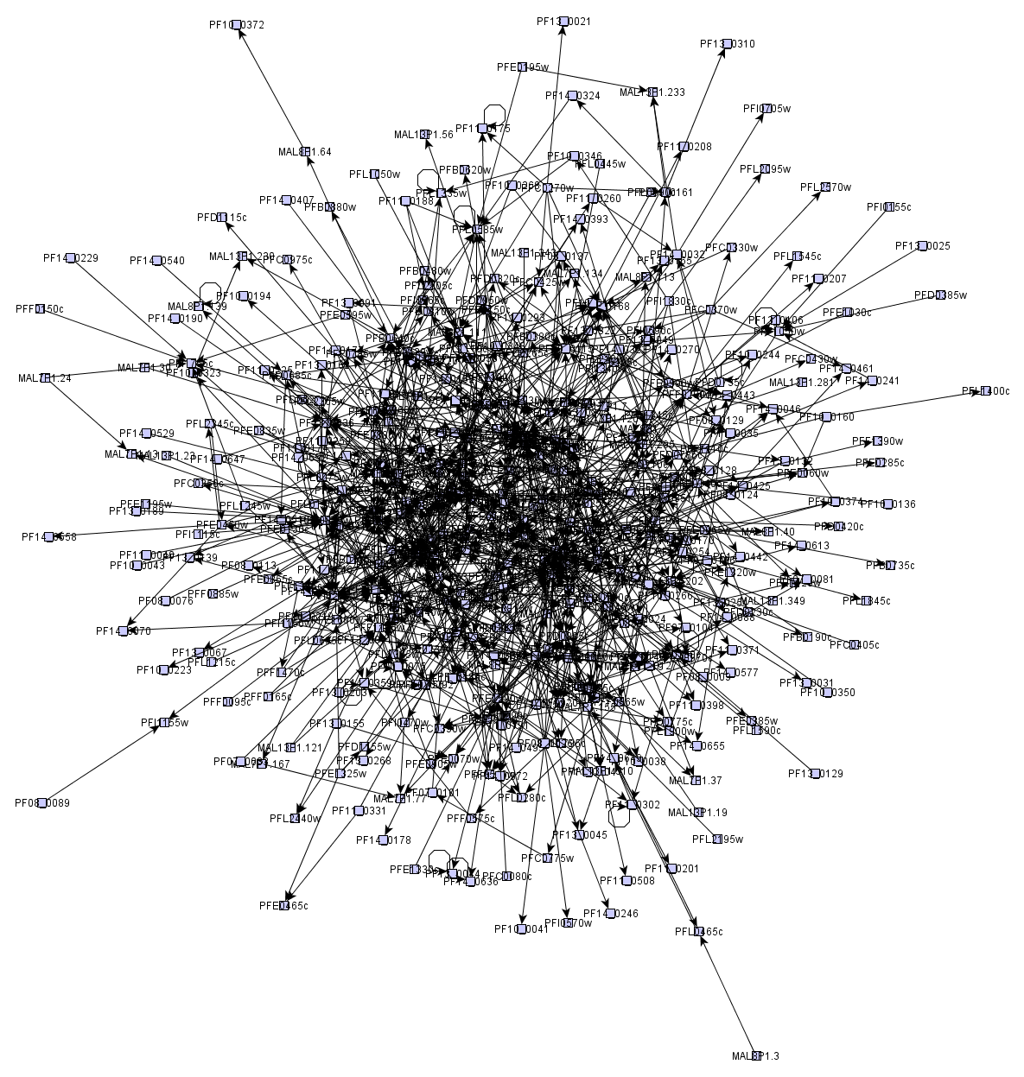
Remember: “hairballs”
Sometimes, at the center these graphs may have an interesting dense sub-graph

Slide 4
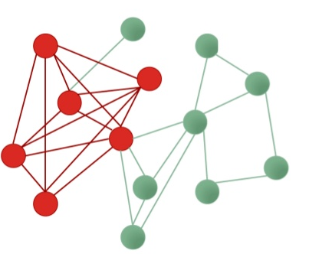
Remember: densest sub-graph
Sub-graph having the maximum density

Slide 5
k-core decomposition is a method to decompose a graph into layers

Slide 6
k-core decomposition
Remove all nodes having degree 1
  Those are in the 1-core
Remove all nodes having degree 2 in the remaining graph
  Those nodes are in the 2-core
Remove all nodes having degree 3 in the remaining graph
  Those nodes are in the 3-core
Etc.

Slide 7
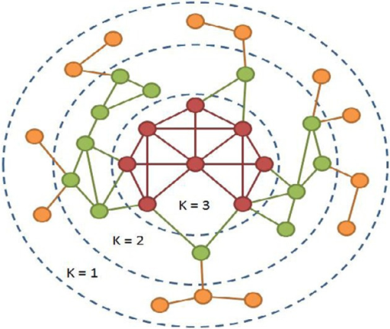
Example
https://openi.nlm.nih.gov/detailedresult.php?img=3368241_fnagi-04-00013-g0001&req=4

Slide 8
Exercise
For each node in the graph, indicate the max k-core to which it belongs
Draw in Nearpod Collaborate
https://nearpod.com/student/
Code to be given during class
http://www.cpt.univ-mrs.fr/~barrat/NHM.pdf

Slide 10
How many nodes are there in each core of this graph?
Core 1:

Slide 11
How many nodes are there in each core of this graph?
Core 1: 3 nodes

Slide 12
How many nodes are there in each core of this graph?
Core 1: 3 nodes

Slide 13
How many nodes are there in each core of this graph?
Core 1: 3 nodes

Slide 14
How many nodes are there in each core of this graph?
Core 1: 3 nodes
Core 2: 3 nodes

Slide 15
How many nodes are there in each core of this graph?
Core 1: 3 nodes
Core 2: 3 nodes

Slide 16
How many nodes are there in each core of this graph?
Core 1: 3 nodes
Core 2: 3 nodes
Core 3: 4 nodes

Slide 17
Summary

Slide 18
Things to remember
What is the k-core decomposition
How to compute it on a graph

Slide 19
Practice on your own
a
Find the 3-core of this graph
b
d
c
g
e
f
h
Solution by Vivekanand Khyade (start at 01:23)
https://youtu.be/8sNZ5d8eNC8?t=83
m

