Slide 1

Dense sub-graphs
Introduction to Network Science
Carlos Castillo
Topic 22

Slide 2
Sources
Barabási 2016 Chapter 9
Networks, Crowds, and Markets Ch 3
C. Castillo (2017) Dense Sub-Graphs
Tutorial by A. Beutel, L. Akoglu, C. Faloutsos [Link]
Frieze, Gionis, Tsourakakis: “Algorithmic techniques for modeling and mining large graphs (AMAzING)” [Tutorial]
A survey of algorithms for dense sub-graph discovery [link]

Slide 3
Density-based methods

Slide 4
Density measures
Density = Average degree =
  Sometimes just
Edge ratio =
What is ?

Slide 5
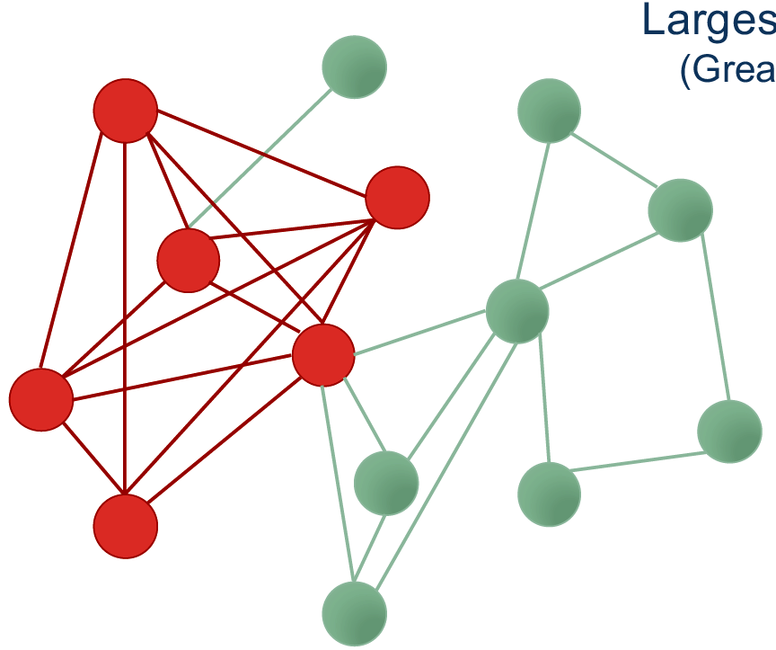
Densest sub-graph

Slide 6
Goldberg’s algorithm
(exact and deterministic)

Slide 7
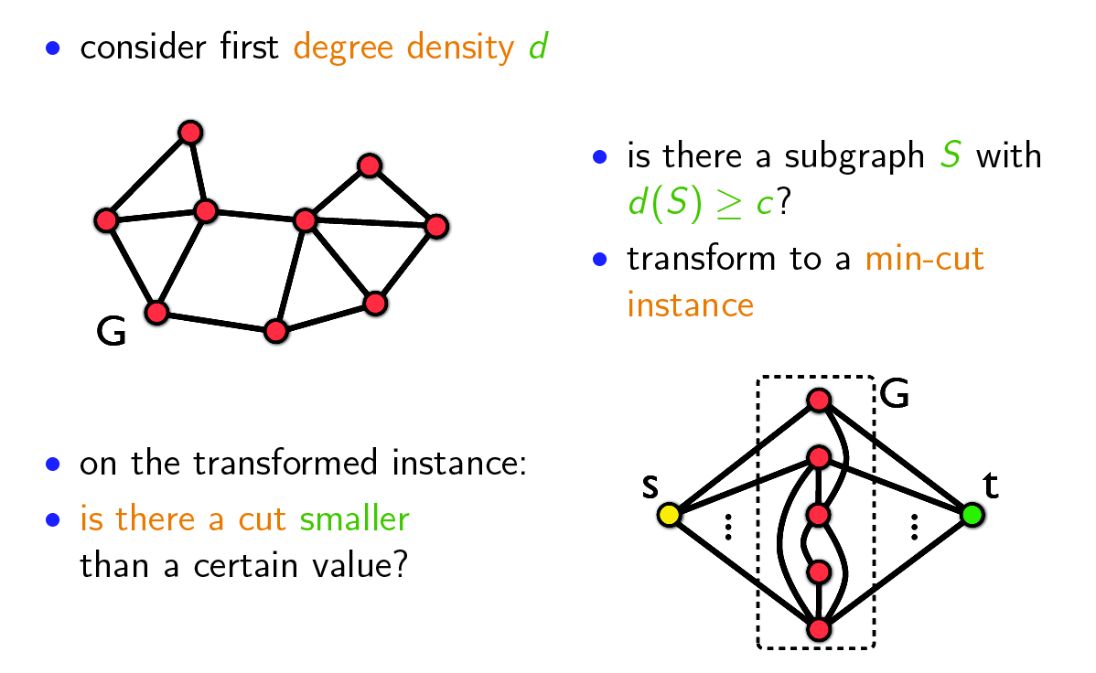
Goldberg's algorithm (1)
Slides on this section from: http://www.math.cmu.edu/~ctsourak/amazing.html

Slide 8
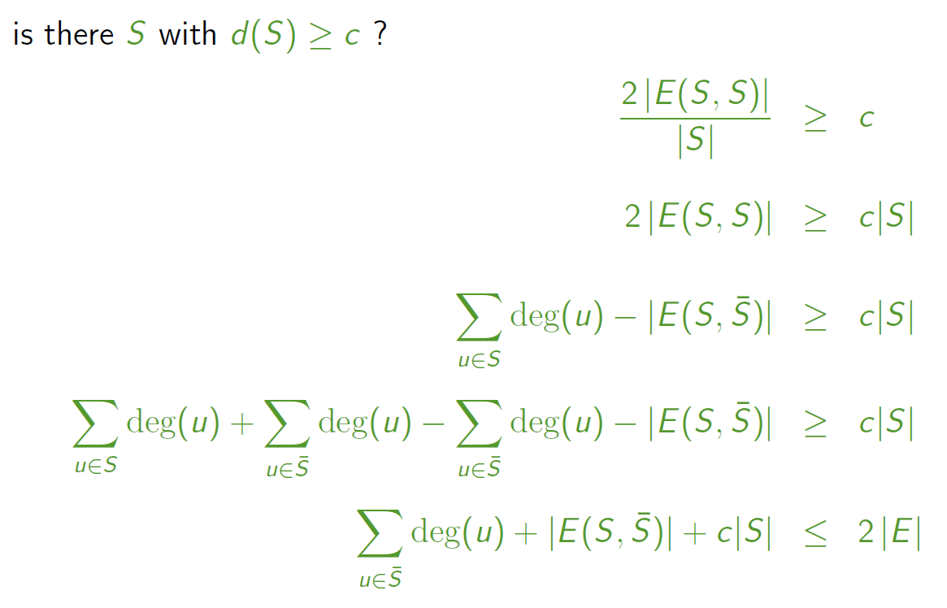
Goldberg's algorithm (2)

Slide 9
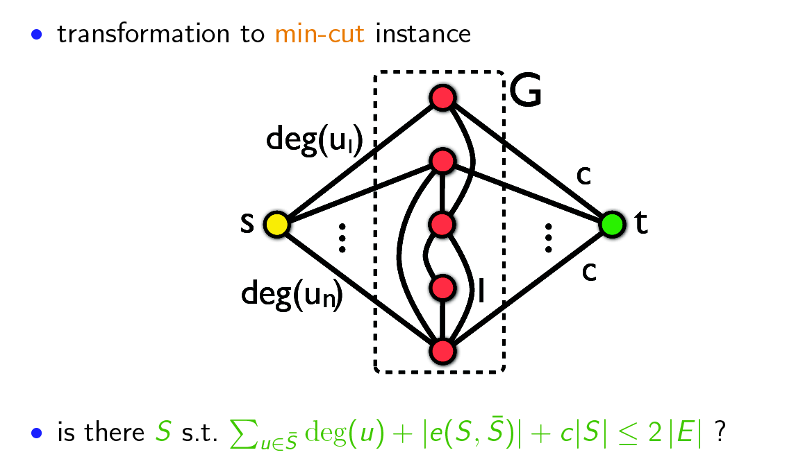
Goldberg's algorithm (3)

Slide 10
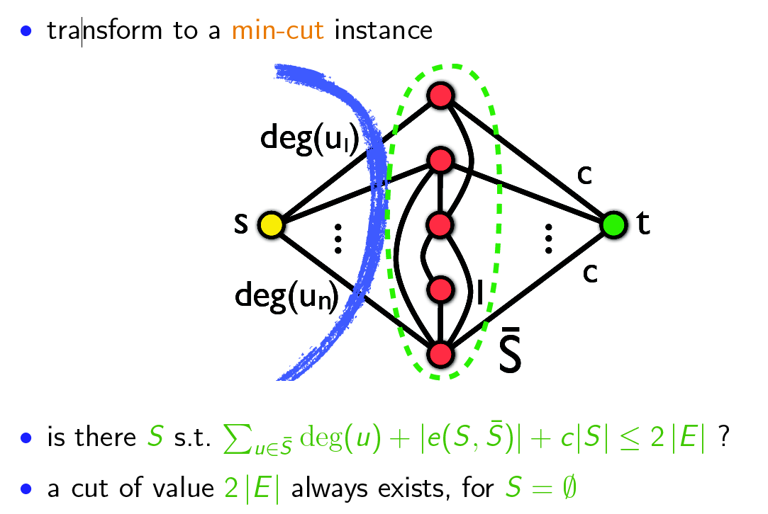
Goldberg's algorithm (4)

Slide 11
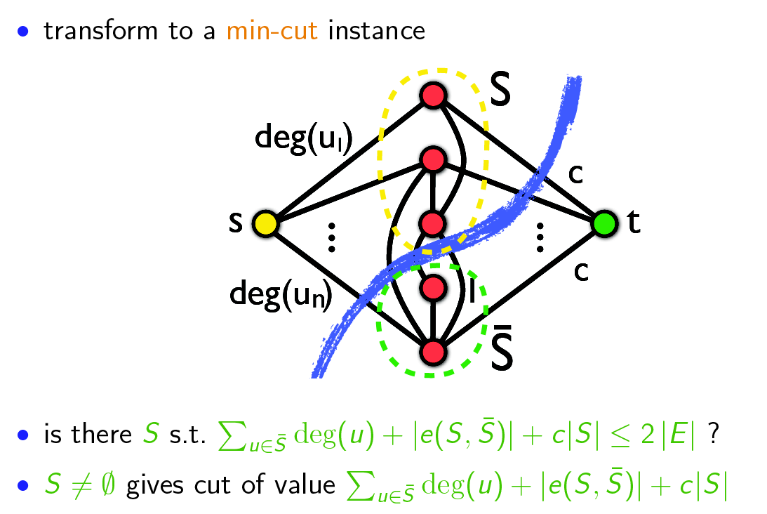
Goldberg's algorithm (5)
If this exists for non-empty S, then S is a sub-graph of density c

Slide 12
Example
Is there S with d(S) ≥ 2?
d(S) = 2 |E(S,S)| / |S|

Slide 13
Example (cont.)
2
2
2
3
s
2
t
3
2
1
Is there S with d(S) ≥ 2?
d(S) = 2 |E(S,S)| / |S|
Is there an s-t cut with cost ≤ 10?
(2|E| = 10)
2
1

Slide 14
Example (cont.)
Yes!
2
2
cost = 10
2
3
s
2
t
3
2
1
Is there S with d(S) ≥ 2?
d(S) = 2 |E(S,S)| / |S|
Is there an s-t cut with cost ≤ 10?
(2|E| = 10)
2
1

Slide 15
Goldberg's algorithm (6)
to find the densest subgraph perform binary search on c
  logarithmic number of min-cut calls
  each min-cut call requires O(|V||E|) time
problem can also be solved with one min-cut call using the parametric max-flow algorithm

Slide 16
Charikar’s algorithm
(approximate and randomized)

Slide 17
Charikar’s algorithm
Charikar, M. (2000). Greedy approximation algorithms for finding dense components in a graph. In APPROX.
Approximate algorithm (by a factor of 2)
  If the optimal density is λ, in the worst case (if you’re very unlucky!) you will get density λ/2

Slide 18
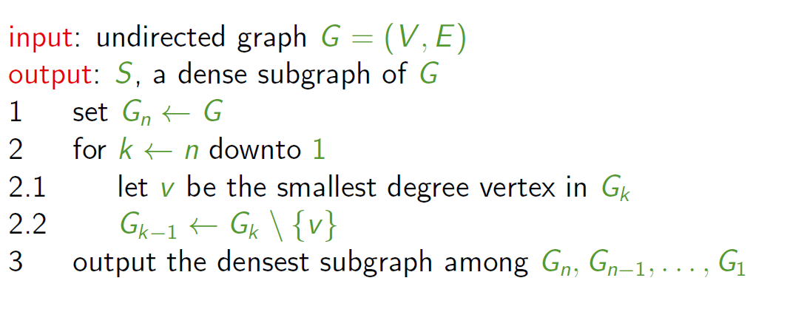
Greedily remove nodes
(break ties randomly)
Compute density as |E|/|V|

Slide 19
Exercise
Density =
Draw in Nearpod Collaborate
https://nearpod.com/student/
Code to be given during class

Slide 20
Example run
Done!

Slide 21
Example run
15/11=1.36
14/10=1.40
13/9=1.44
12/8=1.50
11/7=1.57
9/6=1.50
8/5=1.60
6/4=1.50
Density =
3/3=1.00
1/2=0.50
0/1=0.00

Slide 22
Example run
15/11=1.36
14/10=1.40
13/9=1.44
12/8=1.50
11/7=1.57
9/6=1.50
8/5=1.60
6/4=1.50
Done!
3/3=1.00
1/2=0.50
0/1=0.00

Slide 23
Advanced materials
(not included in the exam)

Slide 24
Approximation guarantee
S* = optimal sub-graph (highest density)
density(S*) = λ = |e(S*)| / |S*|
For all v in S*, deg(v) >= λ, because
Because of optimality of S*
https://people.cs.umass.edu/~barna/paper/dense-subgraph-full.pdf

Slide 25
Approximation guarantee (cont)
Hence,

Slide 26
Approximation guarantee (cont.)
Now, let's consider when greedy removes the first vertex of the optimal solution
At that point, all the vertices of the remaining subgraph (S) have degree >= λ, because v has degree >= λ
Hence, this subgraph has more than edges, and density more than
Hence this is a 2-approximate algorithm

Slide 27
Summary

Slide 28
Things to remember
Goldberg’s algorithm
Charikar’s algorithm
Practice on your own executing these algorithms in small graphs
If useful for you, write code for these algorithms

Slide 29
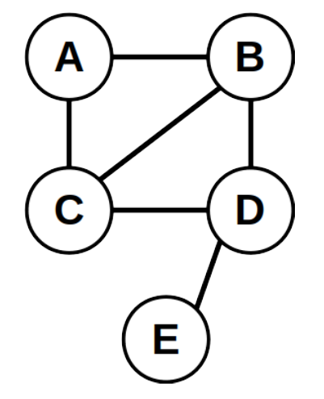
Practice on your own
Consider the graph on the right, which contains a subgraph with density d(S) = 2|E(S, S)|/|S| equal to 5/2.
Draw the graph of Goldberg’s construction, and in that graph, draw the s − t cut that crosses some of the original edges and proves that a subgraph of density 5/2 exists.
Indicate clearly (1) the cost of each edge in the construction, (2) the desired target cost as a function of |E|, (3) the cost of the cut you found, and (4) the sub-graph the method finds.

Slide 30
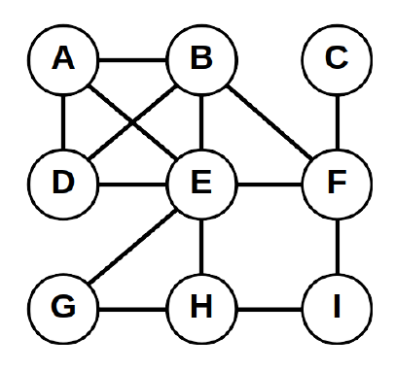
Practice on your own (cont.)
Consider the graph on the right.
Run Charikar’s randomized algorithm for densest subgraph, indicating all intermediate graphs and their density, and marking clearly the graph with the largest density.
For density use |E|/|V| where |E| is the number of edges in the subgraph and |V| the number of nodes in the subgraph.

