Slide 1

Graph partitioning
Introduction to Network Science
Carlos Castillo
Topic 13

Slide 2
Sources
Barabási 2016 Chapter 9
Networks, Crowds, and Markets Ch 3
C. Castillo (2017) Dense Sub-Graphs and Graph partitioning

Slide 3
Communities
2 communities [previous topic]
1 community (dense sub-graphs)
3+ communities

Slide 4
Splitting into multiple communities

Slide 5
Community hypotheses
H1. The community structure of a network is uniquely encoded by its links [discoverable]
H2. A community is a locally dense connected subgraph [dense, connected]

Slide 6
Weak < Strong < Clique
Let C be a community with N_{C} nodes
Given a community C,
  Let count links towards C, towards V\C
Clique:
Strong community:
Weak community:

Slide 7
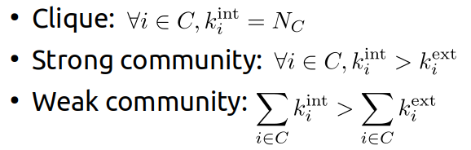
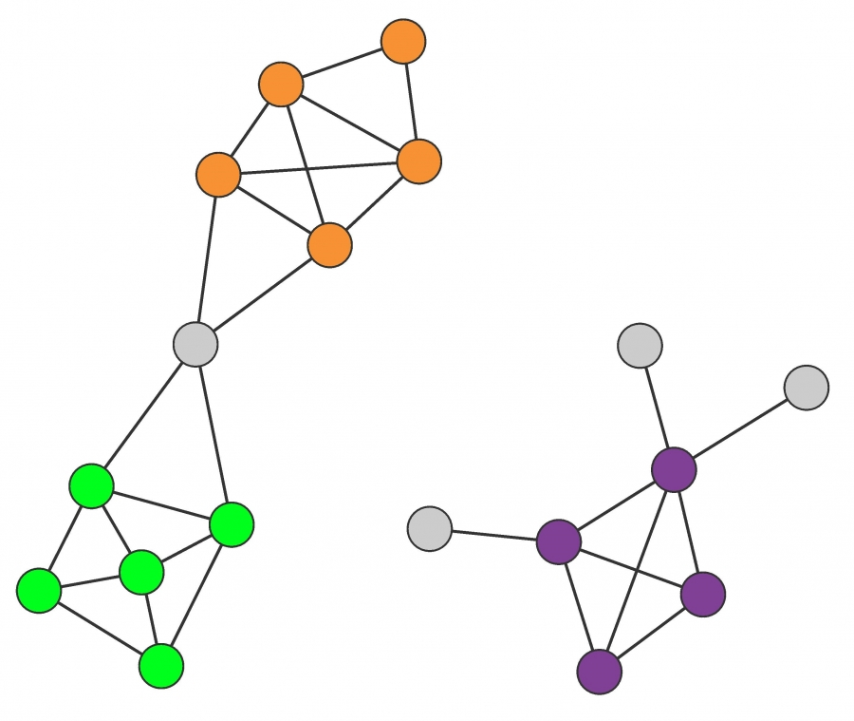
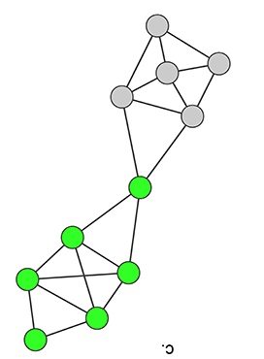
Try it!
Which types of communities are these?
(a)
(d)
(b)
(c)

Slide 8
Solution
Which types of communities are these?
(a)
(a) Strong
(b) Strong
(c) Clique
(d) Weak
(d)
(b)
(c)

Slide 9


How many possible partitions?
With 3 nodes: 5 partitions
With 4 nodes: 15 partitions
http://www-history.mcs.st-andrews.ac.uk/Miscellaneous/StirlingBell/bell.html

Slide 10
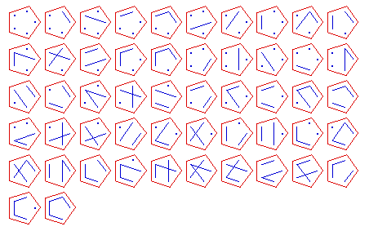
With 5 nodes: 52 partitions
http://www-history.mcs.st-andrews.ac.uk/Miscellaneous/StirlingBell/bell.html

Slide 11
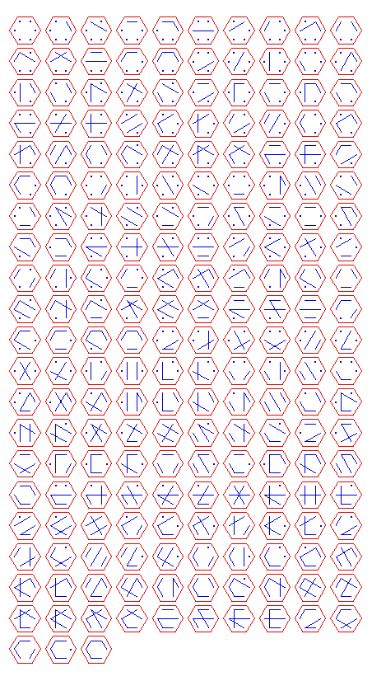
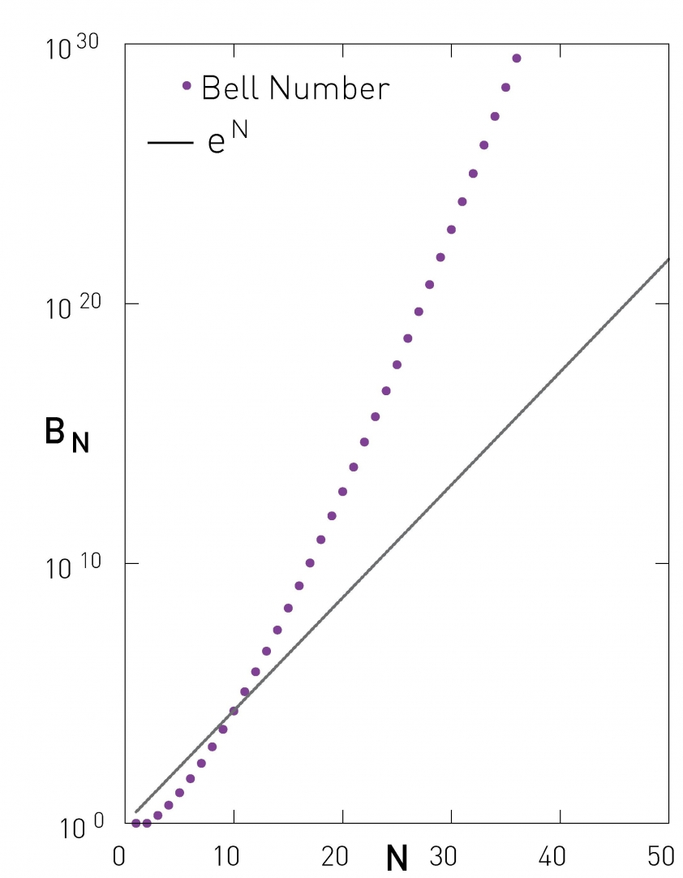
With 6 nodes: 203 partitions
With 7 nodes: 877 partitions
With n nodes: Bell number
http://www-history.mcs.st-andrews.ac.uk/Miscellaneous/StirlingBell/bell.html

Slide 12
Hierarchical algorithms
Recursively:
Merge nodes that are similar (agglomerative)
  — OR —
Split groups that are dissimilar (divisive)

