Slide 1

Distances in Scale-Free Networks
Social Networks Analysis and Graph Algorithms
Prof. Carlos Castillo — https://chato.cl/teach

Slide 2
Contents
Distance distribution of scale-free networks

Slide 3
Sources
A. L. Barabási (2016). Network Science – Chapter 04
URLs cited in the footer of specific slides

Slide 4
Consequences of having extremely large degree nodes
(also known as “large hubs”)

Slide 5
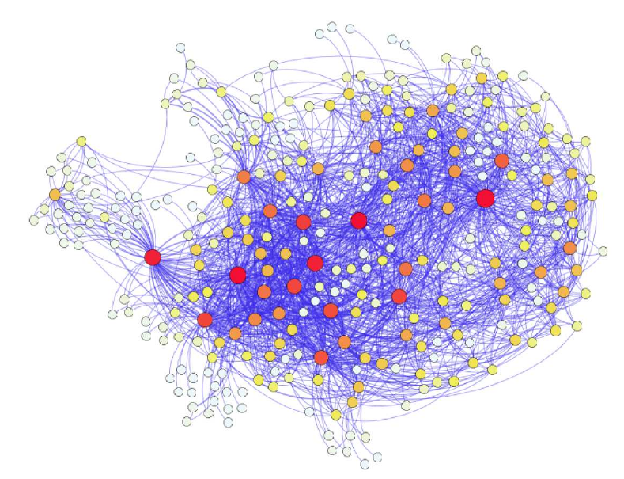
Air travel
You can travel between almost all pairs of European airports directly or (most of the time) with at most one stop
All you have to do is go to a well connected airport
This is because there are large degree airports
Cardillo, A et al. (2013). Modeling the multi-layer nature of the European Air Transport Network: Resilience and passengers re-scheduling under random failures. Euro. Phys. J. Special Topics, 215(1), 23-33. [DOI]

Slide 6
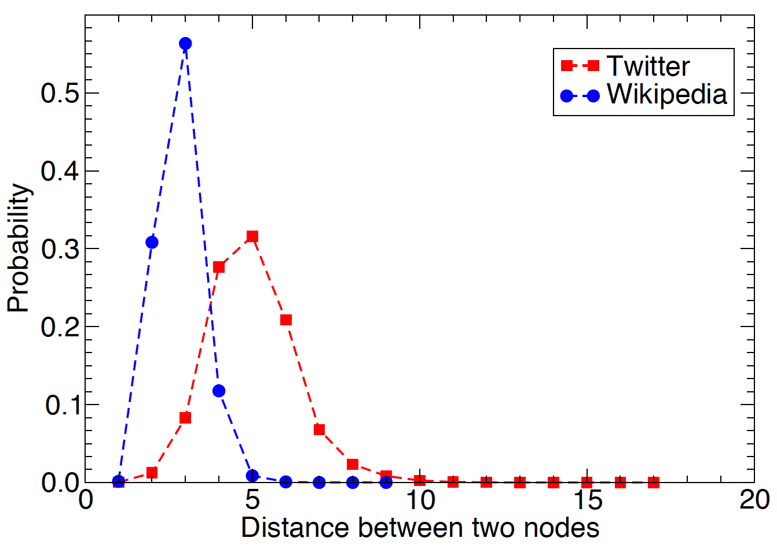
In general, having “hubs” or large degree nodes reduces distances
Source: Menczer, Fortunato, Davis: A First Course on Networks Science. Cambridge, 2020.

Slide 7
Distance regimes

Slide 8
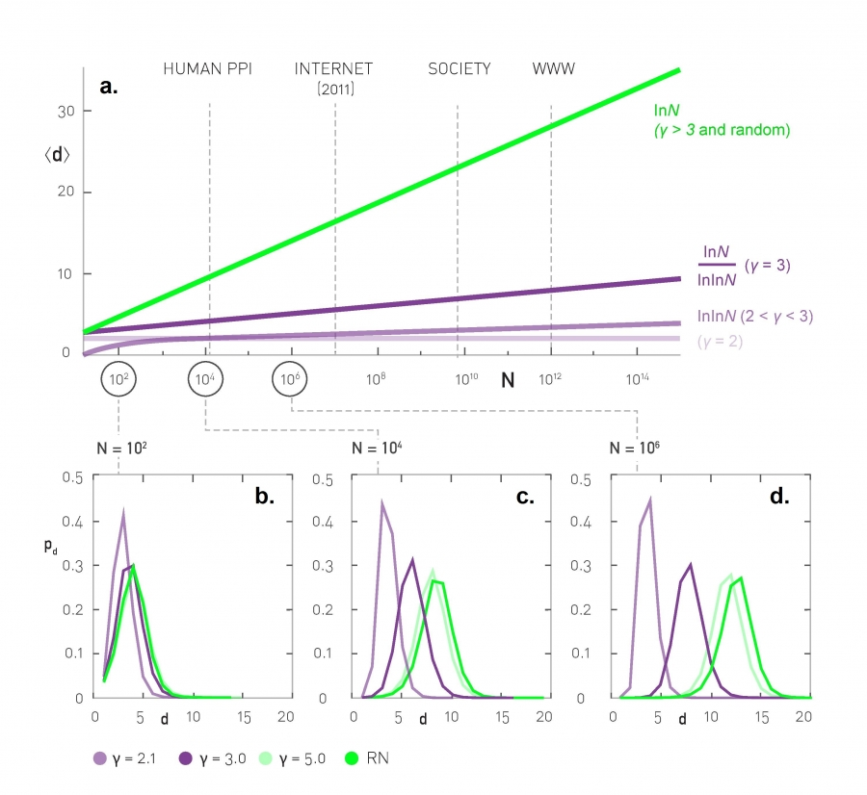
Distance distributions: simulation results
Scale-free networks of increasing size, <k> = 3

Slide 9
Average distance
Depends on Ɣ and N
Same as in ER graphs

Slide 10
Average distance and N

Slide 11
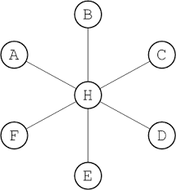
Anomalous regime

Slide 12
Ultra-small world
Average distance follows log(log(N))
Example (humans):

Slide 13
Small world
Average distance follows log(N)
Similar to ER graphs where it followed log(N)/log(<k>)

Slide 14
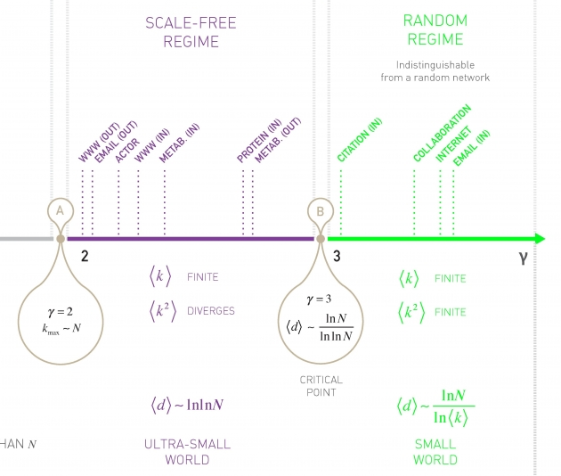
The degree distribution exponent plays an important role

Slide 15
When
In this case it is hard to distinguish this case from an ER graph
In most real complex networks (but not all)

Slide 16
When
Remember
Observing the scale-free properties requires that
k_{max} >> k_{min}, e.g. k_{max} = 10 k_{min}
Then if
There are not many such networks for which we have available data

Slide 17

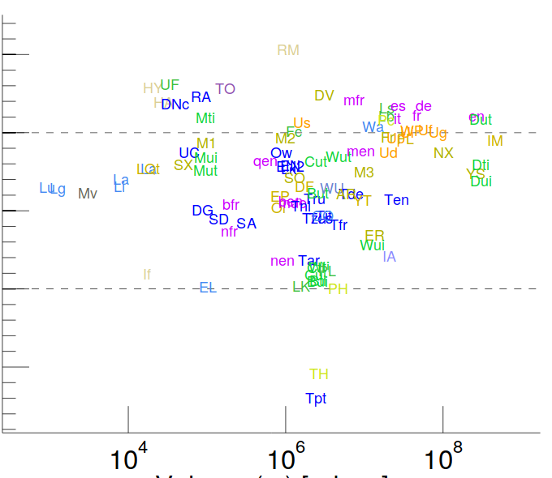
Examples
http://konect.uni-koblenz.de/statistics/prefatt
Etc.

Slide 18
Summary

Slide 19
Things to remember
Regimes of distance and connectivity

Slide 20
Practice on your own
Remember the regimes of a graph given <k>
  (It is useful to know this by heart)
Estimate distance distributions for some graphs

