Slide 1

The Friendship Paradox
Social Networks Analysis and Graph Algorithms
Prof. Carlos Castillo — https://chato.cl/teach

Slide 2
Contents
Sampling nodes and edges
Average degree of friends

Slide 3
Sources
A. L. Barabási (2016). Network Science – Chapter 04
F. Menczer, S. Fortunato, C. A. Davis (2020). A First Course in Network Science – Chapter 03
URLs cited in the footer of specific slides

Slide 4
Sampling a random node vs sampling at random one of the two nodes attached to a random edge

Slide 5
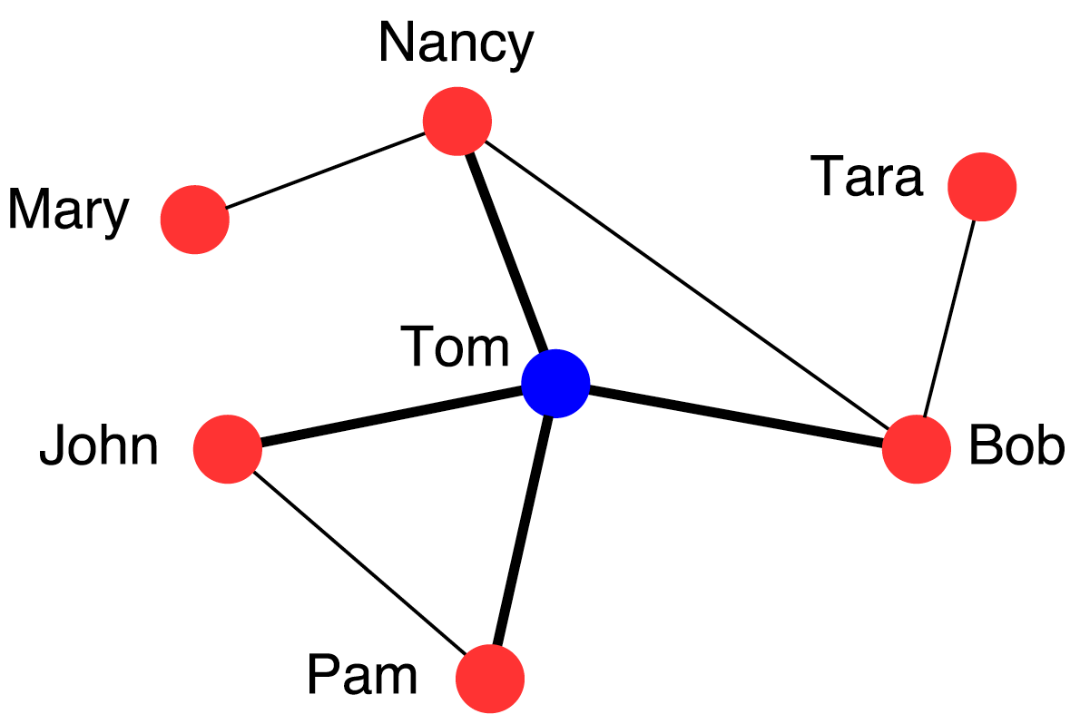
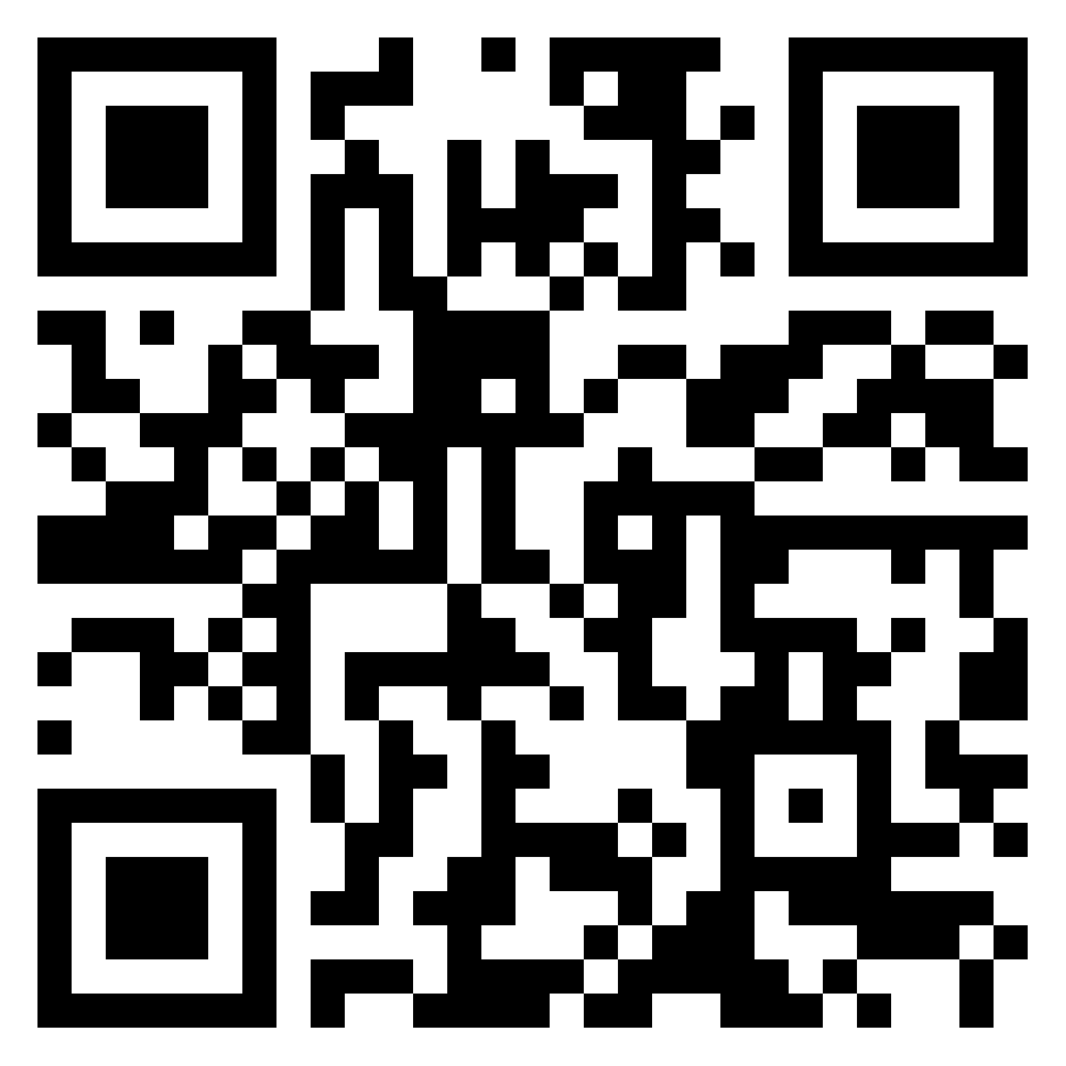
Exercise
Numerical calculation of friendship paradox
What is the probability of selecting Tom if we select a random node?
What is the probability of selecting Tom if we select a random edge and then randomly one of the two nodes attached to it?
Pin board: https://upfbarcelona.padlet.org/chato/ocpl5n14i8hrkr4i

Slide 6
Answer
What is the probability of selecting Tom if we select a random node?
  1/7
What is the probability of selecting Tom if we select a random edge and then one of the two nodes attached to it, at random?
  1/2 × 4/8 = 1/4

Slide 7
Sampling a random node vs sampling a random friend of a random node

Slide 8
Average degree of friends
Average degree
  (1 + 3 + 3 + 1 + 4 + 2 + 2)/7 = 16/7 ≃ 2.29
Average degree of friends of:
  Mary: 3
  Nancy: (1+4+3)/3 = 8/3
  Tara: 3
  Bob: (1+3+4)/3 = 8/3
  Tom: (3+3+2+2)/4 = 10/4
  John: (4+2)/2 = 3
  Pam: (4+2)/2 = 3
  Average degree of friends ≃ 2.83 (> 2.29)

Slide 9
The friendship paradox
Take a random person x; what is the expected degree of this person? <k>
Take a random person x, now pick one of x’s neighbors, let’s say y; what is the expected degree of y?
  It is not <k>
This “paradox” is a useful vaccination strategy

Slide 10
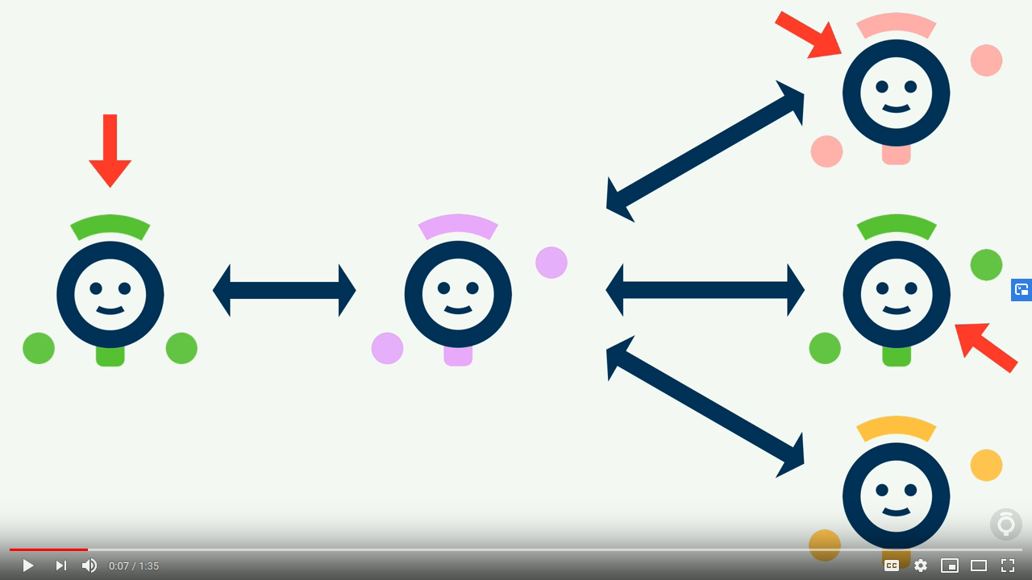
Sampling bias and the friendship paradox (1’35’’)
https://www.youtube.com/watch?v=httLvVufAYs

Slide 11
Imagine you’re at a random airport on earth
Is it more likely to be …
  a large airport or a small airport?
If you take a random flight out of it …
  will it go to a large airport or a small airport?

Slide 12
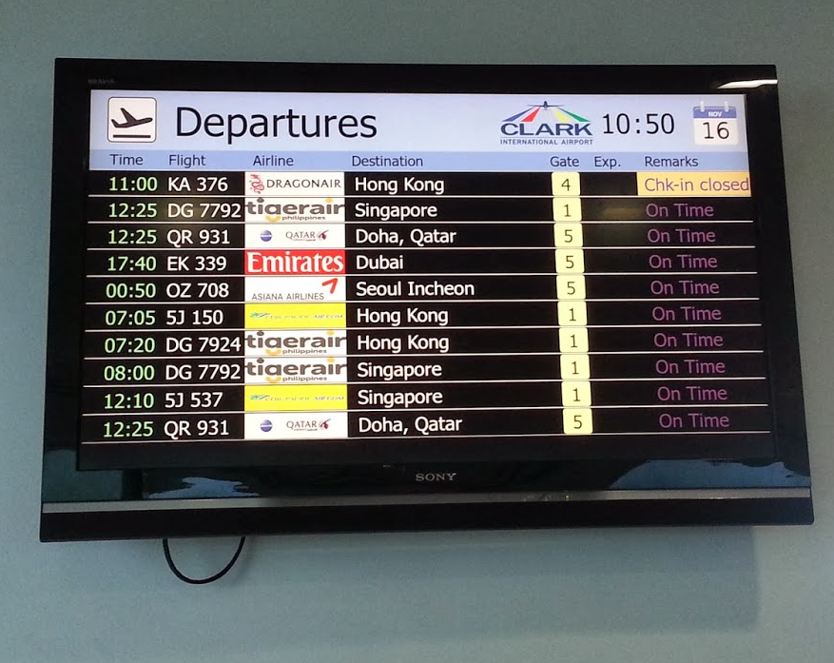
An example of friendship paradox
Pick a random airport on Earth
  Most likely it will be a small airport
However, no matter how small it is, it will have flights to big airports
On average those airports will have much larger degree

Slide 13
Exercise [B. 2016, Ex. 4.10.2]
”Friendship Paradox”
Remember p_{k} is the probability that a node has k “friends”
If we randomly select a link, the probability that a node at any end of the link has k friends is
q_{k} = C k p_{k} where C is a normalization factor
  (a) Find C (the sum of q_{k} must be 1)

Slide 14
Sol. Exercise [B. 2016, Ex. 4.10.2]
(a) Find normalization C if q_{k} = C k p_{k}
See also https://arxiv.org/abs/1407.4062

Slide 15
Exercise [B. 2016, Ex. 4.10.2]
”Friendship Paradox”
If we randomly select a link, the probability that a node at any end of the link has k friends is
q_{k} = C k p_{k} where C is a normalization factor
q_{k} is also the prob. that a randomly chosen node has a neighbor of degree k
  (b) Find its expectation E[q_{k}] which we will call <k_{F}>
  Remember

Slide 16
Sol. Exercise [B. 2016, Ex. 4.10.2]
(b) Find the average degree of a friend of a node
Note this will diverge if

Slide 17
Exercise [B. 2016, Ex. 4.10.2]
”Friendship Paradox”
(c) Compute the expected number of friends of a neighbor of a randomly chosen node in the case below
(d) compare with the expected number of friends of a randomly chosen node

Slide 18
Sol. Exercise [B. 2016, Ex. 4.10.2]
(c-d) Compute numerically the degree of a random neighbor of a node and degree of a random node, compare

Slide 19

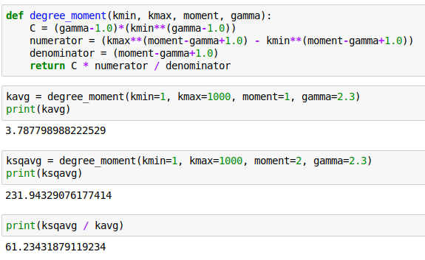
Code

Slide 20
Summary

Slide 21
Practice on your own
Draw a small graph, and sample from that graph until you’re convinced

