Slide 1

Other Graph Evolution Models
Social Networks Analysis and Graph Algorithms
Prof. Carlos “ChaTo” Castillo — https://chato.cl/teach

Slide 2
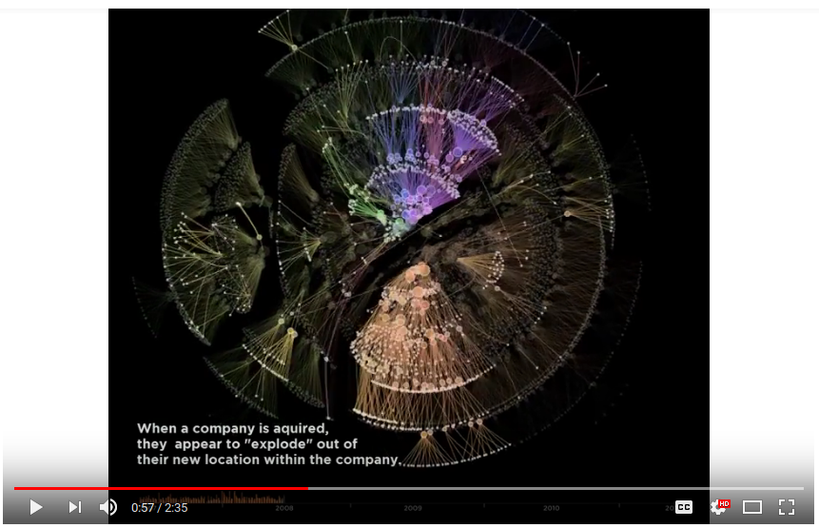
Actual network growth is complex
A snapshot of the Autodesk organizational hierarchy was taken each day between May 2007 and June 2011, a span of 1498 days.
Each day the entire hierarchy of the company is constructed as a tree with each employee represented by a circle, and a line connecting each employee with his or her manager.
Larger circles represent managers with more employees working under them. The tree is then laid out using a force-directed layout algorithm.
From day to day, there are three types of changes that are possible:
Employees join the company
Employees leave the company
Employees change managers
https://www.youtube.com/watch?v=mkJ-Uy5dt5g

Slide 3

Other graph evolution models
Uniform random attachment
Sub-linear and super-linear preferential attachment
Good-get-richer
Aging effects
Link selection
Copy model
No preference and no growth

Slide 4
Sources
A. L. Barabási (2016). Network Science – Chapter 05 and Chapter 06

Slide 5
Uniform Random Attachment

Slide 6
Growth in an ER network
Two assumptions in ER networks:
  There are N nodes that pre-exist
  Nodes connect at random
Let’s challenge the first assumption

Slide 7
Uniform Attachment
Network starts with m fully-connected nodes
Time starts at t₀=m
At every time step we add 1 node
This node will have m outlinks

Slide 8
Expected degree over time
Probability of obtaining one link:
  Decreases over time
Expected degree of node born at

Slide 9
Tail of degree distribution
How many nodes of degree larger than K are there at time t? (Computation in “Advanced materials” at the end of these slides)
Decreases exponentially with K: it’s vanishingly rare to find high-degree nodes

Slide 10
Sub-linear and super-linear preferential attachment

Slide 11
Sub-linear and super-linear preferential attachment
The model we have studied so far has linear preferential attachment because
We could imagine cases where
for or
What do you think should happen in each case?

Slide 12
Answer
More preference for high-degree nodes
Less preference for high-degree nodes
No preference for high-degree nodes
  = uniform preference

Slide 13
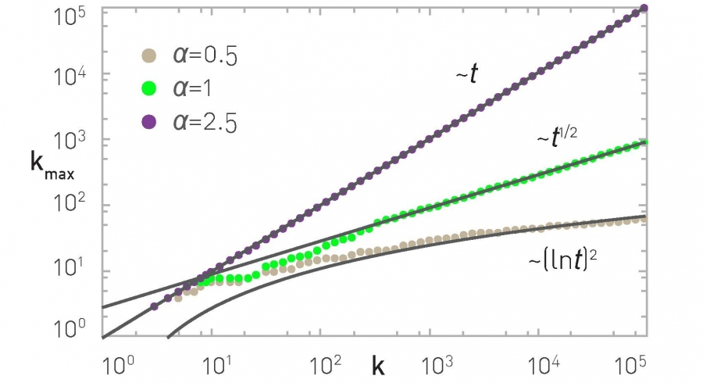
The degree of the largest hub k_{max}

Slide 14
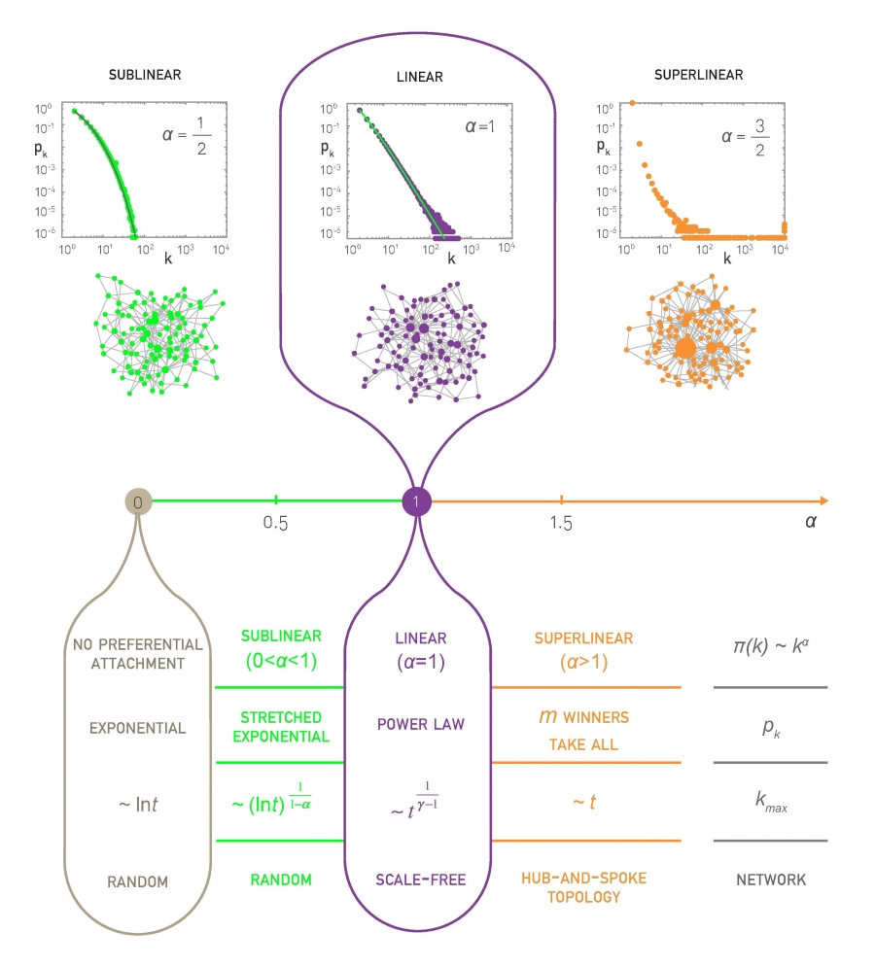

Slide 16
Measuring preferential attachment

Slide 17
Measuring preferential attachment
We should try to measure
This can be too noisy
  Why?
Instead we will measure
If is constant
If then

Slide 18
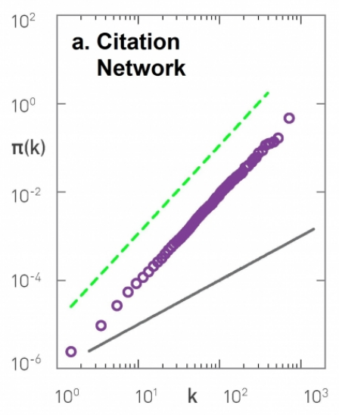
Preferential attachment in a citation network
We observe it follows preferential attachment
(with ) in this case

Slide 19
Aging effects

Slide 20

Sick Boy’s unified theory of life from Trainspotting (1996)
In English: https://www.youtube.com/watch?v=pQD-dXfHrvk
In Spanish: https://www.youtube.com/watch?v=cN_WbiuqyQU
English (bad audio) subs in Spanish: https://www.youtube.com/watch?v=4xTWD9GNRFA

Slide 21
Aging effects
Models without fitness but with a negative effect of age
Older nodes accumulate links more slowly
Parameter v is the decay factor
Qualitatively, what would you expect if:

Slide 22
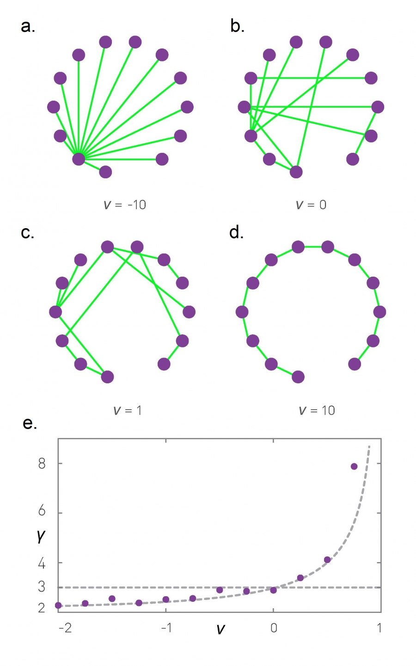
Aging effects
creation order
favors older nodes
is simply preferential attachment
means only youngest are linked

Slide 23
Power-law exponent in models with aging (N=10K, m=1)
More heterogeneous
More homogeneous

Slide 24
“Good get richer”
(incl. Bianconi-Barabási model)

Slide 25
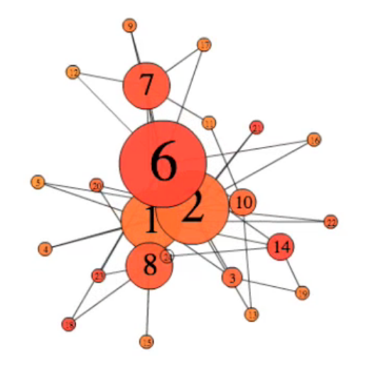
“Good get richer” simulation
(number is attractiveness)
http://networksciencebook.com/images/ch-06/video-6-1.mov

Slide 26
“Good get richer”
A “good get richer” model is one where
  Each node has an “attractiveness” (called “fitness”)
  Preferential attachment is guided by this fitness
The probability of connecting to node i is:

Slide 27
Degree dynamics
With the dynamic exponent
Remember that in linear preferential attachment (for all nodes)

Slide 28
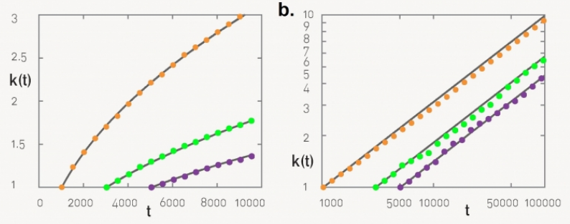
In preferential attachment (BA) a “younger” node cannot overtake an “older” node
Linear plot
Log-log plot

Slide 29
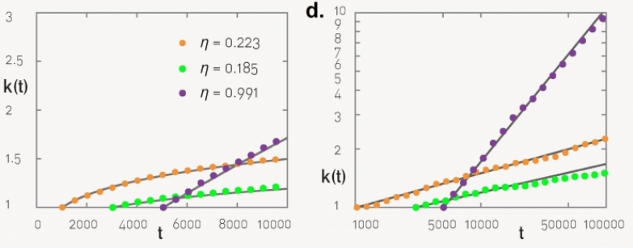
In good-get-richer
(Bianconi-Barabási) this depends on node fitness
Linear plot
Log-log plot

Slide 30
Degree distribution
When is constant this reduces to BA
When is uniformly distributed in [0, 1] this also yields a power law but instead of
we get
Which distribution is more heterogeneous?

Slide 31
Link selection model / copy model

Slide 32
Other processes that generate scale-free networks
Link-selection model — step:
  Add one new node v to the network
  Select an existing link (u,w) at random and connect v to either u or w
Copy model ­— step:
  Add one new node v to the network
  Pick a random existing node u
  With probability p link to u
  With probability 1-p link to a neighbor of u

Slide 33
Exercise: the copy model
In the copy model, start at t=1 with one node, and at every step t :
  Add one new node v to the network
  Pick a random existing node u
  If u has no out-links, link to u
  If u has out-links choose one of the following:
    With probability p link to u
    With probability 1-p link to one of the out-neighbors of u chosen at random
Simulate it on paper (directed graph) for 7 nodes with p=0.5
  Make sure you understand the model fully!
What is N(t) and L(t)? What is ?

Slide 35
Degree distribution in the copy model
Proven in the paper byKumar et al. (FOCS 2000)
“Stochastic models for the web graph” and developed in the advanced materials.
The copy model can generate any exponent between 2 and 3!

Slide 36
In the copy model, at every step t:
Add one new node v to the network
Pick a random existing node u
With probability p link to u
With probability 1-p link to a neighbor of u
We will compute but first ...
How many links on average gets node i at time t? In other words, what is:
Hint: it has a term with p and a term with 1-p

Slide 37
The following is proven in
Kumar et al. (FOCS 2000)
“Stochastic models for the web graph” and developed in the advanced materials.

Slide 38
Integrate between ti and t to obtain an expression for
(we drop the “in” superscript just for simplicity during this exercise)
Note that now

Slide 41
Once you have a expression for
Compute
Now write the cumulative distribution function of
And compute its derivative to obtain
It should show exponent

Slide 44
Summary

Slide 45
Things to remember
Uniform attachment
Sub-linear and super-linear preferential attachment
Measuring preferential attachment
“Good-get-richer” and aging effects
The copy model

Slide 46
Practice on your own
Practice creating graphs using the different models
  By hand
  Or write your own code (it’s not a lot of code)

Slide 47

Advanced materials: expected degree under uniform random attachment

Slide 48
Expected degree in uniform random attachment using a differential equation
Obtain ki
(1) Integrate between time i and time t
(2) Use initial condition

Slide 49
Expected degree over time

Slide 50
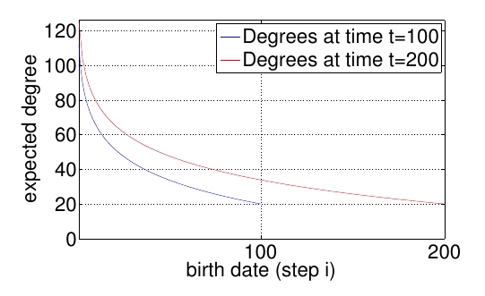
Degree distribution over time is not static
Degree of node born at time

Slide 51
Tail of degree distribution
How many nodes of degree larger than K are there
at time t?
The fraction is
Decreases exponentially with K: it’s vanishingly rare to find high-degree nodes

Slide 52
Advanced materials:
(1) No preference (2) No growth

Slide 53
Remember preferential attachment
Start with m₀ nodes
At every time step
  Add one new node u
  Repeat m times
    Pick a node v with probability
    Connect u to v

Slide 54
Two simple variants
No preference
  Nodes receiving inlinks are picked uniformly at random
No growth
  The network starts with N nodes
  No new nodes are created

Slide 55
No preference model
Write the process on paper
Write
Noting that obtain

Slide 57
No preference model (cont.)
Compute assuming large t, t_{i}
Use it to compute
Derive to obtain

Slide 60
Note: in Barabási 2016 section 5.6.1 there is an extra “e” in the solution.
I didn’t get the exact same result but the exponent is what’s important, and it’s the same.

Slide 61
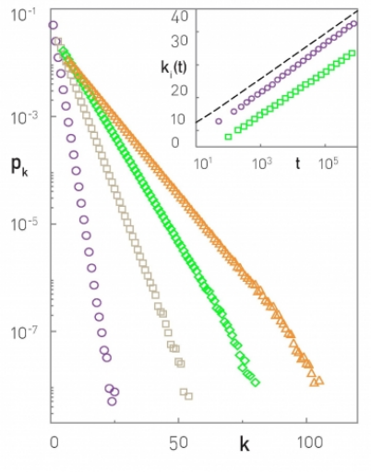
Consequences of the “no preference” model
Two chosen nodes
Degree decays exponentially
No power-law
No large hubs
m=1, m=3, m=5, m=7

Slide 62
No growth model
Write the process on paper
You will need to impose why?
Write
Noting that obtain

Slide 64
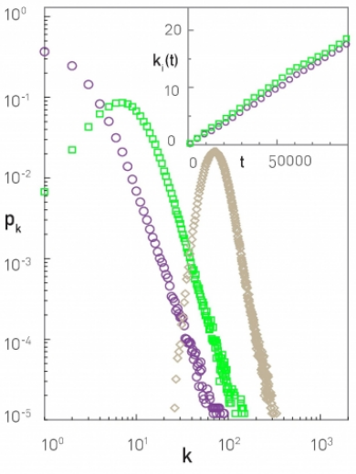
Consequences of the “no growth” model
Two chosen nodes
Degree grows
linearly
Degree distribution is not stationary
N=100K
t=N, t=5N, t=40N

