Slide 1

Community Structure in Networks
Social Networks Analysis and Graph Algorithms
Prof. Carlos Castillo — https://chato.cl/teach

Slide 2
Sources
A. L. Barabási (2016). Network Science – Chapter 09
D. Easly and J. Kleinberg (2010). Networks, Crowds, and Markets – Chapter 03
F. Menczer, S. Fortunato, C. A. Davis (2020). A First Course in Network Science – Chapter 06
URLs cited in the footer of slides

Slide 3
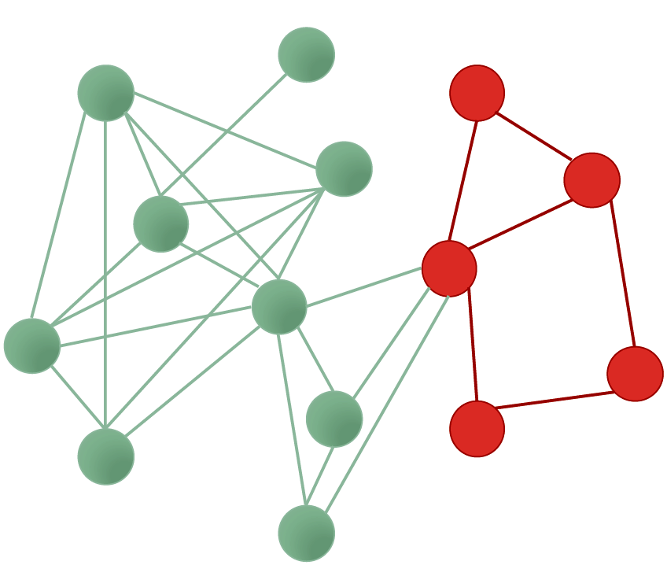
Reminder: sub-graph
A sub-graph is a subset of nodes, and all of the edges among those nodes

Slide 4
Typical community structures
One dense sub-graph
  embedded somewhere within a larger graph
Two groups (polarization)
  plus perhaps some ambiguous nodes
Multiple communities

Slide 5
One dense sub-graph

Slide 6
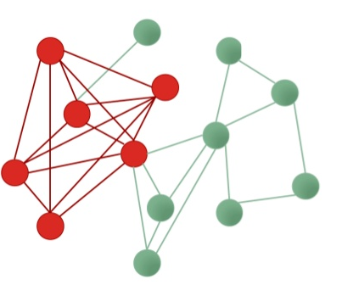
Densest sub-graph
Sub-graph having the maximum density according to some measure
There is more than one definition of density!
Density = |E|/|V|
Density = (2|E|)/(|V|(|V|-1))

Slide 7
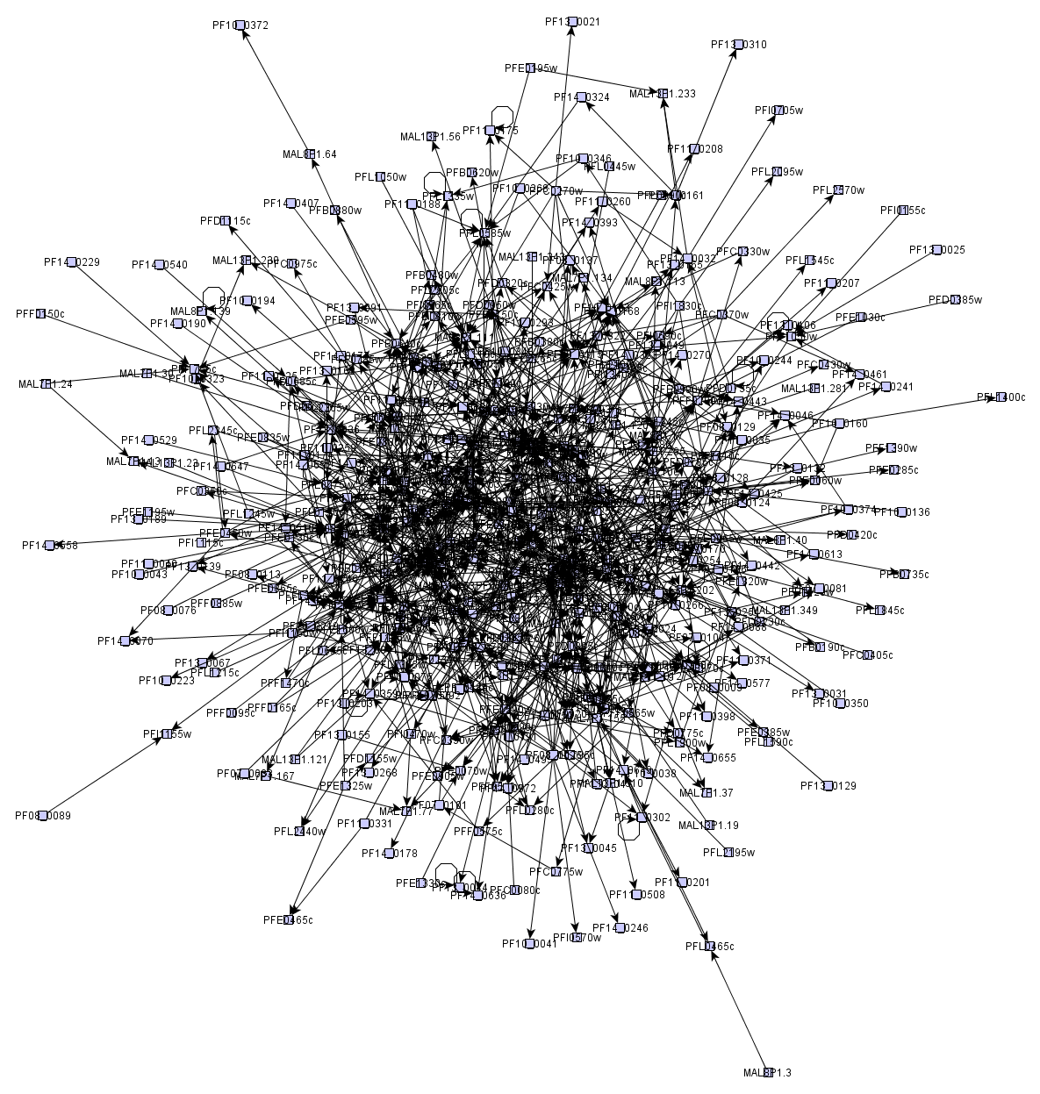
Many graphs look like “hairballs”
Sometimes, at the center these graphs may have an interesting dense sub-graph

Slide 8
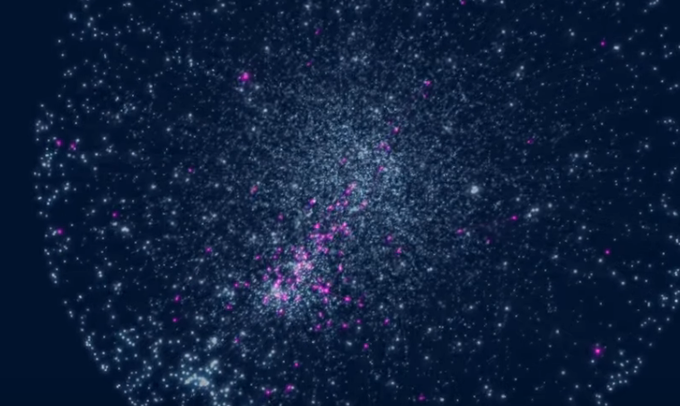
Asthma-related genes
https://www.youtube.com/watch?v=VU_7FHAKMgA

Slide 9
Two groups (polarization)

Slide 10
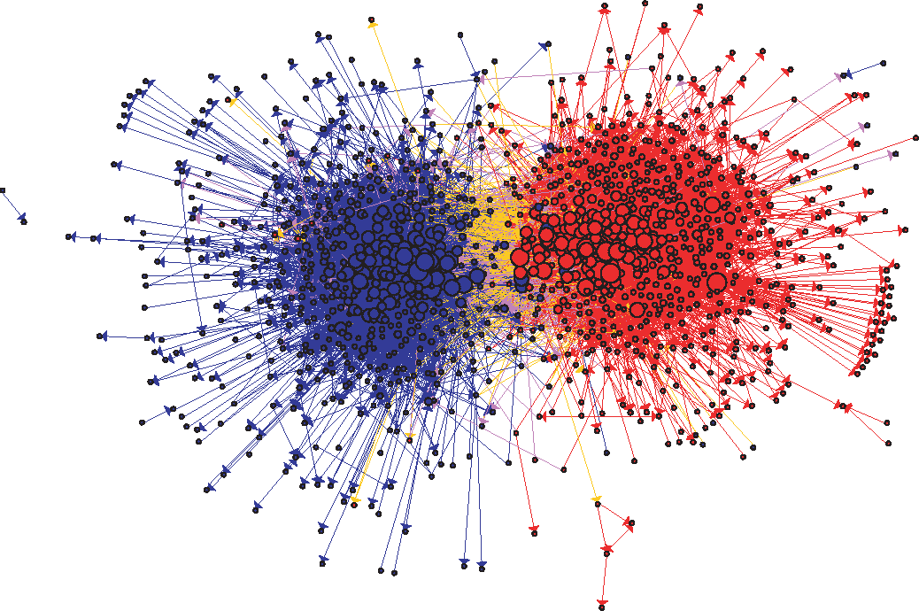
US Political Blogs (2004)
Liberal
Conservative
Adamic, L. A., & Glance, N. (2005, August). The political blogosphere and the 2004 US election: divided they blog. In Proc. LinkKDD (pp. 36-43). ACM.

Slide 11
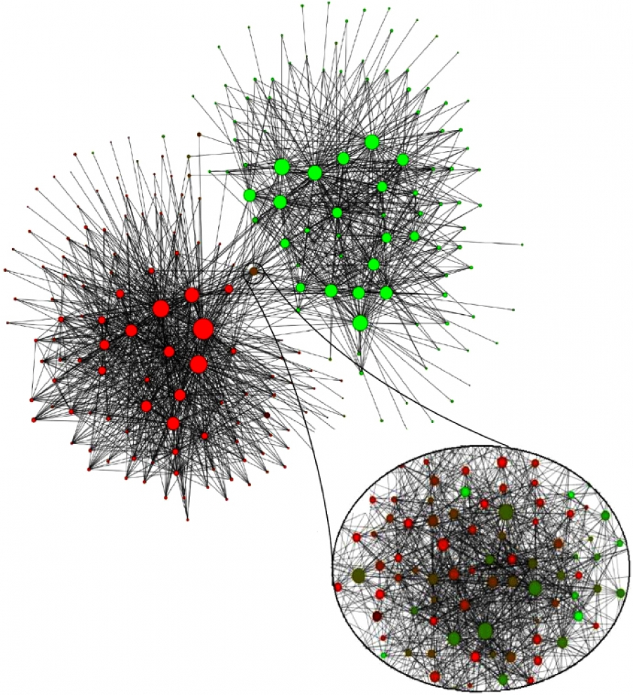
Mobile phone users in Belgium (2008)
Each node is a community of 100 mobile users or more that tend to call each other
Dutch-speaking
French-speaking
V. D. Blondel, J.-L. Guillaume, R. Lambiotte, and E. Lefebvre. Fast unfolding of communities in large networks. J. Stat. Mech., 2008.

Slide 12
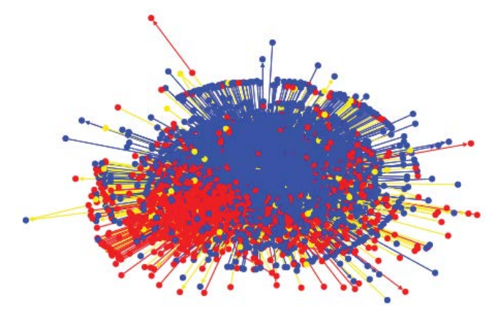
Egyptian Twitter Users (2013)
Islamist
Secularist
Weber, I., Garimella, V. R. K., & Batayneh, A. (2013, August). Secular vs. Islamist polarization in egypt on twitter. In Proc. ASONAM (pp. 290-297). ACM.

Slide 13
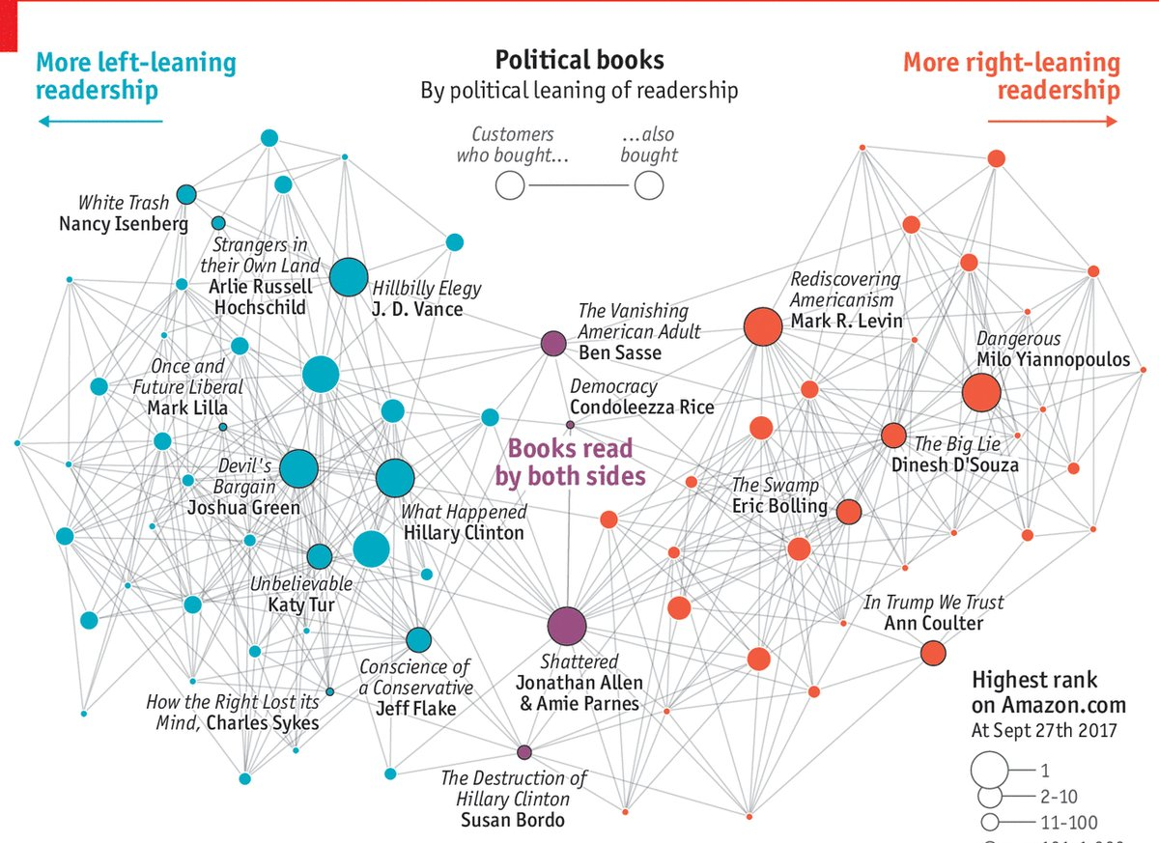
Political Books
Source:
Valdis Kreb
& The Economist

Slide 14
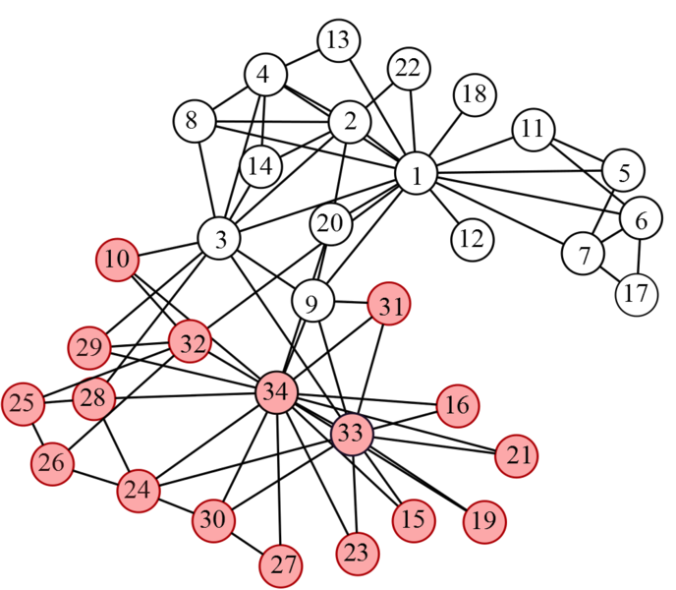
Wayne Zachary’s PhD Thesis (1972)
Studied 34 members of a karate club
Found 78 links between members who regularly interacted outside the club
The club splitted in two during the study
1=sensei, 34=president

Slide 15
Multiple communities

Slide 16
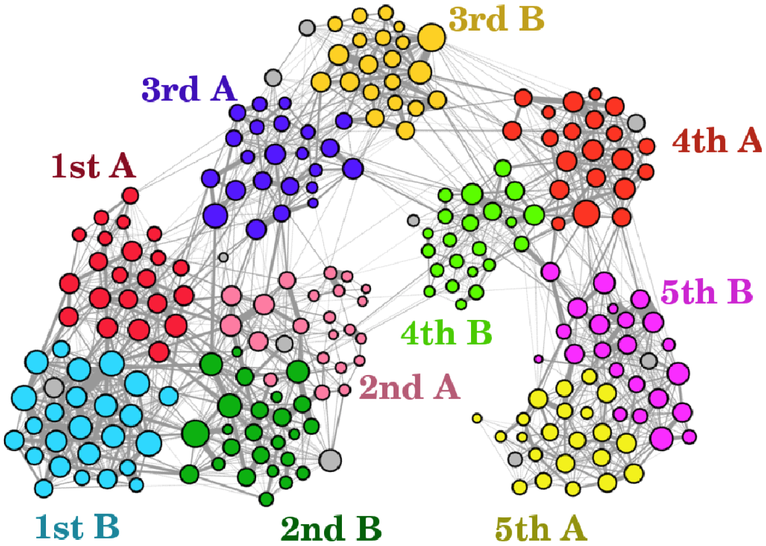
Primary school contacts
Links connect students who spent more than two minutes face to face
Students wore RF-ID badges hanging on their chest, which have a range of about 1.0-1.5 meters
What do you think the colors represent in this visualization?
Stehlé, J., et al. (2011). High-resolution measurements of face-to-face contact patterns in a primary school. PloS one, 6(8), e23176.

Slide 17
Primary school …
Colors represent classes. Teachers are shown in gray color. Node sizes are number of connections.
Note: these communities are hierarchical (more on this later)
Stehlé, J., et al. (2011). High-resolution measurements of face-to-face contact patterns in a primary school. PloS one, 6(8), e23176.

Slide 18
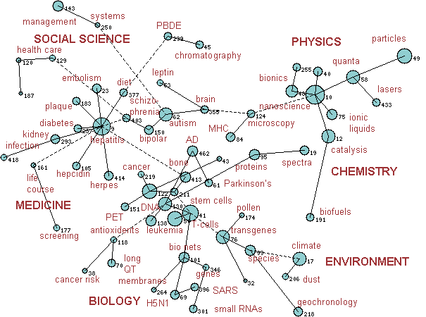
Science
Two topics T1, T2, are connected if there is at least one paper that cites:
a paper u in T1 and
a paper v in T2.
http://archive.sciencewatch.com/dr/rfm/mos/10maymosGLOBAL/

Slide 19
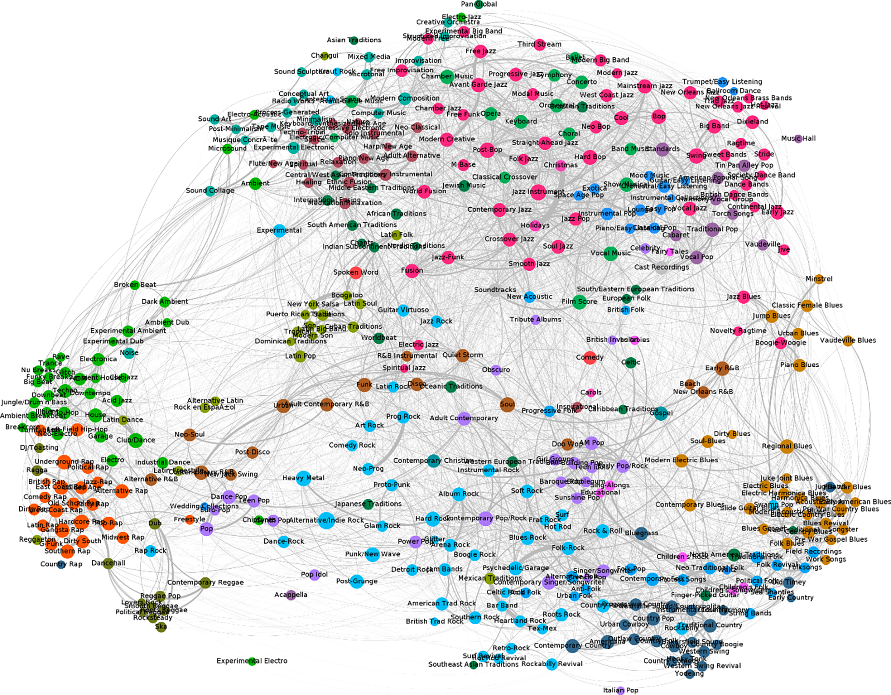
Music
Two Genres, G1, G2, are connected if there is a musician producing tracks in both genres; width of link is number of musicians
https://doi.org/10.1371/journal.pone.0203065.g002

Slide 20
Music (cont.)
https://doi.org/10.1371/journal.pone.0203065.g002

Slide 21
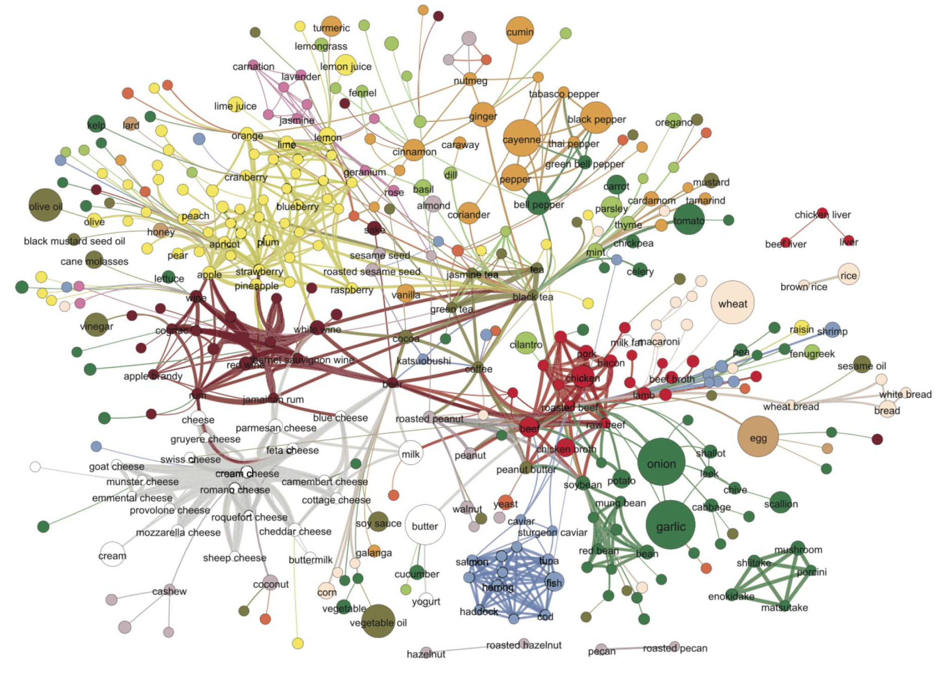
Flavors
Ahn, Y. Y., Ahnert, S. E., Bagrow, J. P., & Barabási, A. L. (2011). Flavor network and the principles of food pairing. Scientific reports, 1, 196.

Slide 22
Flavors
(cont.)

Slide 23
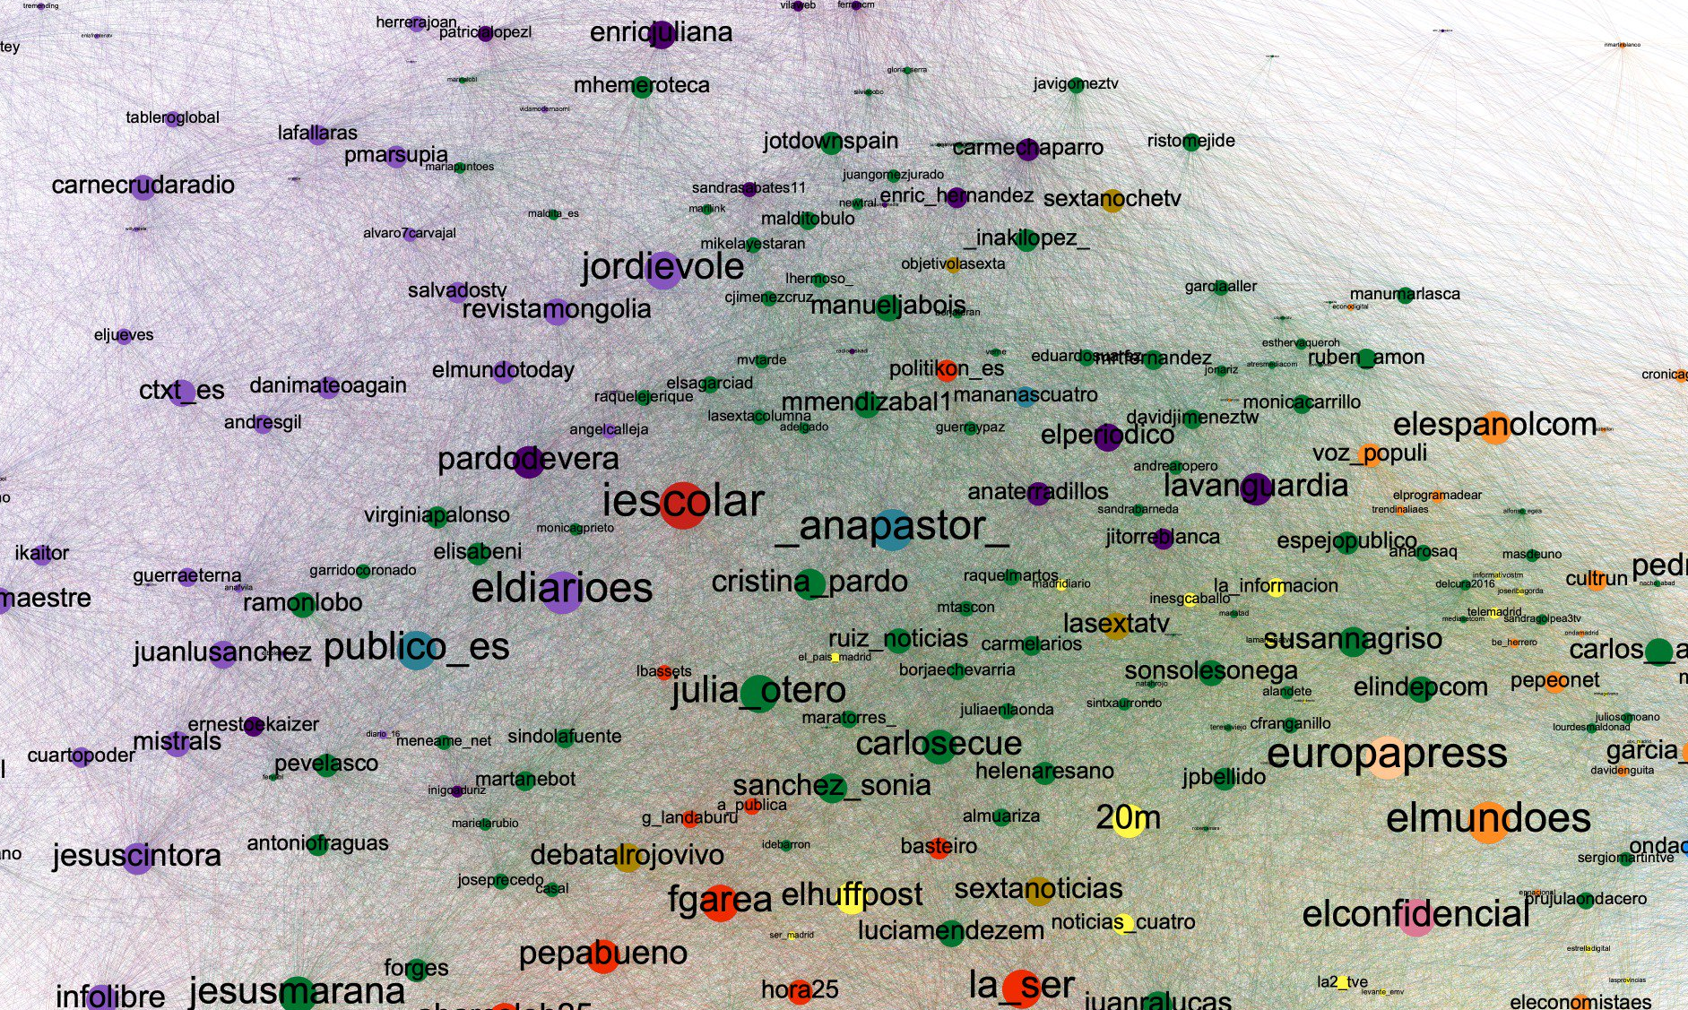
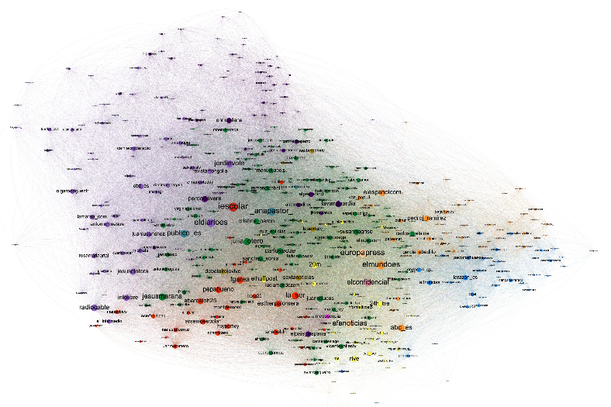
Media and politicians
https://twitter.com/jbo/status/1120444347772821504/photo/1

Slide 24
Partitions vs Overlapping communities
Hierarchical communities

Slide 25
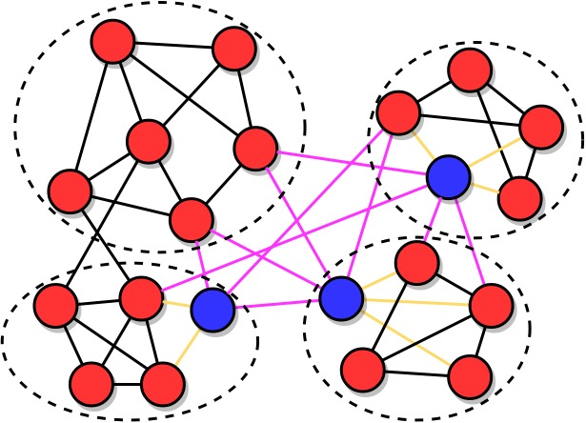
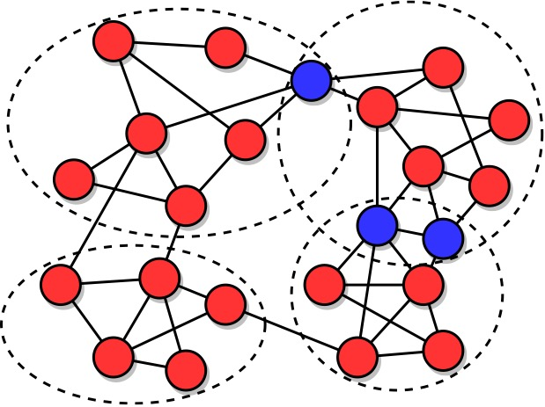
Partition vs Overlapping communities
Partition, or hard clusters
What’s special about blue nodes?
Overlapping communities, or soft clusters
Blue nodes are in more than one community
Source: Menczer, Fortunato, Davis: A First Course on Networks Science. Cambridge, 2020.

Slide 26
Answer: what is special about blue nodes in the partition example?
In the partition example, blue nodes have more links towards nodes in other communities than to the community they belong to (more about this in the next slide deck)

Slide 27
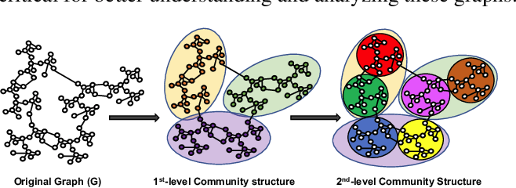
Hierarchical communities
https://www.catalyzex.com/paper/arxiv:2012.05980

Slide 28
How to generate a graph having community structure?

Slide 29
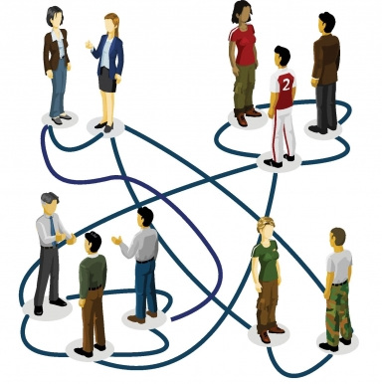

Exercise
Invent a variant of the ER model that generates graphs having two communities, but not necessarily disconnected
Standard ER Model:
Generate N nodes
For each of the N(N-1)/2 pairs of nodes:
  Perform a Bernoulli trial with probability p
  If the trial succeeds, connect those nodes
Pin board: https://upfbarcelona.padlet.org/chato/tt20-community-structure-yhk7nozup8xbiejb

Slide 30
How to generate community structure?
The stochastic block model generates graphs with community structure
Can be described as a variation of the ER model in which:
  There are m groups
  Link probability scalar p becomes an m x m matrix P that contains in position (i,j) the probability of a link between a node in group i and a node in group j

Slide 31
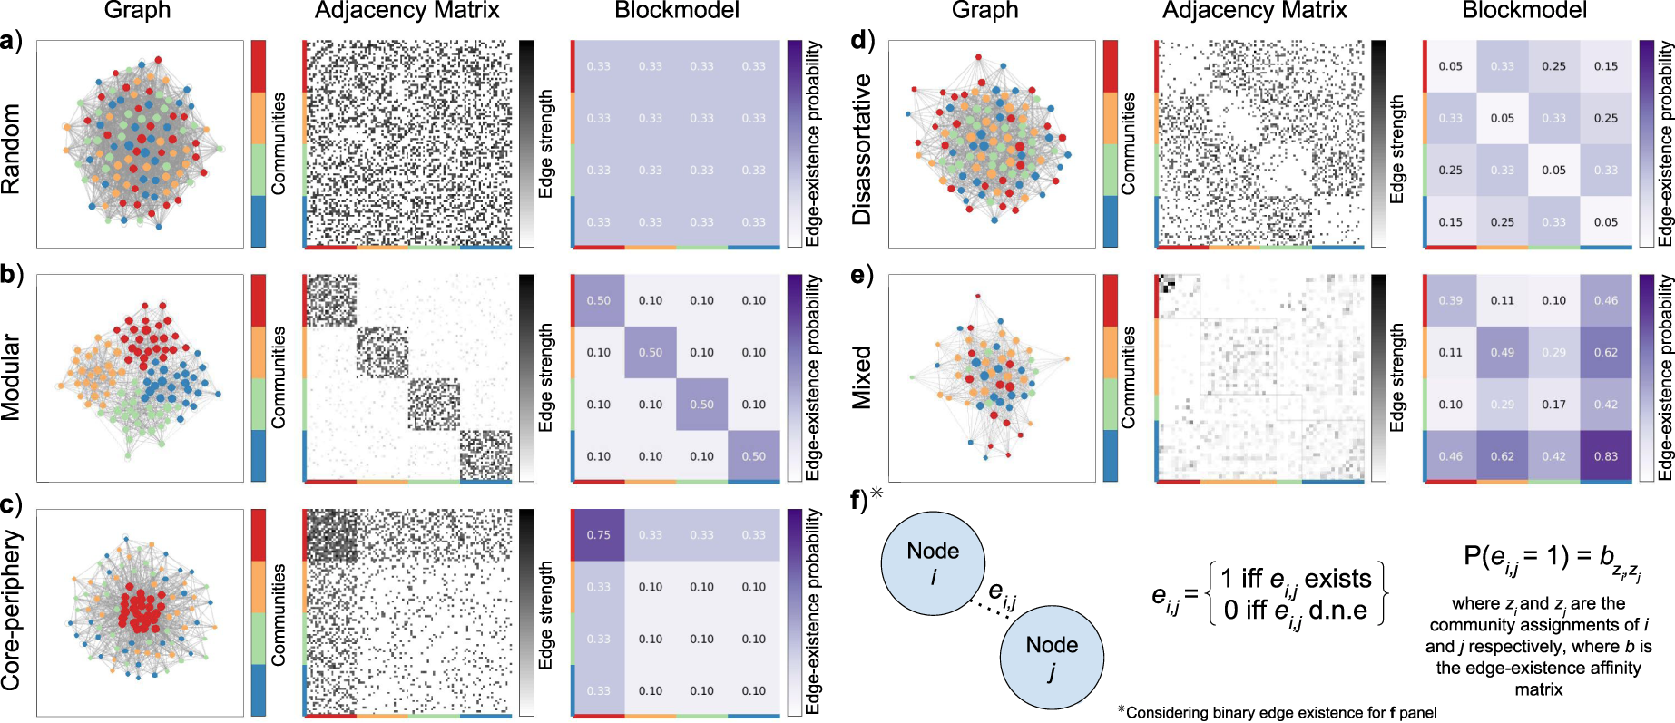
Examples of stochastic block model
z_{i} and z_{j} are the communities to which nodes i and j belong to
Faskowitz, J., Yan, X., Zuo, X. N., & Sporns, O. (2018). Weighted stochastic block models of the human connectome across the life span. Scientific reports, 8(1), 1-16.

Slide 32
Summary

Slide 33
Things to remember
Many networks have community structure
Sometimes it’s:
  One dense sub-graph
  Two communities (polarization)
  Multiple communities
Partitions vs overlapping communities
Hierarchical communities

