Slide 1

PageRank
Introduction to Network Science
Carlos Castillo
Topic 10

Slide 2
Sources
Networks, Crowds, and Markets Ch 14
Fei Li's lecture on PageRank
Evimaria Terzi's lecture on link analysis.
C. Castillo: Link-based ranking slides 2016

Slide 3
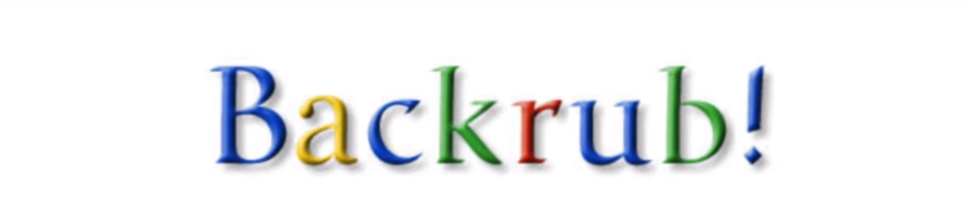
Part of a research project that started in 1995 ...

Slide 4
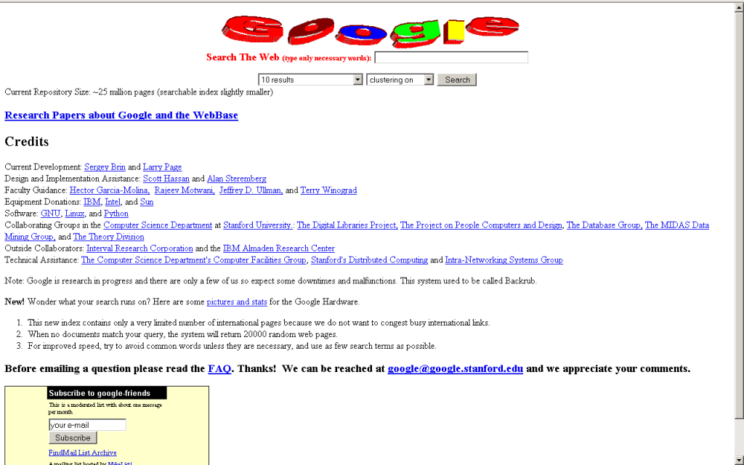

Slide 5
PageRank
The pagerank citation algorithm: bringing order to the web by L Page, S Brin, R Motwani, T Winograd - 7th World Wide Web Conference, 1998 [link].
A very good starting point, but not the end of web ranking!
  Today, it’s unlikely to be a top feature

Slide 6
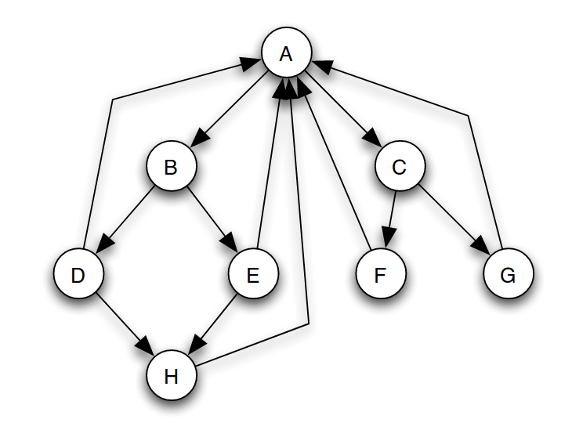
(Simplified) PageRank
All nodes start with score 1/n
Repeat k times:
  Divide equally and “send” its score to out-links
  Add received scores

Slide 7
Execute simplified PageRank:
All nodes start with
score 1/n
Repeat k times:
  Divide equally and “send”
  its score to out-links
  Add received scores
Keep intermediate values in
a table
Try to arrive to equilibrium
values

Slide 8
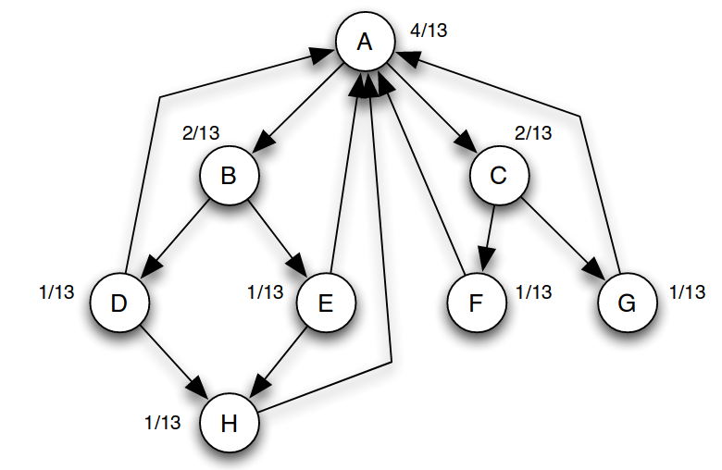
Equilibrium values

Slide 9
(Simplified) PageRank
N_{j}: the number of forward links of page j
c: normalization factor to ensure
  ||P||_{L1}= |P₁ + … + P_{n}| = 1

Slide 10
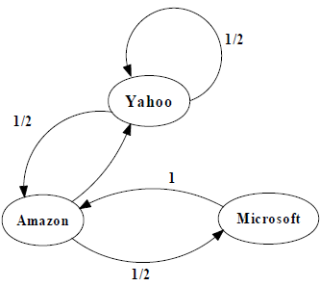
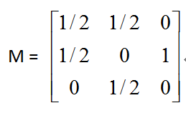
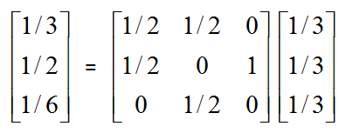
Another example of Simplified PageRank
First iteration of calculation

Slide 11
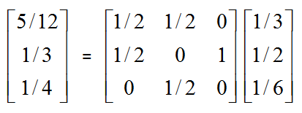
Another example of Simplified PageRank
First iteration of calculation

Slide 12
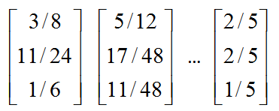
Another example of Simplified PageRank
Final score
First iteration of calculation

Slide 13
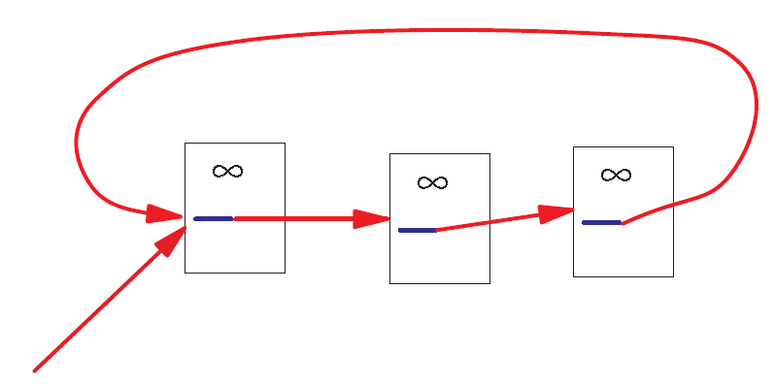
A Problem with Simplified PageRank
A loop:
During each iteration, the loop accumulates score but never distributes score to other pages!

Slide 14
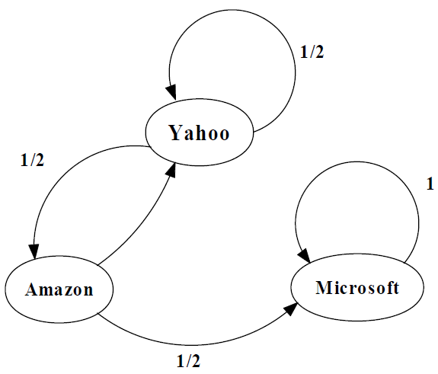
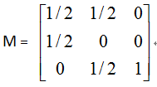
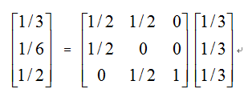
Example of the problem ...
First iteration of calculation

Slide 15
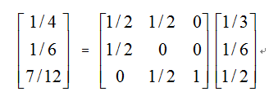
Example of the problem ...
First iteration of calculation

Slide 16
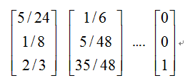
Example of the problem ...
The winner takes all!
First iteration of calculation

Slide 17
What are we computing?
What is p?
How do you call this method to compute p?

Slide 18
What are we computing?
p is an eigenvector of A with eigenvalue 1
This repeated multiplication is
the power method

Slide 19
What are we computing?
This will converge if A is:
  Stochastic (each row adds up to one)
  Irreducible (represents a strongly connected graph)
  Aperiodic (does not represent a bipartite graph)

Slide 20
Markov Chains
Discrete process over a set of states
Next state determined by current state and current state only (no memory of older states)
  Higher-order Markov chains can be defined
Stationary distribution of Markov chain is a probability distribution such that p = Ap
Intuitively, p represents “the average time spent” at each node if the process continues forever

Slide 21
Random Walks in Graphs
Random Surfer Model
  The simplified model: the standing probability distribution of a random walk on the graph of the web. simply keeps clicking successive links at random
Modified Random Surfer
  The modified model: the “random surfer” simply keeps clicking successive links at random, but periodically “gets bored” and jumps to a random page based on the distribution of E
  This guarantees irreducibility
  Pages without out-links (dangling nodes) are a row of zeros, can be replaced by E, or by a row of 1/n

Slide 22
PageRank
pref(i): web pages that “users” jump to when they “get bored”;
Uniform preferences => pref(i) = 1/n

Slide 23
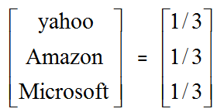
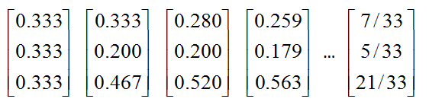
An example of PageRank

Slide 24

Variant: personalized PageRank
Modify pref(i) according to users' tastes
(e.g. user interested in sports vs politics)
http://nlp.stanford.edu/IR-book/html/htmledition/topic-specific-pagerank-1.html

Slide 25
PageRank and internal linking
A website has a maximum amount of Page Rank that is distributed between its pages by internal links [depends on internal links]
The maximum amount of Page Rank in a site increases as the number of pages in the site increases.
By linking poorly, it is possible to fail to reach the site's maximum Page Rank, but it is not possible to exceed it.
http://www.cs.sjsu.edu/faculty/pollett/masters/Semesters/Fall11/tanmayee/Deliverable3.pdf

Slide 26
Liquid democracy

Slide 27
PageRank as a form of actual voting (liquid democracy)
If alpha = 1, we can implement liquid democracy
  In liquid democracy, people chose to either vote or to delegate their vote to somebody else
If alpha < 1, we have a sort of “viscous” democracy where delegation is not total

Slide 28

PageRank as a form of liquid democracy
Boldi, P., Bonchi, F., Castillo, C., & Vigna, S. (2011). Viscous democracy for social networks. Communications of the ACM, 54(6), 129-137.

Slide 29

These two graphs have different alpha (0.2 and 0.9)
Which one is which?

Slide 30
These two graphs have different alpha (0.2 and 0.9)
Which one is which?

Slide 31
PageRank Implementation
Suppose there are n pages and m links
Trivial implementation of PageRank requires O(m+n) memory
Streaming implementation requires O(n) memory … how?
  Streaming: graph is never held on memory

Slide 32
PageRank streaming implementation
Maintain in memory
Update by reading the graph from disk

