Slide 1

Community structure
in networks
Introduction to Network Science
Carlos Castillo
Topic 19

Slide 2
Sources
Barabási 2016 Chapter 9
Networks, Crowds, and Markets Ch 3
C. Castillo: Graph partitioning 2017

Slide 3
Typical community structures
One dense sub-graph
  embedded somewhere within a larger graph
Two groups (polarization)
  plus perhaps some ambiguous nodes
Multiple communities

Slide 4
One dense sub-graph

Slide 5
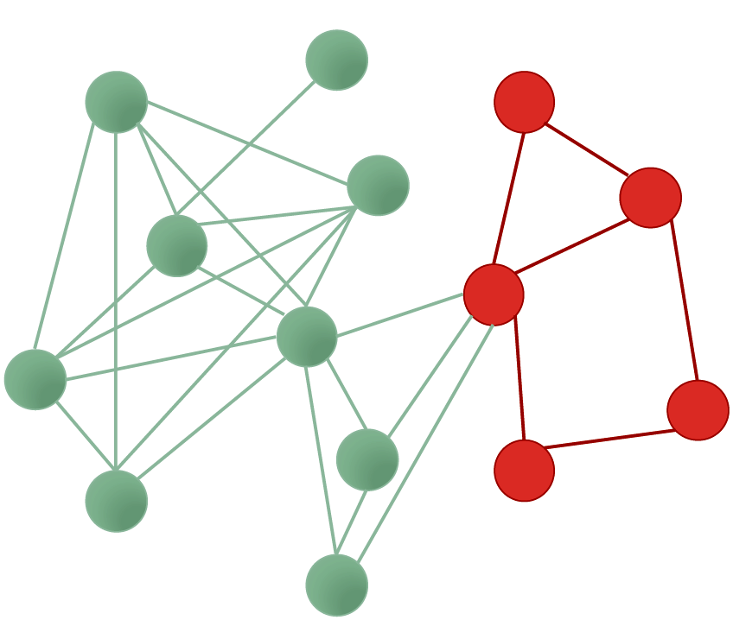
What is a sub-graph?
Subset of nodes, and edges among those nodes

Slide 6
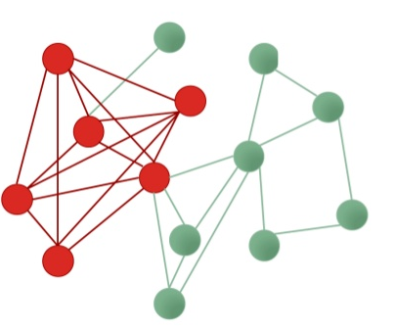
Densest sub-graph
Sub-graph having the maximum density

Slide 7
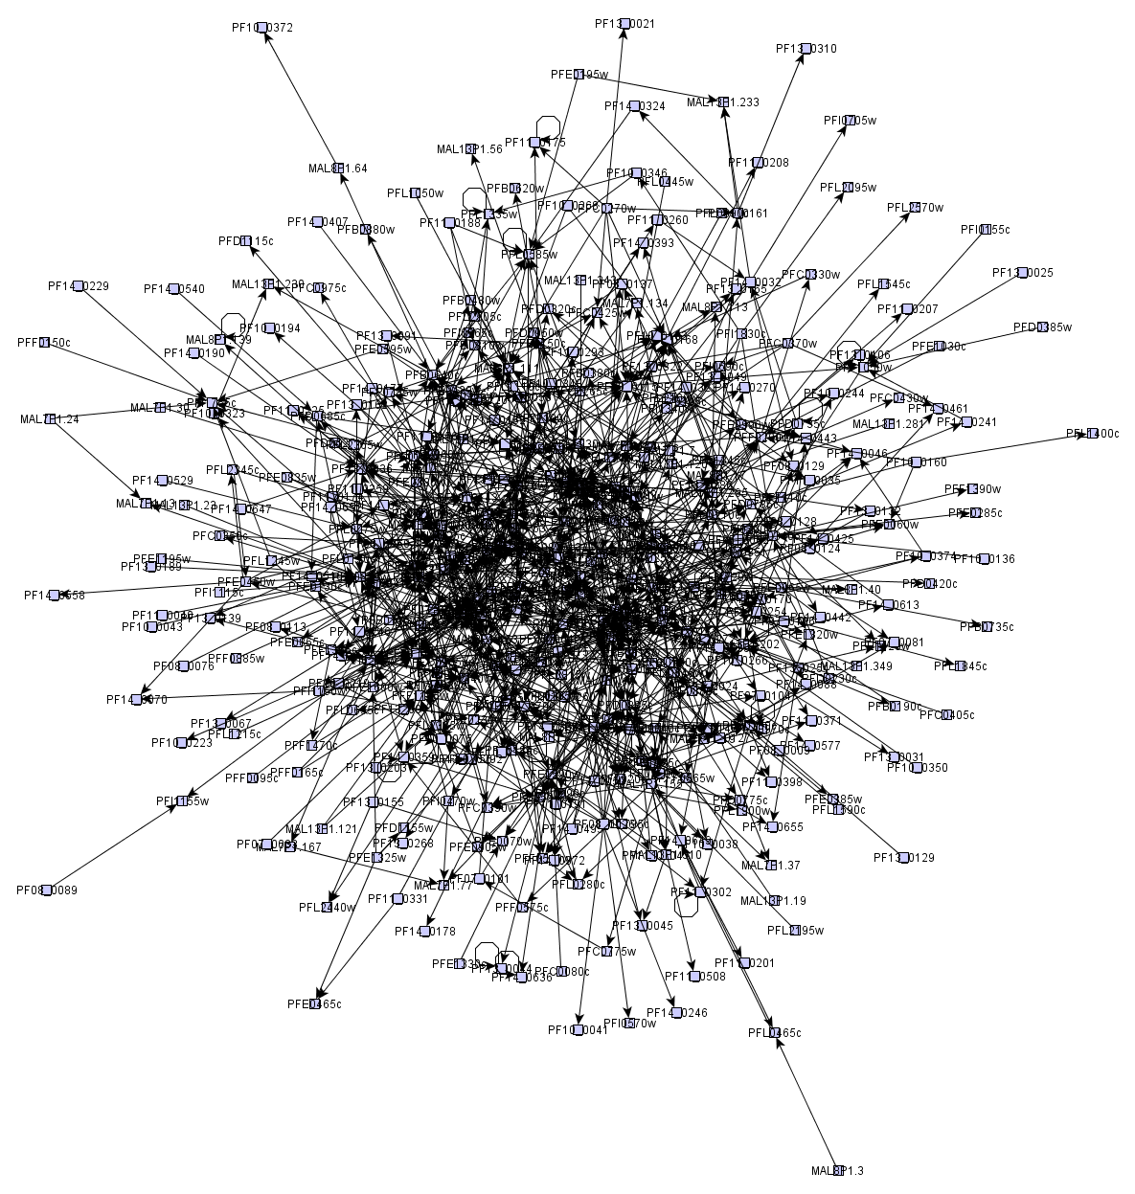
Many graphs look like “hairballs”
Sometimes, at the center these graphs may have an interesting dense sub-graph

Slide 8
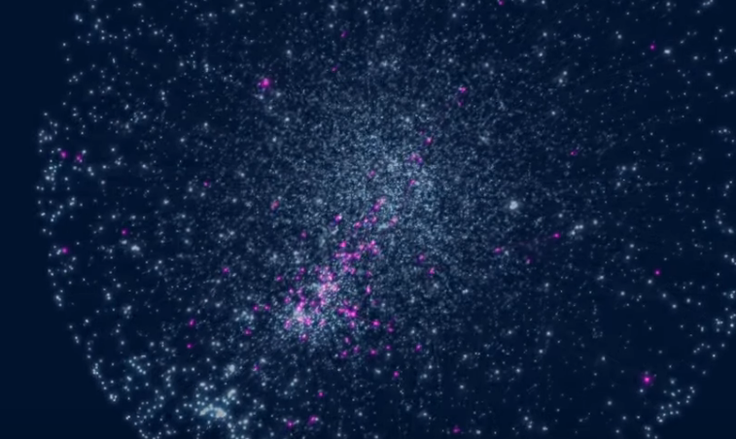
Asthma-related genes
https://www.youtube.com/watch?v=VU_7FHAKMgA

Slide 9
Two groups (polarization)

Slide 10
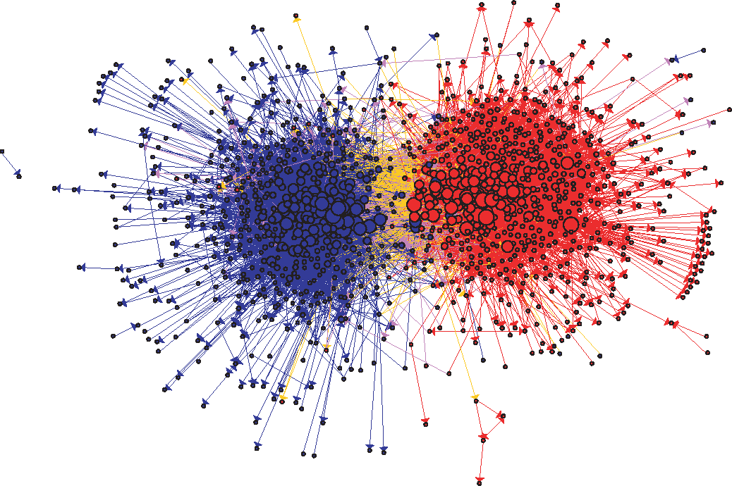
US Political Blogs (2004)
Liberal
Conservative
Adamic, L. A., & Glance, N. (2005, August). The political blogosphere and the 2004 US election: divided they blog. In Proc. LinkKDD (pp. 36-43). ACM.

Slide 11
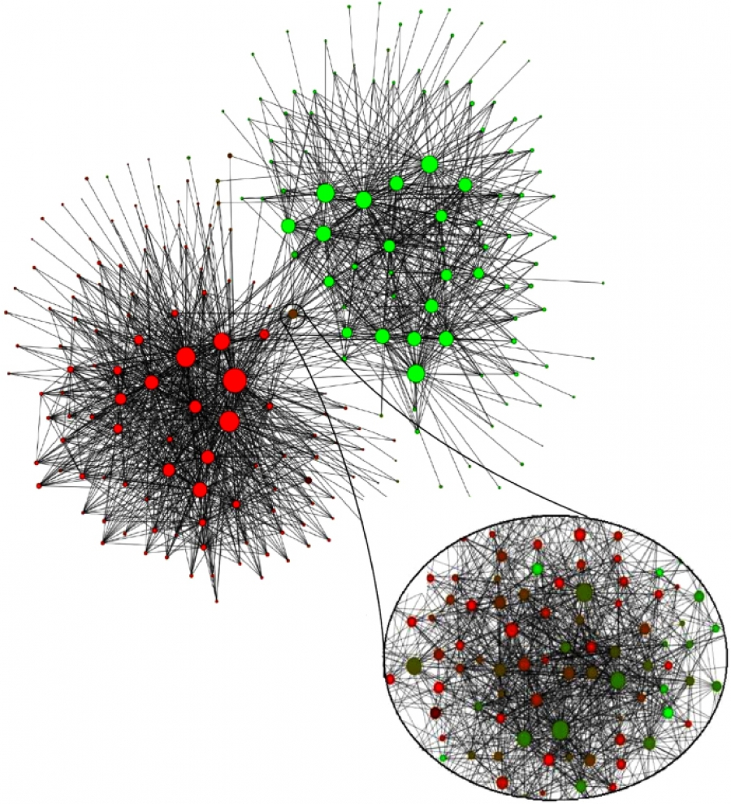
Mobile phone users in Belgium (2008)
Each node is a community of 100 mobile users or more that tend to call each other
Dutch-speaking
French-speaking
V. D. Blondel, J.-L. Guillaume, R. Lambiotte, and E. Lefebvre. Fast unfolding of communities in large networks. J. Stat. Mech., 2008.

Slide 12
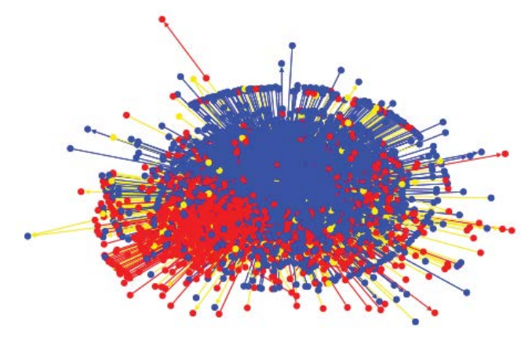
Egyptian Twitter Users (2013)
Islamist
Secularist
Weber, I., Garimella, V. R. K., & Batayneh, A. (2013, August). Secular vs. Islamist polarization in egypt on twitter. In Proc. ASONAM (pp. 290-297). ACM.

Slide 13
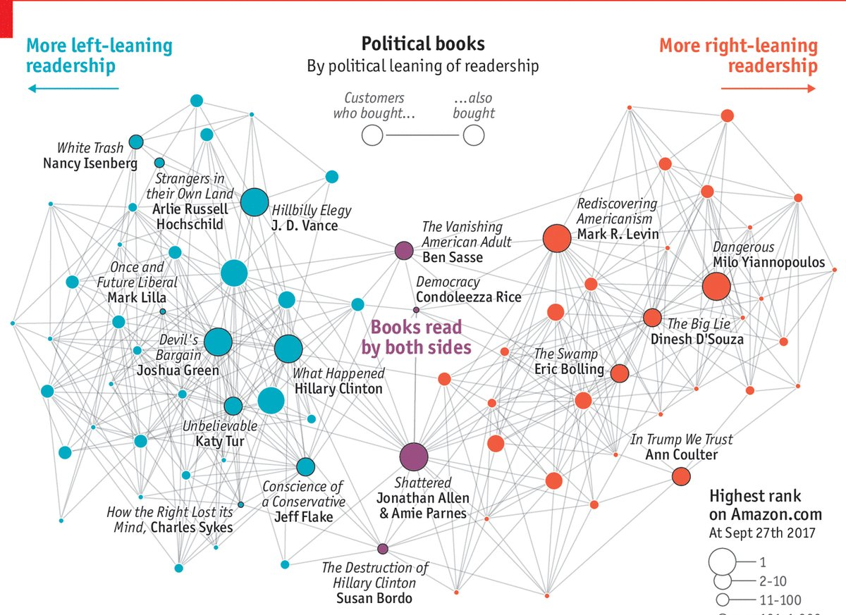
Political Books
Source:
Valdis Kreb
& The Economist

Slide 14
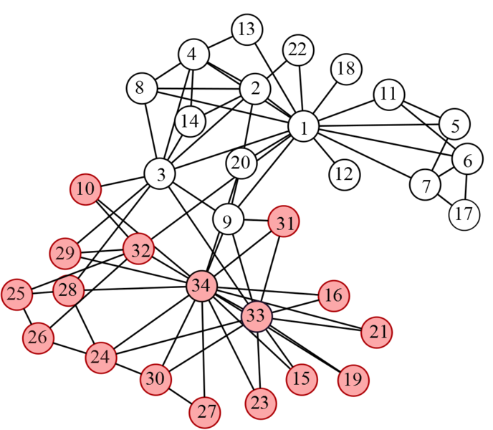
Wayne Zachary’s PhD Thesis (1972)
Studied 34 members of a karate club
Found 78 links between members who regularly interacted outside the club
The club splitted in two during the study
1=sensei, 34=president

Slide 15
Simple exercise
How many edges connect a white node to a red node?
What if node 9 goes to the red component?
Answer in Nearpod Collaborate
https://nearpod.com/student/
Code to be given during class

Slide 16
Multiple communities

Slide 17
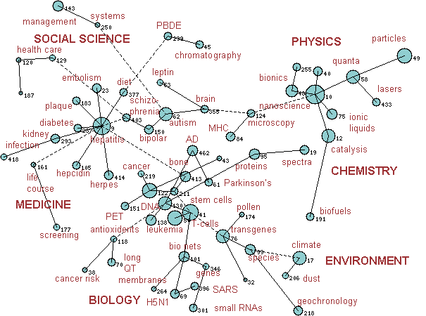
Science
Links connect two topics
T1, T2,
if there is a paper A that
cites:
a paper B in T1 and
a paper C in T2.
http://archive.sciencewatch.com/dr/rfm/mos/10maymosGLOBAL/

Slide 18
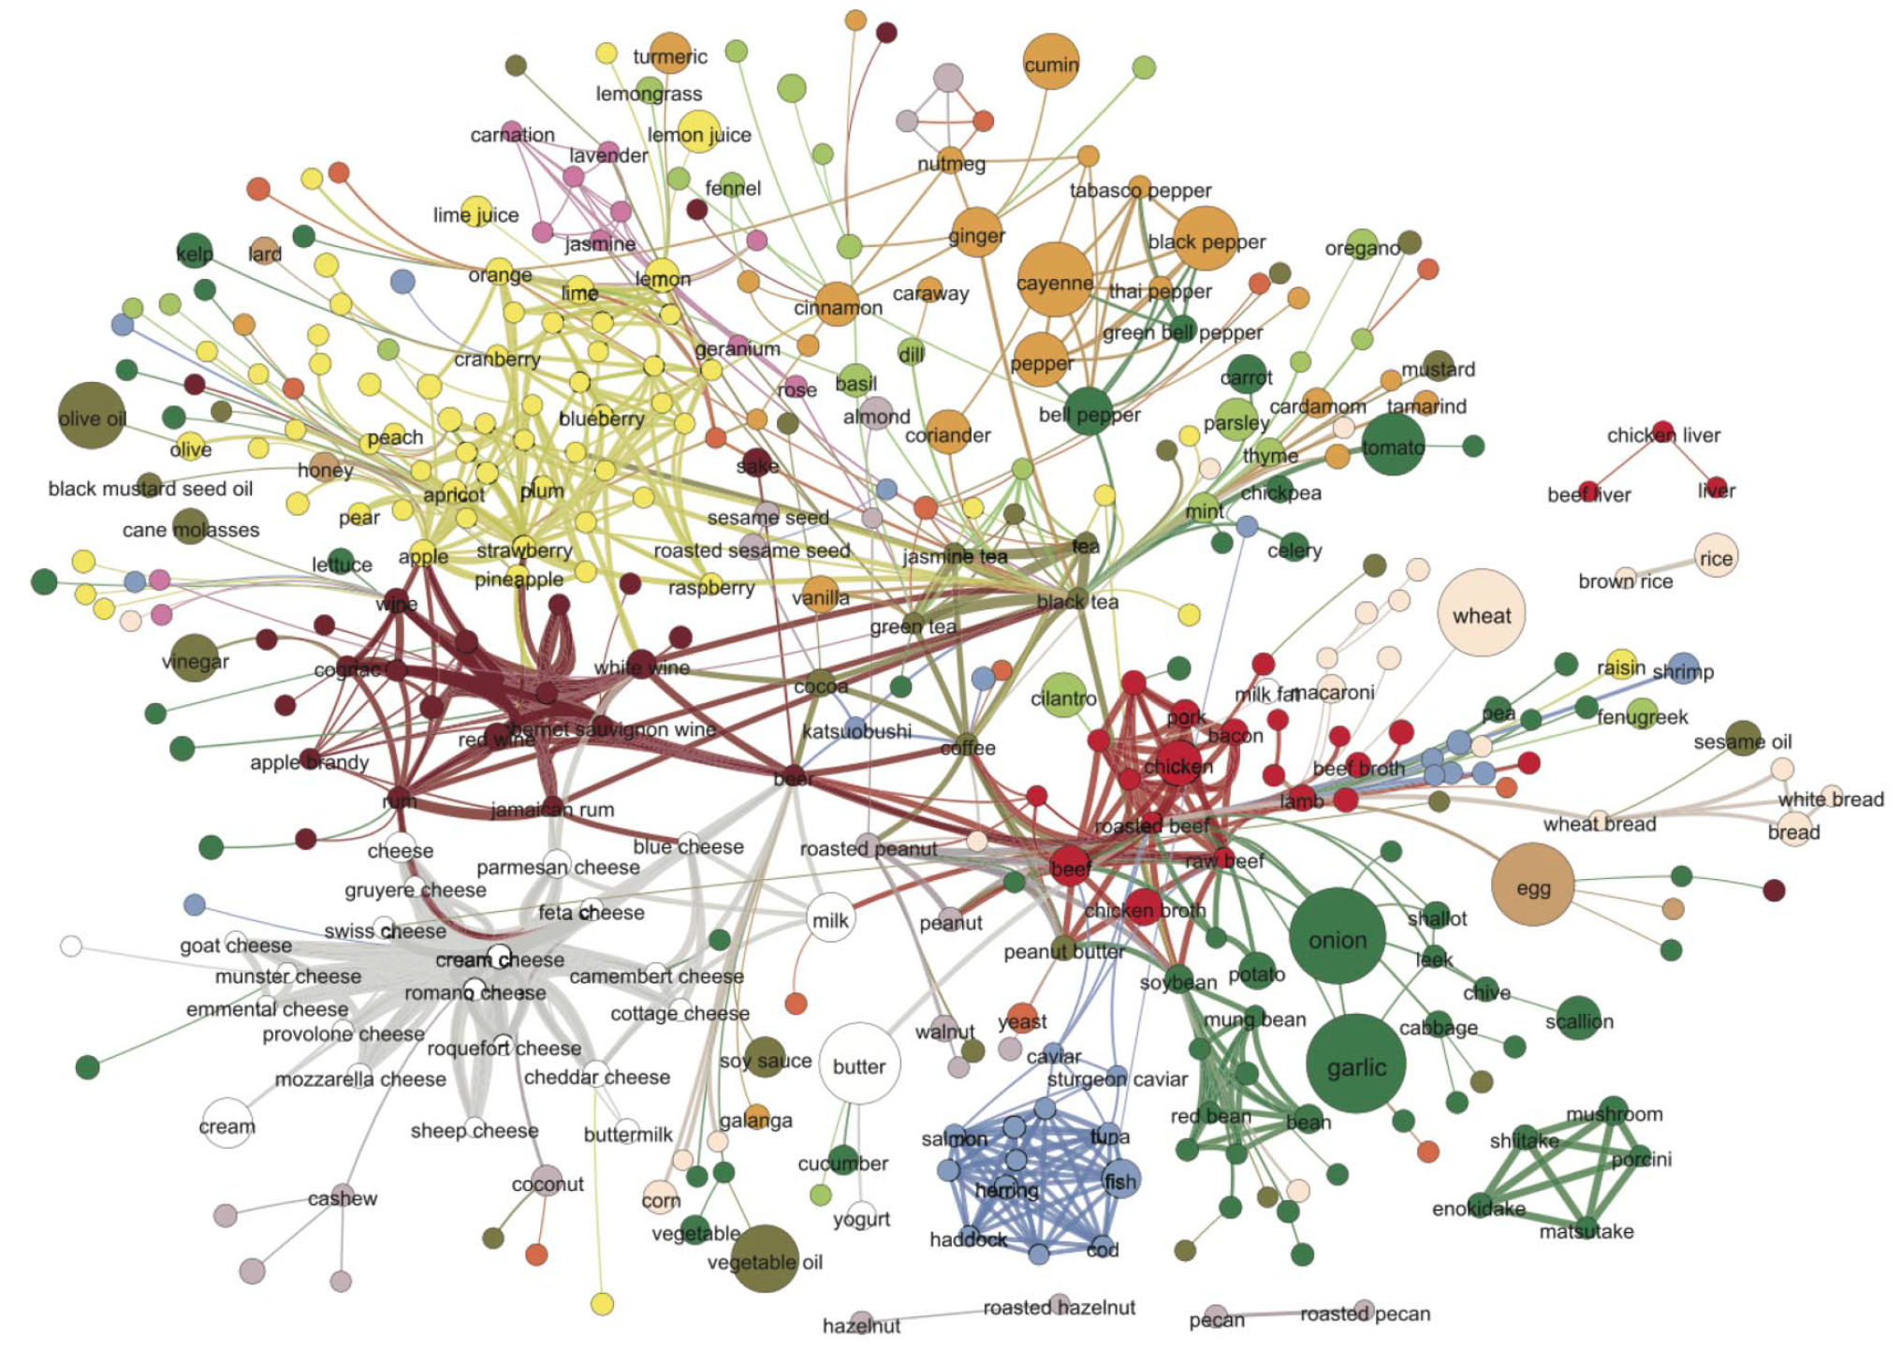
Flavors
Ahn, Y. Y., Ahnert, S. E., Bagrow, J. P., & Barabási, A. L. (2011). Flavor network and the principles of food pairing. Scientific reports, 1, 196.

Slide 19
Flavors
(cont.)

Slide 20
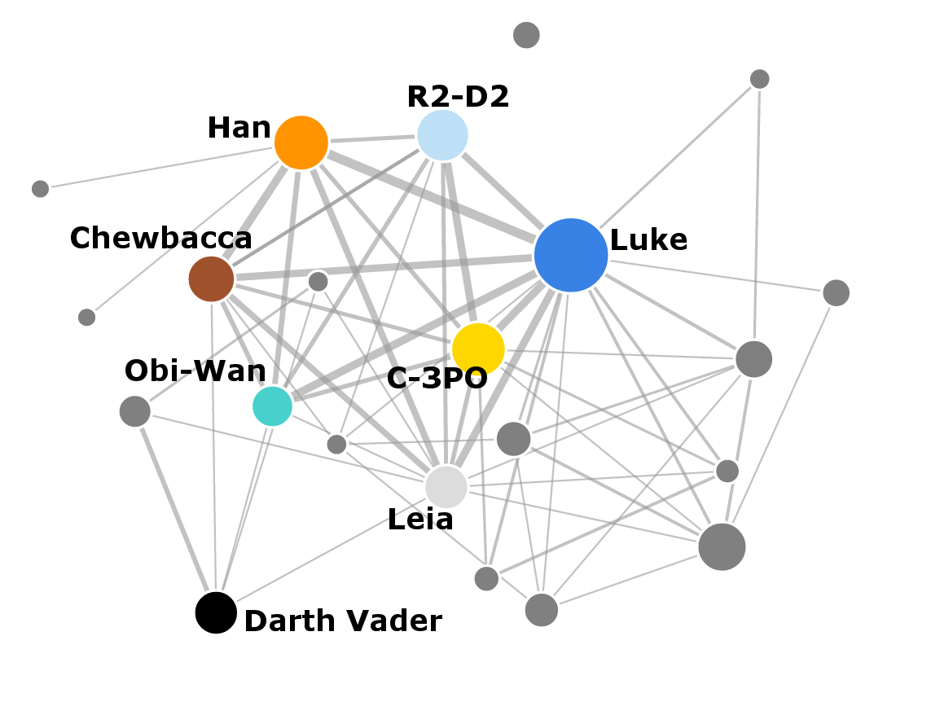
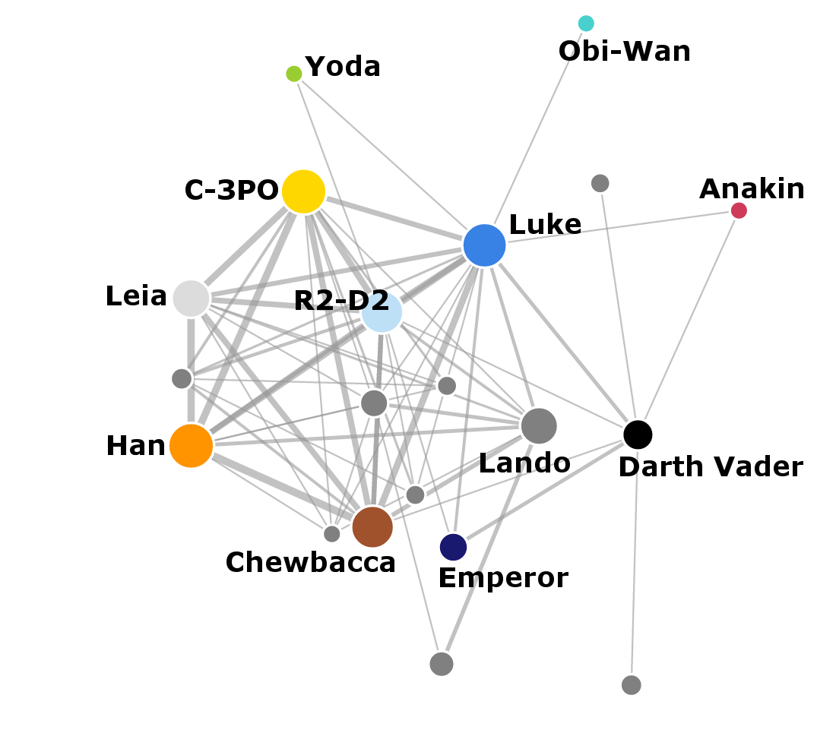
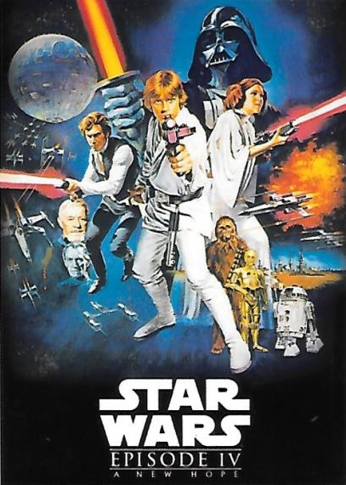

Star Wars

Slide 21
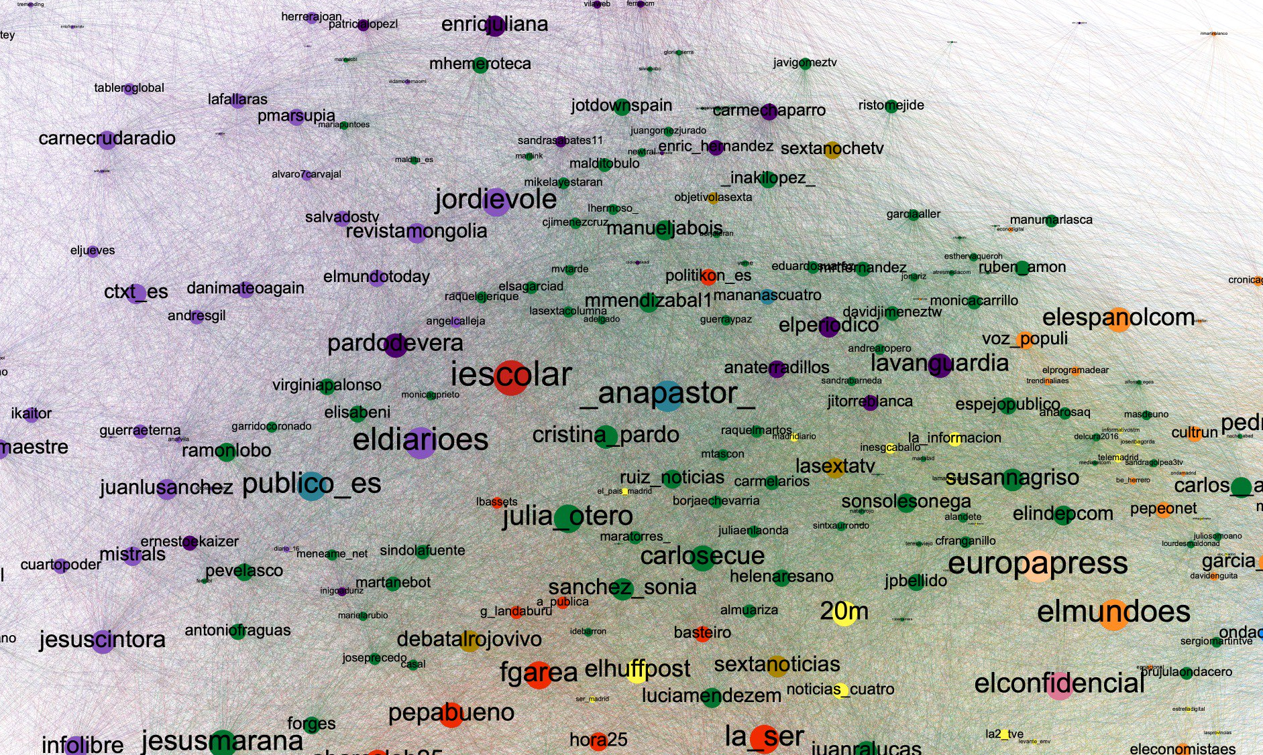
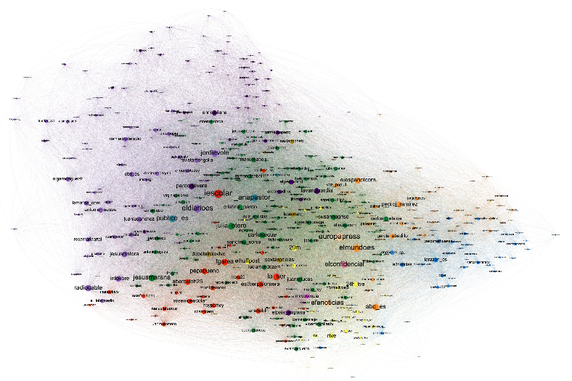
Media and politicians?
https://twitter.com/jbo/status/1120444347772821504/photo/1

Slide 22
Summary

Slide 23
Things remember
Many networks have community structure
Sometimes it’s:
  One dense sub-graph
  Two communities (polarization)
  Multiple communities

