Slide 1

Why studying networks?
Introduction to Network Science
Carlos Castillo
Topic 01

Slide 2
These slides contain ...
A personal introduction
  Why network science is important to me
Examples of complex networks
Overview of the course

Slide 3
Sources
Albert László Barabási: Network Science. Cambridge University Press, 2016.
  Chapters 01-02
URLs cited in the footer of specific slides

Slide 4
A personal introduction

Slide 5
PhD work (2000-2004)
Collecting web pages
Characterizing national web domains
  Chile, Korea, Greece, Spain ...

Slide 6
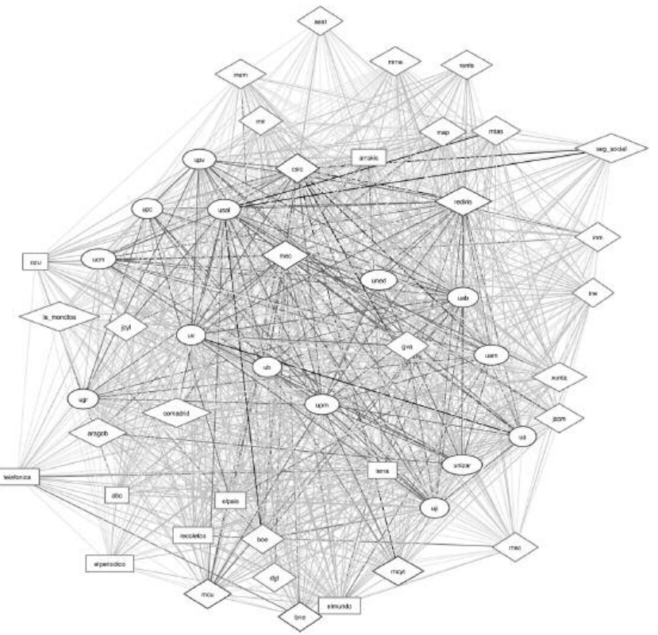
Top domains in .es (~2006)
usal
“GOV”
la_moncloa
“COM”
ub
“EDU”
http://eprints.rclis.org/9292/1/vol15_1.2.pdf
elmundo

Slide 7
Post-doctoral work (2005-2009)
Web spam pages
  Pages created to deceive search engines
  Attract traffic by stuffing themselves with keywords
  Increase link score of other pages
  Methods evolve all the time, how to catch them?

Slide 8
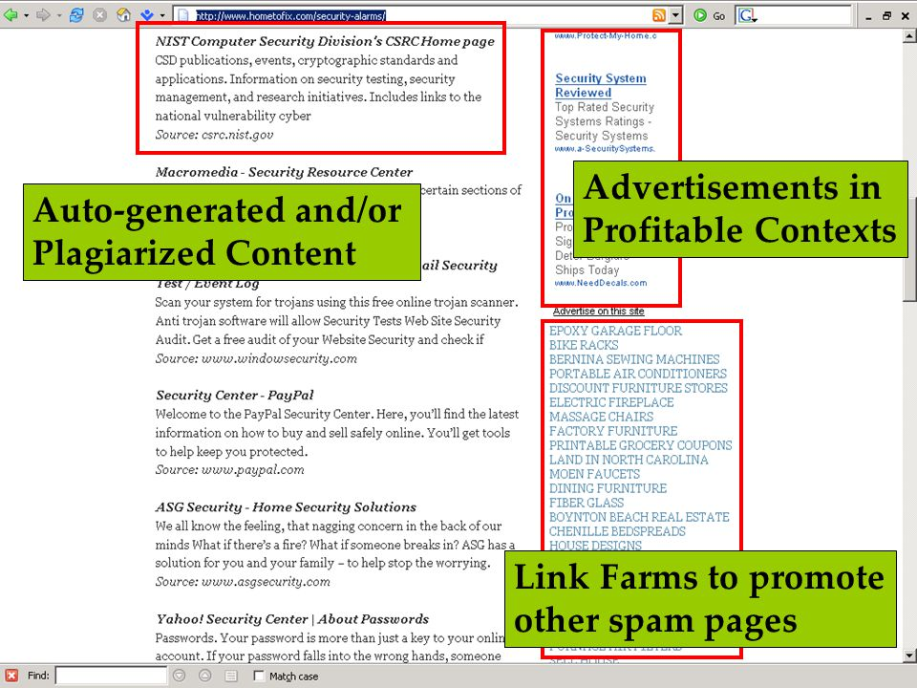
Pranam Kolari’s PhD defense, 2007
https://slideplayer.com/slide/4825954/

Slide 9
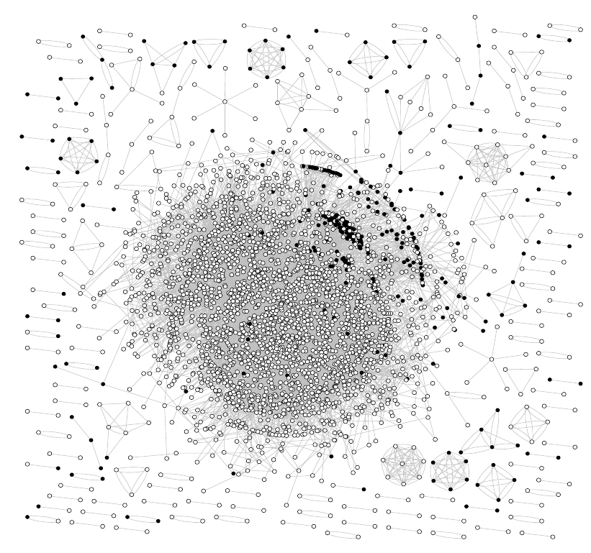
Eureka! Moment
2006
Use gnuplot to visualize an annotated dataset
White: non-spam
Black: spam
https://doi.org/10.1145/1277741.1277814

Slide 10
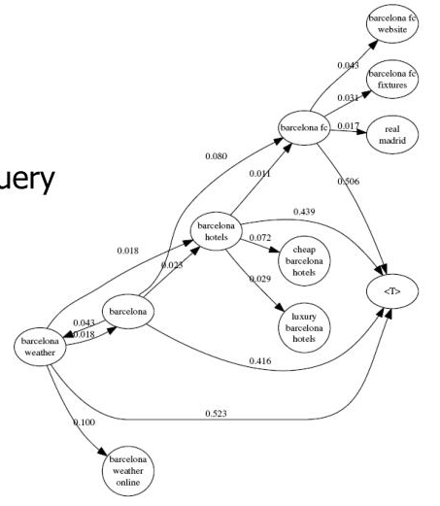
Query flows
2008
What is the most likely query before or after another query?
How are they connected?

Slide 11
Graphs in my own work
Characterizing national web domains
Finding web spam pages
Suggesting queries to searchers
…
Currently:
  part of a larger toolbox
  skeptical about structural-only conclusions

Slide 12
Network Science

Slide 13
Wikipedia definition
Network science is an academic field which studies complex networks such as
  telecommunication networks, computer networks, biological networks, cognitive and semantic networks, and social networks,
considering
  distinct elements or actors represented by nodes and
  the connections between the elements or actors as links.

Slide 14

Complex systems
Many interconnected parts
Complicated arrangement
of connections
Emerging properties

Slide 15
Behind every complex system there is a complex network
Connections between neurons in the brain
Interactions between genes and proteins
Family/friendship links in human and non-human animals
Infrastructure of telecommunications, electricity
Commerce/trade networks

Slide 16
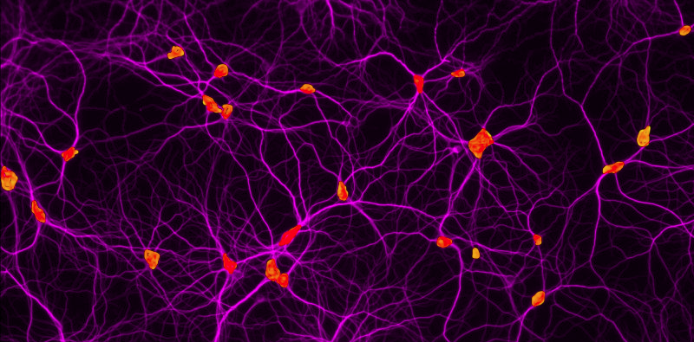
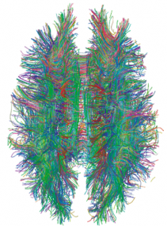
Human brain: |V| ≃ 90 x 10⁹
https://health.uconn.edu/cell-analysis-modeling/microscopy-facility-2/
https://dx.doi.org/10.1371%2Fjournal.pone.0004006

Slide 17
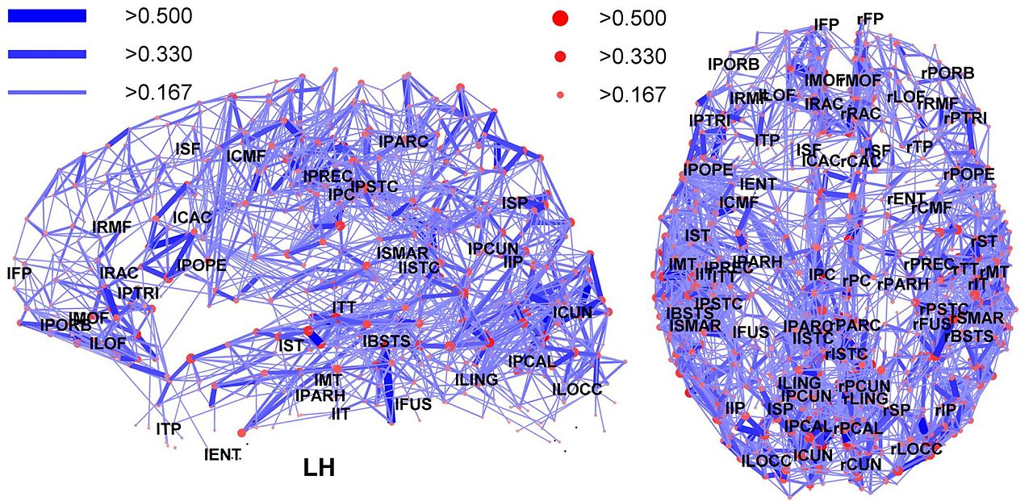
Regions in the human brain
https://en.m.wikipedia.org/wiki/File:Network_representation_of_brain_connectivity.JPG

Slide 18
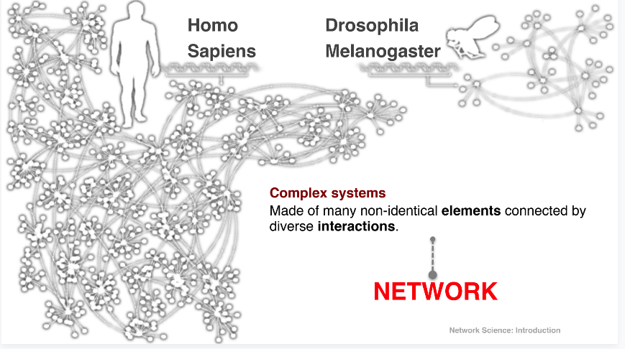
Gene networks

Slide 19
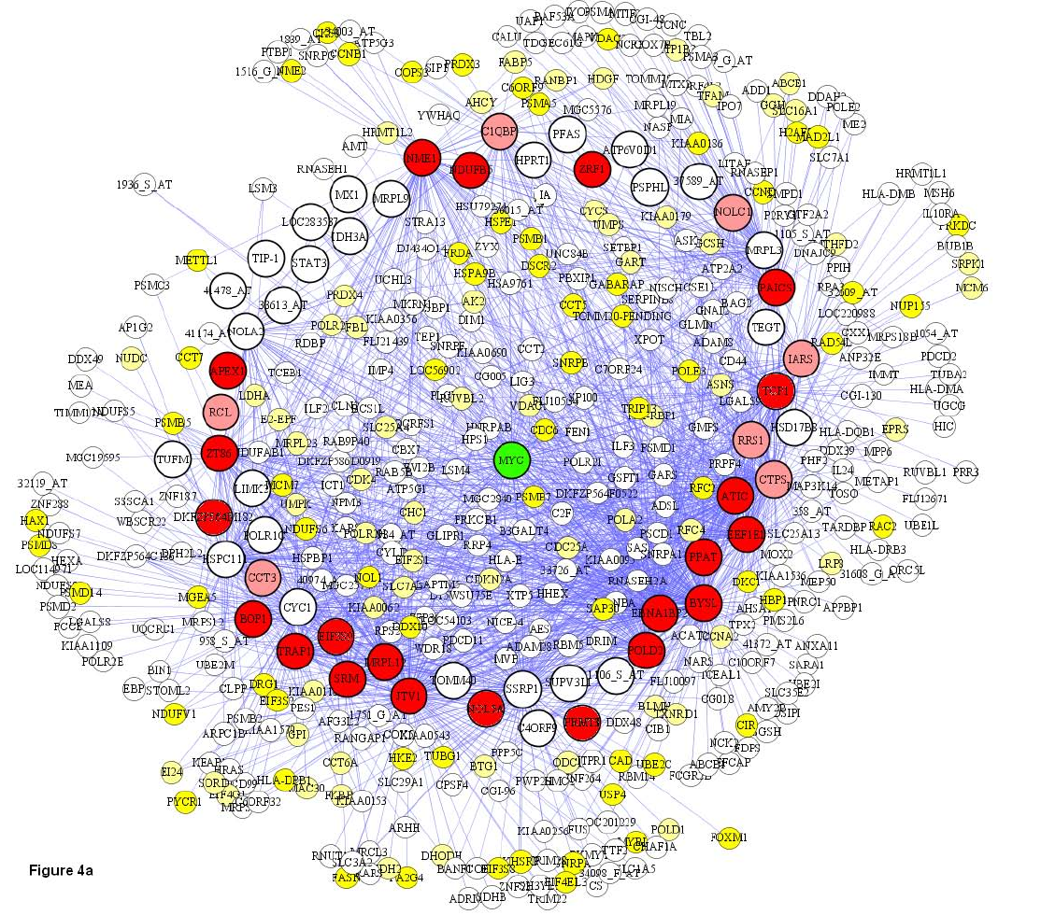
Co-expression of Genes
|V|=500 in this plot
Basso, K., Margolin, A. A., Stolovitzky, G., Klein, U., Dalla-Favera, R., & Califano, A. (2005). Reverse engineering of regulatory networks in human B cells. Nature genetics, 37(4), 382.

Slide 20
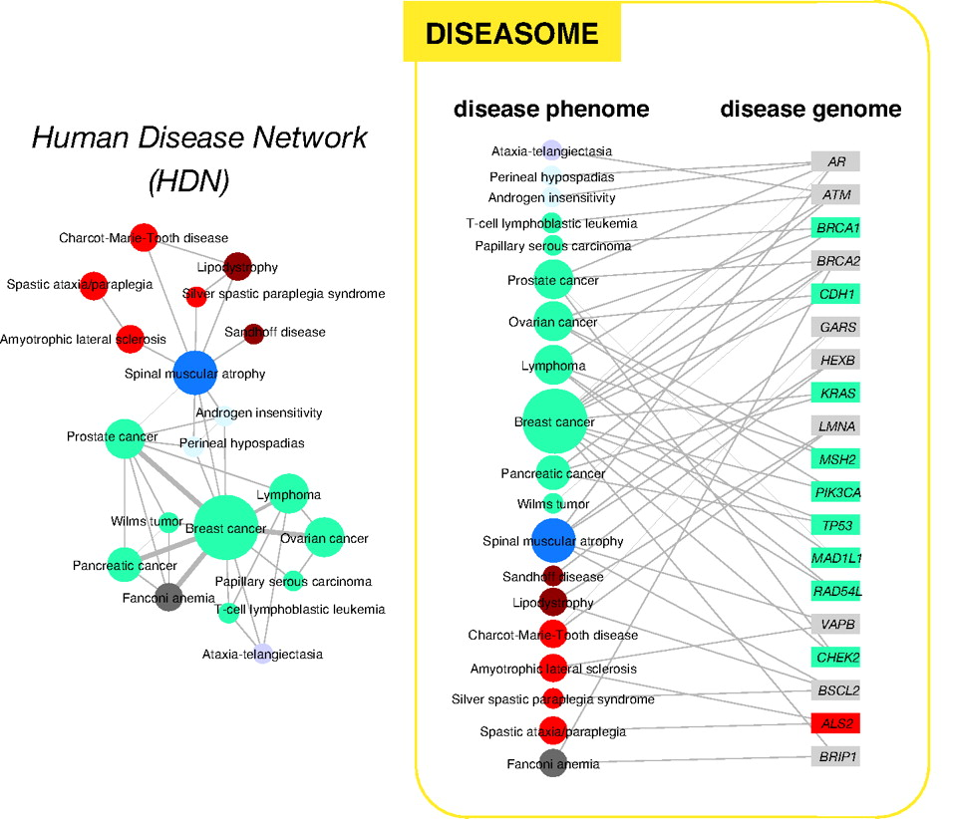
Human disease network
http://www.pnas.org/content/104/21/8685

Slide 21
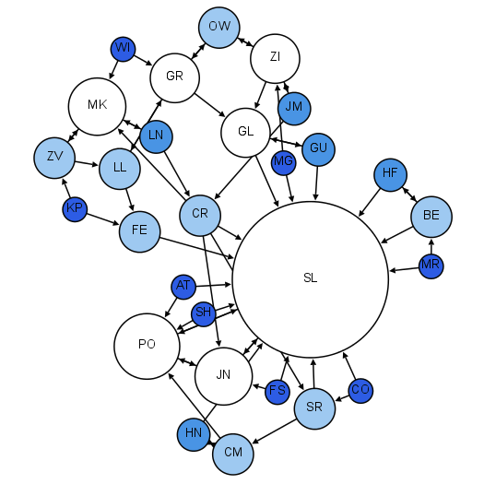
Moreno’s sociograms
Colors and sizes:
indegree
Early 1930s
Children in 2nd grade
Who would you like to sit with?
http://www.martingrandjean.ch/social-network-analysis-visualization-morenos-sociograms-revisited/

Slide 22
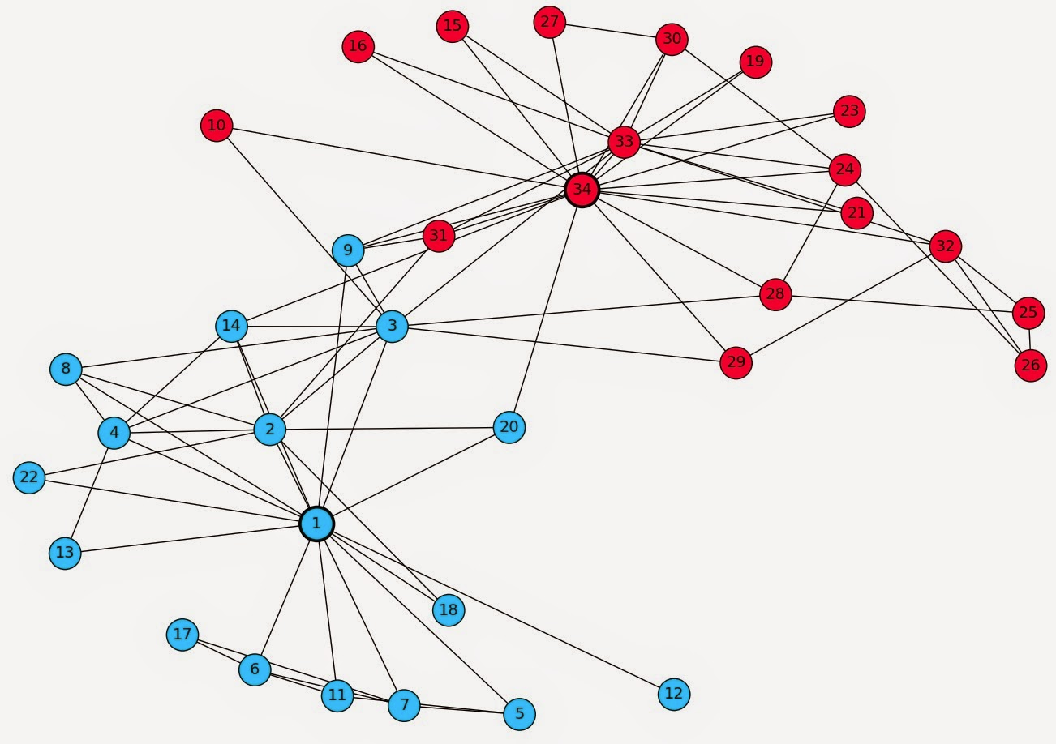
Zachary’s Karate Club
Karate club that split into two clubs
(led by 1 and 34)

Slide 23
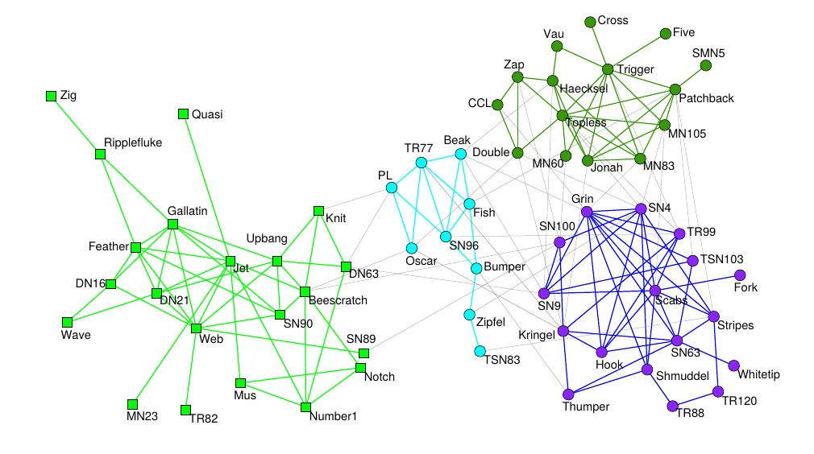
Dolphins in a fjord in New Zealand
Research following a school of dolphins in the wild (2003)
Look for dolphins swimming together
Found long-lasting associations; research has been repeated with other non-human animals (e.g., sheep)
https://doi.org/10.1007/s00265-003-0651-y

Slide 24
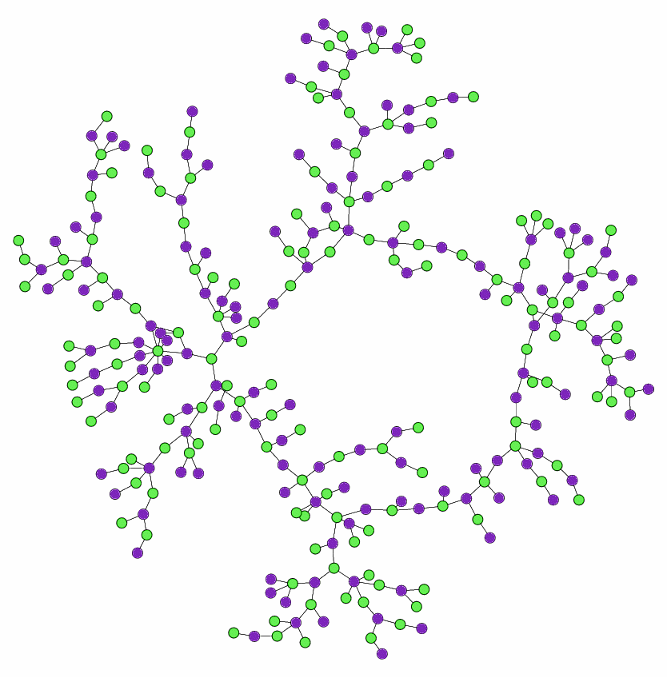
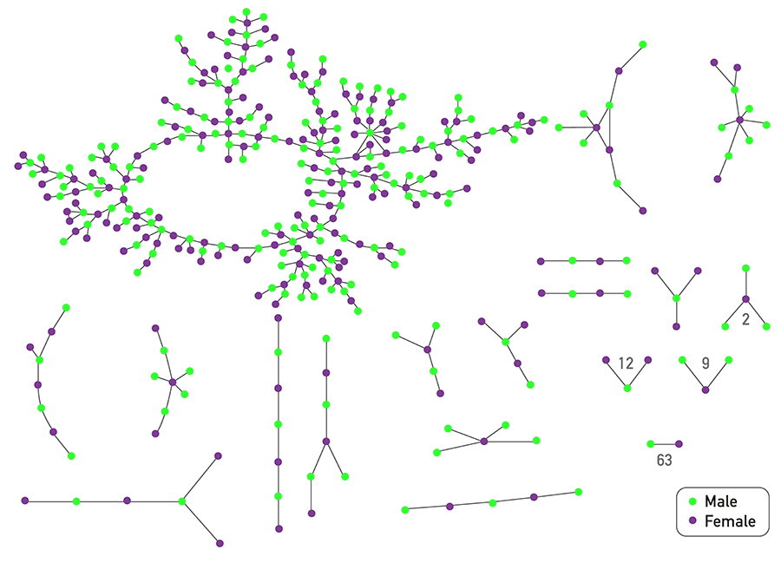
Chains of affection
Early 2000s
Adolescents in high school
A “special romantic relationship” or a “nonromantic sexual relationship” in the past 18 months
Bearman, P. S., Moody, J., & Stovel, K. (2004). Chains of affection: The structure of adolescent romantic and sexual networks. American journal of sociology, 110(1), 44-91.

Slide 26
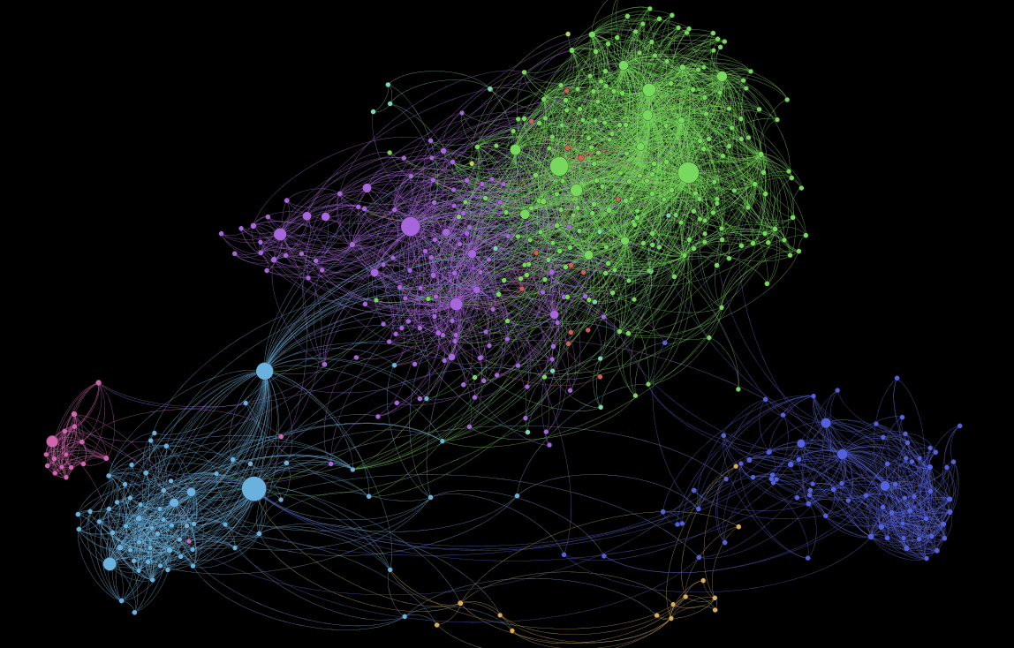
1,000 Somali Users of Facebook
https://kimoquaintance.com/2011/08/22/what-can-we-learn-about-somalis-from-their-facebook-networks/

Slide 27
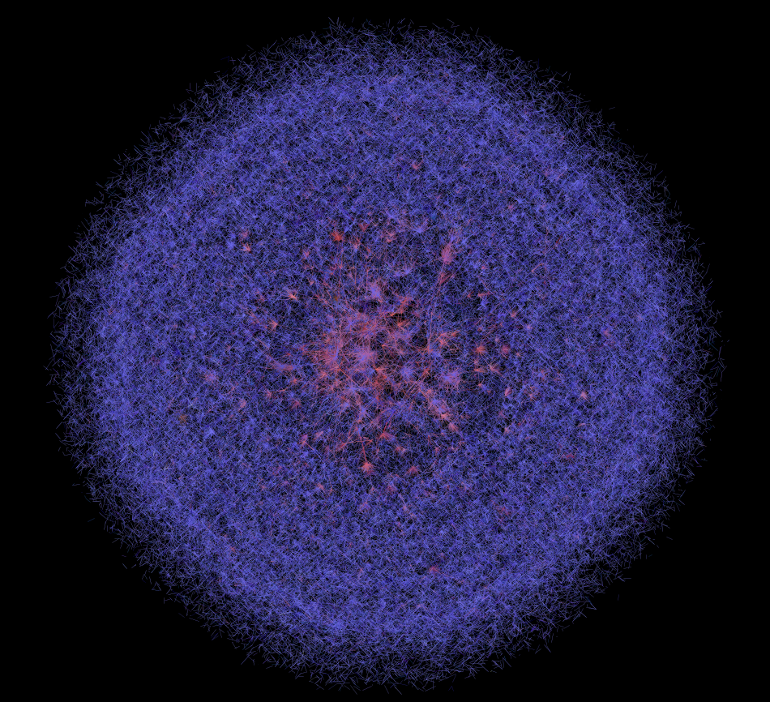
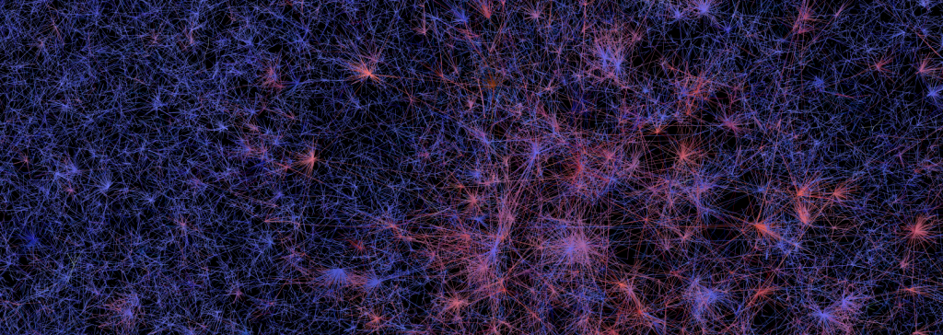
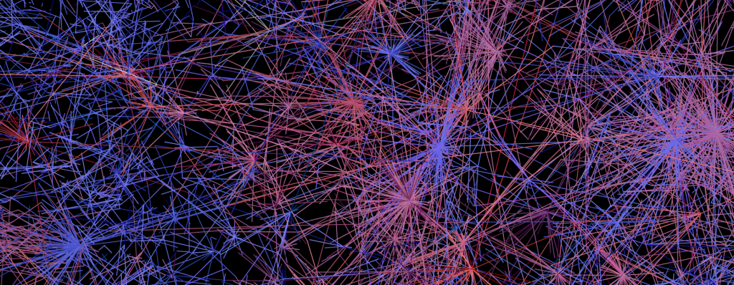
400,000 Twitter Users
https://dhs.stanford.edu/gephi-workshop/twitter-network-gallery/

Slide 28
What could these networks have in common? Why those regularities could be relevant? How would you find out what they are?

Slide 29
Universality of complex networks
“A key discovery of network science is that the architectures of networks emerging in various domains of science, nature and technology are similar to each other, a consequence of being governed by the same organizing principles.” (Barabási 2016)

Slide 30
Characteristics of network science
Interdisciplinary; indeed we often address problems from disciplines other than CS
Empirical and data-driven; it is based on the observation of networks
Quantitative, mathematical, computational

Slide 31
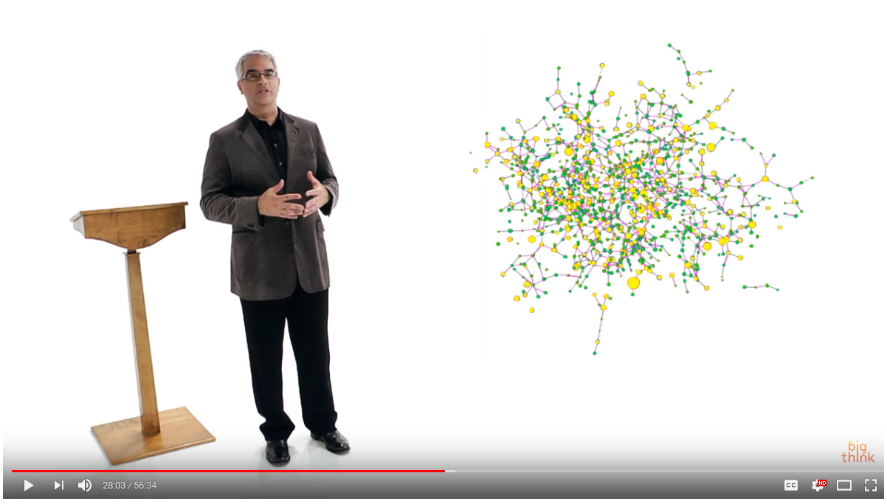
What can you do with this?
Help design new treatments and drugs
...
Highly recommended:
Nicholas Christakis
(one hour lecture)
https://www.youtube.com/watch?v=wadBvDPeE4E

Slide 32
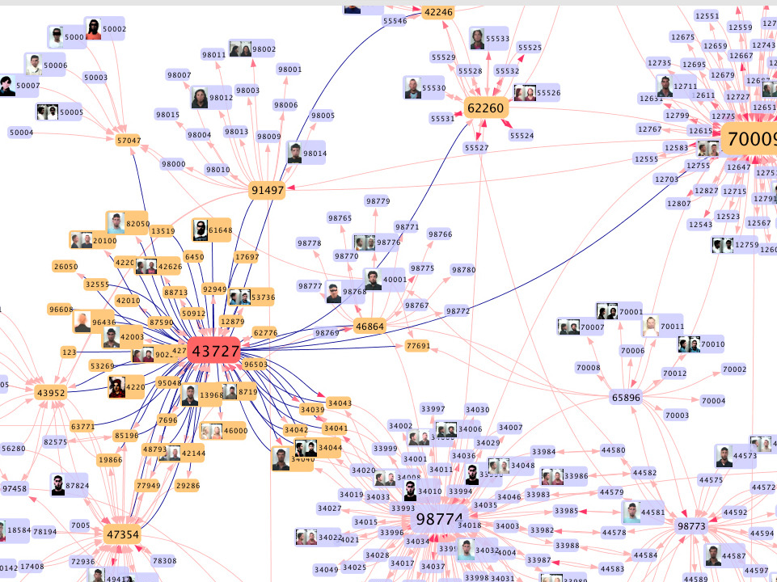
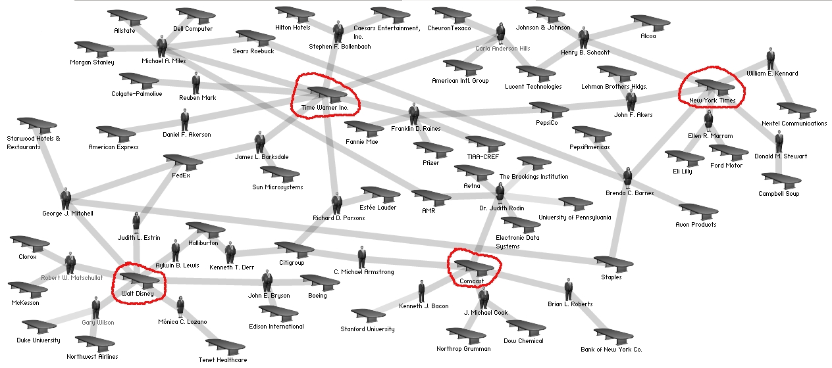
Help fight organized crime and collusion
https://itnews.iu.edu/articles/2014/complex-networks-researcher-at-iu-fighting-crime-with-mobile-phone-data.php
https://en.wikipedia.org/wiki/File:Media_corporation_interlocks_-_2004.jpg

Slide 33
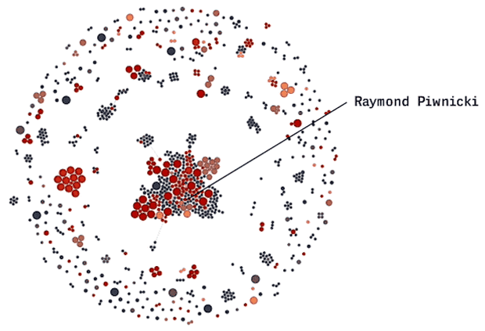
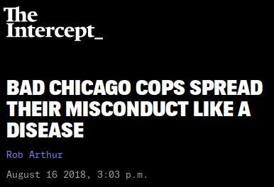
Help fight corruption
https://theintercept.com/2018/08/16/chicago-police-misconduct-social-network/

Slide 34
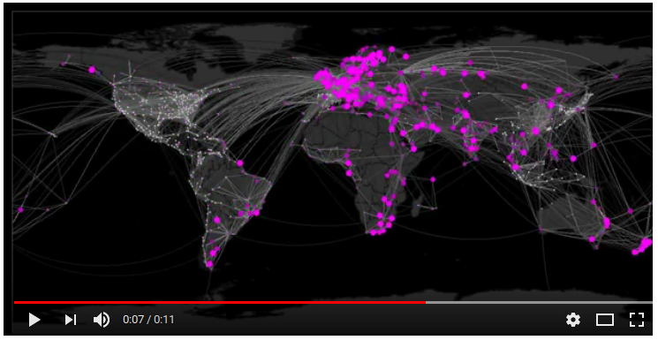
Help to forecast epidemics
https://www.youtube.com/watch?v=mm2u9RKwgsY

Slide 35
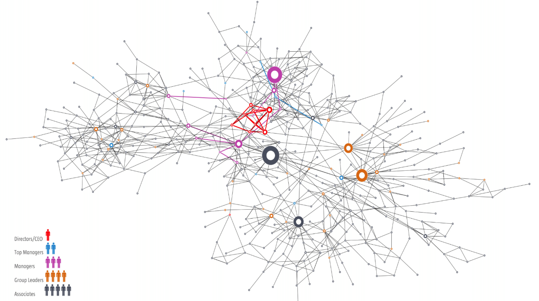
Help understand an organization, a society, or a brain

Slide 36
What can you do with this?
Help design new treatments and drugs
Help fight organized crime and corruption
Help to forecast epidemics
Help to understand an organization, a society, or a brain

Slide 37
What you can learn in this course
To describe a network in formal terms
To identify it as such and characterize it
To visualize different networks
To operate with networks programmatically
To find important nodes and communities
To make discoveries or help others make them
Much more (to a large extent, it’s up to you!)

Slide 38
Organization of the course
Theory sessions:
  Help you understand how to model complex networks
  Help you find important nodes, communities, and track influence
  Do some simple (and not so simple) exercises to check that you understood correctly each concept, and to help you remember
  Follow “Network Science” by Barabási
Practice sessions:
  Help you work with complex networks
  Manage and analyze graphs in Python
  New material
My focus is on what I think has value for you as a data scientist

Slide 39
Summary

Slide 40
Things to remember
Definitions: complex system, complex network
Examples of complex networks
Applications of complex networks analysis

Slide 41
Course overview and evaluation

Slide 42
Theory topics and practice sessions
(See course materials)

Slide 43
Evaluation rules
(See course materials)

