Slide 1

Spreading phenomena
Introduction to Network Science
Carlos Castillo
Topic 16

Slide 2
Sources
Easley and Kleinberg (2010): Networks, Crowds, and Markets Ch 19
Carlos Castillo, Wei Chen, Laks V. S. Lakshmanan (2012): Information and Influence Spread in Social Networks, KDD Tutorial.
Carlos Castillo (2017): Social influence slides

Slide 3
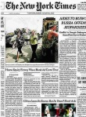


Social influence
nice read
indeed!
09:00
09:30
People are connected and perform actions
friends, fans,
followers, etc.
comment, link, rate, like,
retweet, post a message, photo, or video, etc.

Slide 4
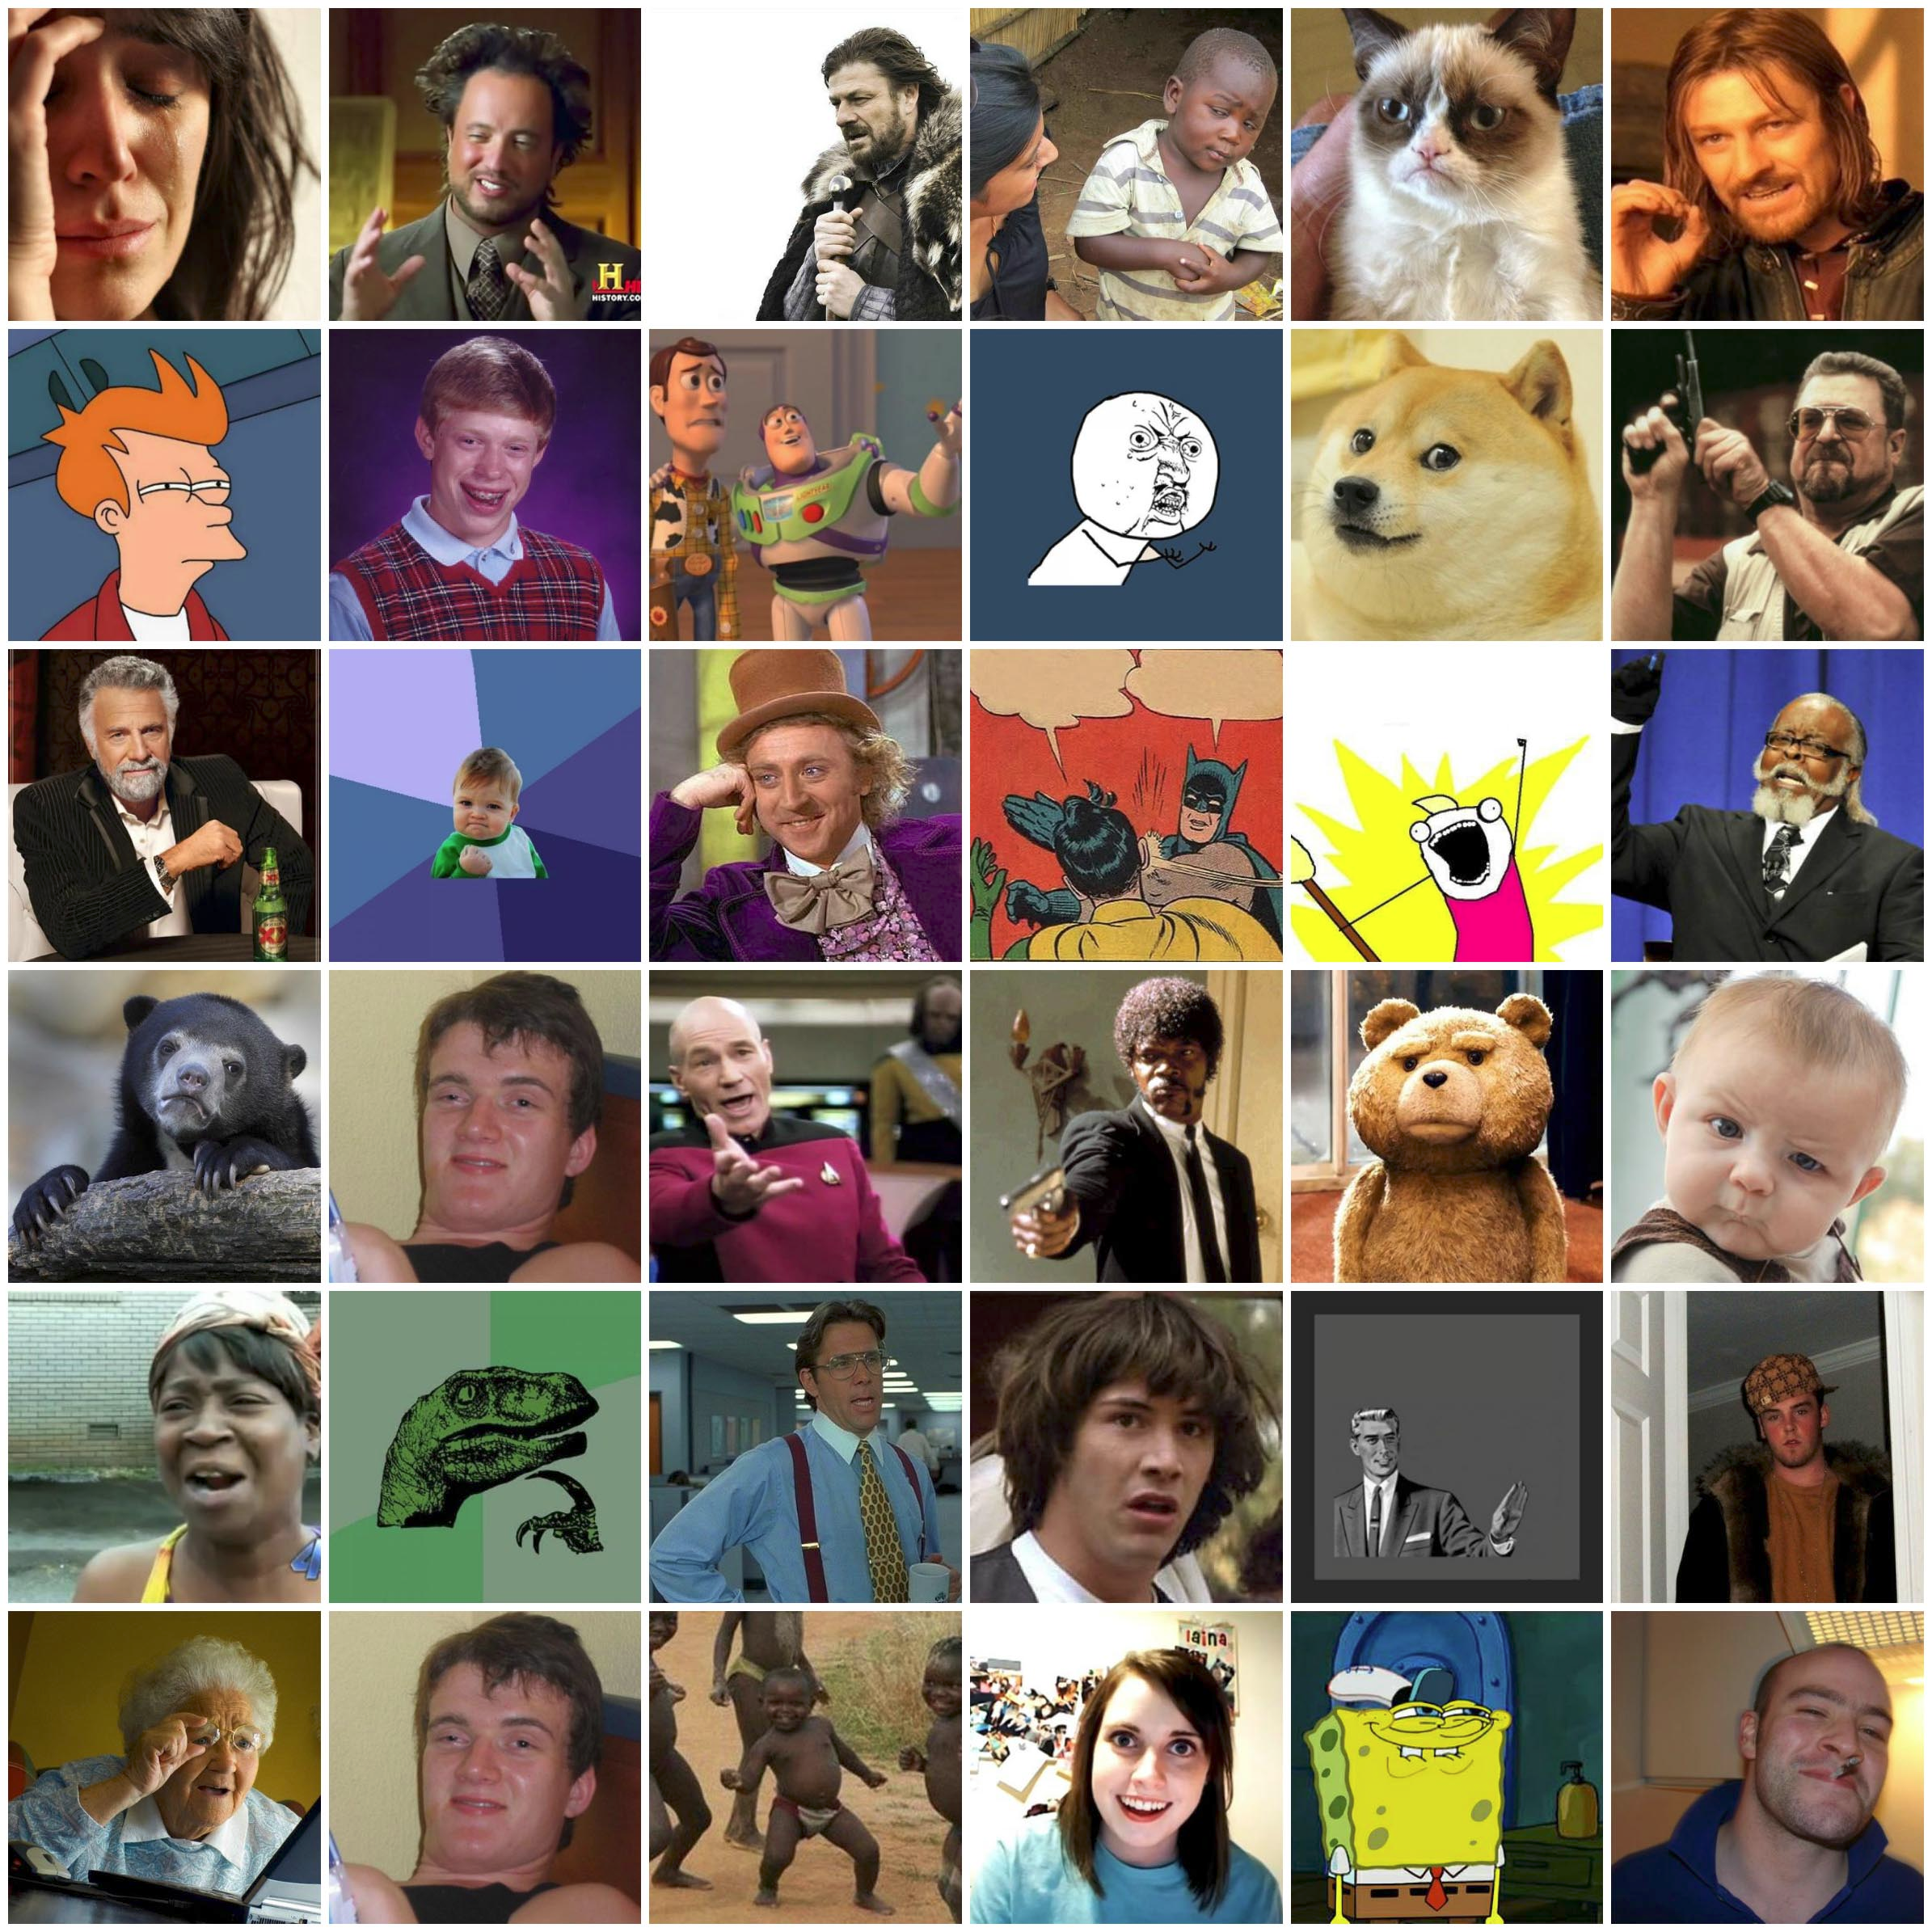
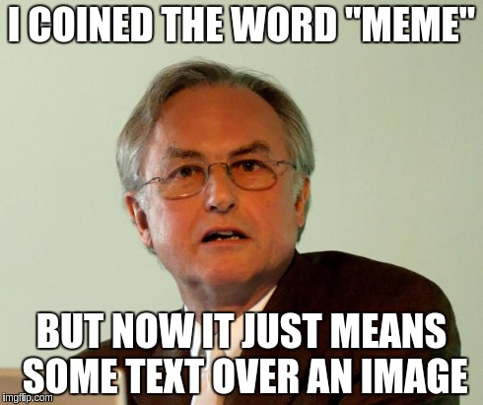
“The Selfish Gene” by Richard Dawkins (1976)
Chapter 11: “Memes: the new replicators”

Slide 5
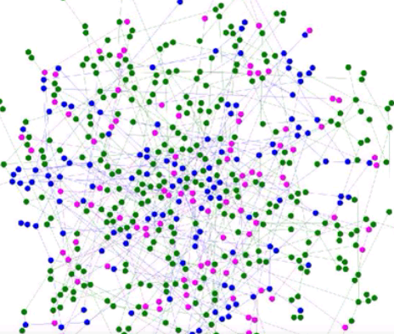
Contagion in graph
https://www.youtube.com/watch?v=WWTmRlDsydA

Slide 6
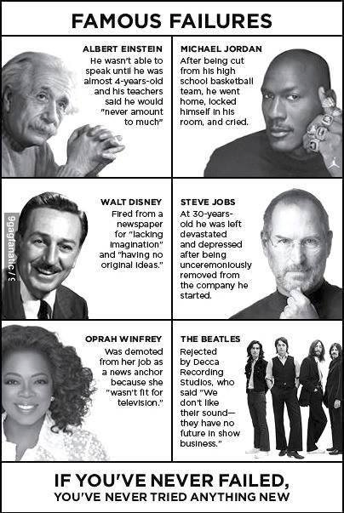
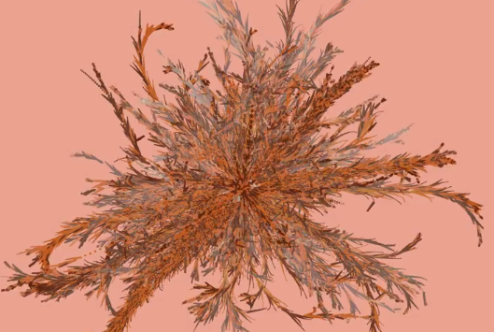
Spread of a Meme
(“Famous Failures”)
https://vimeo.com/50730795

Slide 7
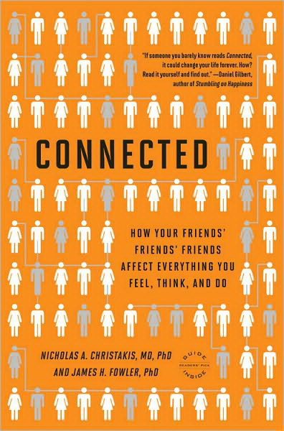
Non-trivial examples
Back pain: spread from West to East in Germany after fall of Berlin Wall
Suicide: well known to spread throughout communities on occasion
Sexual “scripts”: expected sequences of behaviors during intimate situations
Politics: the denser your connections, the more intense your convictions

Slide 8
Viral marketing

Slide 9
Viral Marketing Online
Early example: Hotmail
  Jul 1996: Hotmail.com started service
  Aug 1996: 20K subscribers
  Dec 1996: 100K
  Jan 1997: 1 million
  Jul 1998: 12 million
Bought by Microsoft for $400 million
At the end of each email sent there was a message to subscribe to Hotmail.com: “Get your free email at Hotmail"

Slide 10
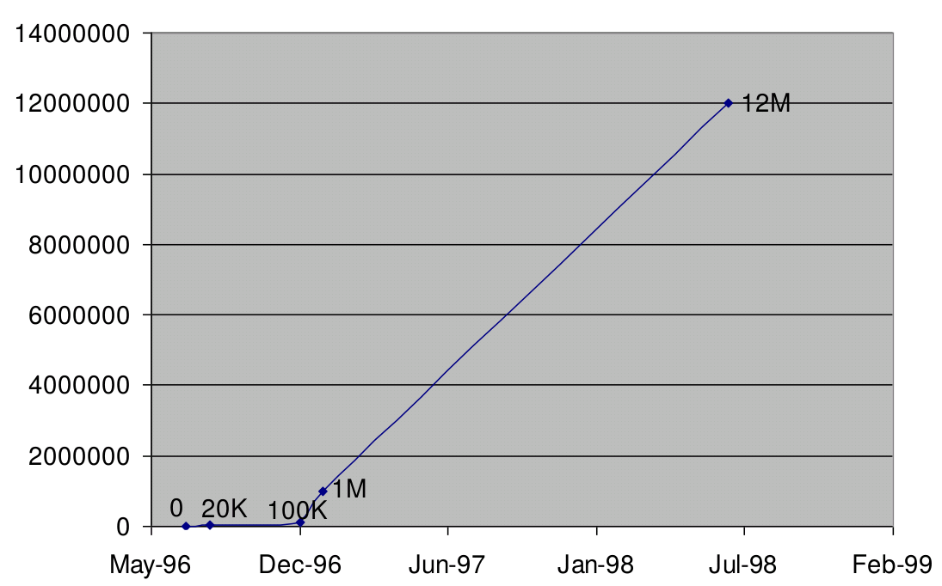
Hotmail users

Slide 11
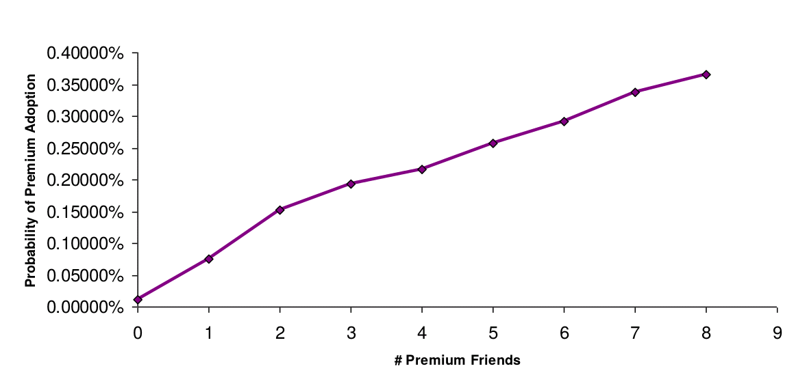
Peer pressure
(pay “premium” subscription)

Slide 12
Models of influence

Slide 13
What are our observables?
Graph: users, links/ties
Log: user, action, time
User | Action | Time
John | Rates with 5 stars “The Artist” | June 3rd
Peter | Watches “The Artist” | June 5th
Jen | … | …
John
Mary
Peter
Jen

Slide 14
Two main models
Linear threshold model
Independent cascade model

Slide 15



Linear threshold model
Nodes have thresholds
Arcs have weights
Nodes that receive weighted influence equal or above their threshold become active
0.5
0.6
0.2
0.5
0.2
0.8
0.1
0.5
0.3
0.3
0.1
0.2
0.3
0.2
0.4
0.3
0.4
0.3
0.1
0.7
0.1
0.2
0.3
0.2
0.3
0.8
0.2
0.3
0.3
[Kempe, Kleinberg and Tardos, KDD 2003]

Slide 16
Try it!
Thick arrows have weight 1.0
Thin arrows have weight 0.5
Execute linear threshold model starting from seed node
0.6
0.4
0.9
0.6
0.4
0.6
1.1
0.4
1.4
0.4
0.4

Slide 17
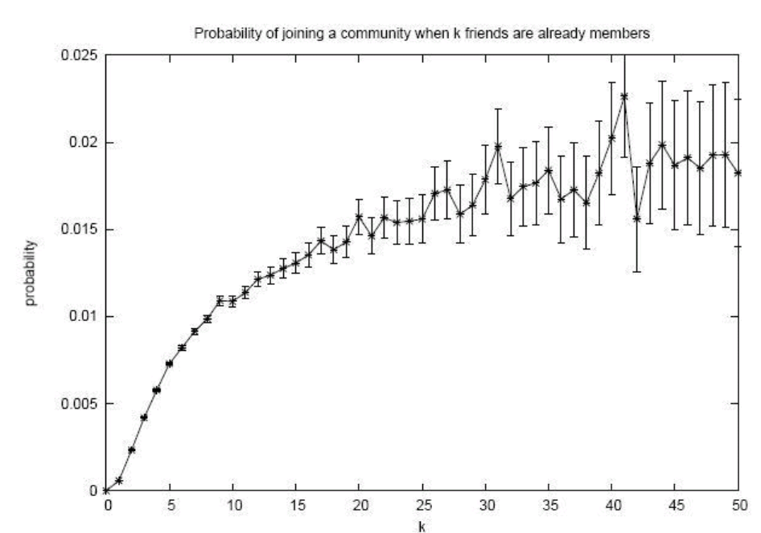
Linear threshold model
Is the linear threshold model compatible with this observation?

Slide 18
Independent cascade model
No thresholds
Each node, when activating, has one chance of activating each of their neighbors
Probability of succeeding represented by arc weights
0.2
0.7
0.2
0.1
0.1
0.1
0.01
0.05
0.3
0.2
0.4
0.1
0.3
0.1
0.1
0.02
0.3
0.04
0.3
0.3
[Kempe, Kleinberg and Tardos, KDD 2003]

Slide 19
Try it! (you need a coin or 1d4)
Thick arrows have probability 0.75
Thin arrows have probability 0.5
Execute independent cascade model starting from seed node

Slide 20
Independent cascade model
Is the independent cascade model compatible with this observation?

Slide 21
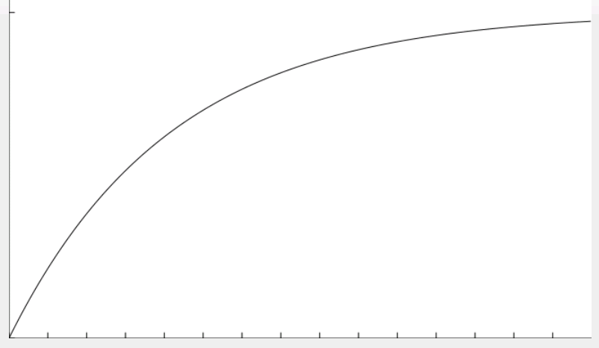
Independent cascade model
Is the independent cascade model compatible with this observation?
Hint:
1 – q^{k} for 0<q<1

Slide 22
Influencers and Viral Marketing

Slide 23
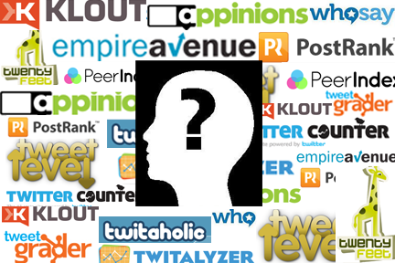
The promise of “influencers”
Influencers increase brand awareness. product conversions through WoMM
Influencers advocate a brand
Influencers influence purchasing actions

Slide 24

Viral marketing went through a stage of ...

Slide 25
Can social influence really drive viral cascades?
Watts et al. challenge the traditional notions and intuitions about SI causing viral spread
Social epidemics are not always responsible for dramatic, possibly sudden social change
Influence is hard to prove
Do not dismiss influence altogether
https://hbr.org/2007/05/viral-marketing-for-the-real-world
Notes:
Duncan J. Watts and Jonah Paretti:
Viral marketing for the real world.
Harvard Business Review, May 2007.
http://hbr.org/2007/05/viral-marketing-for-the-real-world/ar/1

Slide 26
How useful is viral marketing?
Hard to predict which campaign will succeed virally
Lack of predictability makes VM hard to implement;
The magic might not be in a small number of influentials
“Big seed” marketing is a predictable, practical alternative
https://hbr.org/2007/05/viral-marketing-for-the-real-world

Slide 27
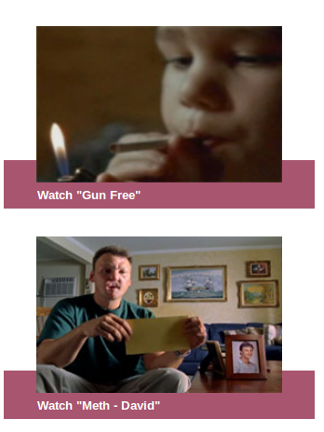
Example: Huffington Post
Ad agency buys all of the ad slots for a week
Displays attractive videos with options for easy sharing
Gets 7x more views due to social referrals, but …
None of the videos “goes viral” (grows exponentially in views) at any time
https://hbr.org/2007/05/viral-marketing-for-the-real-world

Slide 28
Summary
Influence phenomena exist
They can be modeled
  And to some extent “predict” after they happen
They are hard to create/engineer

