Slide 1

Properties of Random Networks
Social Networks Analysis and Graph Algorithms
Prof. Carlos Castillo — https://chato.cl/teach

Slide 2
Contents
Connectedness under the ER model
Distances under the ER model
Clustering coefficient under the ER model

Slide 3
Sources
A. L. Barabási (2016). Network Science – Chapter 03
Data-Driven Social Analytics course by Vicenç Gómez and Andreas Kaltenbrunner
URLs cited in the footer of specific slides

Slide 4

The “Magtension” game
Take turns placing one magnet inside an enclosed space
You lose if, after your play, any two magnets stick to each other
https://www.youtube.com/watch?v=PDyadRTCSOE

Slide 5
Connectivity in ER networks

Slide 6
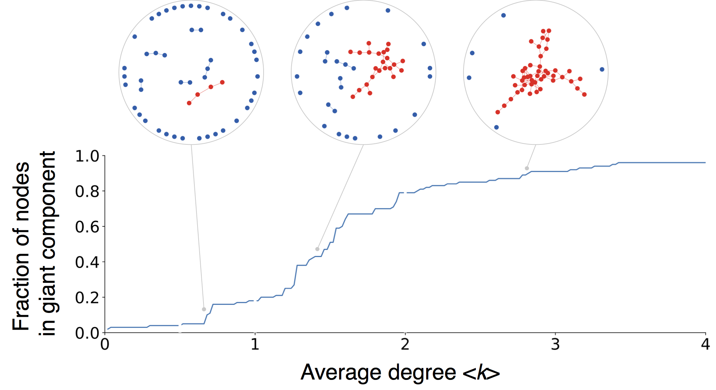
An interesting property of ER networks
Red = nodes in largest connected component
Source: Menczer, Fortunato, Davis: A First Course on Networks Science. Cambridge, 2020.

Slide 7
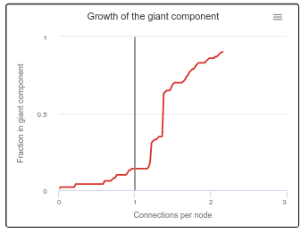

Exercise
Giant component under ER
Go to netlogoweb.org/launch and select:
“Sample Models / Networks / Giant component”
Execute the “Giant Component” program in Netlogo Web
  Select num-nodes N (e.g., 100)
  Click “setup”
  Click “go”
  Write down the point at which there is an elbow in the distribution of links
  Repeat various times
Indicate approximately where, on average, you find the “elbow”
Pin board: https://upfbarcelona.padlet.org/chato/jk9oinetdyuzecol

Slide 8
ER network as <k> increases
When <k> = 0: only singletons
When <k> < 1: disconnected
When <k> > 1: giant connected component
When <k> = N – 1 complete graph
It’s obvious that to have a giant connected it is necessary that <k> = 1
Erdös and Rényi proved it is sufficient in 1959
This result holds on average, not on every execution of the model

Slide 9
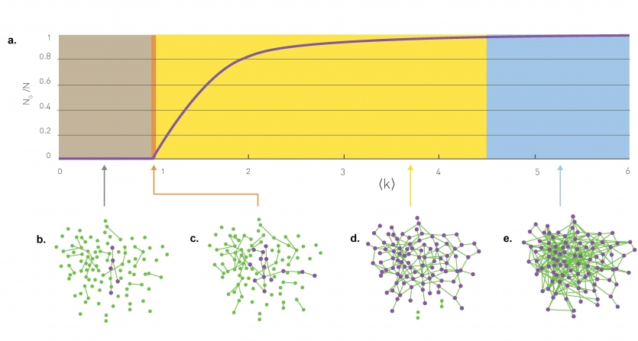
Sub-critical regime:

Slide 10
Critical point:

Slide 11
Supercritical regime:

Slide 12
Connected regime:

Slide 13
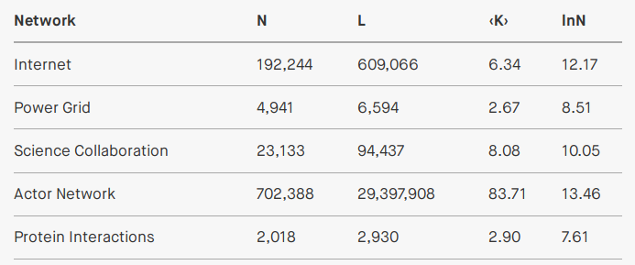
Most real networks are supercritical:

Slide 14
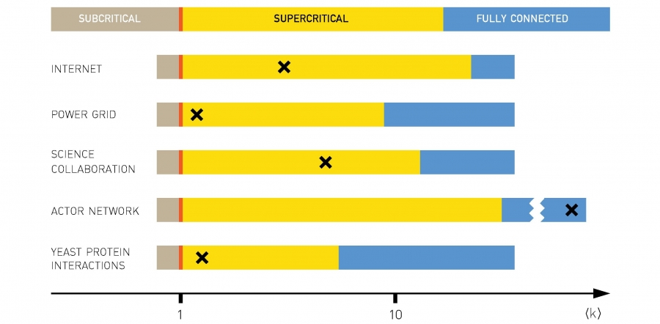
Most real networks are supercritical:

Slide 15
Small-world phenomenon a.k.a. “six degrees of separation”

Slide 16
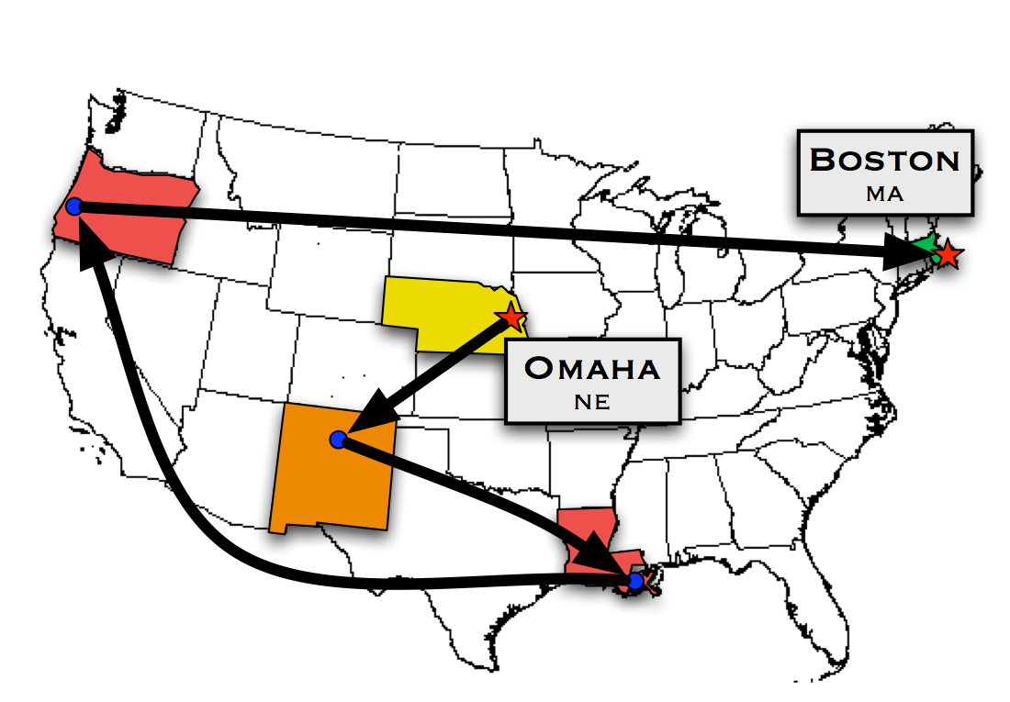
Milgram’s experiment in 1967
Instructions: send to personal acquaintance most likely to know the target
  Sources: 160 people in Wichita and Omaha
  Targets: (1) a stock broker in Boston, MA and (2) a student in Sharon, MA
Materials: short summary of study purpose, target photograph, name, address and information

Slide 17
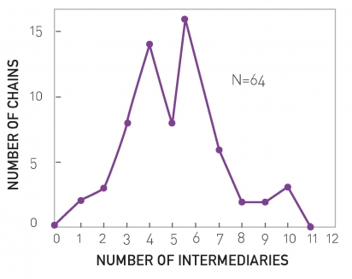
Milgram’s experiment in 1967 (results)
64 of 296 (22%) of the letters reached their destination
Average 6.5 steps, much lower than expected

Slide 18
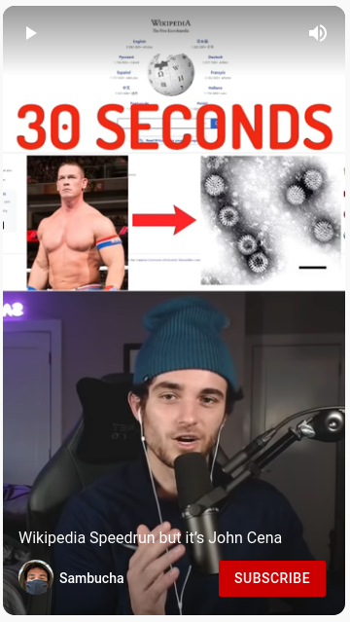
Wikipedia Speedruns
Select Wikipedia’s “Random article” twice
Go from one to the other only by clicking links; no “Ctrl-F” search allowed
Timeout at 30 seconds
Example: from John Cena to Double-stranded RNA viruses
https://www.youtube.com/shorts/5qdZxREcCWw

Slide 19
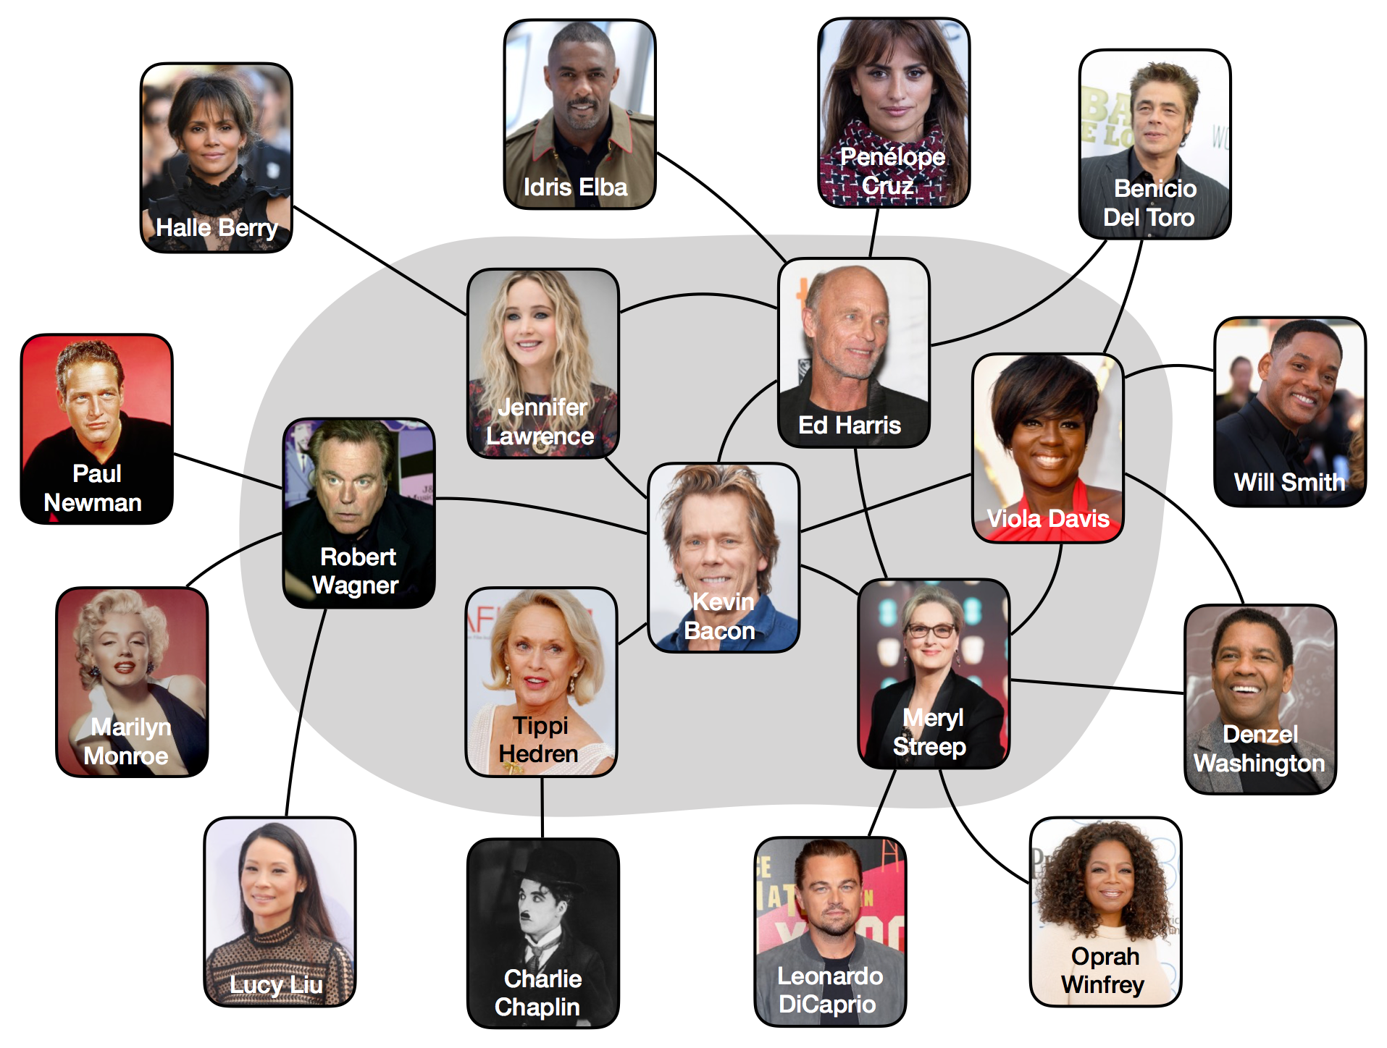
Source: Menczer, Fortunato, Davis: A First Course on Networks Science. Cambridge, 2020.

Slide 20
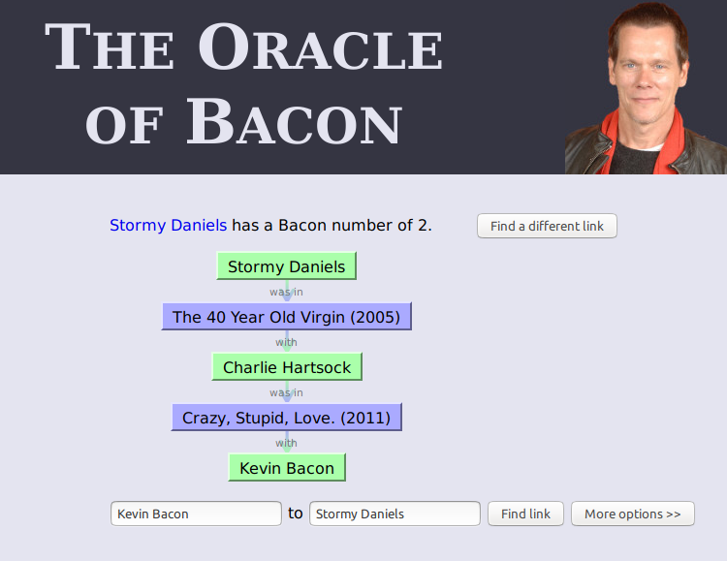
https://oracleofbacon.org/

Slide 21
“Small-world phenomenon”
If you choose any two individuals on Earth, they are connected by a relatively short path of acquaintances
Formally
  The expected distance between two randomly chosen nodes in a network grows much slower than its number of nodes

Slide 22
How many nodes at distance ≤d?
In an ER graph:
  nodes at distance 1
  nodes at distance 2
  …
  nodes at distance d

Slide 23
What is the maximum distance?
Assuming

Slide 24
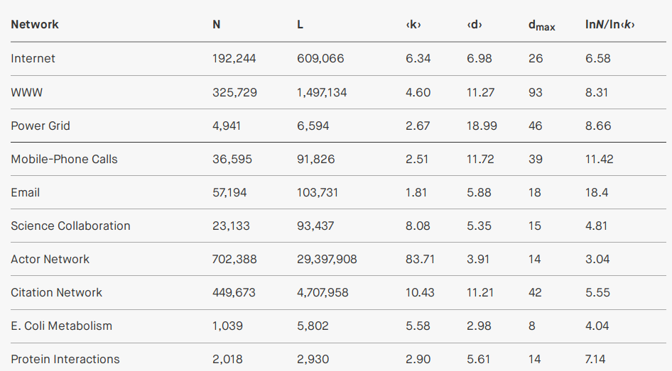
Empirical average and maximum distances

Slide 25
Approximation
Given that d_{max} is dominated by a few long paths, while <d> is averaged over all paths, in general we observe that in an ER graph:

Slide 26

Simple Exercise
Find a famous actress/actor far from Kevin Bacon
Go to https://oracleofbacon.org/ and find a famous actress or actor that has a distance from Kevin Bacon larger than
Write the name of the actress/actor and its distance
Tip: first look for some list of famous actresses/actors
Pin board: https://upfbarcelona.padlet.org/chato/rh0y9s1vngxk7klv

Slide 27
Clustering coefficient or
”a friend of a friend is my friend”

Slide 28
Clustering coefficient C_{i} of node i
Remember
  C_{i} = 0 ⇒ neighbors of i are disconnected
  C_{i} = 1 ⇒ neighbors of i are fully connected

Slide 29
Links between neighbors in ER graphs
The number of nodes that are neighbors of node i is k_{i}
The number of distinct pairs of nodes that are neighbors of i is k_{i}(k_{i}-1)/2
The probability that any of those pairs is connected is p
Then, the expected links L_{i} between neighbors of i are:

Slide 30

Clustering coefficient in ER graphs
Expected links L_{i} between
neighbors of i:
Clustering coefficient

Slide 31
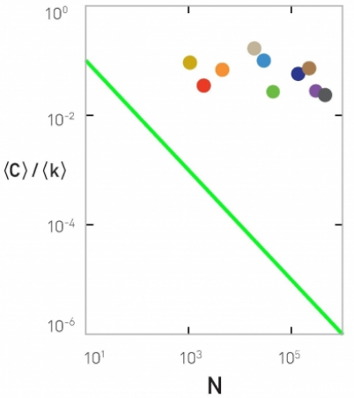
In an ER graph
If 〈k〉 is fixed, large networks should have smaller clustering coefficient
We should have that 〈C〉/〈k〉 follows 1/N

Slide 32
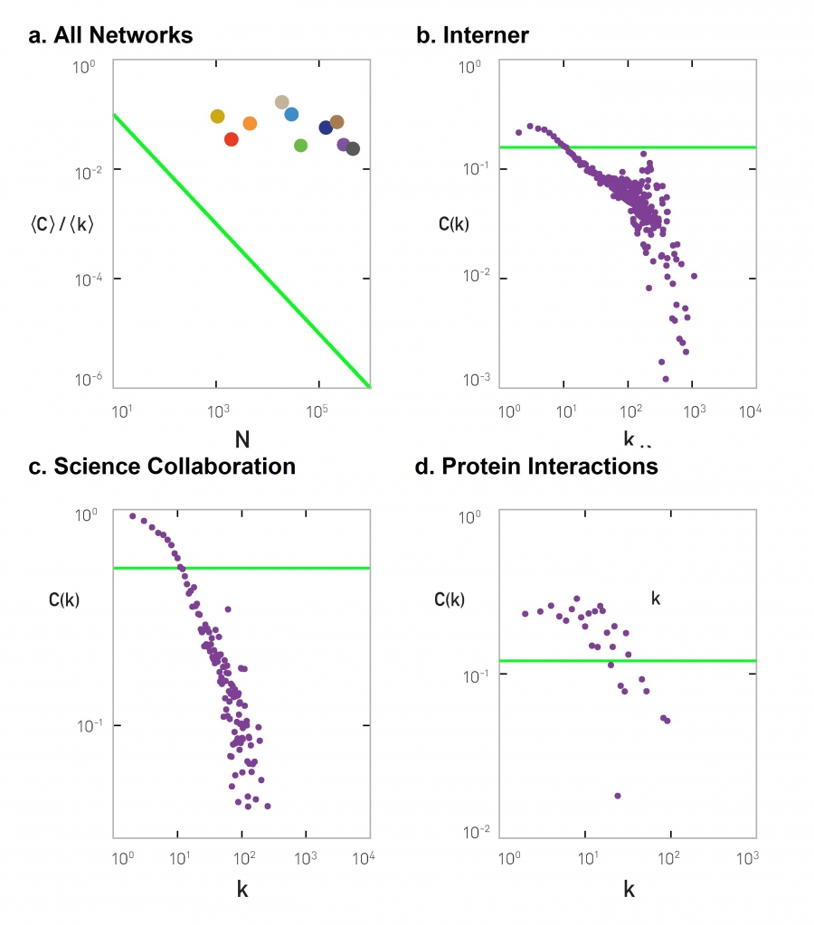
If in an ER graph
Then the clustering coefficient of a node should be independent of the degree
Internet
Science collaborations
Protein interactions

Slide 33
To re-cap ...

Slide 34
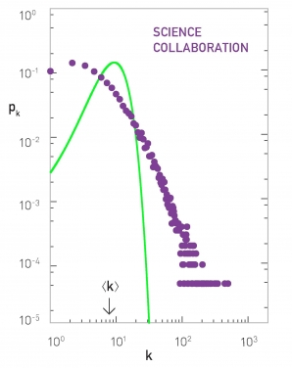
The ER model is a bad model of degree distribution
Predicted
Observed
Many nodes with larger
degree than predicted

Slide 35
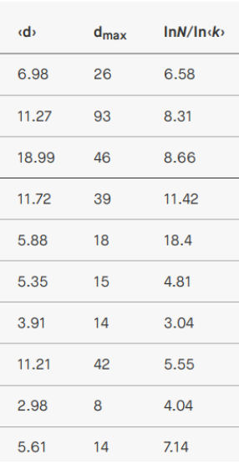
The ER model is a good model of path length
Predicted
Observed

Slide 36
The ER model is a bad model of clustering coefficient
Predicted
Observed
Clustering coefficient decreases
if degree increases

Slide 37
Why do we study the ER model?
Starting point
Simple
Instructional
Historically important, and gained prominence only when large datasets started to become available ⇒ relevant to Data Science!

Slide 38
Exercise [B. 2016, Ex. 3.11.1]
Consider an ER graph with N=3,000 p=10⁻³
  <k> ≃ ?
  In which regime is the network?
  Suppose we want to increase N until there is only one connected component
  3.1) What is <k> as a function of p and N?
  3.2) What should N be, then? Let’s call that value N^{cr}
  Write the equation and solve by trial and error
  What is <k> if the network has N^{cr} nodes?
  What is the expected distance <d> with N^{cr} nodes?

Slide 39
Sol. Exercise [B. 2016, Ex. 3.11.1]
Consider an ER graph with N=3,000 p=10⁻³
  In which regime is the network?
Given that <k> is between 1 and log(N),
the network is in super-critical regime

Slide 40
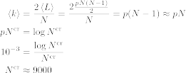
Sol. Exercise [B. 2016, Ex. 3.11.1]
Consider an ER graph with N=3,000 p=10⁻³
What should be N^{cr} to have only one component, i.e. how to make ?
This can be solved by trial and error.

Slide 41
Sol. Exercise [B. 2016, Ex. 3.11.1]
Consider an ER graph with N=9,000 p=10⁻³
  Average degree <k>?
  Average distance between nodes <d>?

Slide 42
Summary

Slide 43
Things to remember
The ER model
Degree distribution in the ER model
Distance distribution in the ER model
Connectivity regimes in the ER model

Slide 44
Practice on your own
Take an existing network
  (e.g., from the slide “Empirical average and maximum distances”)
  Assume it is an ER network
  Indicate in which regime is the network
  Estimate expected distance
  Compare to actual distances, if available
Write code to create ER networks

Slide 45

Additional contents

Slide 46
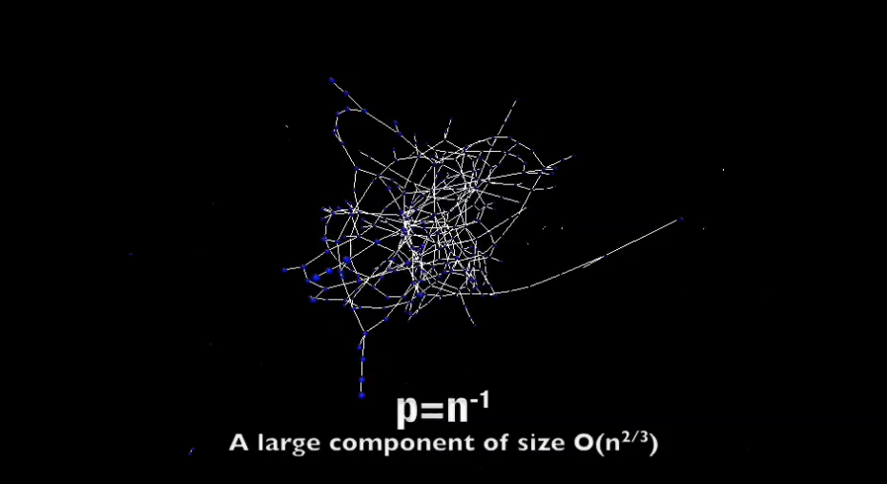
Another visualization of the emergence of a giant connected component
http://networksciencebook.com/images/ch-03/video-3-2.m4v

