Slide 1

Preferential Attachment
(BA Model)
Social Networks Analysis and Graph Algorithms
Prof. Carlos Castillo — https://chato.cl/teach

Slide 2
Contents
The BA or preferential attachment model
Degree distribution under the BA model
Distance distribution under the BA model
Clustering coefficient under the BA model

Slide 3
Sources
A. L. Barabási (2016). Network Science – Chapter 05
R. Srinivasan (2013). Complex Networks – Chapter 12
D. Easley and J. Kleinberg (2010): Networks, Crowds, and Markets – Chapter 18
Data-Driven Social Analytics course by Vicenç Gómez and Andreas Kaltenbrunner

Slide 4
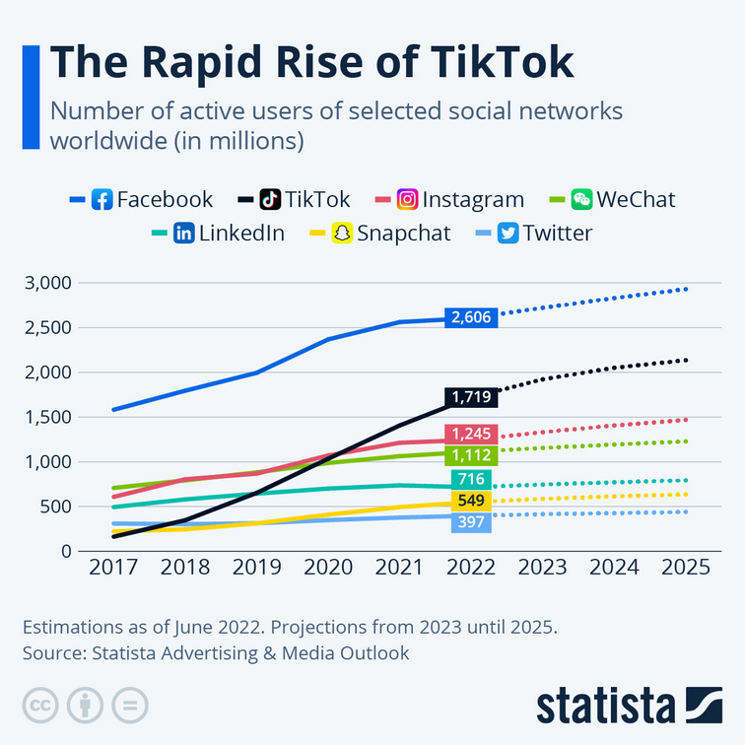
Social networks grow over time
Millions of users
Estimations as of June 2022, with projections.
Source: Statista Advertising & Media Outlook

Slide 5
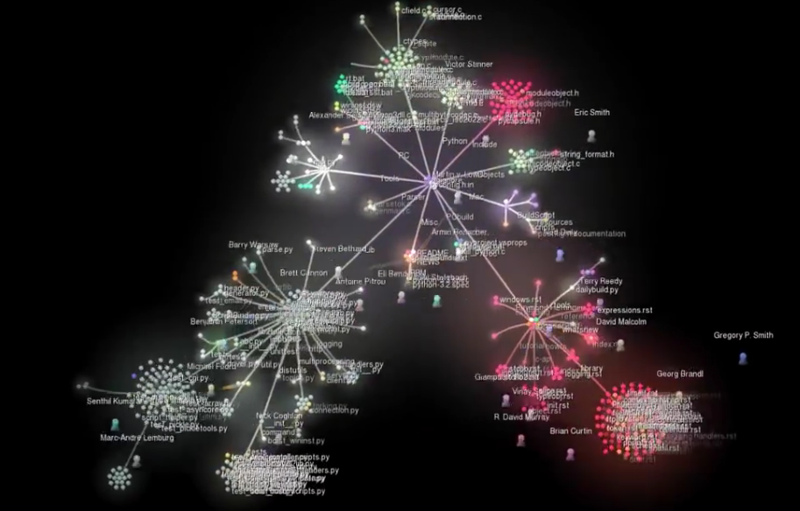
Growth of an Open Source Project: Python
Gource
visualization
https://www.youtube.com/watch?v=cNBtDstOTmA

Slide 6
We have seen what but not how, or why
Power-law degree distributions are prevalent
We will give a possible answer to how
For now, we will not answer why

Slide 7
Preferential Attachment

Slide 8


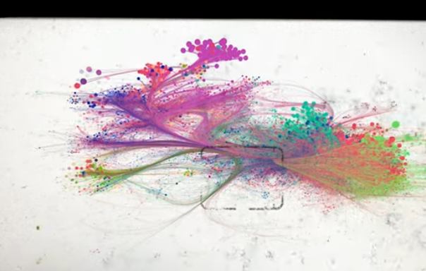
Video (04:43-06:45) by Albert-László Barabási (cont.)
https://www.youtube.com/watch?v=RfgjHoVCZwU
From “Most real-networks do not form by connecting pre-existing ...”
To “… the same universal architecture.”

Slide 9
Growth
Suppose there are two web pages on a topic, one with many inlinks the other with few, which one am I most likely to link to?
Which scientific papers are read?
Which book authors sell more?
Which actors are more sought after?

Slide 10


Slide 11
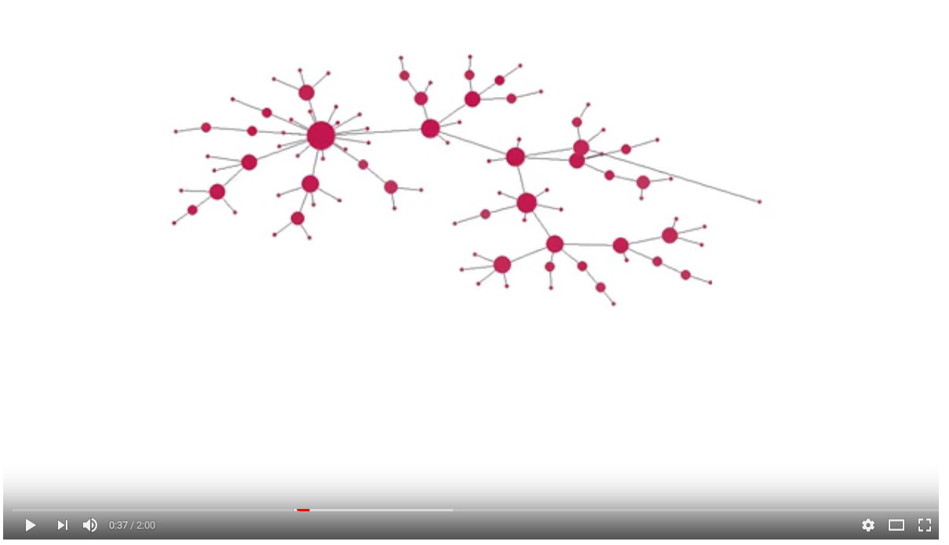
Preferential attachment simulation
https://www.youtube.com/watch?v=4GDqJVtPEGg

Slide 12
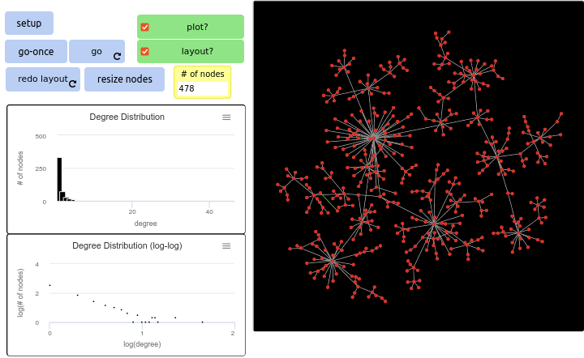

Exercise
Slope of degree distribution
Go to netlogoweb.org/launch and select:
“Sample Models / Networks / Preferential Attachment”
Execute in Netlogo Web the “Preferential Attachment” program:
  Click “setup”
  Click “go”
  Let it run to ~500 nodes
Guess the slope of the degree distribution in log-log scale
Pin board: https://upfbarcelona.padlet.org/chato/y8kw9jcjlluo2p8c

Slide 13
The Barabási-Albert (BA) model
Network starts with nodes connected arbitrarily as long as their degree is ≥ 1
At every time step we add 1 node
This node will have outlinks
The probability of an existing node of degree to gain one such link is
In an ER network,

Slide 14
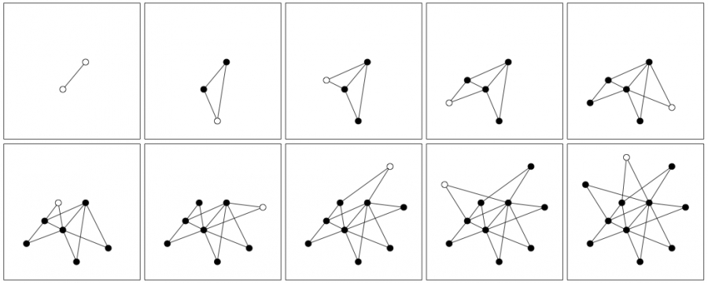
Example (m₀ = 2; m=2)

Slide 15
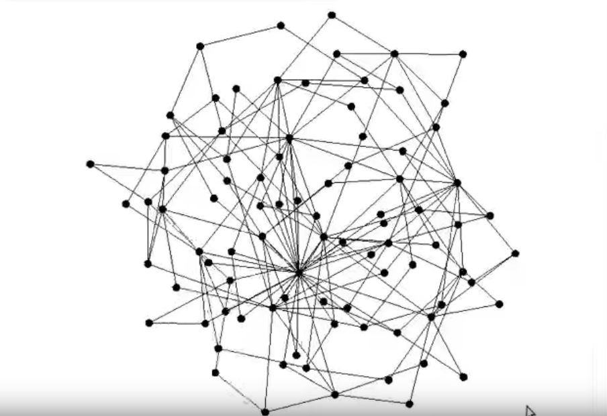
Network growth with m=2
https://www.youtube.com/watch?v=wocaGeNKn7Y

Slide 16
The Barabási-Albert (BA) model
Network starts with nodes connected arbitrarily as long as their degree is ≥ 1
At every time step we add 1 node
This node will have outlinks
The probability of an existing node of degree to gain one such link is
Write the formula for N(t) and L(t): at t=0 the network has m₀ nodes and L(0) links

Slide 17
N(t) and L(t)

Slide 18
Summary

Slide 19
Things to remember
Preferential attachment
How to create a BA network step by step

Slide 20
Practice on your own
Describe step by step in pseudocode how to create a Barabási-Albert graph with N nodes having m₀ starting nodes and m outlinks per node.
For your pseudocode to be valid, if at any point there is a randomized step, you must indicate what is the probability of each possible outcome

