Slide 1

Degree Under the
Preferential Attachment (BA) Model
Social Networks Analysis and Graph Algorithms
Prof. Carlos Castillo — https://chato.cl/teach

Slide 2
Contents
Degree distribution under the BA model
Distance distribution under the BA model
Clustering coefficient under the BA model
BA model means Barabási-Albert model (preferential attachment)

Slide 3
Sources
A. L. Barabási (2016). Network Science – Chapter 05
R. Srinivasan (2013). Complex Networks – Chapter 12
D. Easley and J. Kleinberg (2010): Networks, Crowds, and Markets – Chapter 18
Data-Driven Social Analytics course by Vicenç Gómez and Andreas Kaltenbrunner

Slide 4
Remember the BA model
Network starts with nodes connected arbitrarily as long as their degree is ≥ 1
At every time step we add 1 node
This node will have outlinks
The probability of an existing node of degree to gain one such link is

Slide 5
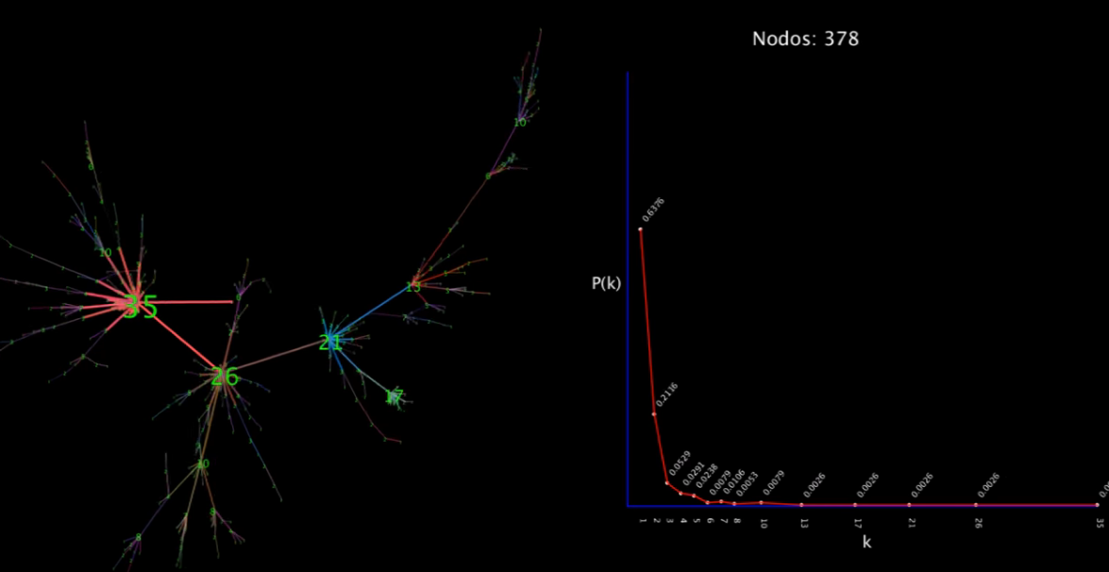
Video of degree distribution
https://www.youtube.com/watch?v=5RIQweqPT6A

Slide 6
Degree k_{i}(t) as a function of time
(For large t)

Slide 7
Degree k_{i}(t) … continued
Note: in exams for this course,
you will not be asked to solve
differential equations on your own
(t_{i} is the creation time of node i)

Slide 8


Degree k_{i}(t) … continued
Is the degree growth linear, super-linear, or sub-linear? Intuitively, why?
is called the dynamical exponent

Slide 9
Sub-linear, because exponent ½ < 1

Slide 10
Degree k_{i}(t) … consequences
If t_{i} < t_{j} (node i is older than node j), what do we expect of k_{i} and k_{j}?

Slide 11
Older nodes have a faster degree growth rate

Slide 12
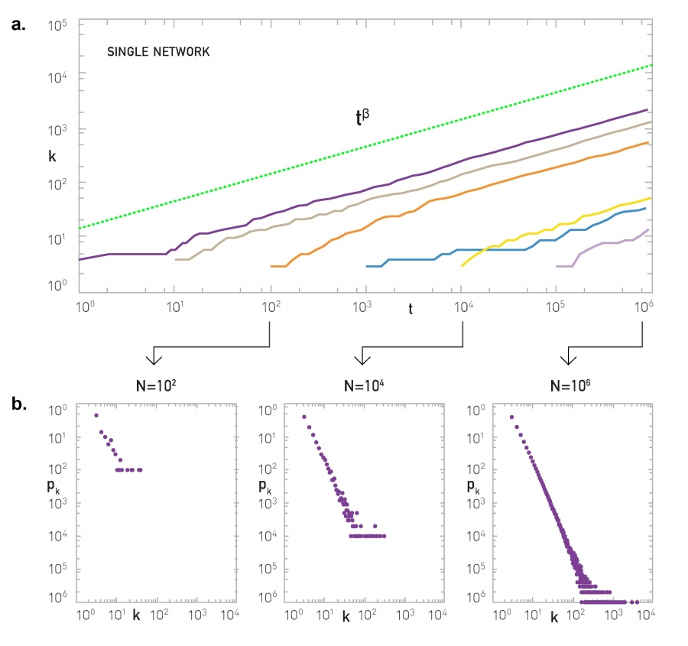
Simulation results
Model
Nodes with t_{i} = 1, 10, 100, 1000, 10000, ...

Slide 13
Degree distribution
The distribution of the degree follows
(Proof at the end of this deck)
Note that it does not depend on the time, hence, it describes a stationary network

Slide 14
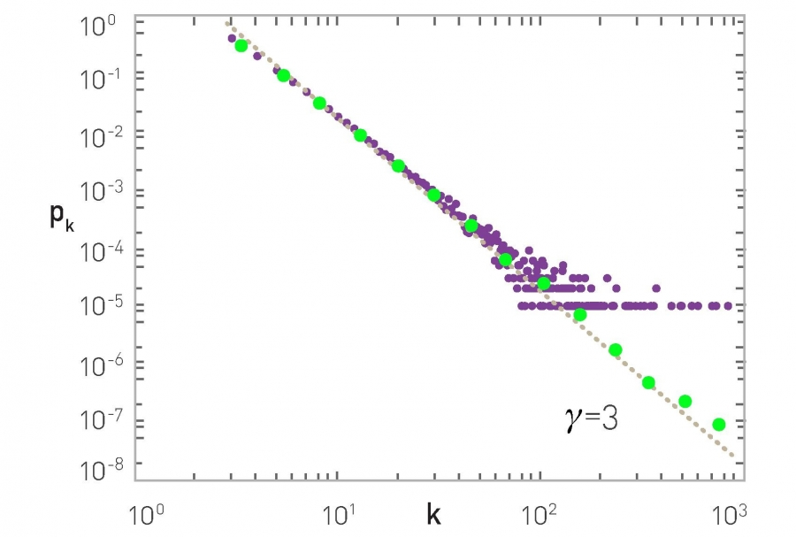
Degree distribution, simulation results
N=100,000 m=3

Slide 15
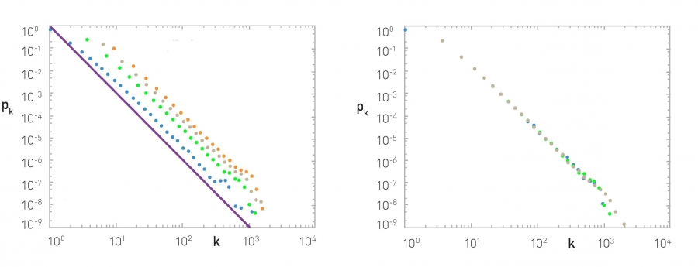
More simulations
N = 100,000; m₀ = m =
1 (blue), 3 (green), 5 (gray), 7 (orange)
Observe γ is independent of m (and m₀)
The slope of the purple line is -3
m₀ = m = 3; N =
50K (blue), 100K (green), 200K (gray)
Observe p_{k} is independent of N

Slide 16
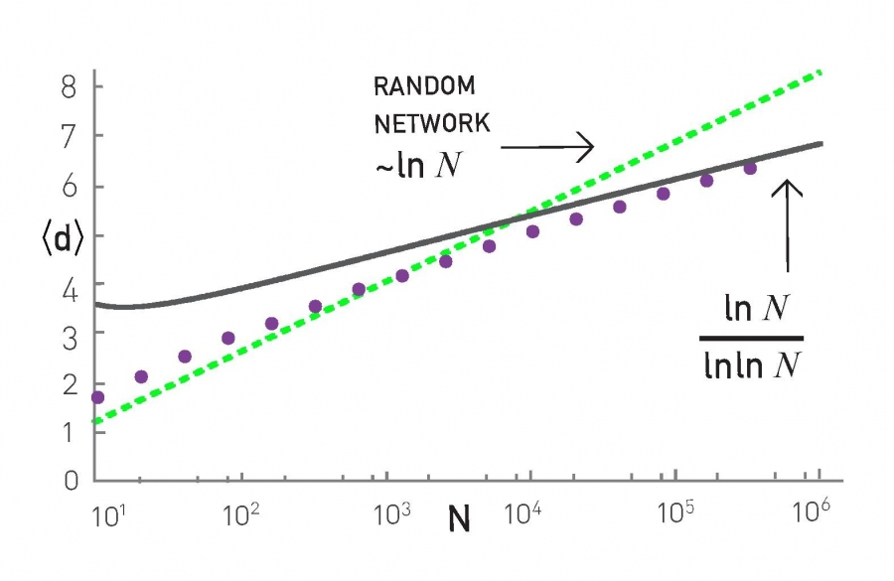
Average distance
Distances grow slower than log N
(Why: scale free network with )

Slide 17
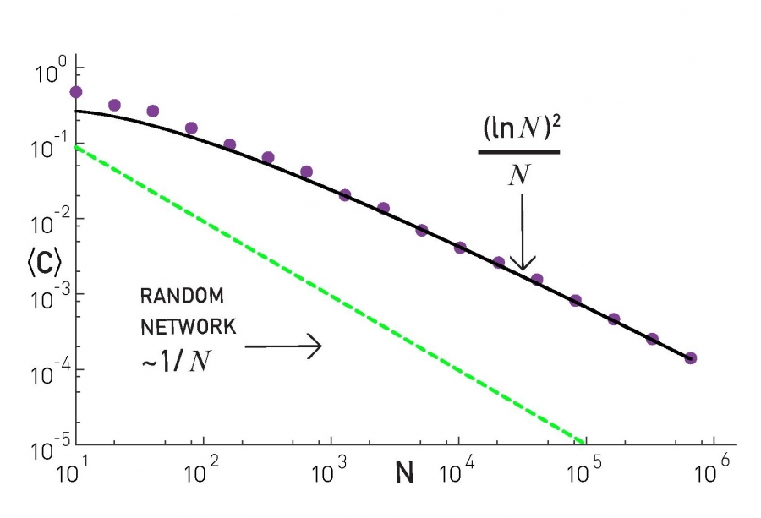
Clustering coefficient
BA networks are locally more clustered than ER networks

Slide 18
Limitations of the BA model
Predicts a fixed exponent of -3
Assumes an undirected network, while many real complex networks are directed
Does not consider node deletions or edge deletions which are common in practice
Considers that all nodes are equal except for their arrival times

Slide 19
Summary

Slide 20
Things to remember
Degree distribution in the BA model
Distances and clustering coefficient in BA

Slide 21
Practice on your own
Try to reconstruct the derivations we have done in class; try to understand every step
Insert a small change in the model and try to recalculate what we have done

Slide 22

Additional contents
(not included in exams)

Slide 23
Cumulative Distribution Function
Let’s calculate the CDF of the degree distribution
By definition of CDF, this is equal to:

Slide 24


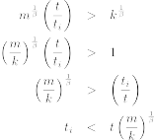
CDF (cont.)
Let’s calculate
This means that nodes i with degree larger than k were created at time t_{i} before a certain timestep, which is expected because older nodes have larger degree.

Slide 25

CDF (cont.)
From the previous slide, we have:
From the previous slide, we have:
Remember there is one node created at each timestep, so by time t there are
N(t) = m₀ + t nodes, and for large t, we have N(t) ≈ t
Imagine the following “game”, in which the larger number wins
You pick a number x in [0,1]
Your opponent picks a number y uniformly at random in [0,1]
The probability that x > y and hence you win is exactly x
Now, what is Pr(x > t_{i}/t) if you pick a node i at random?
It is x, because t_{i}/t is distributed uniformly in [0,1]
Hence:

Slide 26

CDF (cont.)
Hence:

Slide 27
Probability Density Function (PDF)
Now let’s take the derivative of the CDF to obtain the PDF

Slide 28
Degree distribution
is called the dynamical exponent
is the power-law exponent
Note that
does not depend on t
hence, it describes a stationary network

