Slide 1

Applications of Network Science
Social Networks Analysis and Graph Algorithms
Prof. Carlos Castillo — https://chato.cl/teach

Slide 2
Sources
A. L. Barabási (2016). Network Science – Chapter 01 and Chapter 02
F. Menczer, S. Fortunato, C. A. Davis (2020). A First Course in Network Science – Chapter 00
URLs cited in the footer of specific slides

Slide 3
Networks Science
Interdisciplinary; indeed we often address problems from disciplines other than CS
Empirical and data-driven; it is based on the observation of networks
Quantitative, mathematical, computational

Slide 4
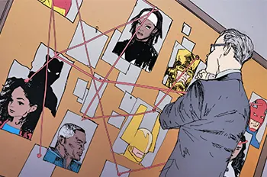

“Red string” suspect boards
A very common TV trope involves detectives looking at a wall where suspects are connected by red strings
https://tvtropes.org/pmwiki/pmwiki.php/Main/StringTheory

Slide 5
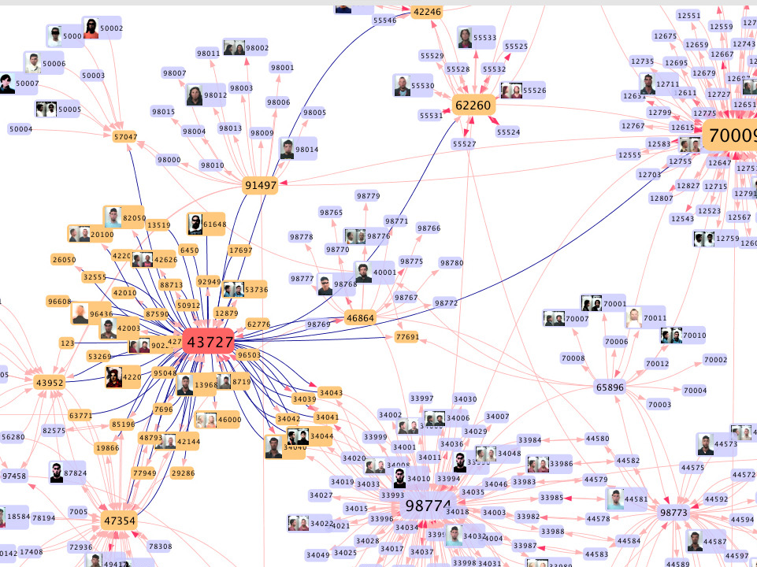
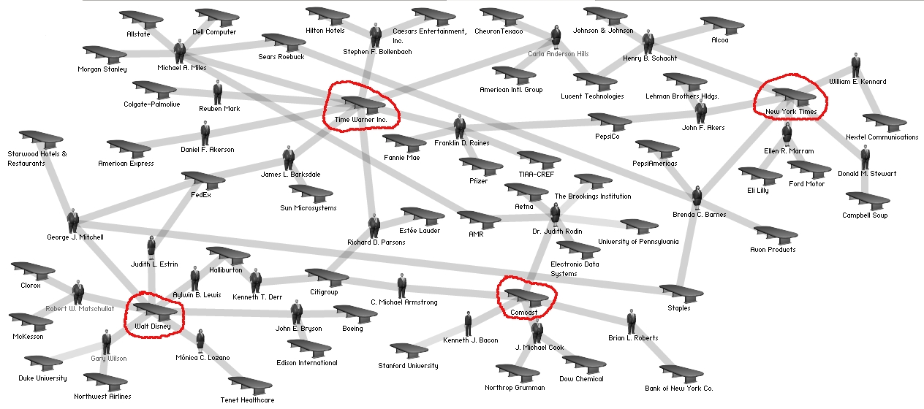
Help fight organized crime and collusion
https://itnews.iu.edu/articles/2014/complex-networks-researcher-at-iu-fighting-crime-with-mobile-phone-data.php
https://en.wikipedia.org/wiki/File:Media_corporation_interlocks_-_2004.jpg

Slide 6
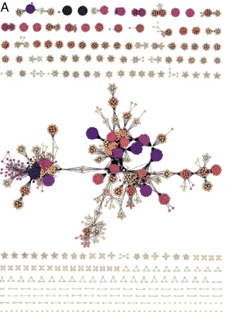
Help understand political corruption
37 corruption cases in Spain in 1989-2018 involving 2,753 people having 27,545 connections
There are 197 connected components, 58 isolated nodes, and a giant component of 40% of nodes and 53% of edges
“empirical results and simulations indicate that a few recidivist agents typically play a prominent role in corruption activities. These agents act as bridges among minor corrupt groups and possibly engage and coordinate them to work in more extensive and often much more harmful corruption processes to society.” (emphasis added)
https://www.nature.com/articles/s41598-022-10909-2 based on data from https://casos-aislados.com/

Slide 7
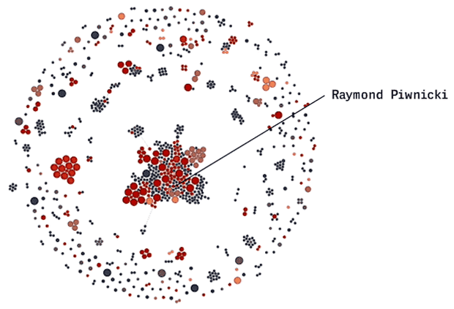
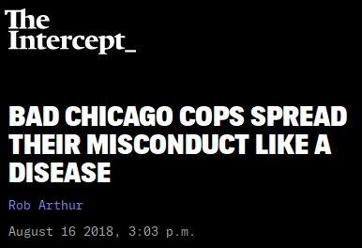
Help fight police corruption
https://theintercept.com/2018/08/16/chicago-police-misconduct-social-network/

Slide 8
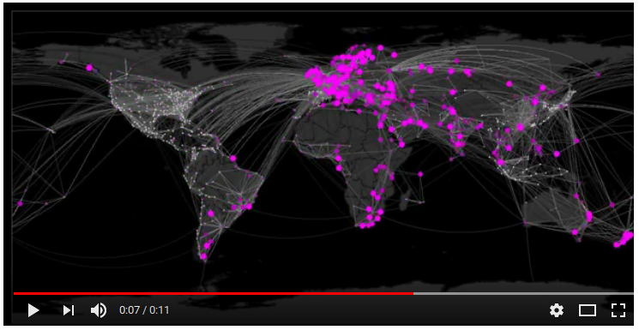
Help to forecast epidemics
https://www.youtube.com/watch?v=mm2u9RKwgsY

Slide 9
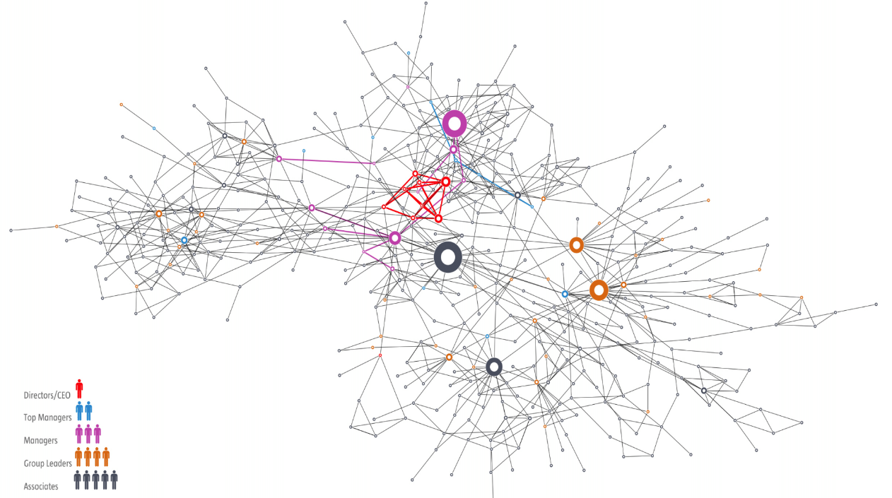
Help understand organization structures

Slide 10
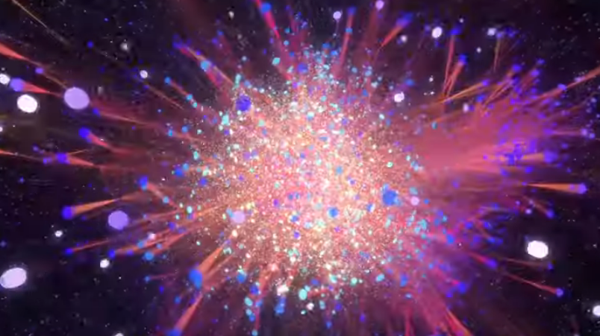
Help improve the communications of an organization
About 3M e-mails sent or received by an EU research organization address
Nodes are e-mail addresses (~1K internal, ~250K external)
Edges are e-mails
https://www.youtube.com/watch?v=4JS-30dglqg

Slide 11
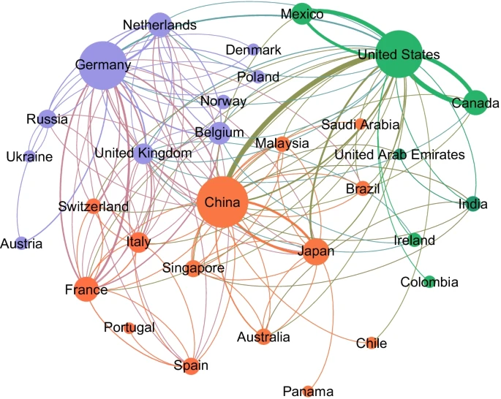
Help to understand international trade
Multiple structural, economic, geographical, and political factors affect the global trade network structure.
https://doi.org/10.1007/s41109-022-00479-7

Slide 12
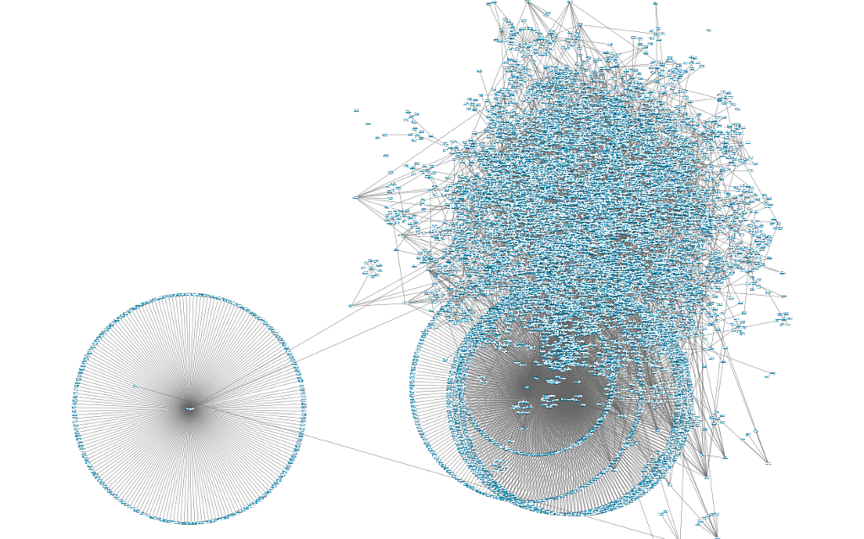
Fight misinformation and hate online
Inauthetentic accounts a.k.a. “bots” are anomalies in terms of connectivity patterns
https://gigazine.net/gsc_news/en/20150310-graph-8000-fake-twitter-account/

Slide 13
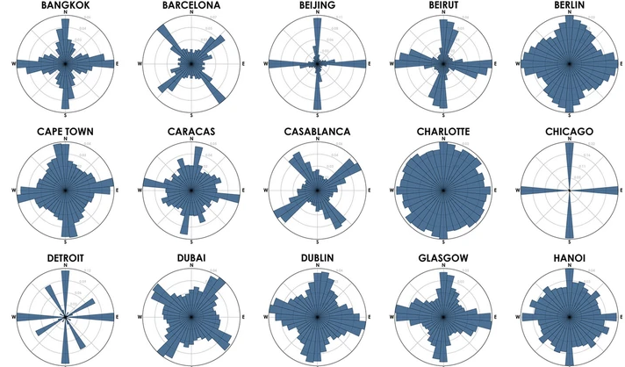
Improve mobility within cities
City grids have polarities that can be seen through networks analysis.
https://doi.org/10.1007/s41109-019-0189-1

Slide 14
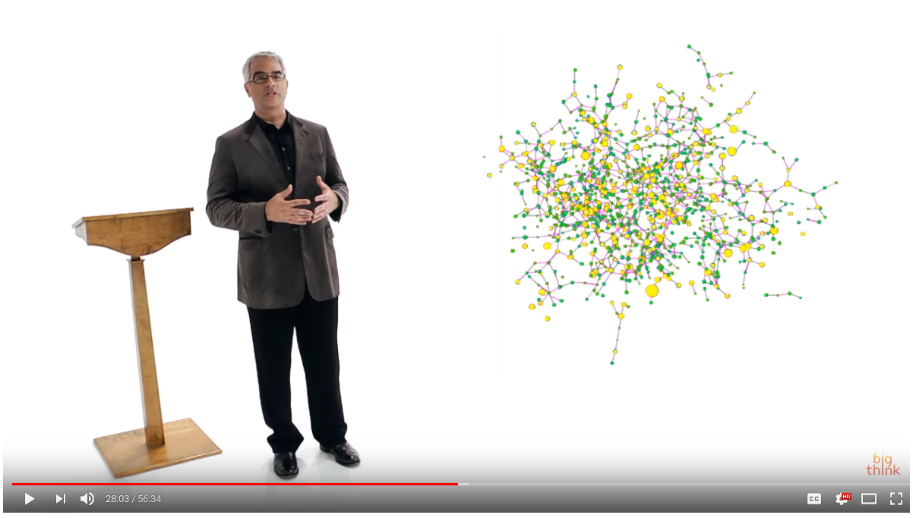
Help understand society, diseases, and design new treatments and drugs
Must watch:
Nicholas Christakis (1 hour)
https://www.youtube.com/watch?v=wadBvDPeE4E

Slide 15
What we will learn
To describe a network in formal terms
To identify it as such and characterize it
To visualize different networks
To operate with networks programmatically
To find important nodes and communities
To make discoveries or help others make them
Much more (to a large extent, it’s up to you!)

Slide 16
How we will learn
https://github.com/chatox/networks-science-course/
Theory sessions:
  Help you find important nodes, communities, and track influence
  Help you understand how to model complex networks
  Do some simple (and not so simple) exercises to check that you understood correctly each concept, and to help you remember
Practice sessions:
  Help you work with complex networks
  Manage and analyze graphs in Python
My focus is on what I think has value for you as a data scientist

Slide 17
Summary

Slide 18
Things to remember
Applications of complex networks analysis

Slide 19

Additional contents
(not included in exams)

Slide 20
Why network science is important to me

Slide 21
PhD work (2000-2004)
Collecting web pages
Characterizing national web domains
  Chile, Korea, Greece, Spain ...

Slide 22
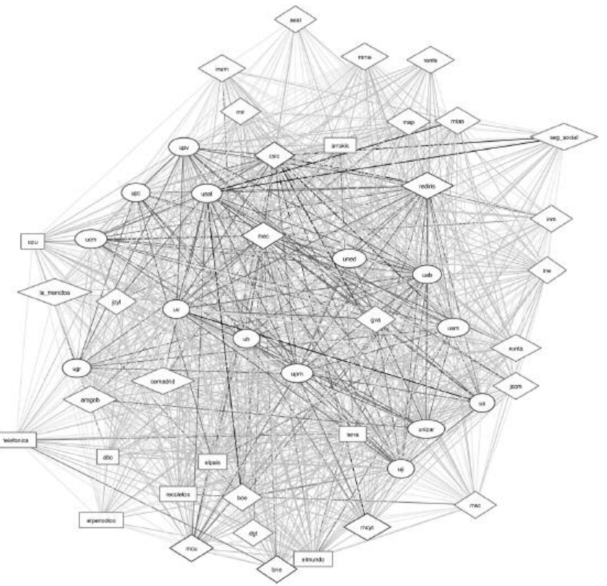
Top .es domains (~2006)
usal
“GOV”
la_moncloa
“COM”
ub
“EDU”
http://eprints.rclis.org/9292/1/vol15_1.2.pdf
elmundo

Slide 23
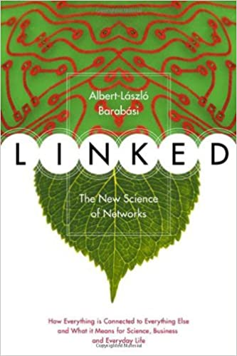
An influential book (to me)
This book came out in 2002 and made me see networks everywhere; it’s an easy read, written for the general public, highly recommended
Its author, Albert-László Barabási visited my university in Chile while I was a PhD student :-)

Slide 24
Early post-doctoral work (~2006-2009)
Web spam pages
  Pages created to deceive search engines
  Attract traffic by stuffing themselves with keywords
  Increase link score of other pages
  Methods evolve all the time, how to catch them?

Slide 25
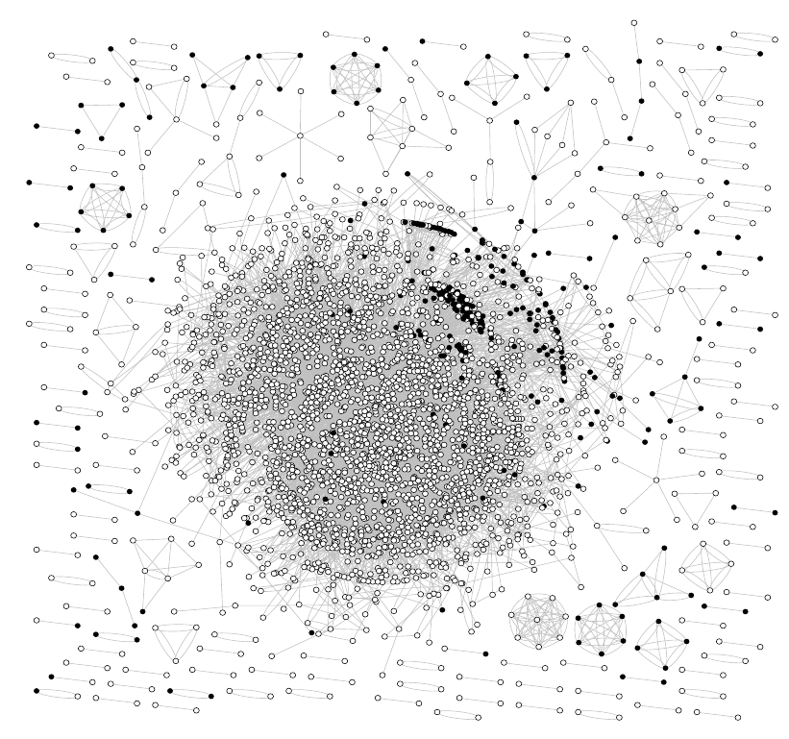
An Eureka! Moment
2006
Visualization of a web spam dataset using gnuplot; spam nodes (in black) cluster together!
Paper: https://doi.org/10.1145/1277741.1277814

Slide 26
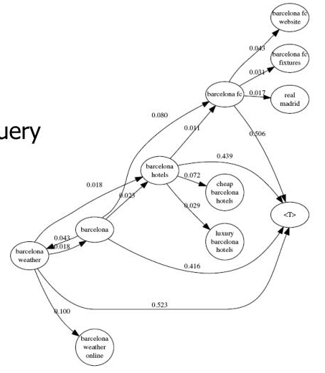
Query flows
2008
We wonder what is the most likely query before or after another query?
How are they connected? This is how we developed query flow graphs
Paper: https://doi.org/10.1145/1458082.1458163

Slide 27
Graphs in my own work
Everywhere! — See https://chato.cl/research/
Currently:
  part of a larger toolbox
  skeptical about structural-only conclusions

