Slide 1

Epidemics
Introduction to Network Science
Carlos Castillo
Topic 16

Slide 2
Sources
Barabási (2016): Network Science Ch. 10
Easley and Kleinberg (2010): Networks, Crowds, and Markets Ch 21.

Slide 3
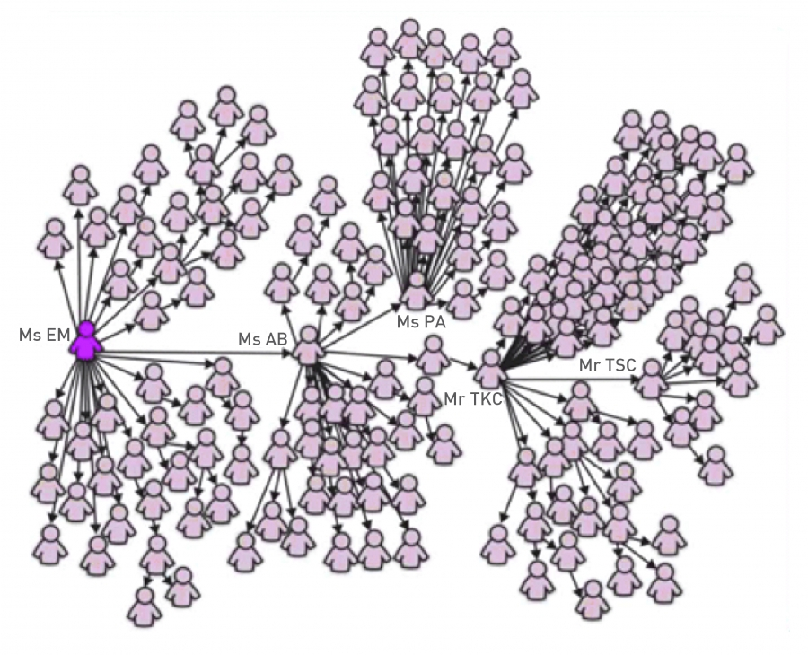
SARS Outbreak (2003)
February 21st: Chinese doctor who have been several treating “atypical pneumonia” cases check-ins into hotel in Hong Kong
  Hospitalized on Feb 22nd
  Died on March 4th
March 1st: “Ms. E. M.” returns to Singapore after visiting Hong Kong
  Graph depicts 144 out of the first 206 SARS patients in Singapore
  Ms. E. M. lived, various of her family members died
https://en.wikipedia.org/wiki/Timeline_of_the_SARS_outbreak

Slide 4
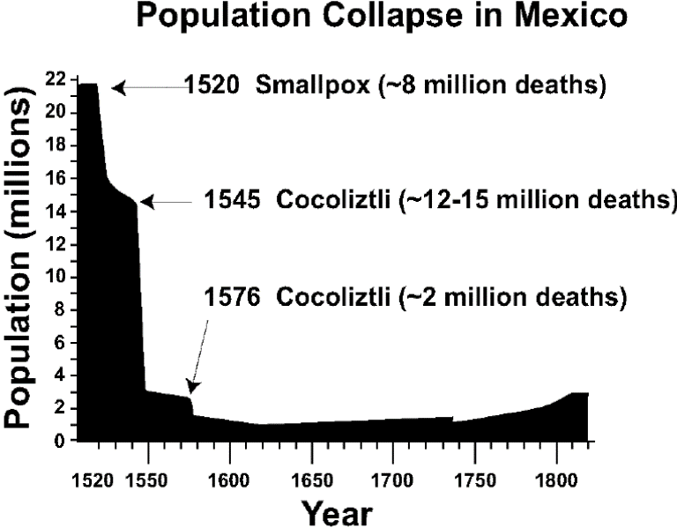
Examples: human epidemics
Influenza, measles, STDs
Bubonic plague in the 1300s in Europe, killed 20% of population in 7 years
Smallpox and other diseases brought by Europeans to America since early 1500s
https://en.wikipedia.org/wiki/Cocoliztli_Epidemic_of_1545-1548

Slide 5
Simple models for epidemics
There are many factors:
  Contagiousness
  Length of infectious period,
  Severity
  ...
Structure of contacts in a population

Slide 6
Diffusion of ideas

Slide 7
Try drawing this graph
V = {v1, v2, …, v8}
E = { (v1, v2), (v2, v3), (v3, v4), (v4, v1), (v5, v6), (v6, v7), (v7, v8), (v8, v5), (v1,v5), (v2, v6), (v3, v7), (v4, v8) }
Draw this graph on paper
What constitutes a good drawing?

Slide 8


Example drawings
Look at the 3 neighbors of each corner, they should all be at the same distance
Distances are not preserved well

