Slide 1

Connectivity in graphs
Social Networks Analysis and Graph Algorithms
Prof. Carlos “ChaTo” Castillo — https://chato.cl/teach

Slide 2
Contents
Sparsity
Paths and distances
Connected components

Slide 3
Sources
Albert László Barabási: Network Science. Cambridge University Press, 2016 (chapter 1).
Filippo Menczer, Santo Fortunato, and Clayton A. Davis. A First Course in Network Science. Cambridge University Press, 2020 (chapter 2).
URLs cited in the footer of specific slides

Slide 4
Sparsity

Slide 5
Real networks are sparse
Theoretically
Most real networks are sparse, i.e.,
L is the number of links in the network, N is the number of nodes on it

Slide 6
How sparse are some networks?
Network | |V| | |E| | Max |E|
Zachary’s Karate Club | 34 | 78 | 561
Game of Thrones | 84 | 216 | 3496
US companies ownership | 1351 | 6721 | 911K
Marvel comics | 6K | 167K | 17M
https://github.com/chatox/networks-science-course/tree/master/practicum/data

Slide 7

Example: protein interaction network
(N=2K, L=3K)

Slide 8
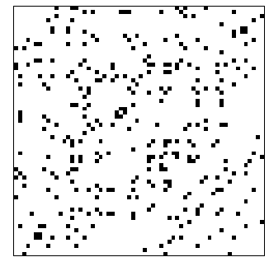

Example: dolphins
(N=62, L=318)
https://www.cise.ufl.edu/research/sparse/matrices/Newman/dolphins.html

Slide 9
Why are networks sparse?
Different mechanisms, think about it from the node perspective:
  How many items could the node be connected to
  Would it be realistic to connect to a large fraction of them?
In social networks, Dunbar’s number (≃150)
https://en.wikipedia.org/wiki/Dunbar's_number

Slide 10
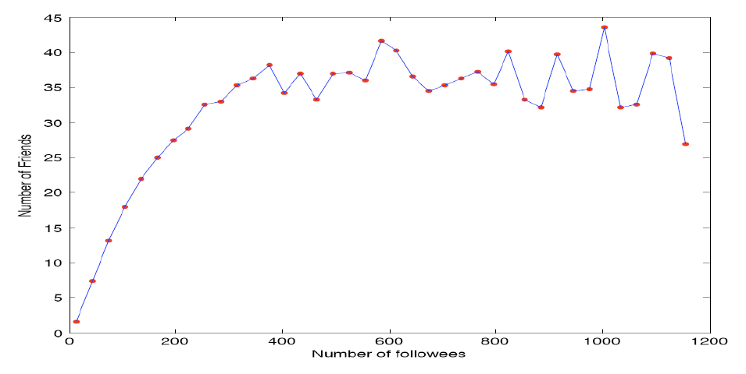
Example: actual friends in Twitter vs people you follow in Twitter
Huberman, B., Romero, D. M., & Wu, F. (2008). Social networks that matter: Twitter under the microscope. First Monday, 14(1).

Slide 11
Paths and distances

Slide 12
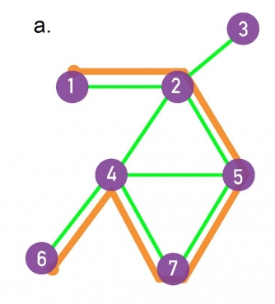
Paths: sequences of edges
The destination of each edge is the origin of the next edge
  In directed graphs, paths follow the direction of the edges
The length of the path is the number of edges on it
  Example: path in orange has length 5

Slide 13
Distance
If two nodes i, j are in the same connected component:
  the distance between i and j, denoted by d_{ij} is the length of the shortest path between them
If they are not in the same connected component, the distance is by definition infinite (∞)

Slide 14
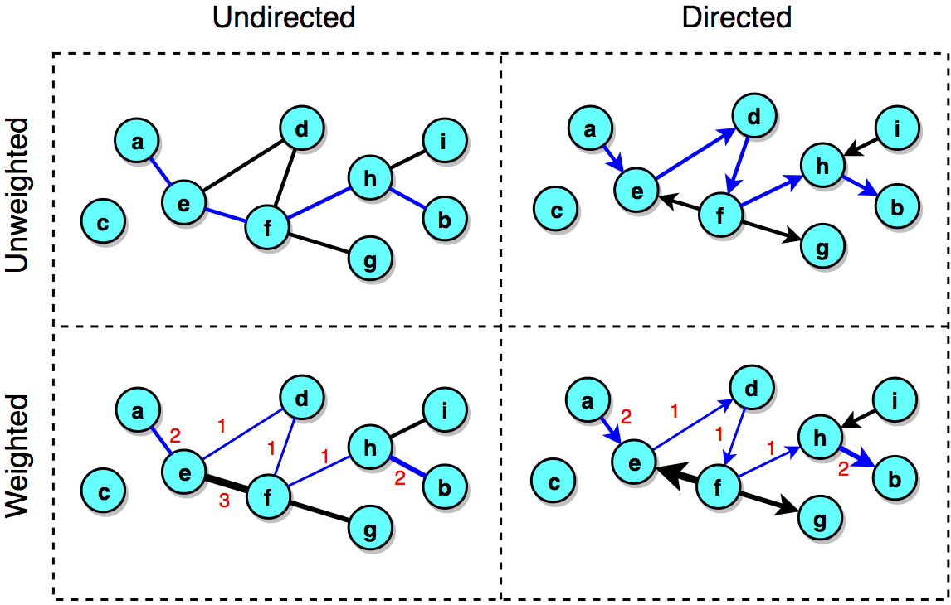
Blue = shortest path between nodes a and b
Source: Menczer, Fortunato, Davis: A First Course on Networks Science. Cambridge, 2020.

Slide 15
Diameter
The diameter of a network is the maximum distance between two nodes on it, d_{max}
The effective diameter (or effective-90% diameter) is a number d such that 90% of the pairs of nodes (i,j) are at a distance smaller than d
The average distance is <d>, and is measured only for nodes that are in the same connected component

Slide 16
Connected components

Slide 17
Connectedness
If a path exists between two nodes i, j: those nodes are part of the same connected component
A connected graph has only one connected component
A singleton is a connected component with only one node

Slide 18
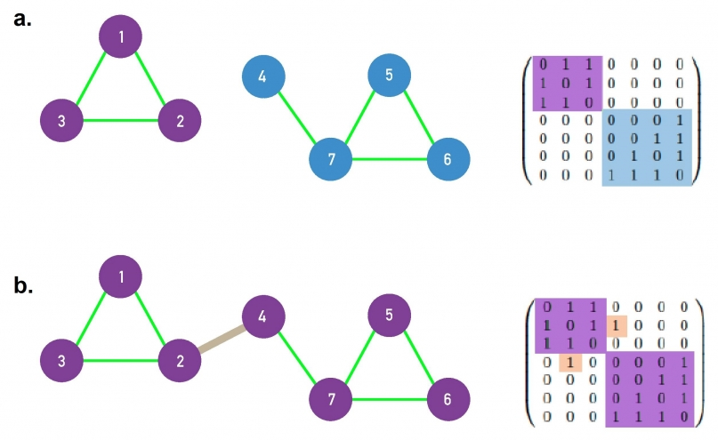
Connected graphs
A disconnected graph has an adjacency matrix that can be arranged in block diagonal form
a. disconnected
b. connected

Slide 19
Connectedness in directed graphs
A directed graph is strongly connected if it has only one connected component
A directed graph is weakly connected if, when seen as undirected, has only one connected component

Slide 20
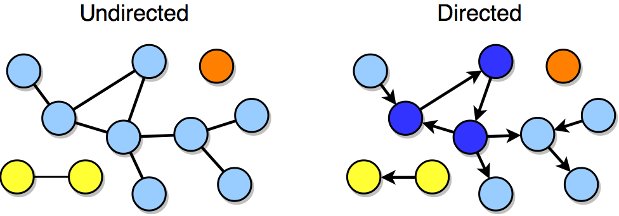
Connectedness example (directed)
Is not connected
Has 3 connected components
One of the connected components is a singleton

Slide 21
Connectedness example (directed)
Is not strongly connected
Is not weakly connected
Has 3 connected components

Slide 22
Summary

Slide 23
Things to remember
Sparse vs dense graph
Distance, diameter, effective diameter
  In directed and undirected graphs
Connected components
  In directed and undirected graphs

Slide 24
Practice on your own
Measure the sparsity of a graph
Compute the distance between two nodes
Compute the diameter of a graph
Identify connected components

