Slide 1

Spreading phenomena
Introduction to Network Science
Carlos Castillo
Topic 24

Slide 2
Sources
Easley and Kleinberg (2010): Networks, Crowds, and Markets Ch 19
Carlos Castillo, Wei Chen, Laks V. S. Lakshmanan (2012): Information and Influence Spread in Social Networks, KDD Tutorial.
Carlos Castillo (2017): Social influence slides

Slide 3
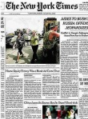


Social influence
nice read
indeed!
09:00
09:30
People are connected and perform actions
friends, fans,
followers, etc.
comment, link, rate, like,
retweet, post a message, photo, or video, etc.

Slide 4
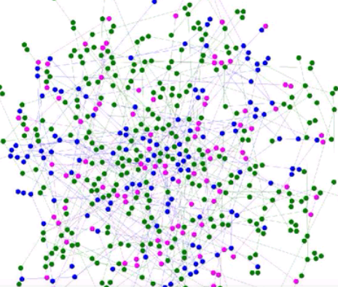
Simulated contagion in graph
https://www.youtube.com/watch?v=WWTmRlDsydA

Slide 5
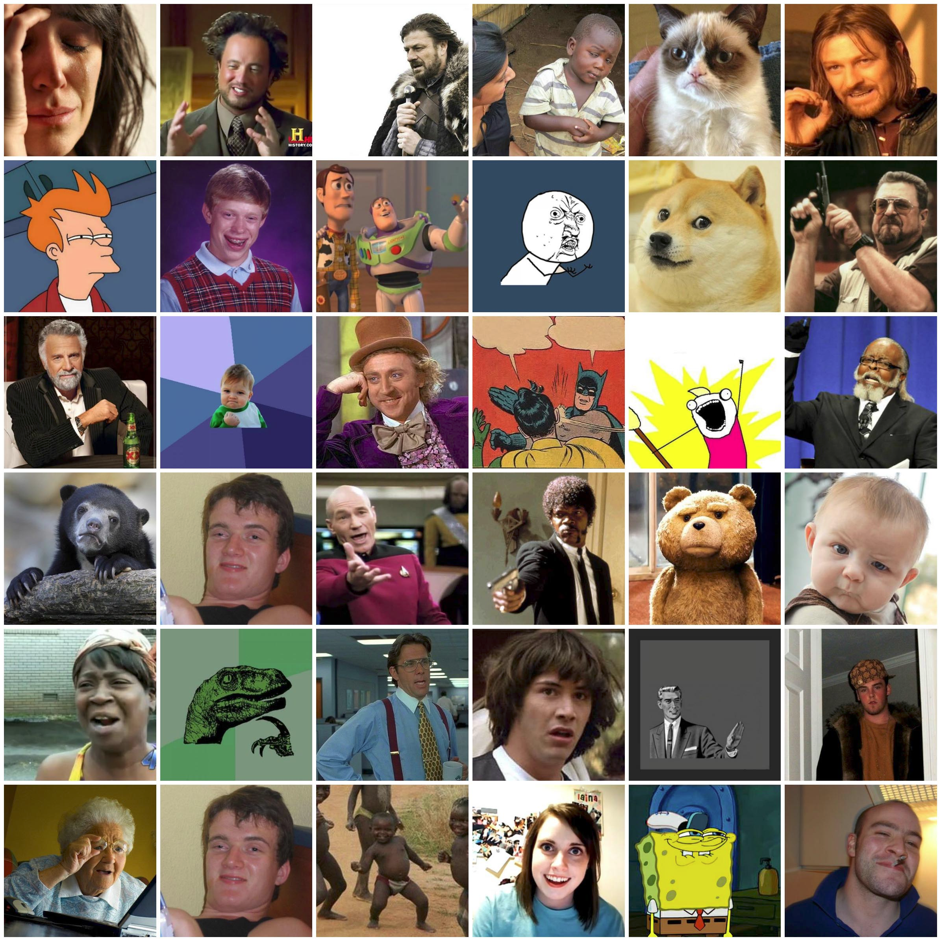
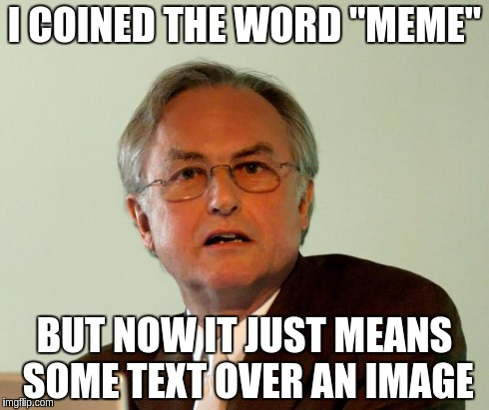
“The Selfish Gene” by Richard Dawkins (1976)
Chapter 11: “Memes: the new replicators”

Slide 6
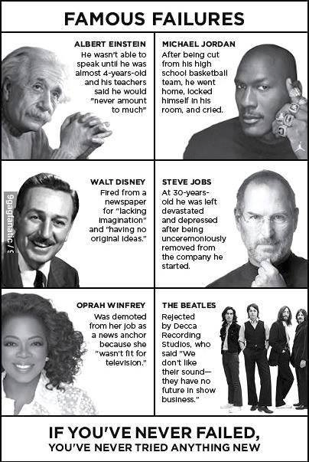
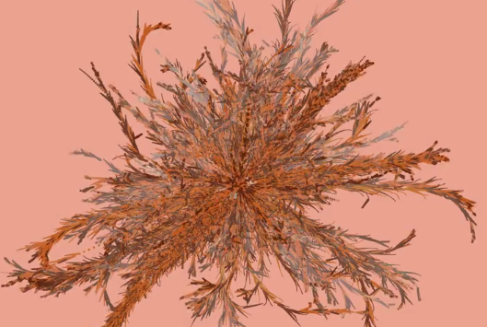
Spread of a Meme
(“Famous Failures”)
https://vimeo.com/50730795

Slide 7
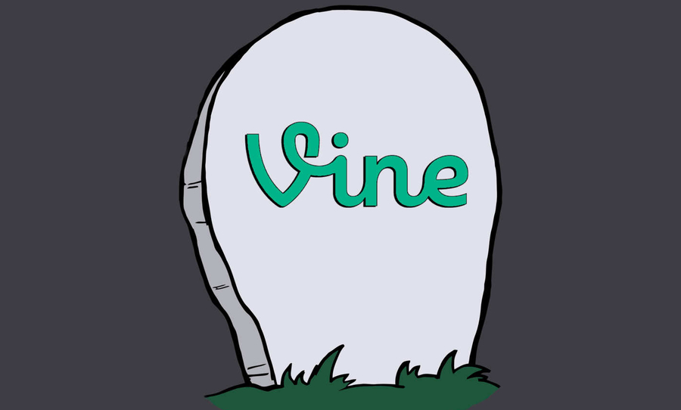
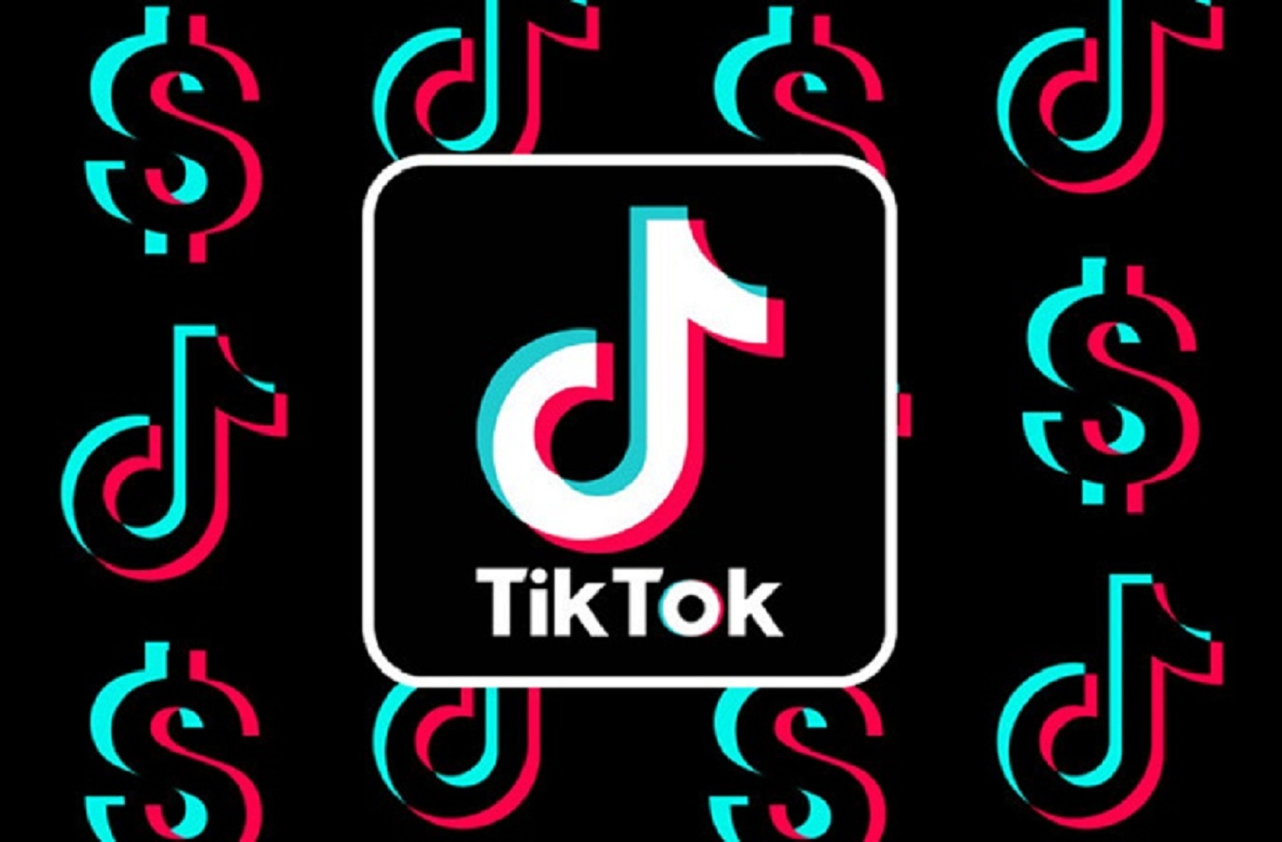

Slide 8
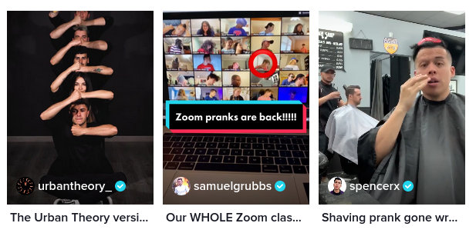

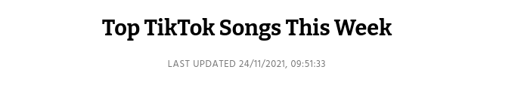
Various forms of “trend”: music/audio that is re-used, stitches, side-by-side “duets”, actions/challenges, etc.

Slide 9
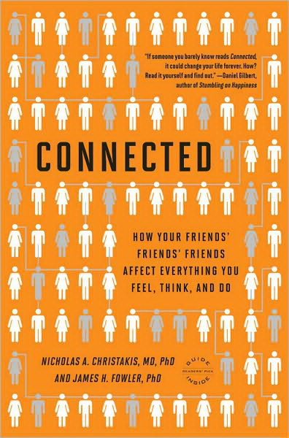
Non-trivial examples
Back pain: spread from West to East in Germany after fall of Berlin Wall
Suicide: well known to spread throughout communities on occasion
Sexual “scripts”: expected sequences of behaviors during intimate situations
Politics: the denser your connections, the more intense your convictions

Slide 10
What else?
What else propagates in a contagion-like manner?
Answer in Nearpod Collaborate
https://nearpod.com/student/
Code to be given during class

Slide 11
Viral marketing

Slide 12
History of Viral Marketing
Early example: Hotmail
  Jul 1996: Hotmail.com started service
  Aug 1996: 20K subscribers
  Dec 1996: 100K
  Jan 1997: 1 million
  Jul 1998: 12 million
Bought by Microsoft for $400 million
At the end of each email sent there was a message to subscribe to Hotmail.com: “Get your free email at Hotmail"

Slide 13
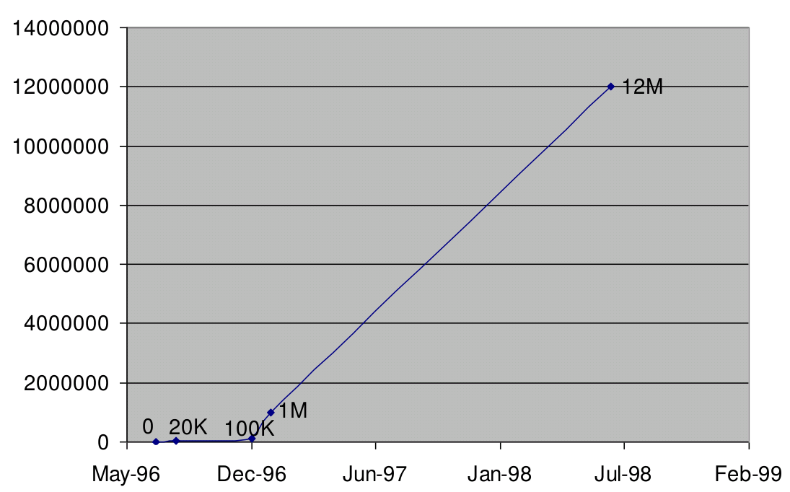
Hotmail users

Slide 14
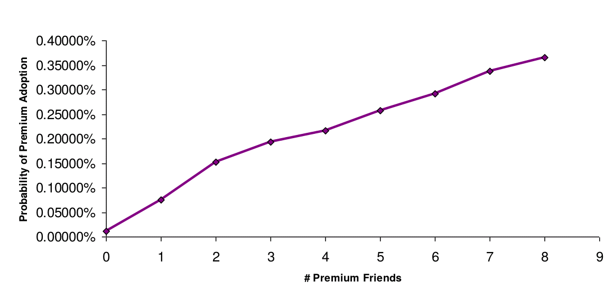
Peer pressure
(pay “premium” subscription)

Slide 15
Influencers and Viral Marketing

Slide 16
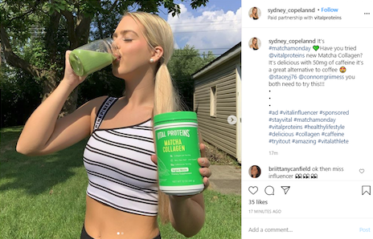
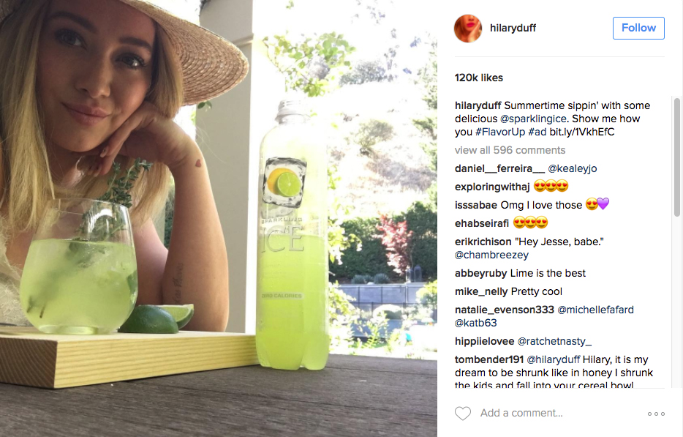
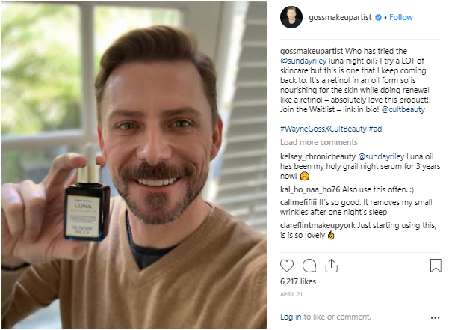
Paid partnerships or sponsored posts in Instagram

Slide 17
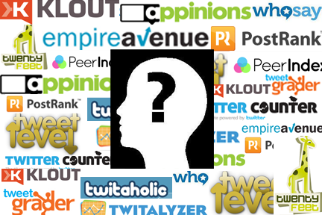
The promise of “influencers”
Influencers increase brand awareness. product conversions through Word-of-Mouth Marketing (WoMM)
Influencers advocate a brand
Influencers influence purchasing actions

Slide 18
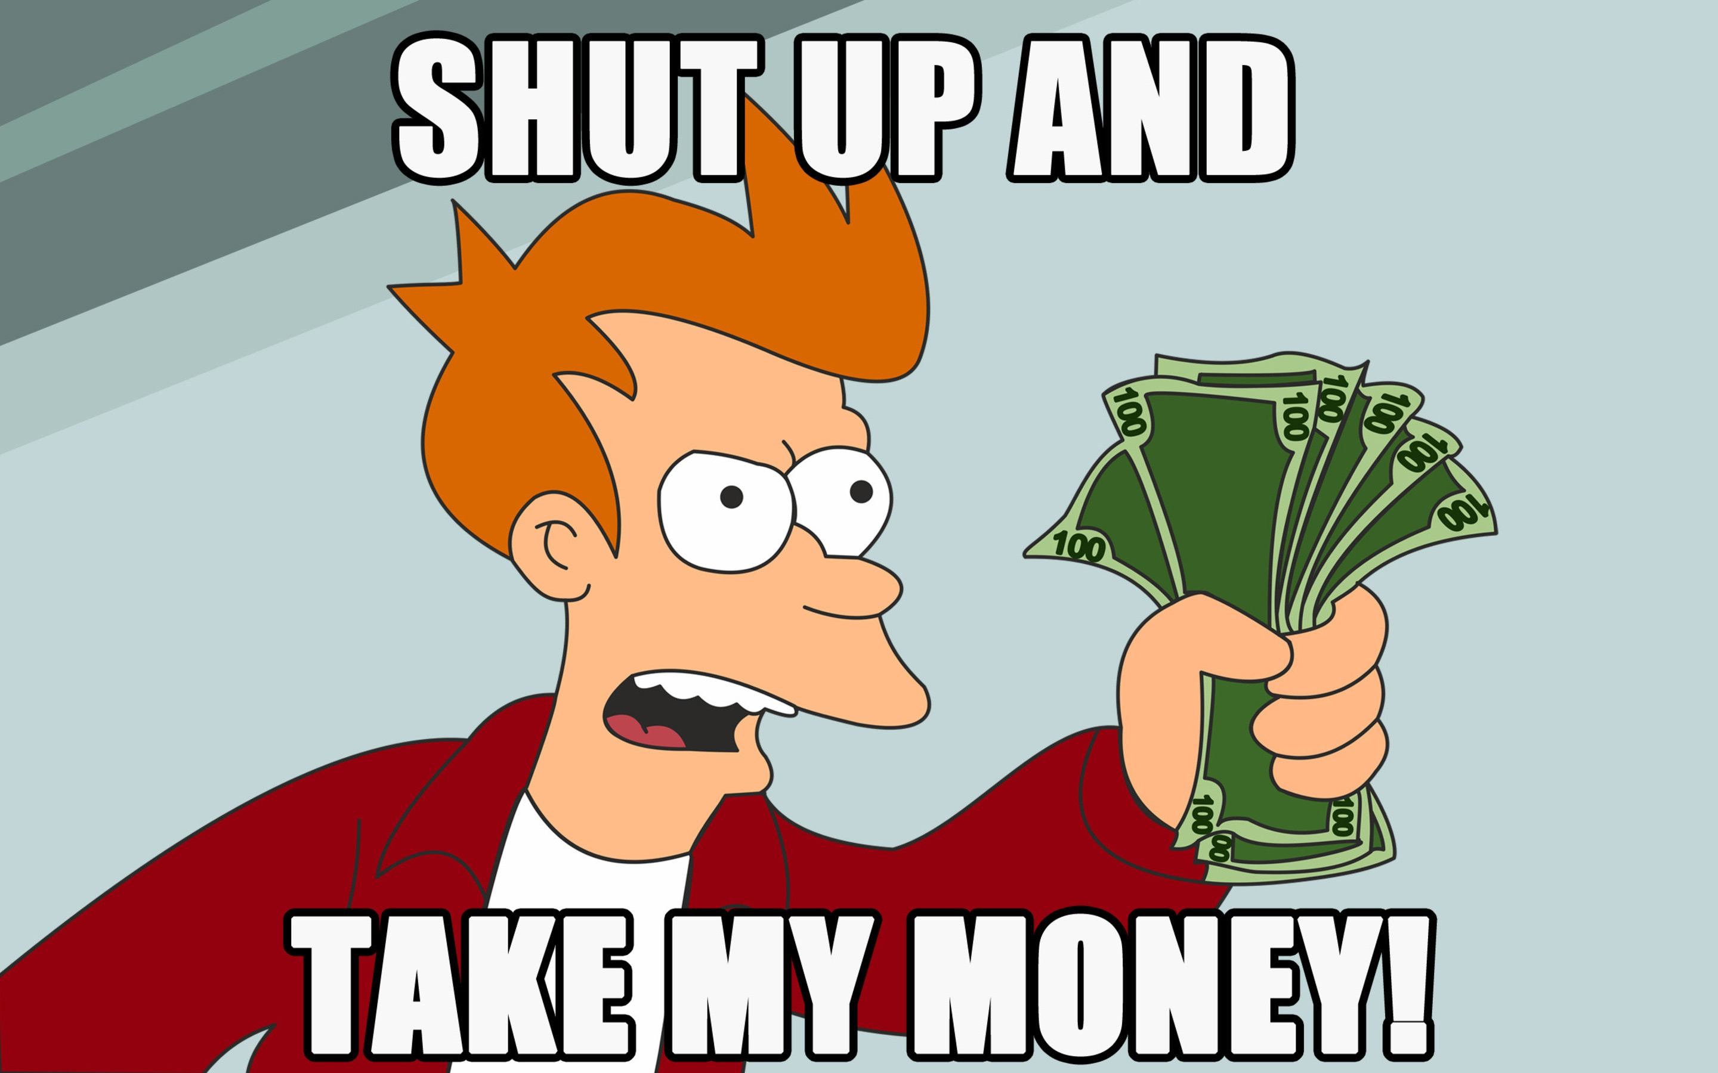
Viral marketing went through a stage of ...

Slide 19
Can social influence really drive viral cascades?
Watts et al. challenge the traditional notions and intuitions about SI causing viral spread
Social epidemics are not always responsible for dramatic, possibly sudden social change
Influence is hard to prove
Do not dismiss influence altogether
https://hbr.org/2007/05/viral-marketing-for-the-real-world
Notes:
Duncan J. Watts and Jonah Paretti:
Viral marketing for the real world.
Harvard Business Review, May 2007.
http://hbr.org/2007/05/viral-marketing-for-the-real-world/ar/1

Slide 20
How useful is viral marketing?
Hard to predict which campaign will succeed virally
Lack of predictability makes VM hard to implement;
The magic might not be in a small number of influentials
“Big seed” marketing is a predictable, practical alternative
https://hbr.org/2007/05/viral-marketing-for-the-real-world

Slide 21
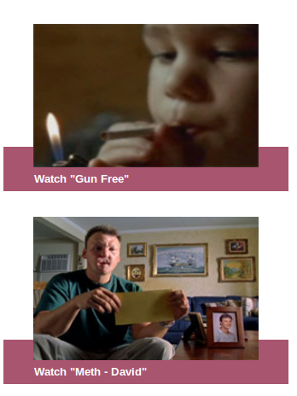
Example: Huffington Post
Ad agency buys all of the ad slots for a week
Displays attractive videos with options for easy sharing
Gets 7x more views due to social referrals, but …
None of the videos “goes viral” (grows exponentially in views) at any time
https://hbr.org/2007/05/viral-marketing-for-the-real-world

Slide 22
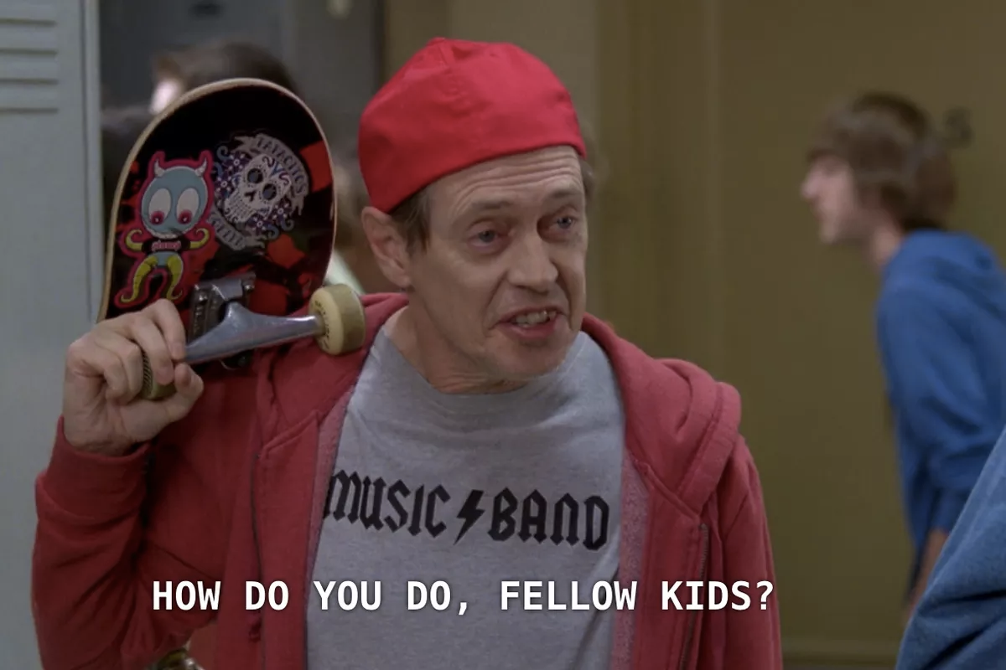
Viral content from many companies

Slide 23
Summary

Slide 24
Things to remember
Influence phenomena exist,
  but they are hard to engineer
Viral content exists,
  but it is hard to create it intentionally

