Slide 1

Betweenness
Introduction to Network Science
Carlos Castillo
Topic 18

Slide 2
Sources
Networks, Crowds, and Markets Ch 3.6B
Barabási 2016 Section 9.3.2
P. Boldi and S. Vigna: Axioms for Centrality in Internet Mathematics 2014.
Esposito and Pesce: Survey of Centrality 2015.
C. Castillo: Other centrality slides 2016

Slide 3
Types of centrality measure
Spectral
  HITS
  PageRank
Non-spectral
  Degree
  Closeness and harmonic closeness
  Betweenness

Slide 4
Betweenness

Slide 5
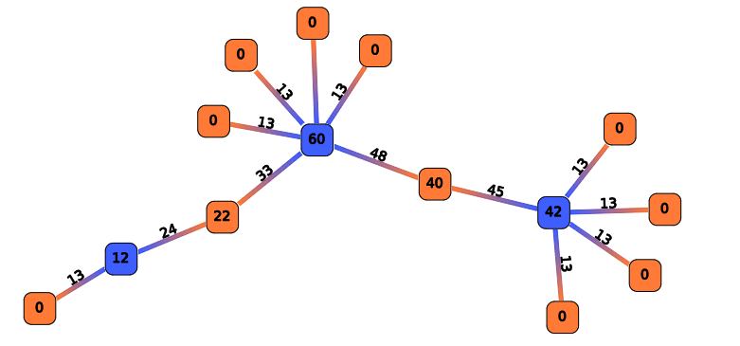
Node and Edge Betweenness
A node/edge has high betweenness if it participates in many shortest-paths
http://rnav.labri.fr/rNAV2.0_public_version/online_doc/_images/ComputeBetweennessCentrality.png

Slide 6
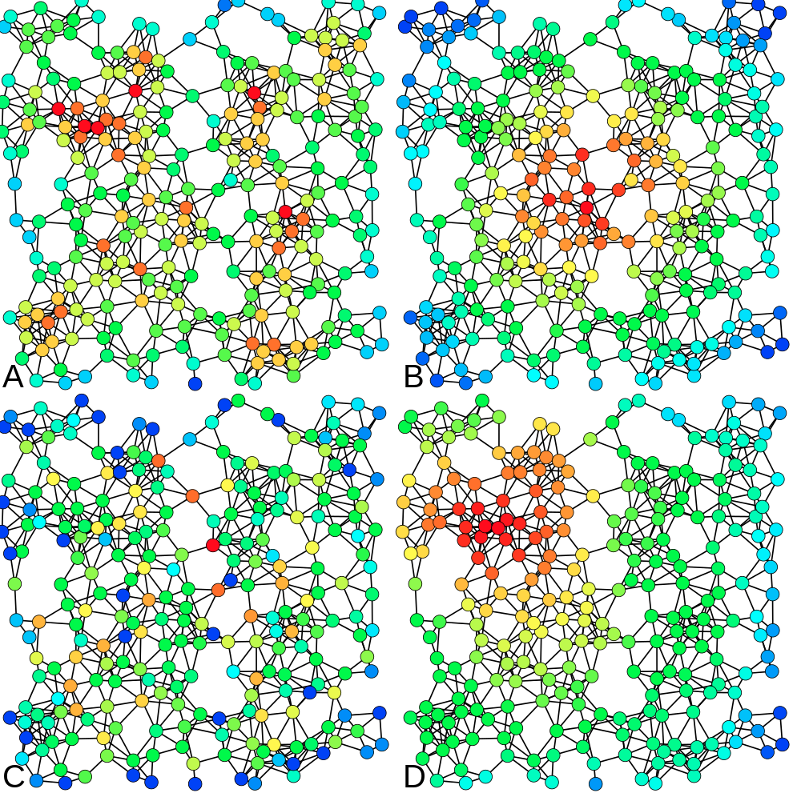
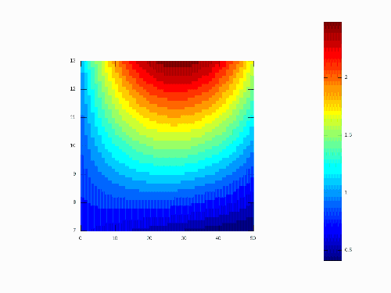
HIGH
A: Degree
B: Closeness
C: Betweenness
D: PageRank
LOW

Slide 7
Edge Betweenness
An edge has high betweenness if it is part of many shortest-paths … how to compute this efficiently?
http://rnav.labri.fr/rNAV2.0_public_version/online_doc/_images/ComputeBetweennessCentrality.png

Slide 8
Algorithm [Brandes, Newman]
For every node u in V
  Layer the graph performing a BFS from u
  For every node v in V, v≠u, sorted by layer
    Assign to v a number s(v) indicating how many shortest paths from u arrive to v
  For every node v in V, v≠u, sorted by reverse layer
    Score to distribute = 1 + score from children
    Add score to parent edges in proportion to s(v)
In the end divide all edge scores by two
Ulrich Brandes. A faster algorithm for betweenness centrality. Journal of Mathematical Sociology, 25:163–177, 2001.
Mark E. J. Newman. Scientific collaboration networks: II. Shortest paths, weighted networks, and centrality. Physical Review E, 64:016132, 2001.

Slide 9
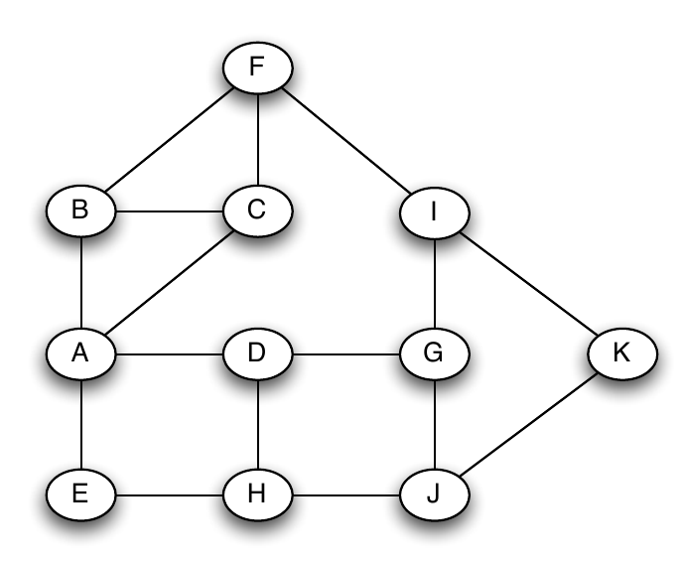
Example
For every node u in V
Layer the graph performing a BFS from u
For every node v in V, v≠u, sorted by layer
  Assign to v a number s(v) indicating how many shortest paths from u arrive to v
For every node v in V, v≠u, sorted by reverse layer
  Score to distribute = 1 + score from children
  Add score to distribute to parent edges in proportion to s(v)
In the end divide all edge scores by two

Slide 10
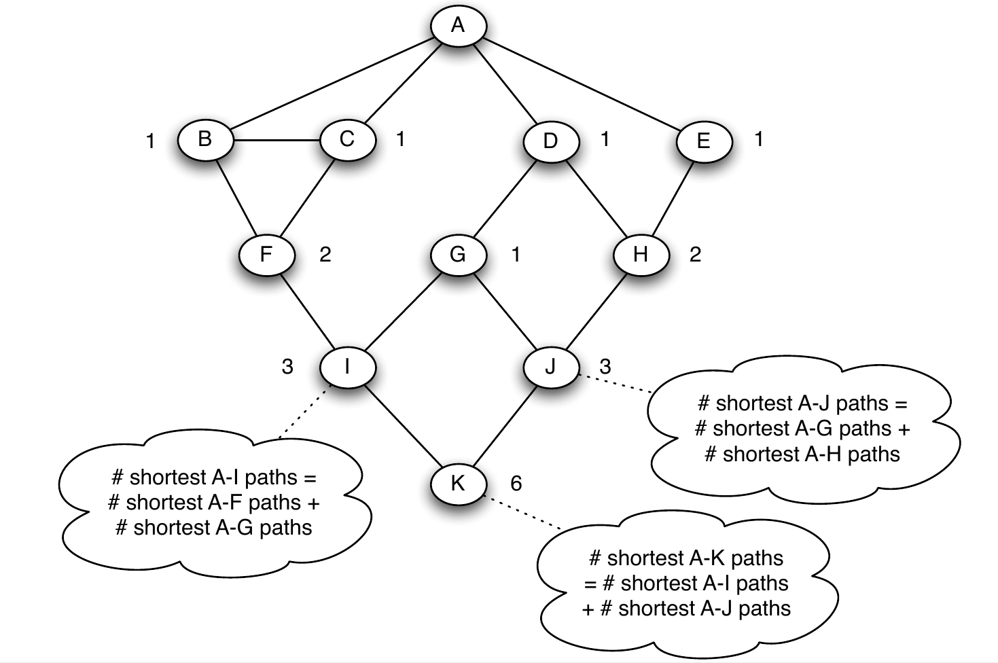
Example
For every node u in V
Layer the graph performing a BFS from u
For every node v in V, v≠u, sorted by layer
  Assign to v a number s(v) indicating how many shortest paths from u arrive to v
For every node v in V, v≠u, sorted by reverse layer
  Score to distribute = 1 + score from children
  Add score to distribute to parent edges in proportion to s(v)
In the end divide all edge scores by two
All nodes in layer 1 get s(v)=1
Remaining nodes: simply add s(.) of their parents

Slide 11
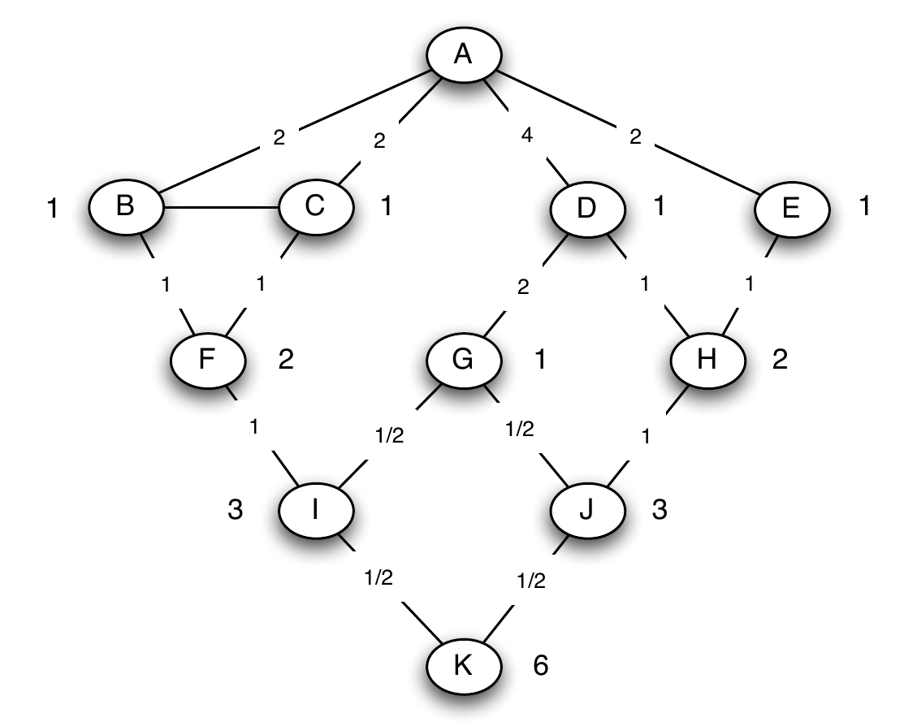
Example
For every node u in V
Layer the graph performing a BFS from u
For every node v in V, v≠u, sorted by layer
  Assign to v a number s(v) indicating how many shortest paths from u arrive to v
For every node v in V, v≠u, sorted by rev. layer
  Score to distribute = 1 + score from children
  Add score to distribute to parent edges in proportion to s(v)
In the end divide all edge scores by two
Nodes without children distribute a score of 1
Other nodes distribute 1 + whatever they receive from their children

Slide 12
Result
For every node u in V
Layer the graph performing a BFS from u
For every node v in V, v≠u, sorted by layer
  Assign to v a number s(v) indicating how many shortest paths from u arrive to v
For every node v in V, v≠u, sorted by reverse layer
  Score to distribute = 1 + score from children
  Add score to distribute to parent edges in proportion to s(v)
In the end divide all edge scores by two
6.19
6.19
1.00
Computed using NetworkX
(edge betweenness)
7.39
7.39
8.52
7.38
10.75
8.88
8.02
6.50
6.11
6.71
7.35
8.75

Slide 13
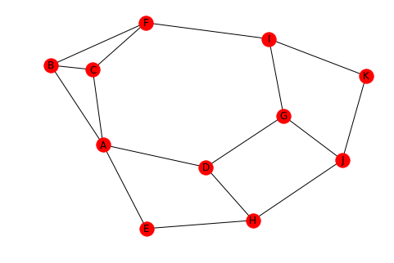
NetworkX code
import networkx as nx
g = nx.Graph()
g.add_edge("A", "B")
g.add_edge("A", "C")
g.add_edge("A", "D")
g.add_edge("A", "E")
g.add_edge("B", "C")
g.add_edge("B", "F")
g.add_edge("C", "F")
g.add_edge("D", "G")
g.add_edge("D", "H")
g.add_edge("E", "H")
g.add_edge("F", "I")
g.add_edge("G", "I")
g.add_edge("G", "J")
g.add_edge("H", "J")
g.add_edge("I", "K")
g.add_edge("J", "K")
nx.edge_betweenness(g, normalized=False)
nx.draw_spring(g, with_labels=True)

Slide 14
Exercise
For every node u in V
Layer the graph performing a BFS from u
For every node v in V, v≠u, sorted by layer
  Assign to v a number s(v) indicating how many shortest paths from u arrive to v
For every node v in V, v≠u, sorted by reverse layer
  Score to distribute = 1 + score from children
  Add score to distribute to parent edges in proportion to s(v)
In the end divide all edge scores by two
Try to compute it by inspection first
Then use the algorithm;
you should get the same results
a
b
c
Answer in Nearpod Draw-ithttps://nearpod.com/student/
Access to be provided during class
d
e

Slide 15
a
b
c
d
e

Slide 16
Solution
For every node u in V
Layer the graph performing a BFS from u
For every node v in V, v≠u, sorted by layer
  Assign to v a number s(v) indicating how many shortest paths from u arrive to v
For every node v in V, v≠u, sorted by reverse layer
  Score to distribute = 1 + score from children
  Add score to distribute to parent edges in proportion to s(v)
In the end divide all edge scores by two
Computed by inspection, by hand using the algorithm, and using NetworkX
a
4
b
6
c
3
3
d
e
1

Slide 17
Fractional values?
In a graph with cycles, you may get fractional values of the edge betweenness for an edge

Slide 18
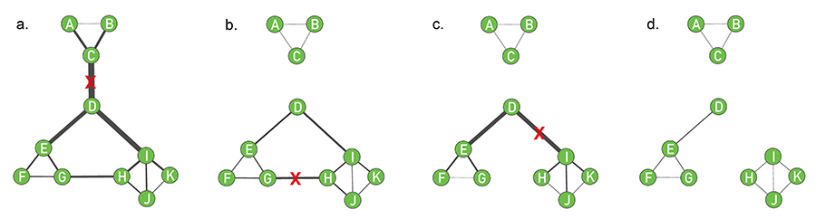
Application: the Girvan-Newman algorithm
Repeat:
  Compute edge betweenness
  Remove edge with larger betweenness

Slide 19
Summary

Slide 20
Things to remember
Closeness and harmonic closeness
Node and edge betweenness
Practice running the Brandes-Newman algorithm on small graphs
Write code to execute the Brandes-Newman algorithm

Slide 21
Practice on your own
Compute edge betweenness on this graph
a
b
c
d
e
f

Slide 22
Practice on your own
a
4.00
b
4.00
c
2.67
3.67
2.67
d
4.00
e
4.00
f
If you don’t get this result, check: https://www.youtube.com/watch?v=uYjWbp8VC7c

