Slide 1

Network flows
Introduction to Network Science
Carlos Castillo
Topic 12

Slide 2
Sources
Barabási 2016 Chapter 9
Networks, Crowds, and Markets Ch 3
C. Castillo: Graph partitioning 2017

Slide 3
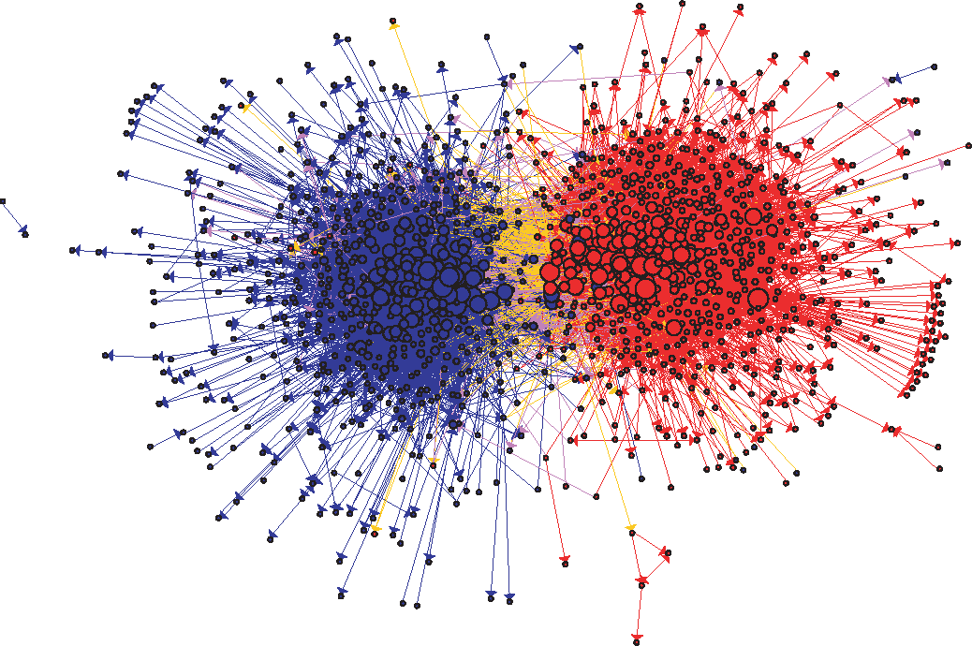
US Political Blogs (2004)
Liberal
Conservative
Adamic, L. A., & Glance, N. (2005, August). The political blogosphere and the 2004 US election: divided they blog. In Proc. LinkKDD (pp. 36-43). ACM.

Slide 4
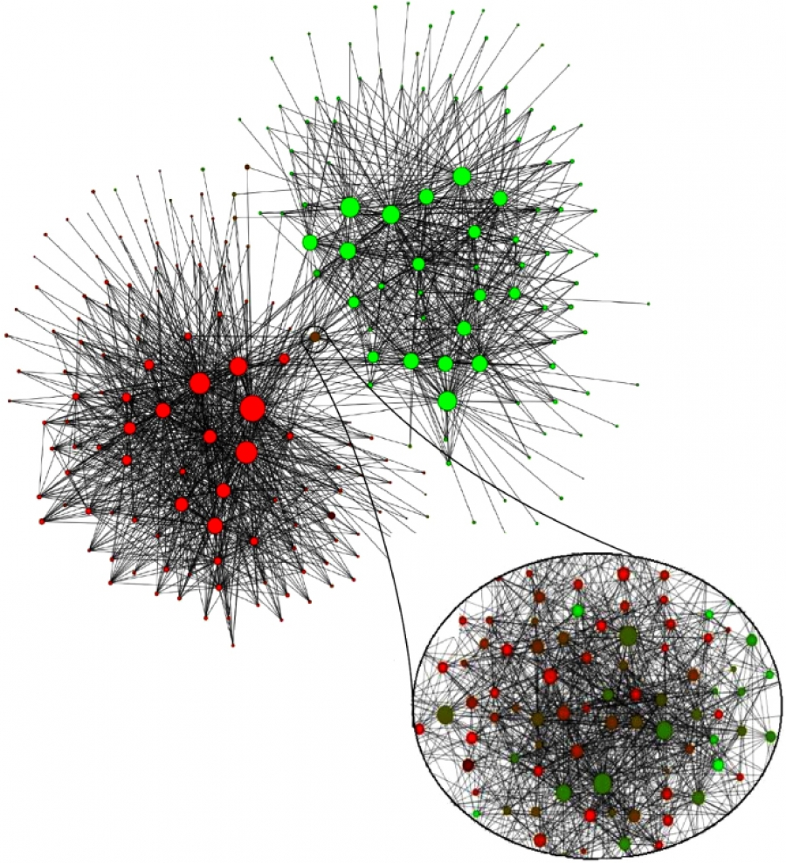
Mobile phone users in Belgium (2008)
Each node is a community of 100 mobile users or more that tend to call each other
Dutch-speaking
French-speaking
V. D. Blondel, J.-L. Guillaume, R. Lambiotte, and E. Lefebvre. Fast unfolding of communities in large networks. J. Stat. Mech., 2008.

Slide 5
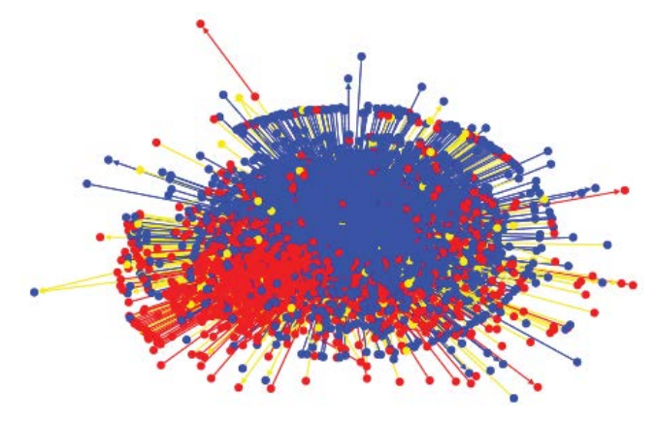
Egyptian Twitter Users (2013)
Islamist
Secularist
Weber, I., Garimella, V. R. K., & Batayneh, A. (2013, August). Secular vs. Islamist polarization in egypt on twitter. In Proc. ASONAM (pp. 290-297). ACM.

Slide 6

Political Books
Source:
Valdis Kreb
& The Economist

Slide 7

Wayne Zachary’s PhD Thesis (1972)
Studied 34 members of a karate club
Found 78 links between members who regularly interacted outside the club
The club splitted in two during the study
1=sensei, 34=president

Slide 8
Splitting into two communities:
Max-flow and Min-cut

Slide 9
Maximum flow: example 1
If edge weights were capacities, what is the maximum flow that can be sent from s to t?
s
t
5 m³/second
1 m³/second
3 m³/second

Slide 10
Maximum flow: example 2
If edge weights were capacities, what is the maximum flow that can be sent from s to t?
1
5
4
s
t
4
2
6

Slide 11
Maximum flow problem
What is the maximum “flow” that can be carried from s to t?
  Think of edge weights as capacities (e.g. m³/s of water)
What is the flow of an edge?
  The amount sent through that edge (an assignment)
What is the net flow of a node?
  The amount exiting the node minus the amount entering the node

Slide 12
Formulating the max flow problem
The flow through each edge should be
Net flow at node h:
flow(h) = out_flow(h) - in_flow(h)
Node s has only out_flow, should have positive flow v
Node t has only in_flow, should have negative flow -v
What should be the flow of the other nodes?

Slide 13
Formulating the max flow problem
Let v be a feasible flow
Node s should have positive flow v
Node t should have negative flow -v
What should be the flow of an arbitrary node h?
h

Slide 14
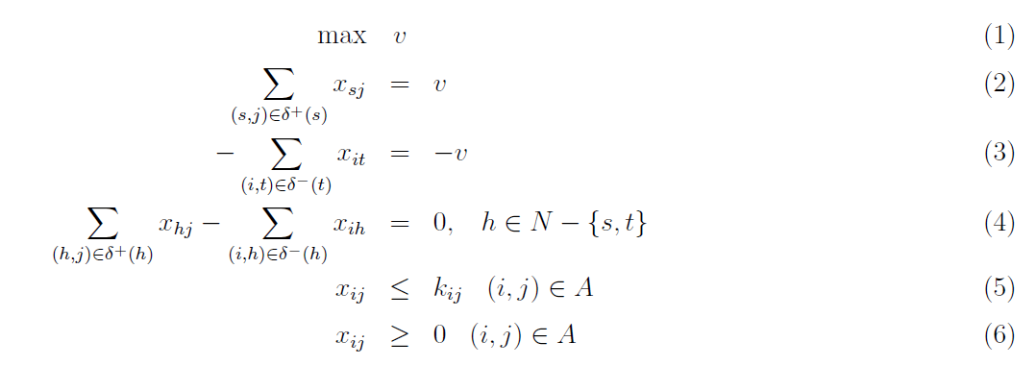
Max flow as a linear program
N: set of nodes, A: set of edges
http://www.dii.unisi.it/~agnetis/mincutENG.pdf

Slide 15
Primal-Dual in Linear Programming
PRIMAL
DUAL

Slide 16
Writing the dual: each constraint will become a variable

Slide 17
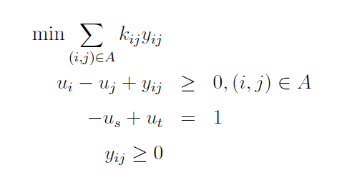
Writing the dual
Remember: the infimum of the solutions of the dual is the supremum of the solutions of primal
(
)
Think of y_{ij} as
0 or 1
Variables u_{i} don't enter the objective, only their difference is in the constraints
We can set them arbitrarily, in particular u_{s} = 0, u_{t} = 1

Slide 18
Dual (after simplification)
What happens with the values of u in every simple path going from s to t ?
u=0
u=?
u=?
u=?
u=1
...

Slide 19
Dual (after simplification)
Given these constraints, the sequence must increase, and can only increase once
u=0
u=0
u=1
u=1
u=1
...

Slide 20
Dual (after simplification)
Every feasible solution represents a cut (S, S')

Slide 21
Dual solutions are cuts
Every feasible solution of the dual has the form of a cut (S, S')
S'
S
u_{s}=0
u_{t}=1

Slide 22
Dual solutions are cuts
Every feasible solution of the dual has the form of a cut (S, S')
u_{s}=0
u_{t}=1
S'
S
u_{s}=0
u_{t}=1
u_{s}=0

Slide 23
Dual solutions are (s-t)-cuts
and remember we're trying to minimize
u_{s}=0
u_{t}=1
S'
S
u_{s}=0
u_{t}=1
u_{s}=0

Slide 24
One more thing about the solution
y_{ij} is a dual variable corresponding to primal constraint
If y_{ij} is non-zero, then the corresponding constraint is tight
What does it mean for the edges in the cut?

Slide 25
One more thing about the solution
y_{ij} is a dual variable corresponding to primal constraint
If y_{ij} is non-zero, then the corresponding constraint is tight
Edges in the cut are saturated (at full capacity)

Slide 26
This is an efficient method
Min-cut and Max-flow are equivalent problems
  Their solutions are also equal: the value of the maximum flow is equivalent to the minimum cut
Think of a chain that breaks at the weakest link
Both can be solved exactly in polynomial time

Slide 27
Randomized algorithm for (s-t)-cuts

Slide 28
Randomized algorithm for (s-t)-cuts
Pick an edge at random (u,v)
Merge u and v in new vertex uv
Edges between u and v are removed
Edges pointing to u or v are added as multi-edges to vertex uv
When only s and t remain, the multi-edges are a cut, probably the minimum one

Slide 29
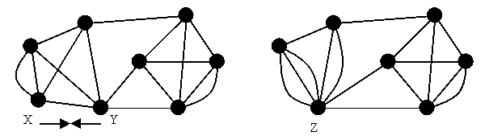
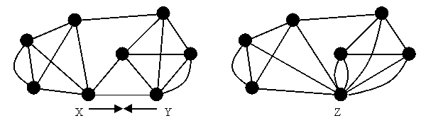
Example merges (“contractions”)
http://www.cs.berkeley.edu/~jfc/cs174lecs/lec18/lec18.html

Slide 30
Try it!
Pick an edge at random (u,v)
Merge u and v in new vertex uv
Edges between u and v are removed
Edges pointing to u or v are added as multi-edges to vertex uv
When only s and t remain, the multi-edges are a cut, probably the minimum one
Run the randomized
algorithm on this graph
a
b
s
t
c
d

Slide 31
Example run
s
t
s
t
s
t
s
t
s
t
s
s
t
t
s
s
t
t
Cut of weight 2 found!

Slide 32
The randomized algorithm might miss the min cut
Multiple runs are required
The probability that this finds the min cut in one run is about 1/log(n), so O(log n) iterations are required to find min cut
Each iteration costs O(n² log n)
O(n² log² n) operations needed to find min cut
Exact algorithm: O(n³ + n² log n); the n³ is because of |V||E| operations required
http://www.cs.berkeley.edu/~jfc/cs174lecs/lec18/lec18.html

Slide 33
To remember
Minimum s-t cut in a graph = set of edges
The sum of the capacities of those edges is the maximum s-t flow the graph can carry
Solvable in polynomial time
Approximate randomized algorithm exists

