Slide 1

Random networks
Introduction to Network Science
Carlos Castillo
Topic 03

Slide 2
Sources
Albert László Barabási: Network Science. Cambridge University Press, 2016.
  Follows almost section-by-section chapter 03
URLs cited in the footer of specific slides

Slide 3
Why studying random networks?
One way of studying complex networks is by running stochastic models of network creation and then see if they generate networks that look like real ones
The “random network” model is one such stochastic model in which each link is created independently at random

Slide 4
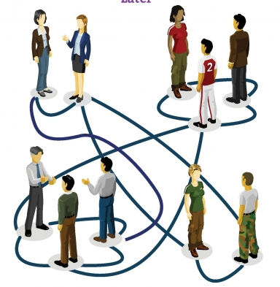
Meeting people at a party
You pick a random person
Talk to that person for a while, now you are connected
Then pick another person
  And repeat
The result is what we call a random network

Slide 5
Formalization (Erdös-Rényi or ER)
For each pair of nodes in the graph
  Perform a Bernoulli trial with probability p
    “Toss a biased coin with probability p of landing heads”
  If the trial succeeds, connect those nodes
    “If the coin lands heads, connect those nodes”
Repeat for all N(N-1)/2 pairs

Slide 6
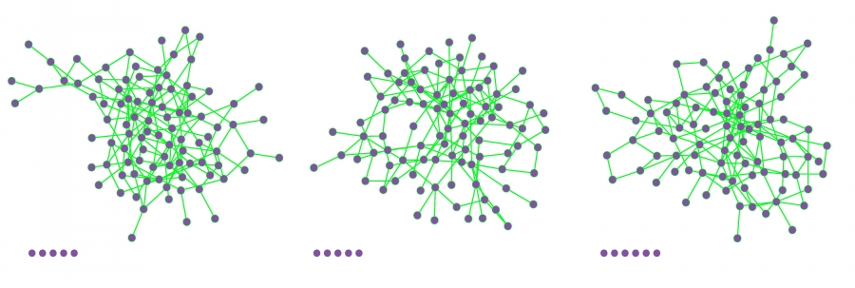
Examples
These 3 networks were generated with N=100 and p=0.03; nodes at the bottom ended up isolated

Slide 7
The binomial distribution
The distribution of the probability of obtaining x successes in N independent trials, in which each trial has probability of succeeding p

Slide 8
Properties
Expected number of links
Average degree

Slide 9
Degree distribution
The degree distribution is simply a Binomial distribution
Note that the maximum number of “successes” (links) of a node is N-1, hence:

Slide 10
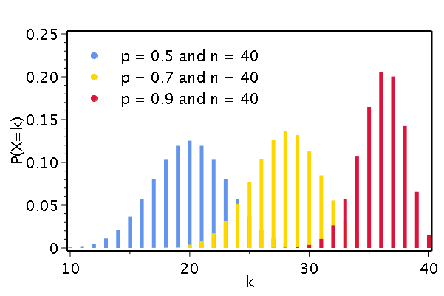
Degree distribution examples
The peak is always at <k>

Slide 11
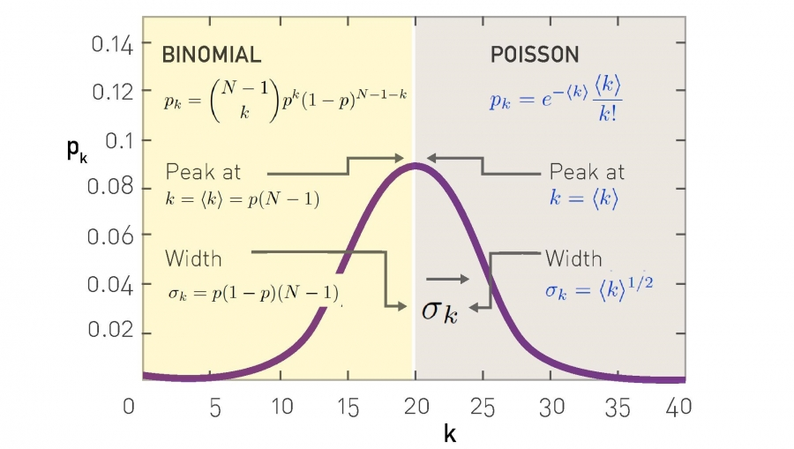
Approximation with a Poisson distribution for

Slide 12
“Back of the envelope” calculations
Suppose N = 7 x 10⁹
Suppose <k> = 1,000
  A person knows the name of approx. 1,000 others
Then on expectation k_{max} = 1,185
<k> ± σ is the range from 968 to 1,032
Is this realistic?

Slide 13

Survey: how many WhatsApp contacts do you have?
https://goo.gl/forms/ovVvdnlWmZgMWdiL2

Slide 14
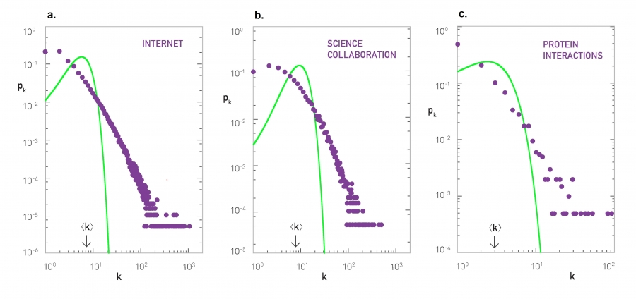
Real networks (green = )

Slide 15
ER network as <k> increases
When <k> = 0: only singletons
When <k> < 1: disconnected
When <k> > 1: giant connected component
When <k> = N – 1 complete graph
It’s kind of obvious that to have a giant connected it is necessary that <k> = 1, ER proved it’s sufficient in 1959

Slide 16
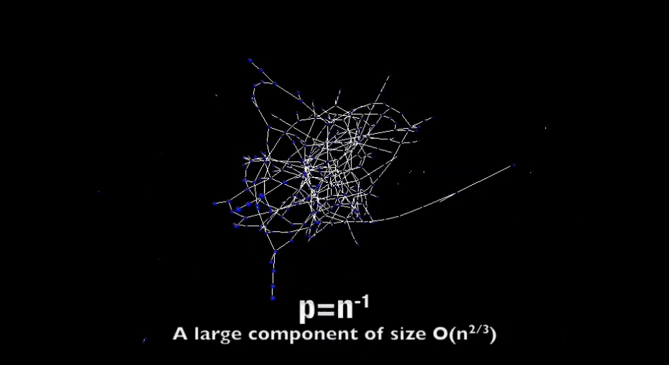
Visualization of increasing p
http://networksciencebook.com/images/ch-03/video-3-2.m4v

Slide 17
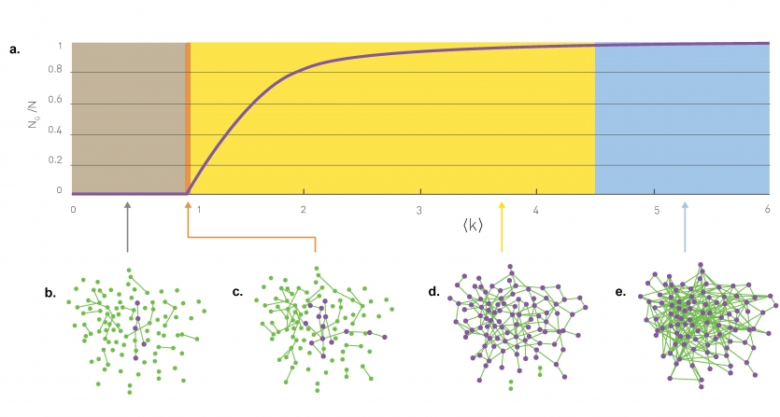
Sub-critical regime:

Slide 18
Critical point:

Slide 19
Supercritical regime:

Slide 20
Connected regime:

Slide 21
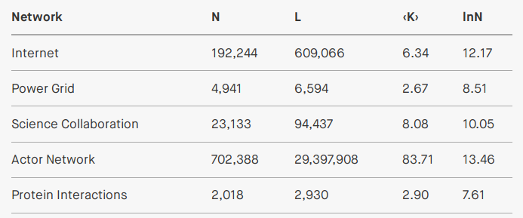
Most real networks are supercritical:

Slide 22
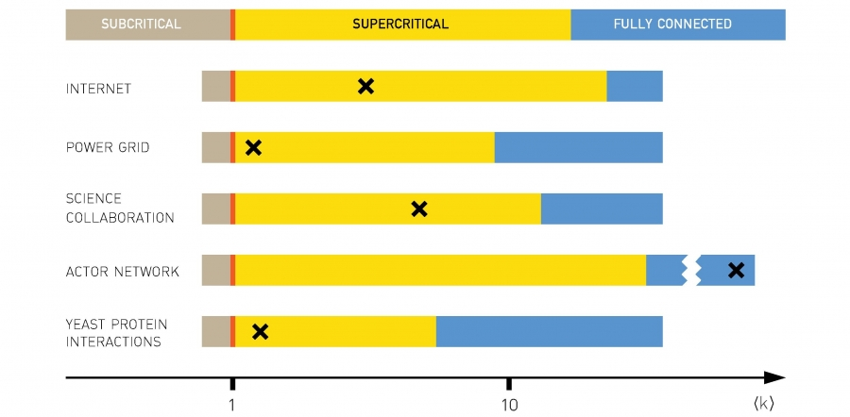
Most real networks are supercritical:

Slide 23
Small-world phenomenon a.k.a. “six degrees of separation”

Slide 24
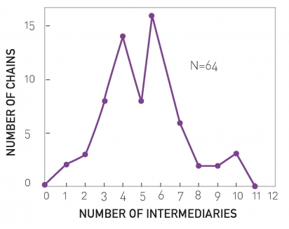
Milgram’s experiment in 1967
Targets: (1) a stock broker in Boston, MA and (2) a student in Sharon, MA
Sources: residents of Wichita and Omaha
Materials: a short summary of the study’s purpose, a photograph, the name, address and information about the target person
Request: to forward the letter to a friend, relative or acquaintance who is most likely to know the target person.
64 of 296 letters reached destination

Slide 25
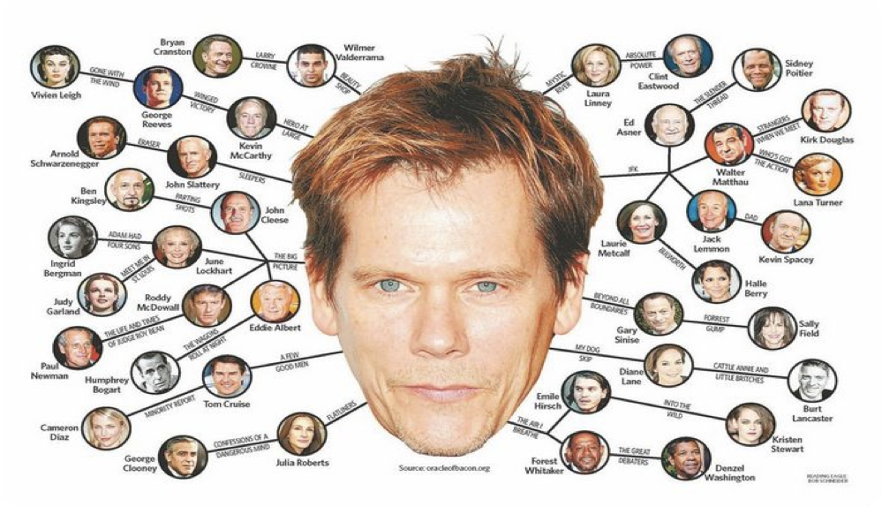

Slide 26
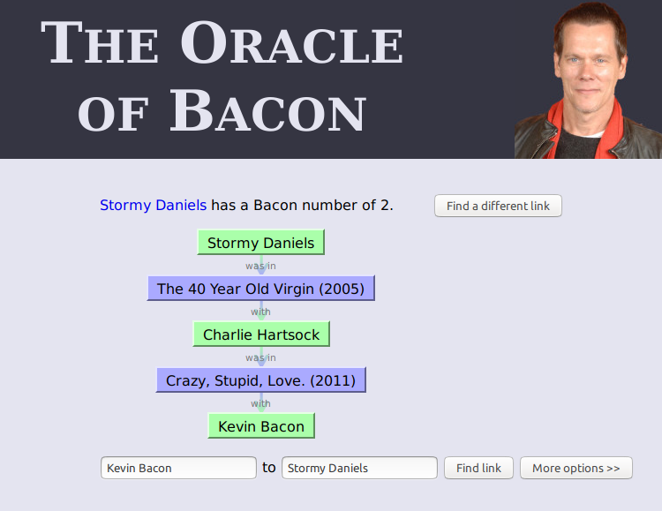
https://oracleofbacon.org/

Slide 27
“Small-world phenomenon”
If you choose any two individuals on Earth, they are connected by a relatively short path of acquaintances (around six at most)
Formally
  The distance between two randomly chosen nodes in a network is short

Slide 28
How many nodes at distance ≤d?
In an ER graph:
  nodes at distance 1
  nodes at distance 2
  …
  nodes at distance d

Slide 29
What is the maximum distance?
Assuming

Slide 30
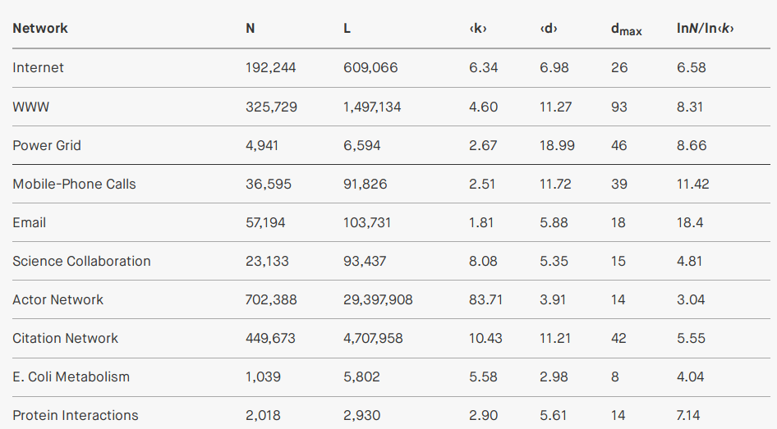
Empirical average and maximum distances

Slide 31
Approximation
Given that d_{max} is dominated by a few long paths, while <d> is averaged over all paths, in general we observe that in an ER graph:

Slide 32
Clustering coefficient or
”a friend of a friend is my friend”

Slide 33
Clustering coefficient C_{i} of node i
C_{i} = 0 ⇒ neighbors of i are disconnected
C_{i} = 1 ⇒ neighbors of i are fully connected

Slide 34
Links between neighbors in ER graphs
The number of nodes that are neighbors of node i is k_{i}
The number of distinct pairs of nodes that are neighbors of i is k_{i}(k_{i}-1)/2
The probability that any of those pairs is connected is p
Then, the expected links L_{i} between neighbors of i are:

Slide 35
Clustering coefficient in ER graphs
Expected links L_{i} between
neighbors of i:
Clustering coefficient

Slide 36
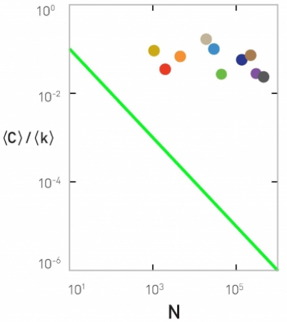
In an ER graph
If <k> is fixed, large networks should have smaller clustering coefficient
We should have that <C>/<k> follows 1/N

Slide 37
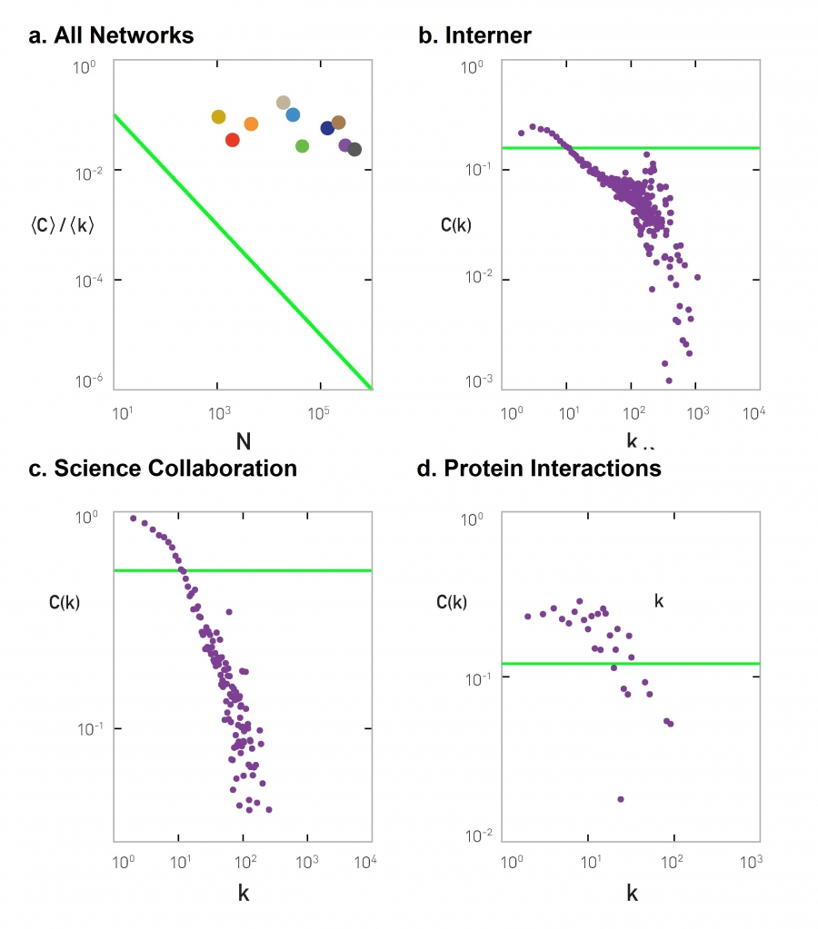
If in an ER graph
Then the clustering coefficient of a node should be independent of the degree
Internet
Science collaborations
Protein interactions

Slide 38
To re-cap ...

Slide 39
The ER model is a bad model of degree distribution
Predicted
Observed
Many nodes with larger
degree than predicted

Slide 40
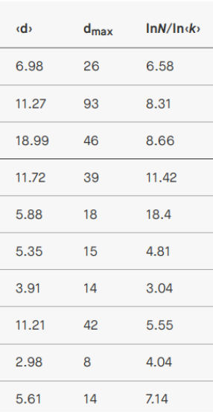
The ER model is a good model of path length
Predicted
Observed

Slide 41
The ER model is a bad model of clustering coefficient
Predicted
Observed
Clustering coefficient depends
on the degree of the node

Slide 42
Why do we study the ER model?
Starting point
Simple
Instructional
Historically important, and gained prominence only when large datasets started to become available ⇒ relevant to Data Science!

