Slide 1

Graph Theory Basics
Social Networks Analysis and Graph Algorithms
Prof. Carlos Castillo — https://chato.cl/teach

Slide 2
Contents
Notation for graphs
Degree distributions
Adjacency matrices

Slide 3
Sources
A. L. Barabási (2016). Network Science – Chapter 02
URLs cited in the footer of specific slides

Slide 4
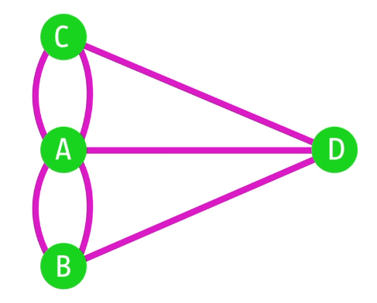
Notation for a graph
G = (V,E)
  V: nodes or vertices
  E: links or edges
|V| = N size of graph
|E| = L number of links

Slide 5
Subgraph
Given G = (V,E)
A subgraph induced by a nodeset S is the graph G’=(S,F) defined by:
  nodes in S
  edges in F = { (u,v) ∊ E s.t. u ∊ S and v ∊ S }

Slide 6
Typical notation variations
You may find that G is denoted by (N, A), this is typical of directed graphs, means “nodes, arcs”
You may find that
  |V| is denoted by n or N
  |E| is denoted by m, M, or L

Slide 7
Example graphs we will use
Network | |V| | |E|
Zachary’s Karate Club (karate.gml) | 34 | 78
Game of Thrones (got-relationships.csv) | 84 | 216
US companies ownership | 1351 | 6721
Marvel comics (hero-network.csv) | 6K | 167K
https://github.com/chatox/networks-science-course/tree/master/practicum/data

Slide 8
Directed vs undirected graphs
In an undirected graph
  E is a symmetric relation
In a directed graph, also known as “digraph”
  E is not a symmetric relation

Slide 9
Weighted vs unweighted graphs
In a weighted graphs edges have weights denoting the strength or importance of a connection
When drawing, typically larger weights are drawn with ticker lines

Slide 10
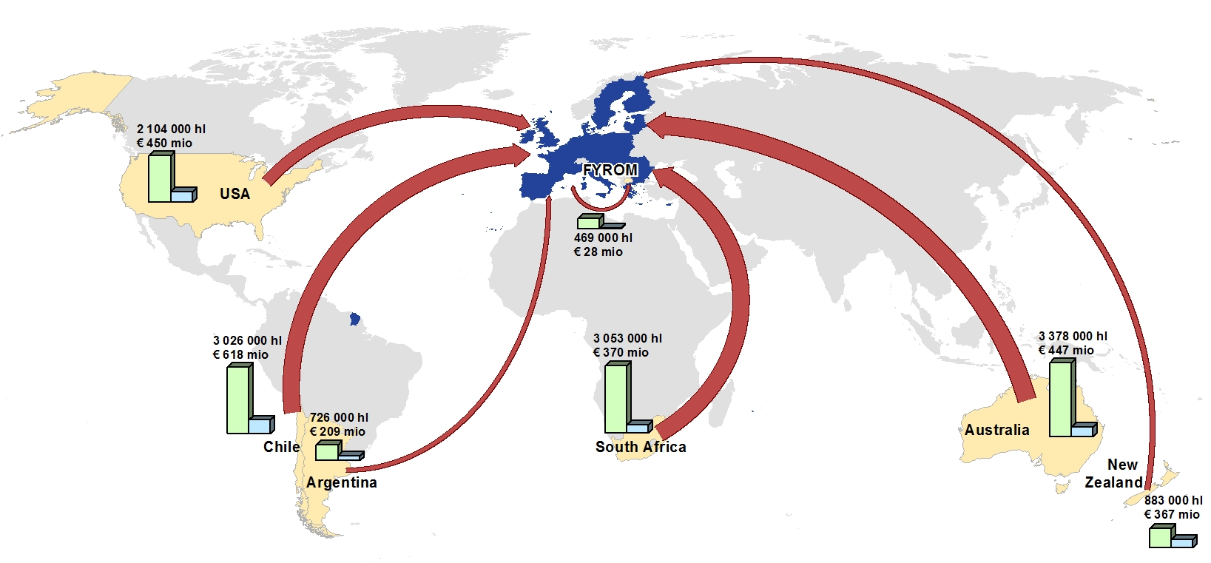
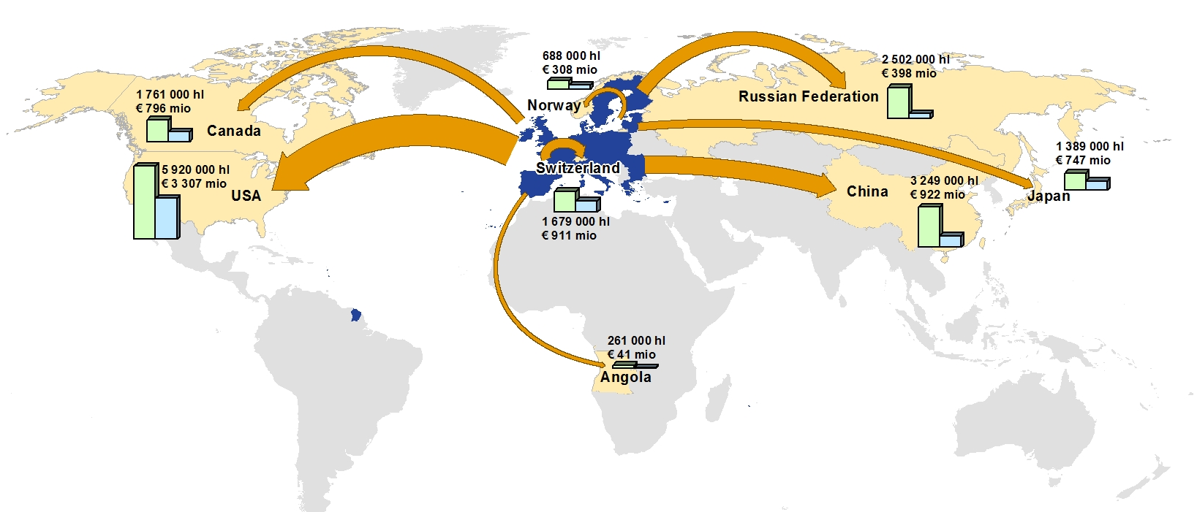
Example: weighted networks
EU imports (top) and exports (bottom) of wine
https://ec.europa.eu/agriculture/wine/statistics_sl

Slide 11
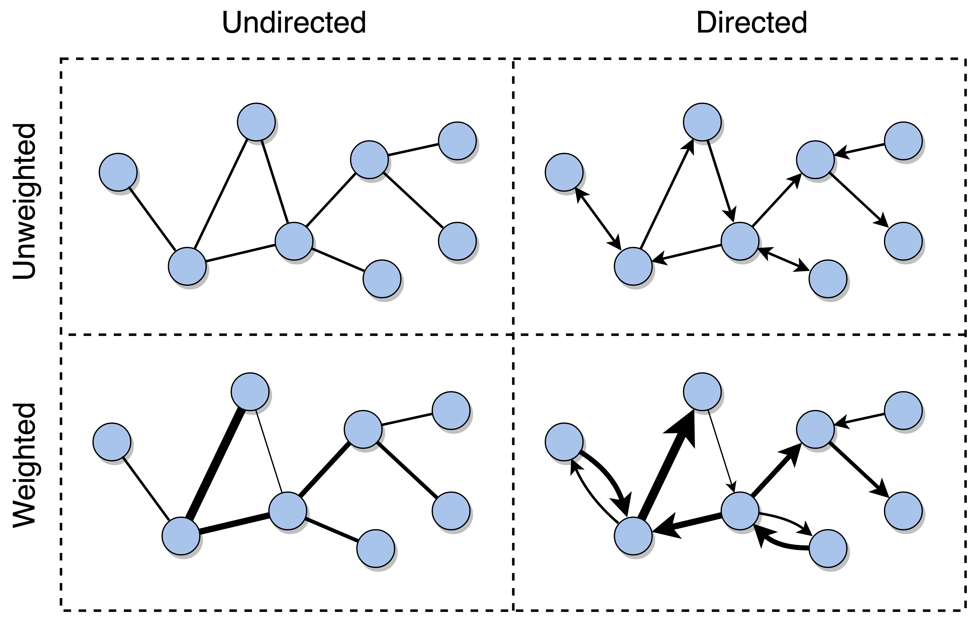
Source: Menczer, Fortunato, David: A First Course on Networks Science. Cambridge, 2020.

Slide 12
Degree

Slide 13
Degree
Node i has degree k_{i}
  This is the number of links incident on this node
  The total number of links L is given by
Average degree

Slide 14
In directed graphs
We distinguish in-degree from out-degree
  Incoming and outgoing links, respectively
Degree is the sum of both
Counting total number of links:

Slide 15
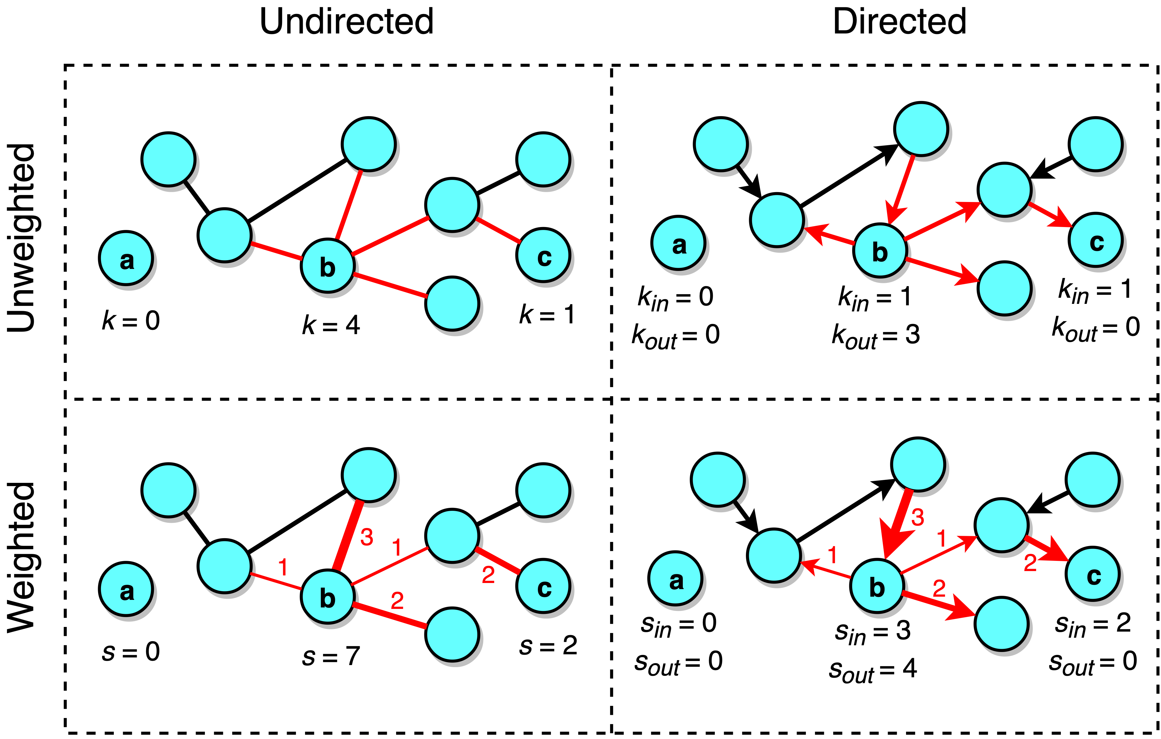
In weighted graphs
We speak of “weighted degree” or “strength”

Slide 16
Degree distribution
If there are N_{k} nodes with degree k
The degree distribution is given by
The average degree is then

Slide 17
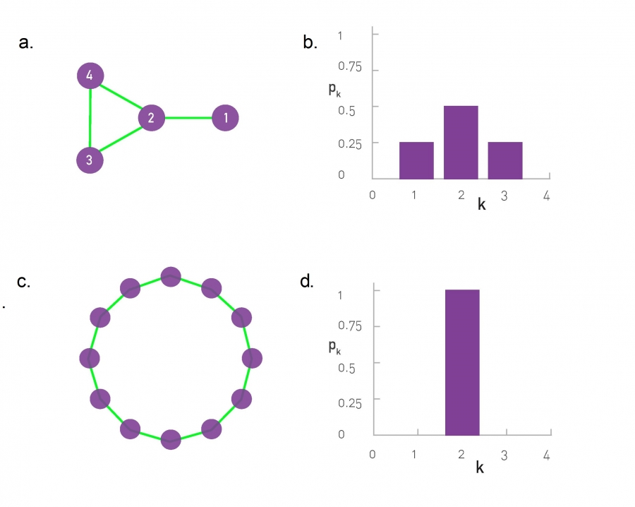
Degree distribution; two toy graphs

Slide 18
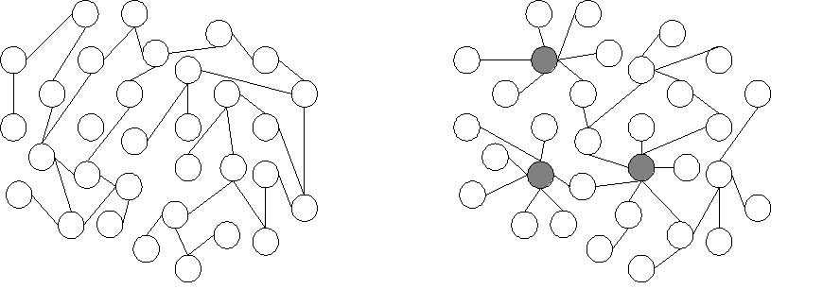

Exercise
Draw the degree distribution of these graphs
Spreadsheet links: https://upfbarcelona.padlet.org/chato/shyq9m6f2g2dh1bw

Slide 19
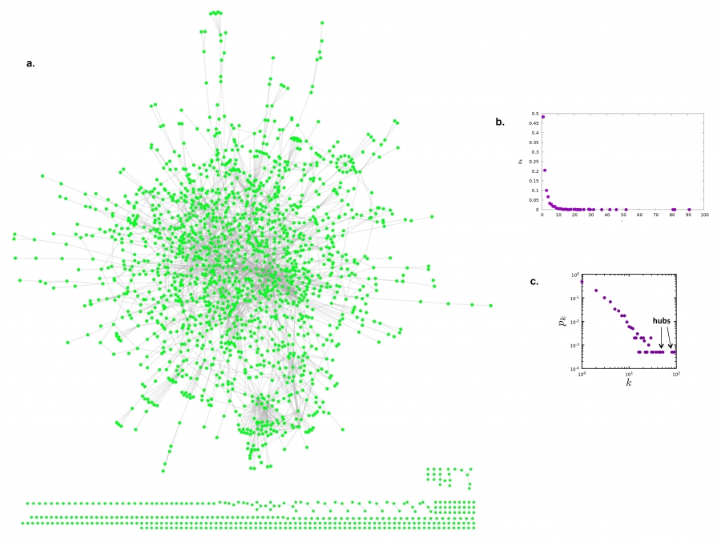
Degree distribution; real graph
Linear
scale
Log-log
scale

Slide 20
Adjacency matrix

Slide 21
What is an adjacency matrix
A is the adjacency matrix of G = (V, E) iff:
  A has |V| rows and |V| columns
  A_{ij} = 1 if (i,j)∈ E
  A_{ij} = 0 if (i,j)∉ E
A_{ij} always means row i, column j
  Sometimes Barabási’s book has this wrong

Slide 22
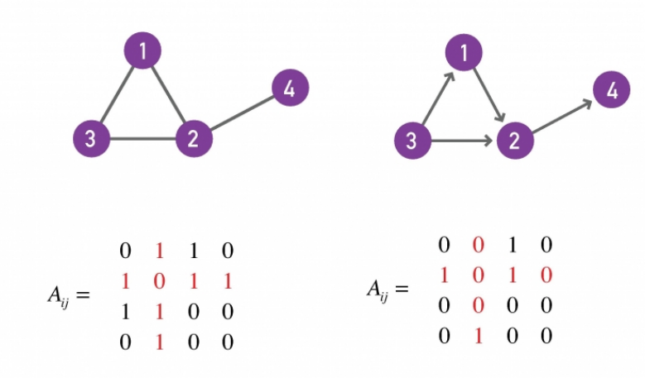
Examples
Undirected graph
Directed graph
0 1 1 0
1 0 1 1
1 1 0 0
0 1 0 0
0 1 0 0
0 0 0 1
1 1 0 0
0 0 0 0

Slide 23
A_{ij} always means row i, column j
Undirected graph
Directed graph
Row 2
Column 4
0 1 1 0
1 0 1 1
1 1 0 0
0 1 0 0
0 1 0 0
0 0 0 1
1 1 0 0
0 0 0 0

Slide 24
Properties of adjacency matrices
G is undirected ⇔ A is symmetric
G has a self-loop
⇔ A has a non-zero element in the diagonal
G is complete ⇔ A_{ij} ≠ 0 (except if i=j)

Slide 25
Quick Exercise
In terms of A, what is the expression for:

Slide 26

Answer
In terms of A, what is the expression for:

Slide 27
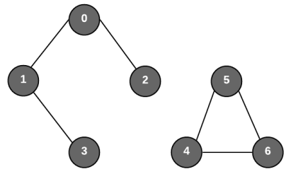
If a graph is disconnected
Disconnected graphs have adjacency matrices with block structure
S
S’

Slide 28
More concepts

Slide 29
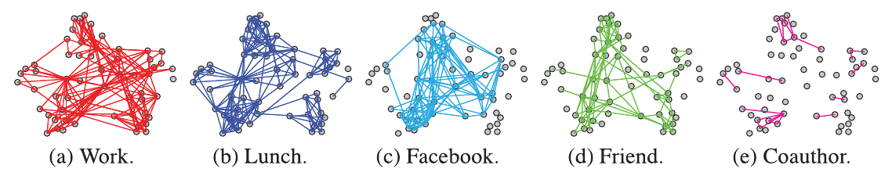
Some graphs are multi-layer
Multi-layer graphs have different edges over the same nodes
Example graph of 61 employees of a university department, with links indicating: coworking, having lunch together, being connected on Facebook, being actual friends, or being co-authors
https://dl.acm.org/doi/abs/10.1145/2898362

Slide 30
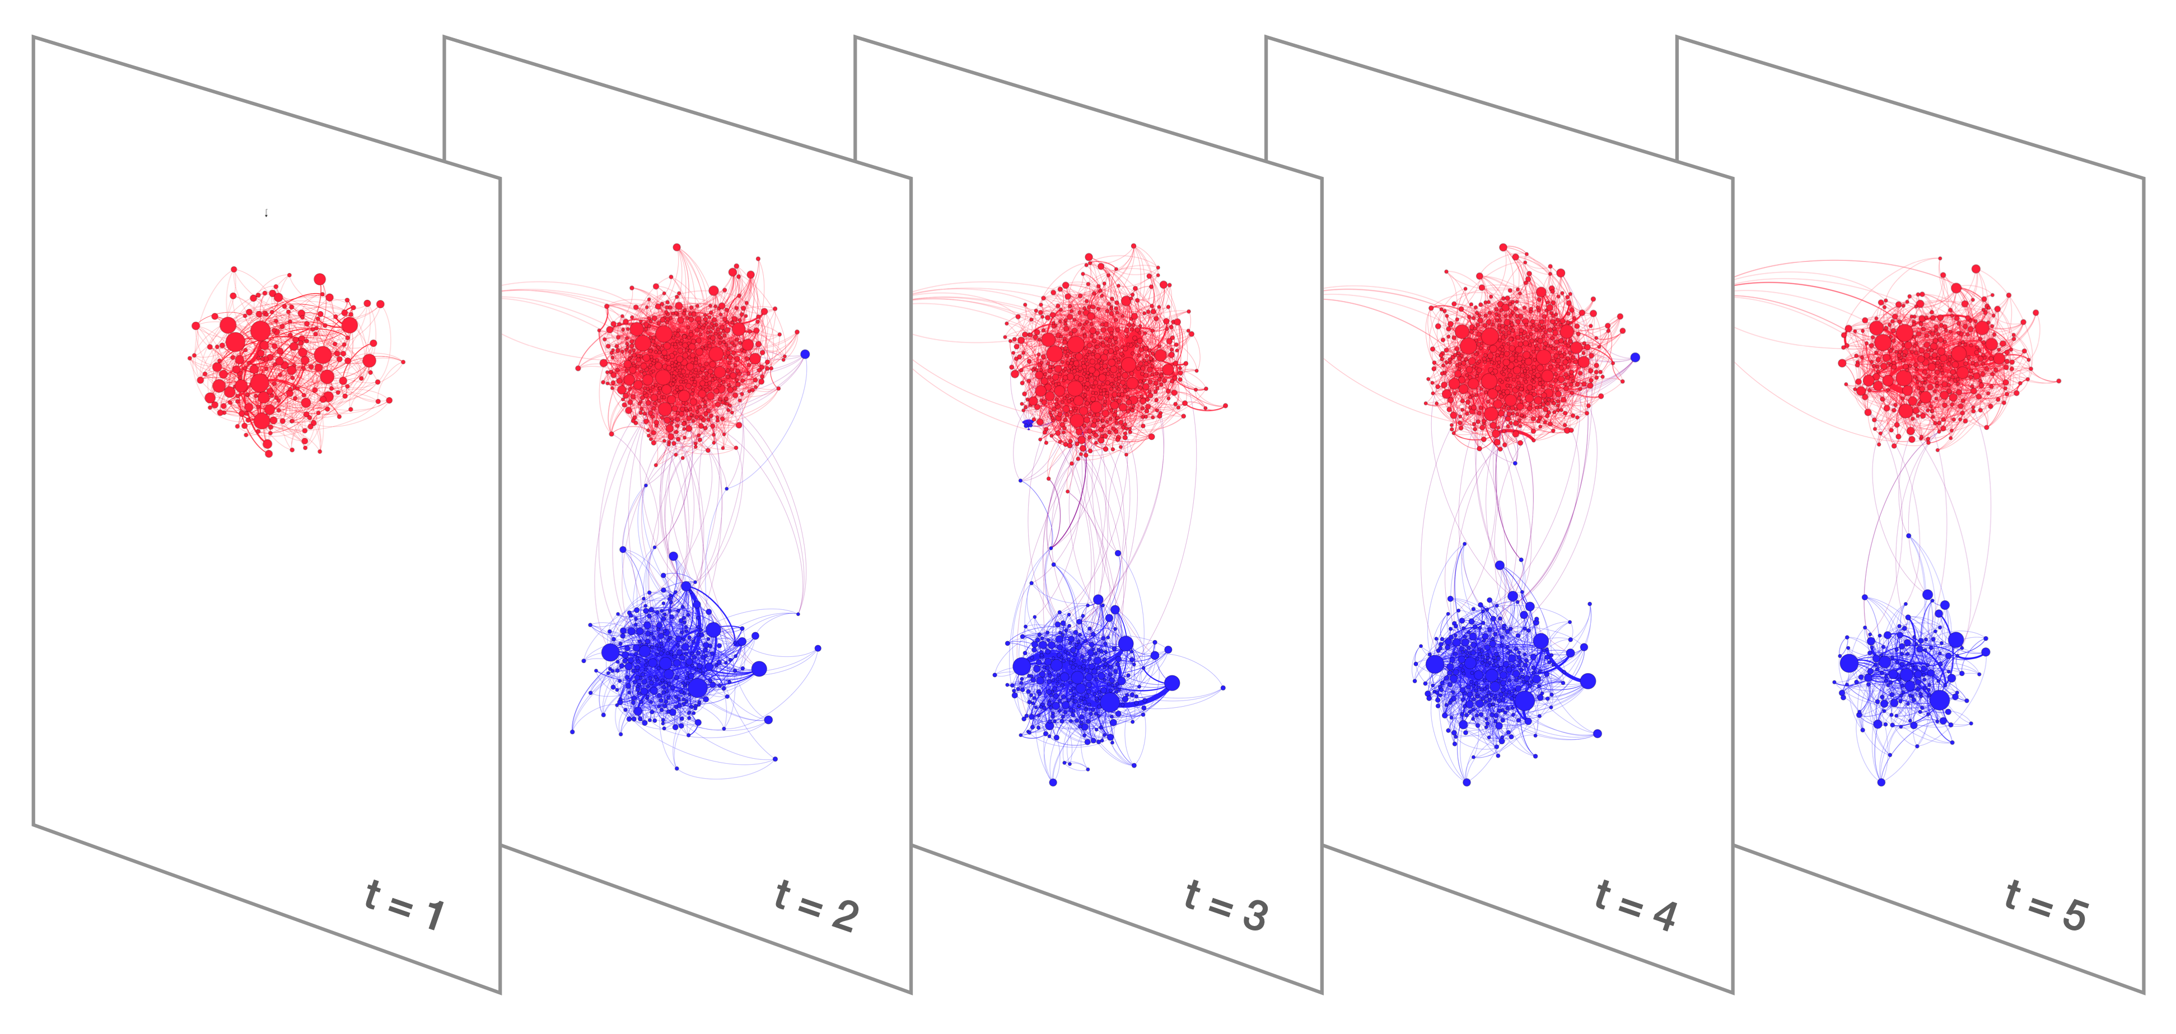
Some graphs are time-evolving
Temporal, or “time-evolving” graph
At each timestep there are new nodes and/or edges (and/or deletions)
Source: Menczer, Fortunato, David: A First Course on Networks Science. Cambridge, 2020.

Slide 31
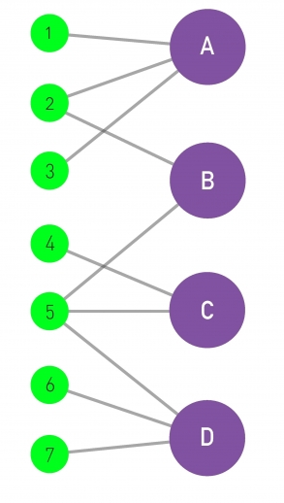
Some graphs are bi-partite
A bipartite graph is a graph
G = (V,E) such that

Slide 32
Exercise: project a bipartite network
?
Left projection:
graph where nodes
are 1, 2, …, 7 and
nodes are connected
if they share a
neighbor
?
Right projection:
graph where nodes
are A, B, …, D and
nodes are connected
if they share a
neighbor

Slide 33
Answer
A
1
3
B
C
2
5
4
D
6
7
Left projection
Right projection

Slide 34
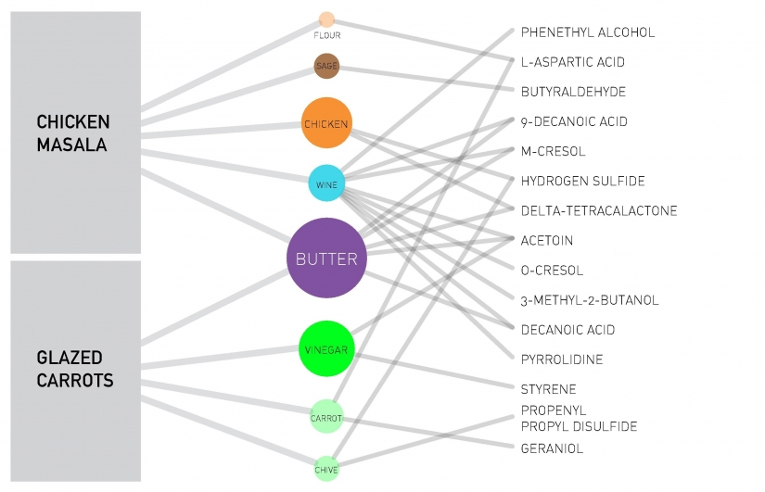
Tripartite network

Slide 35

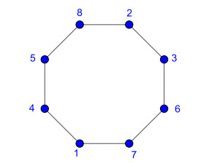
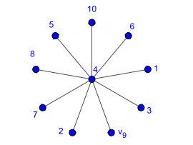
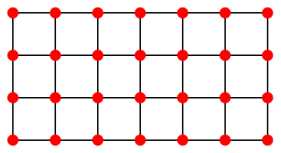
Some graphs have a name
Line
Cycle
Star
Lattice

Slide 36
Clique and Bi-partite clique
A clique is a complete (sub)graph:
An n-clique is a complete graph of n nodes
A bi-partite clique is such that
A (n₁, n₂)-clique is a bipartite clique such that

Slide 37

Note: “clique” in popular culture
In some parts of Latin America, a “clica” is a close group of friends, or sometimes a group within a gang
Photo credit: @astro_jr

Slide 38
Summary

Slide 39
Things to remember
Definitions
  degree, in-degree, out-degree
  time-evolving graph, multi-layer graph
  line graph, cycle graph, star graph, lattice, bi-partite graph, clique
Writing the adjacency matrix of a graph, and drawing a graph given its adjacency matrix
Plotting the degree distribution of a graph
Projecting a bi-partite graph

Slide 40
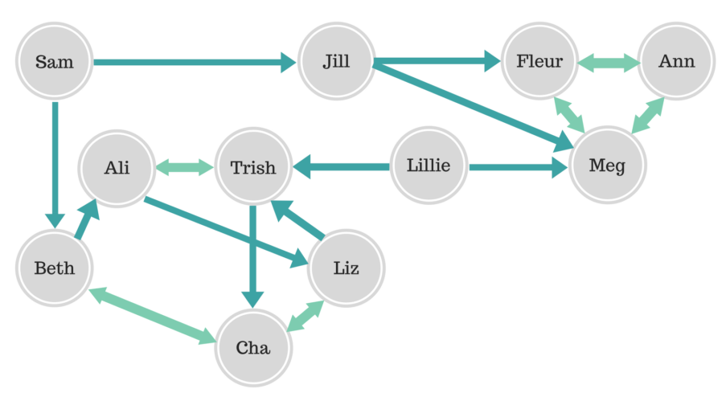
Practice on your own
Draw the indegree, outdegree, degree distribution
Write the adjacency matrix
https://www.6seconds.org/2017/07/03/20125/

Slide 41
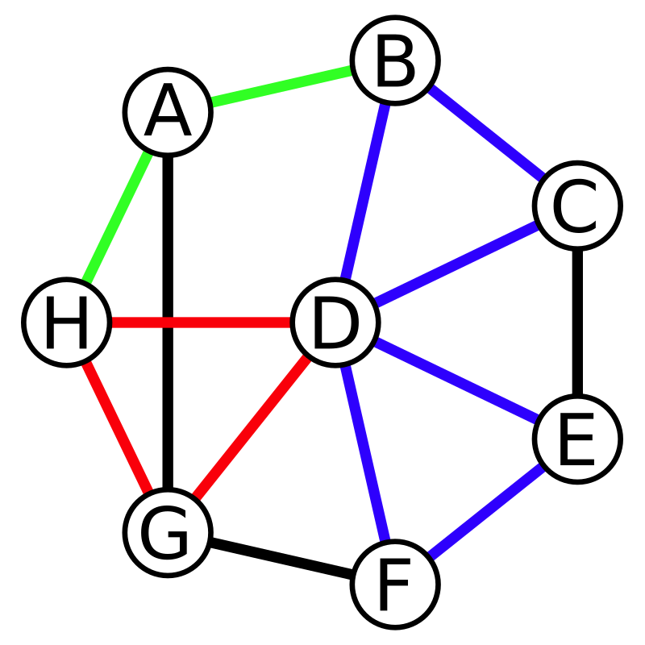
Practice on your own
How do you call the sub-graph induced by nodesets:
{H, A, B}
{G, H, D}
{B, D, E, G}
{A, B, D, E}

Slide 42
Answers to previous slide
{H, A, B} is a “line graph”
{G, H, D} is a “cycle graph” and also a “clique”
{B, D, E, G} is a “star graph”
{A, B, D, E} is a “bi-partite” graph, for instance it can be partitioned in {A, D} U {B, E}

