Slide 1

Examples of
Complex Networks
Introduction to Network Science
Carlos Castillo
Topic 02

Slide 2
Sources
Albert László Barabási: Network Science. Cambridge University Press, 2016.
  Chapter 01, Chapter 02
Filippo Menczer, Santo Fortunato, and Clayton A. Davis. A First Course in Network Science. Cambridge University Press, 2020.
  Chapter 00
URLs cited in the footer of specific slides

Slide 3
Wikipedia definition
Network science is an academic field which studies complex networks such as
  telecommunication networks, computer networks, biological networks, cognitive and semantic networks, and social networks,
considering
  distinct elements or actors represented by nodes and
  the connections between the elements or actors as links.

Slide 4

Complex systems
Many interconnected parts
Complicated arrangement
of connections
Emerging properties

Slide 5
Behind every complex system there is a complex network
Connections between neurons in the brain
Interactions between genes and proteins
Family/friendship links in human and non-human animals
Infrastructure of telecommunications, electricity
Commerce/trade networks

Slide 6
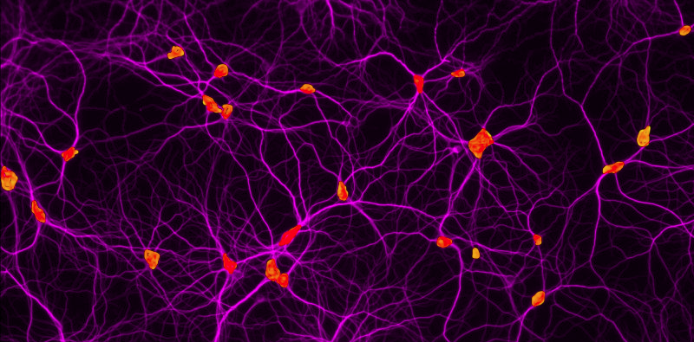
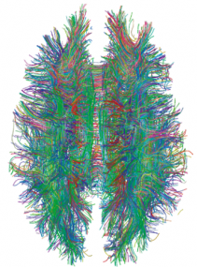
Human brain: |V| ≃ 90 x 10⁹
https://health.uconn.edu/cell-analysis-modeling/microscopy-facility-2/
https://dx.doi.org/10.1371%2Fjournal.pone.0004006

Slide 7
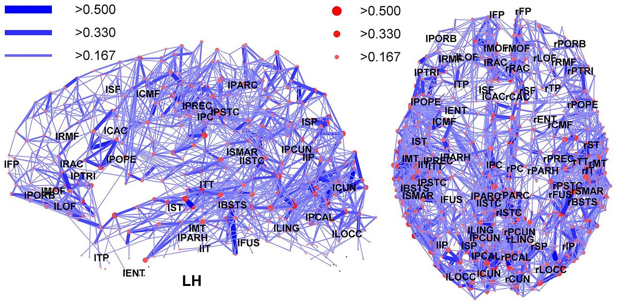
Regions in the human brain
https://en.m.wikipedia.org/wiki/File:Network_representation_of_brain_connectivity.JPG

Slide 8
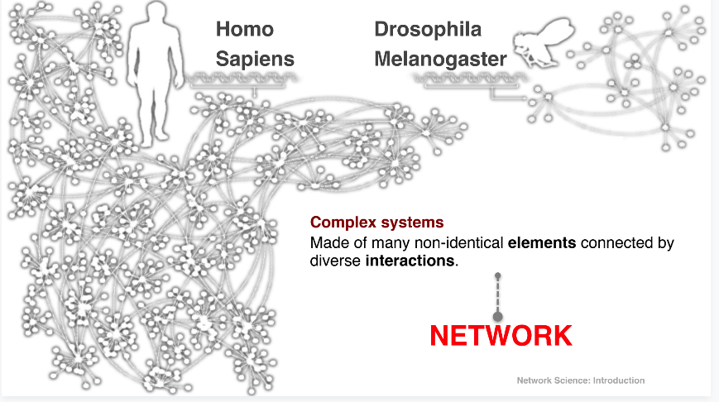
Gene networks

Slide 9
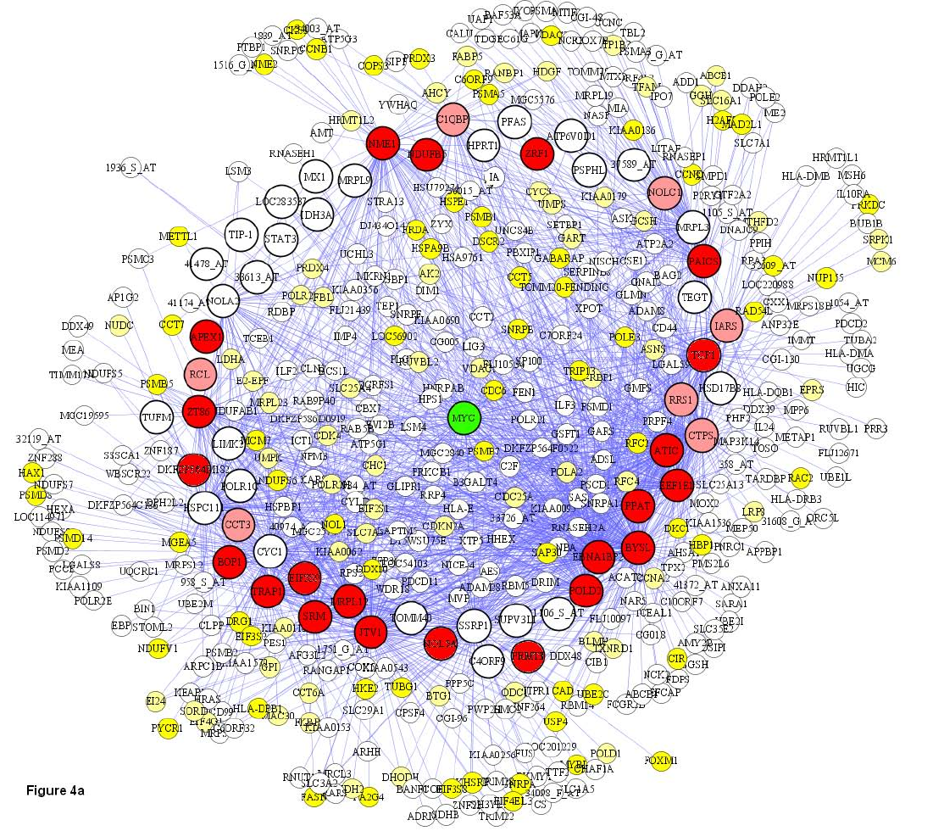
Co-expression of Genes
|V|=500 in this plot
Basso, K., Margolin, A. A., Stolovitzky, G., Klein, U., Dalla-Favera, R., & Califano, A. (2005). Reverse engineering of regulatory networks in human B cells. Nature genetics, 37(4), 382.

Slide 10
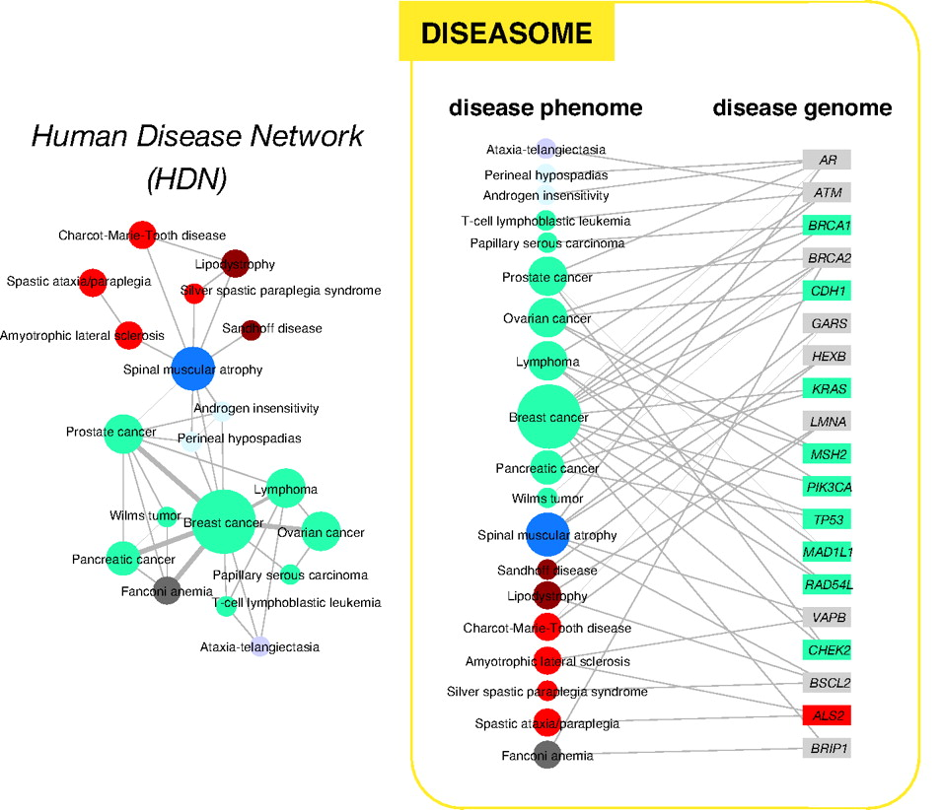
Human disease network
http://www.pnas.org/content/104/21/8685

Slide 11
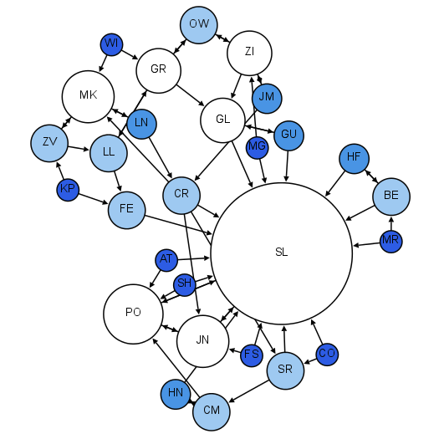
Moreno’s sociograms
Colors and sizes:
indegree
Early 1930s
Children in 2nd grade
Who would you like to sit with?
http://www.martingrandjean.ch/social-network-analysis-visualization-morenos-sociograms-revisited/

Slide 12
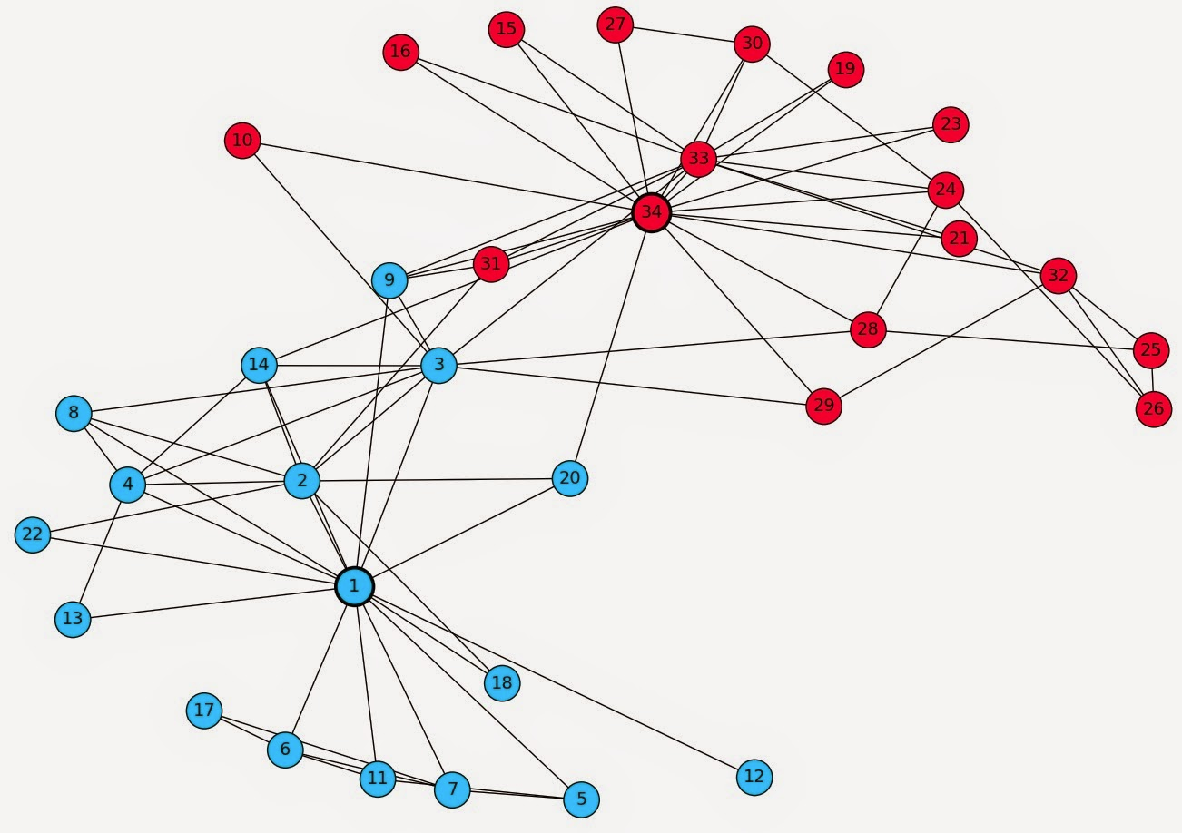
Zachary’s Karate Club
Karate club that split into two clubs
(led by 1 and 34)

Slide 13
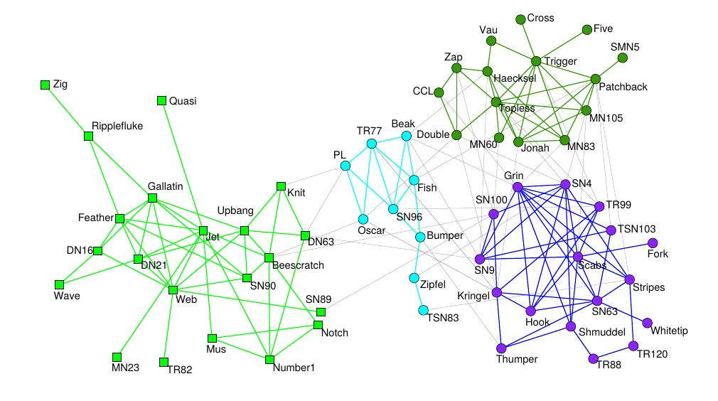

Dolphins in a fjord in New Zealand
Research following a school of dolphins in the wild (2003)
Look for dolphins swimming together
Found long-lasting associations; research has been repeated with other non-human animals (e.g., sheep)
https://doi.org/10.1007/s00265-003-0651-y
I really like dolphins

Slide 14
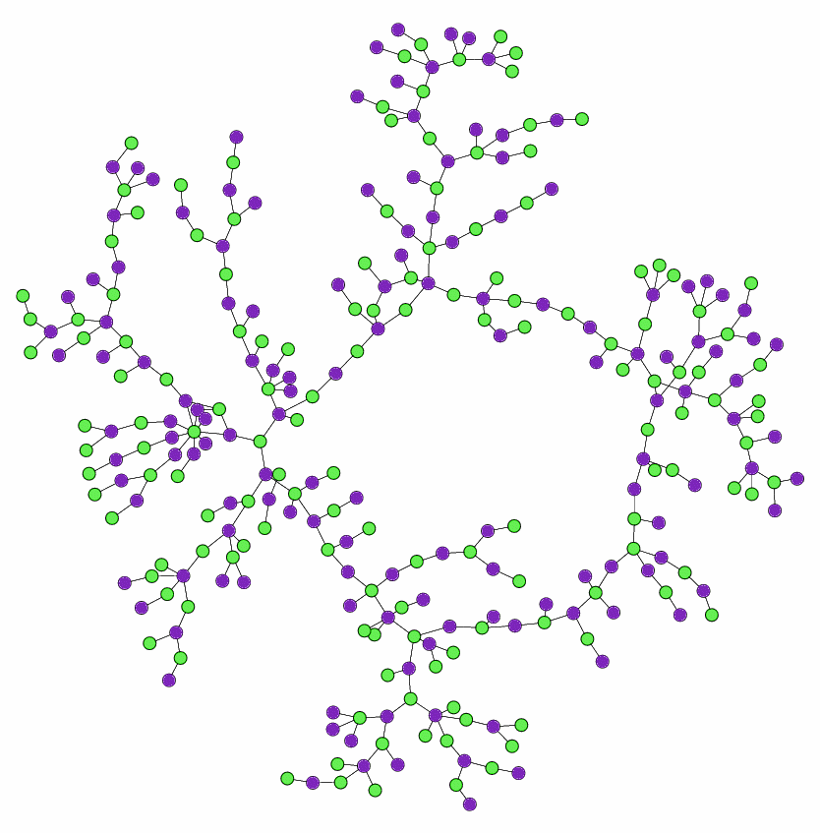
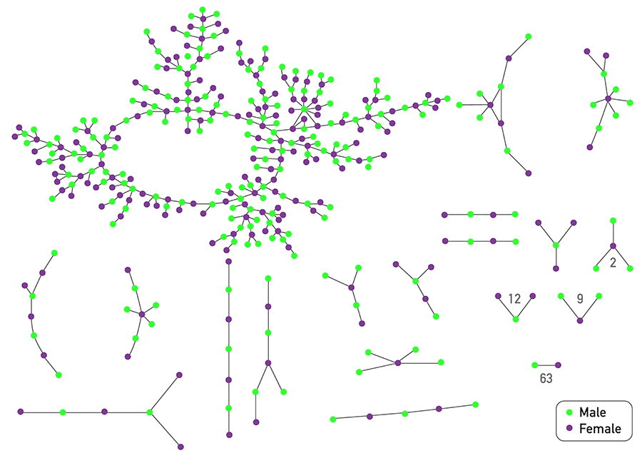
Chains of affection
Early 2000s
Adolescents in high school
A “special romantic relationship” or a “nonromantic sexual relationship” in the past 18 months
Bearman, P. S., Moody, J., & Stovel, K. (2004). Chains of affection: The structure of adolescent romantic and sexual networks. American journal of sociology, 110(1), 44-91.

Slide 16
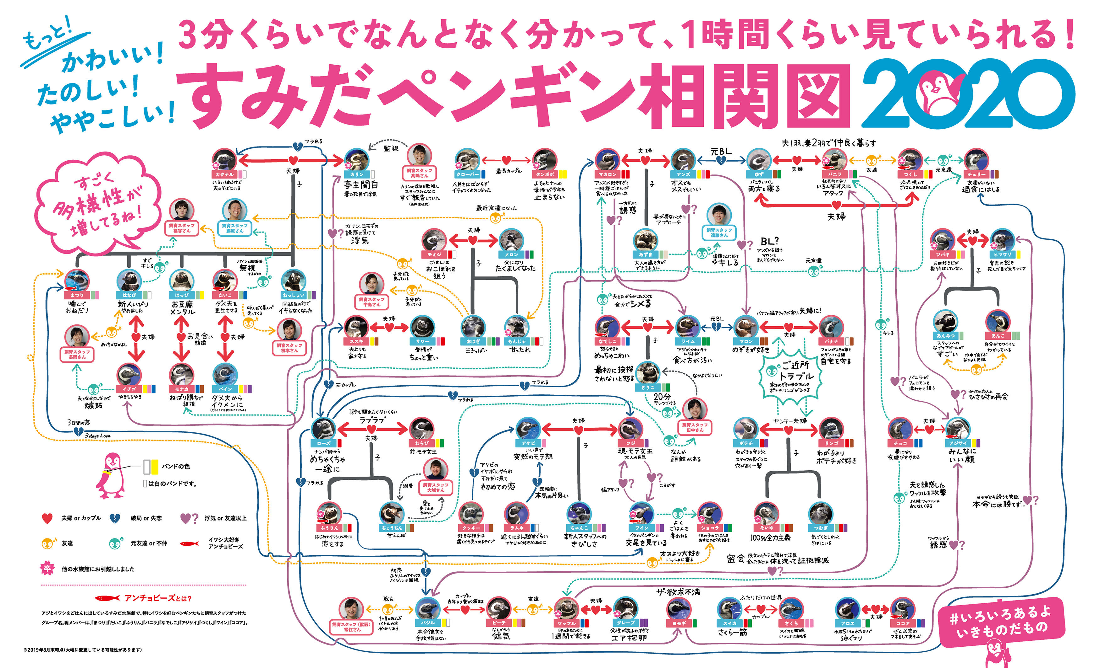
Complex relationships between penguins
Image: https://www.sumida-aquarium.com/

Slide 17
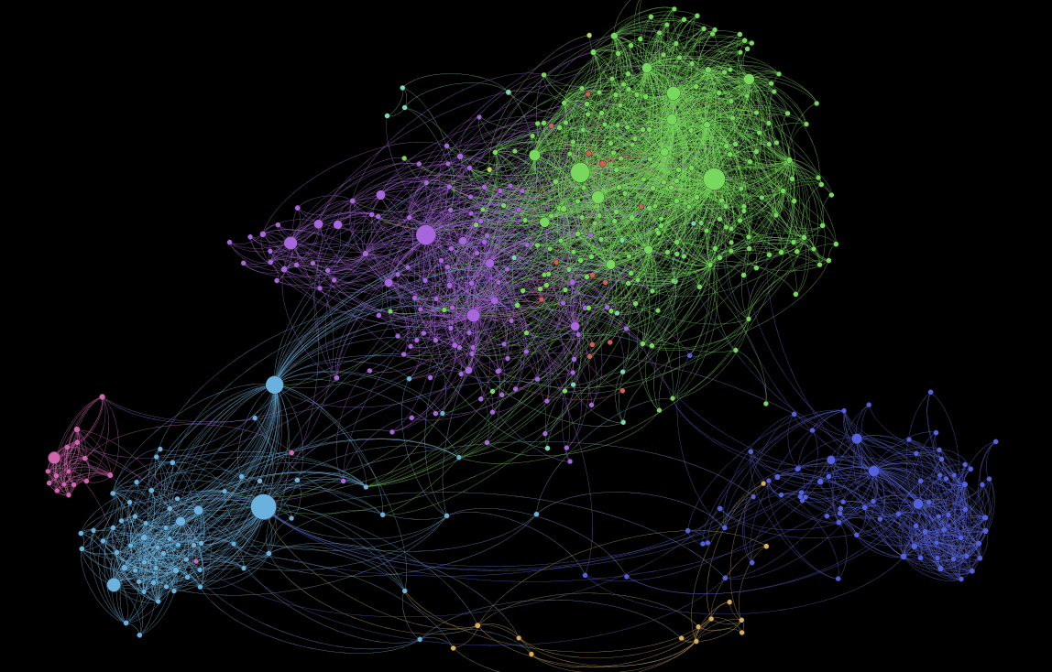
1,000 Somali Users of Facebook
https://kimoquaintance.com/2011/08/22/what-can-we-learn-about-somalis-from-their-facebook-networks/

Slide 18
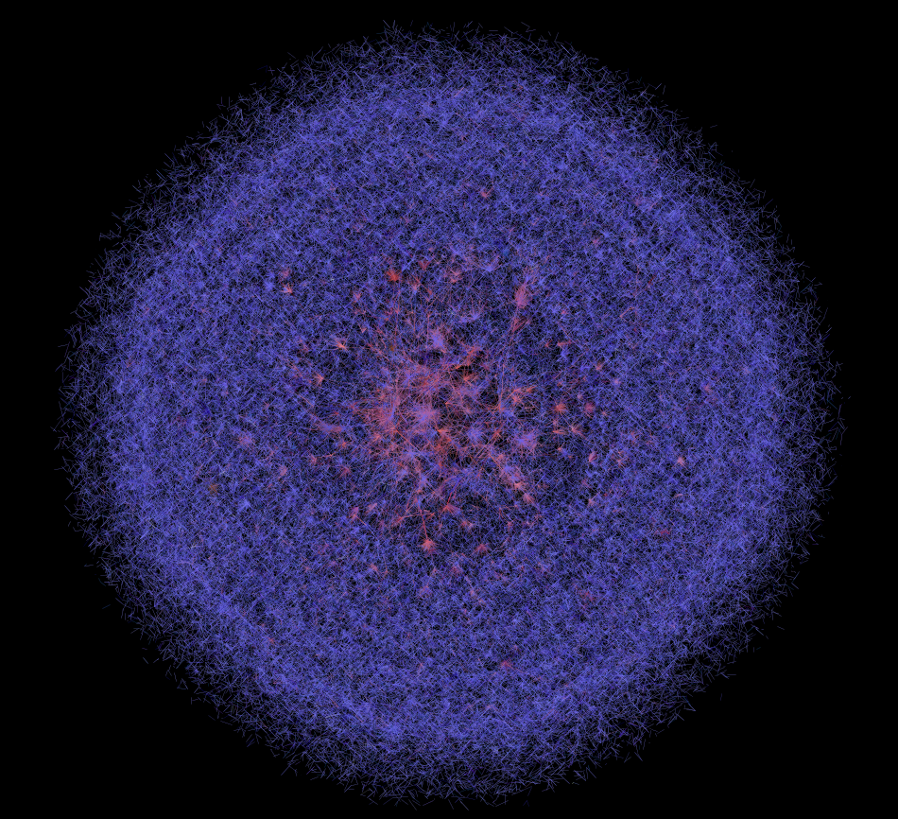
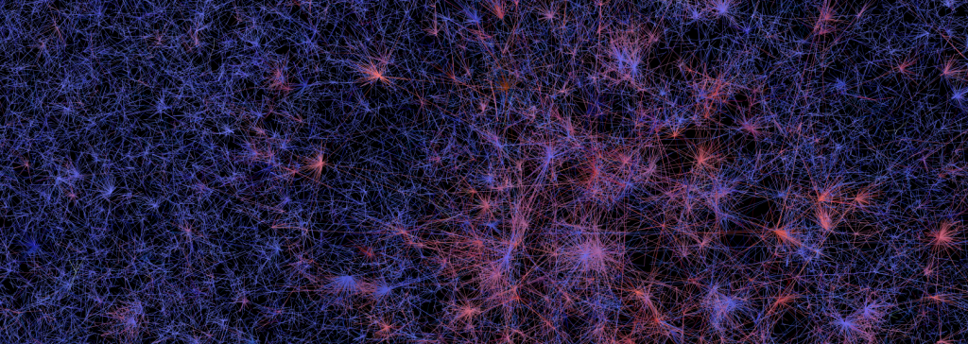
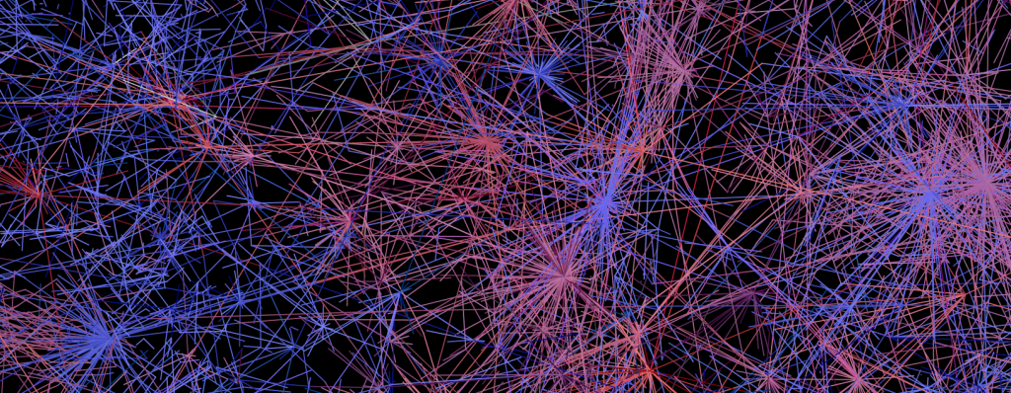
400,000 Twitter Users
https://dhs.stanford.edu/gephi-workshop/twitter-network-gallery/

Slide 19
Exercise
Find examples of networks, just indicating:
  Name
  Number of nodes (approximately)
  Number of edges (approximately)
Answer in Nearpod Collaborate
https://nearpod.com/student/
Code to be given during class

Slide 20
Things to remember
Definitions: complex system, complex network
Examples of complex networks

