Slide 1

Sparsity and Connectivity
Introduction to Network Science
Carlos Castillo
Topic 05

Slide 2
Contents
Degree
Sparsity
Bi-partite networks
Connectedness

Slide 3
Sources
Albert László Barabási: Network Science. Cambridge University Press, 2016.
  Follows almost section-by-section chapter 02
URLs cited in the footer of specific slides

Slide 4
Real networks are sparse
Theoretically
Most real networks are sparse, i.e.,
L is the number of links in the network, N is the number of nodes on it

Slide 5
How sparse are some networks?
Network | |V| | |E| | Max |E|
Zachary’s Karate Club | 34 | 78 | 561
Les Misérables | 77 | 254 | 2962
E-mail exchanges | 868 | 25K | 376K
US companies ownership | 1351 | 6721 | 911K
Marvel comics | 6K | 167K | 17M
https://github.com/chatox/networks-science-course/tree/master/practicum/data

Slide 6

Example: protein interaction network
(N=2K, L=3K)

Slide 7
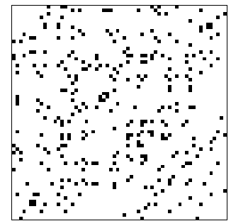

Example: dolphins
(N=62, L=318)
https://www.cise.ufl.edu/research/sparse/matrices/Newman/dolphins.html

Slide 8
Why are networks sparse?
Different mechanisms, think about it from the node perspective:
  How many items could the node be connected to
  Would it be realistic to connect to a large fraction of them?
In social networks, Dunbar’s number (≃150)
https://en.wikipedia.org/wiki/Dunbar's_number

Slide 9
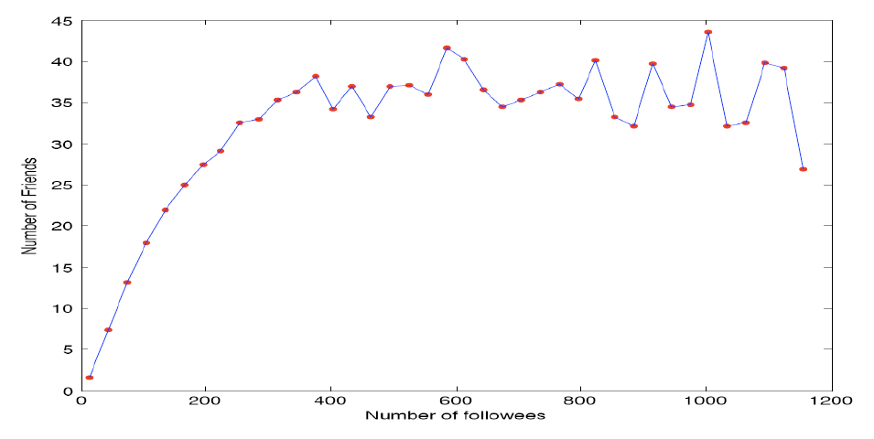
Example: actual friends in Twitter vs people you follow in Twitter
Huberman, B., Romero, D. M., & Wu, F. (2008). Social networks that matter: Twitter under the microscope. First Monday, 14(1).

Slide 10
Weighted networks
In weighted networks, instead of
We have that
Weights may represent different tie strengths

Slide 11
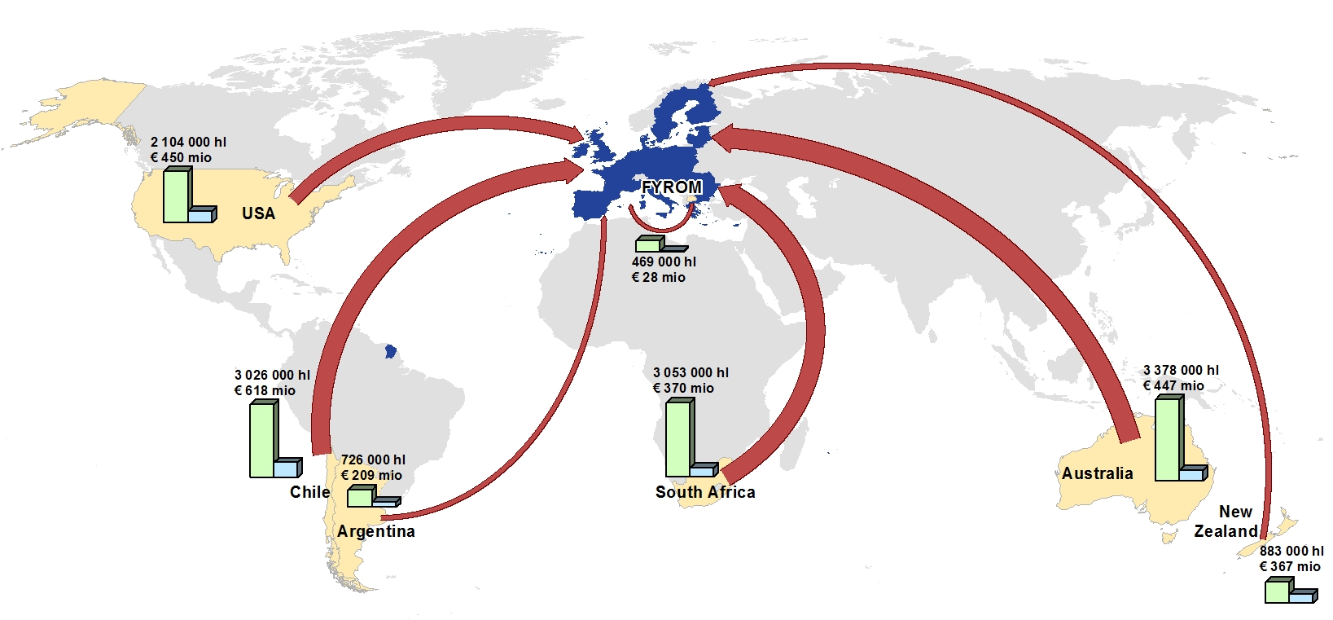
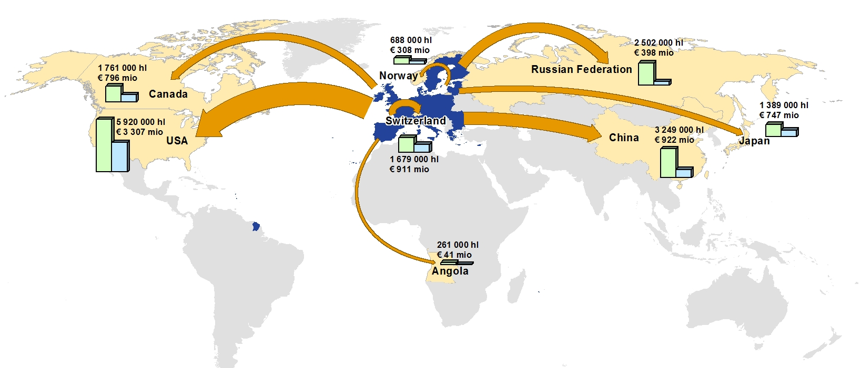
Example: weighted networks
EU imports (top) and exports (bottom) of wine
https://ec.europa.eu/agriculture/wine/statistics_sl

Slide 12
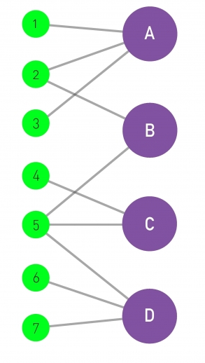
Bipartite networks
A bipartite graph is a graph
G = (V,E) such that

Slide 13
Exercise: project a bipartite network
?
Left projection:
graph where nodes
are 1, 2, …, 7 and
nodes are connected
if they share a
neighbor
?
Right projection:
graph where nodes
are A, B, …, D and
nodes are connected
if they share a
neighbor
Draw in Nearpod Collaborate
https://nearpod.com/student/
Code to be given during class

Slide 14
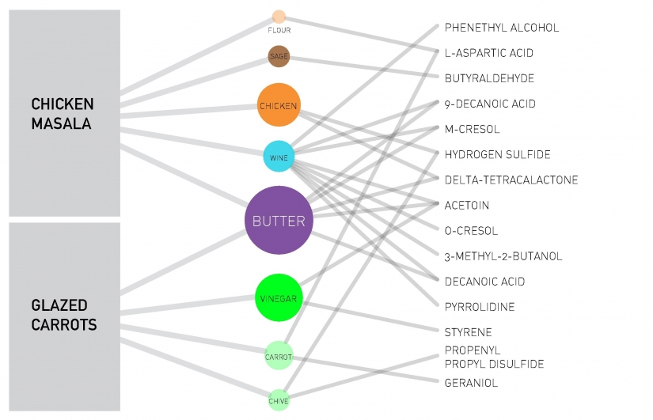
Tripartite network

Slide 15
Clique and Bi-partite clique
A clique is a complete (sub)graph:
An n-clique is a complete graph of n nodes
A bi-partite clique is such that
A (n₁, n₂)-clique is a bipartite clique such that

Slide 16

The word “clique” in popular culture
In some parts of Latin America, a “clika” or “clica” means a close group of friends, sometimes a gang
Photo credit: @astro_jr

Slide 17
Paths and distances

Slide 18
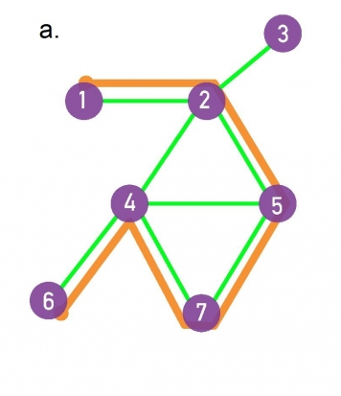
Paths
A path is a sequence of edges from E
The destination of each edge is the origin of the next edge
The length of the path is the number of edges on it
Example: a path marked in orange, having length 5

Slide 19
Connectedness
If a path exists between two nodes i, j:
  those nodes are part of the same connected component
A graph that has only one connected component is called a connected graph

Slide 20
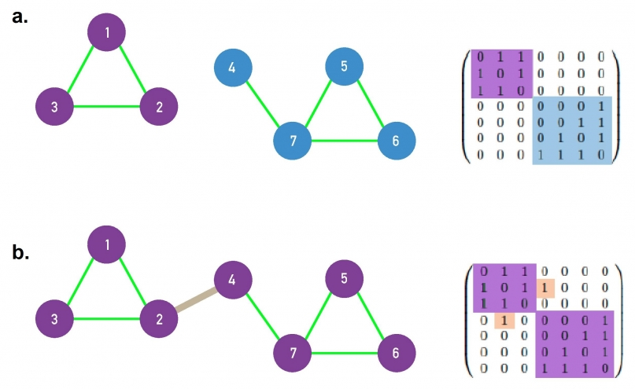
Connected graphs
A disconnected graph has an adjacency matrix that can be arranged in block diagonal form
a. disconnected
b. connected

Slide 21
Distance
If two nodes i, j are in the same connected component:
  the distance between i and j, denoted by d_{ij} is the length of the shortest path between them

Slide 22
Diameter
The diameter of a network is the maximum distance between two nodes on it, d_{max}
The effective diameter (or effective-90% diameter) is a number d such that 90% of the pairs of nodes (i,j) are at a distance smaller than d
The average distance is <d>, and is measured only for nodes that are in the same connected component

Slide 23
Summary

Slide 24
Things to remember
Definitions:
  Degree, in-degree, out-degree
  Bi-partite graph, clique
  Sparse vs dense graph
Distance, diameter, effective diameter
Connected components

Slide 25
Practice on your own
Measure the sparsity of a graph
Compute the distance between two nodes
Compute the diameter of a graph
Identify connected components

