Slide 1

Case study on centrality
Social Networks Analysis and Graph Algorithms
Prof. Carlos Castillo — https://chato.cl/teach

Slide 2
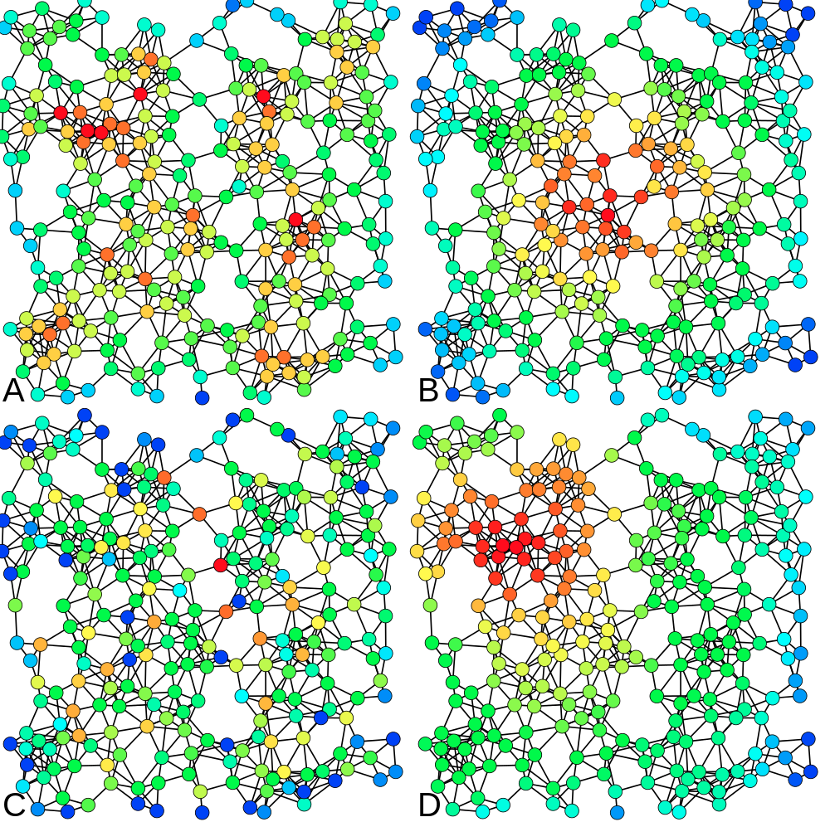
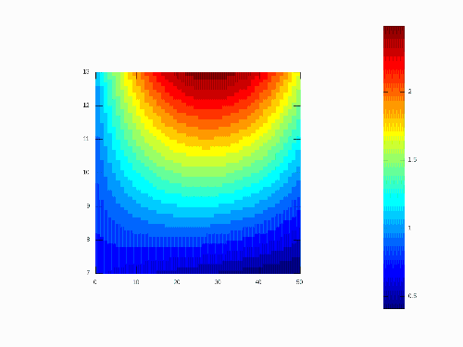
HIGH
A: Degree
B: Closeness
C: Betweenness
D. PageRank
LOW

Slide 3
Florentine families … (TBC)

Slide 4
Summary

Slide 5
Things to remember
...

