Slide 1

Spectral Graph Embedding
Social Networks Analysis and Graph Algorithms
Prof. Carlos Castillo — https://chato.cl/teach

Slide 2
Sources
J. Leskovec (2016). Defining the graph laplacian [video]
E. Terzi (2013). Graph cuts — The part on spectral graph partitioning
D. A. Spielman (2009): The Laplacian
URLs cited in the footer of slides

Slide 3
Graphs are nice, but ...
They describe only local relationships
We would like to understand a global structure
We will try to transform a graph into a more familiar object: a cloud of points in R^{k}
R¹

Slide 4
Graphs are nice, but ...
They describe only local relationships
We would like to understand a global structure
We will try to transform a graph into a more familiar object: a cloud of points in R^{k}
R¹
Distances should be somehow preserved

Slide 5
What is a graph embedding?
A graph embedding (or graph projection) is a mapping from a graph to a vector space
If the vector space is you can think of an embedding as a way of drawing a graph on paper

Slide 6


Exercise: draw this graph
V = {v1, v2, …, v8}
E = { (v1, v2), (v2, v3), (v3, v4), (v4, v1), (v5, v6), (v6, v7), (v7, v8),
(v8, v5), (v1,v5), (v2, v6), (v3, v7), (v4, v8) }
Draw this graph on paper, upload a photo
What constitutes a good drawing?
Padlet: https://upfbarcelona.padlet.org/chato/3hwnctvqb7p1z6xx

Slide 7


Example drawings
Look at the 3 neighbors of each corner, they should all be at the same distance
Distances are not preserved well

Slide 8
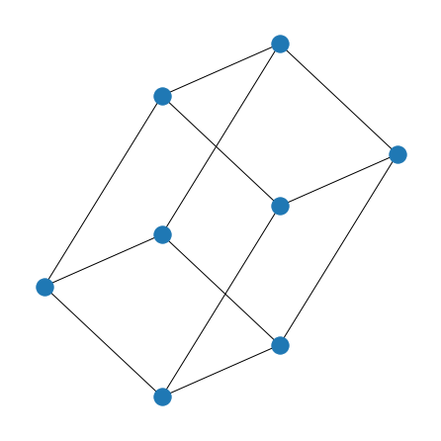
2D graph embeddings in NetworkX
import matplotlib.pyplot as plt
import networkx as nx
G = nx.hypercube_graph(3)
display(list(G.edges()))
[((0, 0, 0), (1, 0, 0)),
((0, 0, 0), (0, 1, 0)),
((0, 0, 0), (0, 0, 1)),
((0, 0, 1), (1, 0, 1)),
((0, 0, 1), (0, 1, 1)),
((0, 1, 0), (1, 1, 0)),
((0, 1, 0), (0, 1, 1)),
((0, 1, 1), (1, 1, 1)),
((1, 0, 0), (1, 1, 0)),
((1, 0, 0), (1, 0, 1)),
((1, 0, 1), (1, 1, 1)),
((1, 1, 0), (1, 1, 1))]
plt.figure(figsize=(6,6))
nx.draw_spectral(G)
_ = plt.show()

Slide 9
In a good graph embedding ...
Pairs of nodes that are connected to each other should be close
Pairs of nodes that are not connected should be far
Compromises will need to be made

Slide 10
Random projections

Slide 11
Random graph projection (2D)
Start a BFS from a random node, that has x=1, and nodes visited have ascending x
Start a BFS from another random node, which has y=1, and nodes visited have ascending y
Project node i to position (x_{i}, y_{i})

Slide 12

Exercise: random projection
Given this graph
Pick a random node u
  Distances from u are the x positions
Pick a random node v
  Distances from v are the y positions
Draw the graph in an plane
a
e
b
f
c
g
d
h
i
Padlet: https://upfbarcelona.padlet.org/chato/9pd56scbpko5svdj

Slide 13
Answer (Random nodes: e, c)
(2,2)
a
e
(0,2)
b
(3,1)
(1,1)
f
(3,1)
c
g
(2,0)
d
(4,2)
(3,1)
h
(5,3)
i

Slide 14

Answer (Random nodes: e, c)
0
1
2
3
4
5
(2,2)
a
e
(0,2)
0
c
b
(3,1)
(1,1)
f
f
g
(3,1)
c
g
1
b
(2,0)
d
d
(4,2)
(3,1)
h
2
e
a
h
(5,3)
i
3
i

Slide 15
Refresher about eigenvectors/eigenvalues

Slide 16
Eigenvectors and eigenvalues
In general Av = λv means A has an eigenvector v of eigenvalue λ
In symmetric matrices, eigenvectors are orthogonal
Suppose λ1 ≠ λ2
This implies

Slide 17
In symmetric matrices
The multiplicity of an eigenvalue λ is the dimension of the space of eigenvectors of eigenvalue λ
Every n x n symmetric matrix has n eigenvalues counted with multiplicity
Hence, it has an orthonormal basis of eigenvectors

Slide 18
Rayleigh quotient
In symmetric matrices M, the second eigenvalue is
https://en.wikipedia.org/wiki/Rayleigh_quotient

Slide 19
Eigenvectors of the adjacency matrix

Slide 20
Properties of adjacency matrix
How many non-zeros are in every row of A?
https://www.youtube.com/watch?v=AR7iFxM-NkA

Slide 21
Adjacency matrix of G=(V,E)
Can you write yi using E ?
https://www.youtube.com/watch?v=AR7iFxM-NkA

Slide 22
Adjacency matrix of G=(V,E)
What is Ax? Think of x as a set of labels/values:
Ax is a vector whose i^{th} coordinate contains the sum of the x_{j} who are in-neighbors of i
https://www.youtube.com/watch?v=AR7iFxM-NkA

Slide 23
Spectral graph theory ...
Studies the eigenvalues and eigenvectors of a graph matrix
  Adjacency matrix
  Laplacian matrix (next)
Suppose graph is d-regular:
What is the value of
What does that imply?

Slide 24
An eigenvector of a d-regular graph
Suppose graph is d-regular, i.e. all nodes have degree d:
Hence, [1, 1, …, 1]^{T} is an eigenvector of eigenvalue d

Slide 25
Disconnected graphs
Suppose the graph is regular and disconnected
Then its adjacency matrix has block structure:
S
S'

Slide 26
Disconnected graphs
Suppose the graph is regular and disconnected
S
S'

Slide 27
Disconnected graphs
Suppose the graph is regular and disconnected
S
S'

Slide 28
Disconnected graphs
Suppose the graph is regular and disconnected
What is the multiplicity of eigenvalue d?
What happens if there are more than 2 connected components?
S
S'

Slide 29
In general
Disconnected graph
Almost disconnected graph
Small “eigengap”

Slide 30
Graph Laplacian

Slide 31
Adjacency matrix
1
5
2
6
3
4

Slide 32
Degree matrix
1
5
2
6
3
4

Slide 33
Laplacian matrix
1
5
2
6
3
4
Given A is symmetric, L is symmetric.
They only differ in the diagonal.

Slide 34
Laplacian matrix L = D - A

Slide 35
The constant vector is an eigenvector of L
The constant vector x=[1,1,...,1]^{T} is an eigenvector of the Laplacian, and has eigenvalue 0
Does it need to be this specific graph? Why?
Does it need to be the vector [1, 1, …, 1]? Why?

Slide 36
If the graph is disconnected
If the graph is disconnected into two components, the same argument as for the adjacency matrix applies, and
The multiplicity of eigenvalue 0 is equal to the number of connected components

Slide 38
Prove this!
Prove that
Think of this quantity as the “stress” produced by the assignment of node labels x

Slide 39
Proof

Slide 40
Proof (detail)
Example
a
b
c
Node u appears in this sum ku times
The degree of node u is the number of times it is one of the ends of an edge in E

Slide 41
As shown before, the constant vector is one of the eigenvectors of L, with eigenvalue 0
If x is such that xi = xj for all i,j:
This means the constant vector is an eigenvector of L with eigenvalue 0

Slide 42
The eigenvector x of λ=0 is the constant vector if the graph is connected
If x is the eigenvector of eigenvalue 0, Lx = 0
Then
From this, we deduct that xi = xj for any pair i, j
even if i and j are not directly connected by an edge. Why?

Slide 43
The eigenvector x of λ=0 is the constant vector if the graph is connected
If x is the eigenvector of eigenvalue 0, Lx = 0
Then
Hence, for any pair of nodes (i,j) connected by an edge, xi = xj
Given the graph is connected, there is a path between any two nodes ⇒
  for any pair of nodes (i,j), even the ones not connected by an edge, xi = xj
Hence x is a constant vector

Slide 44
All the eigenvalues of the Laplacian are non-negative
If v is an eigenvector of L of eigenvalue λ:
This means all eigenvalues λ are non-negative

Slide 45
In summary, the
Laplacian matrix L = D - A
Is symmetric, eigenvectors are orthogonal
Has N eigenvalues that are non-negative
0 is one eigenvalue
The multiplicity of eigenvalue 0 equals the number of connected components of the graph

Slide 46
The second eigenvector of the Laplacian in a connected graph

Slide 47
x^{T}Lx and graph cuts
Suppose (S, S') is a cut of graph G
Set
1
1
0
1
0

Slide 48
Remember
For symmetric matrices
https://en.wikipedia.org/wiki/Rayleigh_quotient

Slide 49
Second eigenvector
Orthogonal to the first one:
Normal:

Slide 50
The second eigenvalue tells us how well the graph can be partitioned into two
+1/4
—1/3
—1/3
+1/4
+1/4
If the graph is divided into two connected components of sizes N1 and N2, the optimal x is:
+1/4
—1/3
xi = +1/N1 for nodes in one component, and
xi = -1/N2 for nodes in the second component
Nodes should be placed at both sides of 0 because

Slide 51
The second eigenvalue tells us how well the graph can be partitioned into two
If the graph is connected but almost partitioned into two component, the optimal x should have values similar to each other in each partition
0
Nodes should be placed at both sides of 0 because

Slide 52
Example Graph 1
2
7
1
8
3
6
4
5

Slide 53
Example Graph 1 (second eigenvalue of L)
2
7
1
8
3
6
4
5

Slide 54
Example Graph 1, projected in R¹
2
7
1
8
3
6
4
5
-0.383
-0.247
0
0.247
0.383

Slide 55
Example Graph 1, communities
S
S'
2
7
1
8
3
6
4
5
-0.383
-0.247
0
0.247
0.383

Slide 56
Example Graph 2
2
7
1
8
3
6
4
5

Slide 57
Example Graph 3
2
7
1
8
3
6
4
5

Slide 58
Example Graph 3, projected (where to cut?)
2
8
7
1
3
6
4
5
-0.364
-0.246
-0.057
0
0.139
0.551
-0.210

Slide 59
Example Graph 3, projected (where to cut?)
S
S'
2
8
7
1
3
6
4
5
-0.364
-0.246
-0.057
0
0.139
0.551
-0.210

Slide 60

A graph with two communities in
Second eigenvector
Ordered from smaller to larger value
https://www.youtube.com/watch?v=jpTjj5PmcMM

Slide 61

A graph with four communities in
Second eigenvector
Ordered from smaller to larger value
https://www.youtube.com/watch?v=jpTjj5PmcMM

Slide 62
Application: graph drawing

Slide 63

A graph with four communities in
Second eigenvector
Third eigenvector
Value in third eigenvector
Value in second eigenvector
https://www.youtube.com/watch?v=jpTjj5PmcMM

Slide 64
A graph with four communities in R² (cont)
Second eigenvector
Third eigenvector
This can be used to draw the graph in R²
Value in third eigenvector
Value in second eigenvector
https://www.youtube.com/watch?v=jpTjj5PmcMM

Slide 65
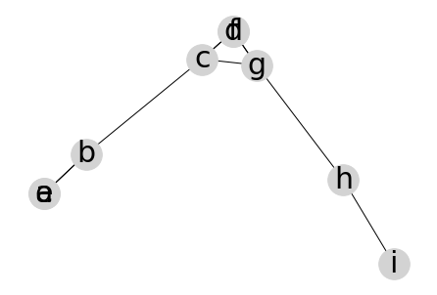
The graph from the initial exercise
d=f
a
e
b
f
c
value in third eigenvector
g
d
h
a=e
i
value in second eigenvector
Input nodes and edges
Spectral embedding

Slide 66

Exercise: spectral projection
Write the Laplacian
Get the second and third eigenvector
Obtain projection
a
f
b
e
c
d
Link to spreadsheet: https://upfbarcelona.padlet.org/chato/shyq9m6f2g2dh1bw

Slide 67
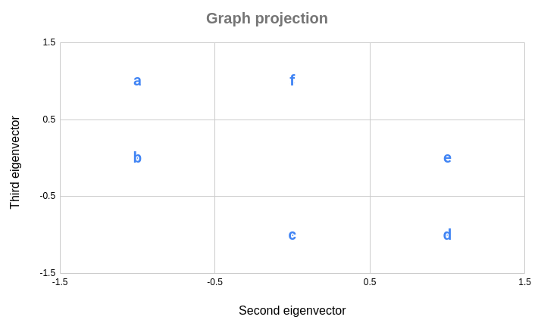
Answer: spectral projection
a
f
b
e
c
d

Slide 68
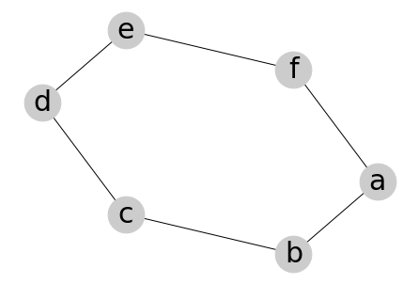
Answer: spectral projection (Python)
import networkx as nx
G = nx.from_edgelist([('a', 'b'), ('b', 'c'), ('c', 'd'), ('d', 'e'), ('e', 'f'), ('f', 'a')])
nx.draw_spectral(G, with_labels=True, font_size=30, node_size=1500, node_color='#ccc')
a
f
b
e
c
d

Slide 69
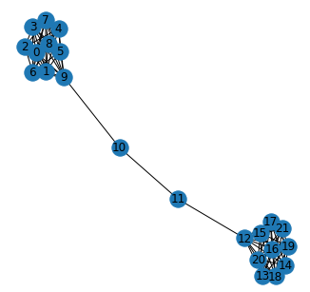
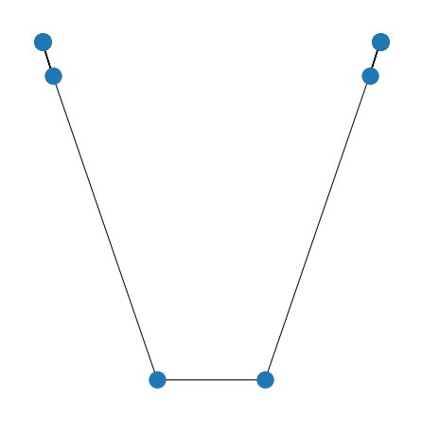
A barbell graph in R² (code)
B = nx.barbell_graph(10,2)
plt.figure(figsize=(6,6))
nx.draw_networkx(B)
_ = plt.show()
plt.figure(figsize=(6,6))
nx.draw_spectral(B)
_ = plt.show()
Graph Laplacian

Slide 70

Dodecahedral graph in 3D
g = nx.dodecahedral_graph()
pos = nx.spectral_layout(g, dim=3)
network_plot_3D_alt(g, 60, pos)
https://www.idtools.com.au/3d-network-graphs-python-mplot3d-toolkit/

Slide 71
Application: spectral clustering

Slide 72
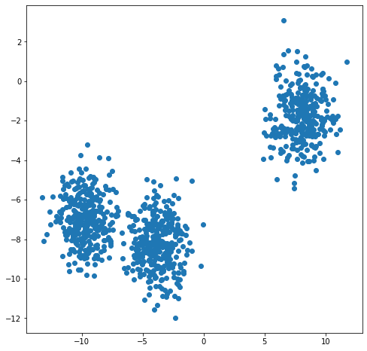
Generating data
from sklearn.datasets import
make_blobs
N = 1000
x, _ = make_blobs(
n_samples=N,
centers=3,
cluster_std=1.2)
plt.figure(figsize=(8,8))
plt.scatter(x[:,0], x[:,1])
plt.show()

Slide 73
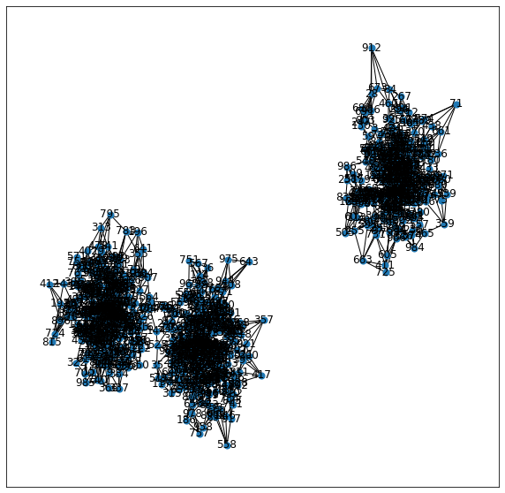
Connect nodes to k=5 nearest neighbors
from sklearn.neighbors
import NearestNeighbors
nbrs = NearestNeighbors(
n_neighbors=6, # includes self
algorithm='ball_tree')
.fit(x)
distances, neighbors =
nbrs.kneighbors(x)
G = nx.Graph()
for neighbor_list in neighbors:
source_node = neighbor_list[0]
for target_index in range(1,
len(neighbor_list)):
target_node = neighbor_list[target_index]
G.add_edge(source_node, target_node)

Slide 74
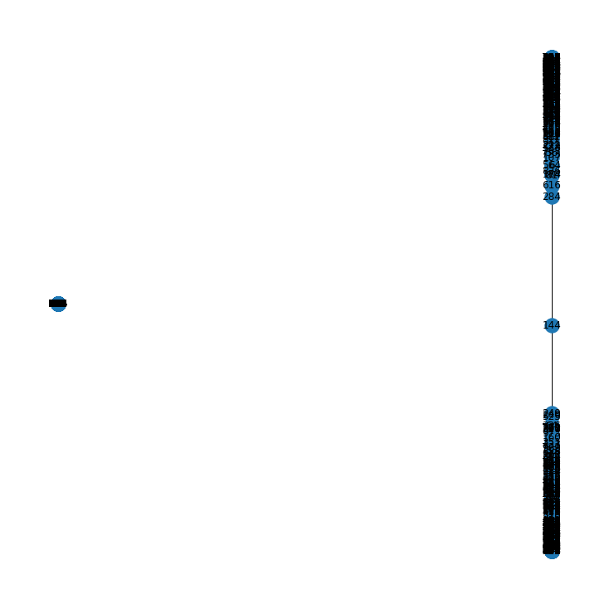
Perform spectral embedding
nx.draw_spectral(G, with_labels=True)

Slide 75
Perform spectral embedding
nx.draw_spectral(G, with_labels=True)

Slide 76
Summary

Slide 77
Things to remember
Graph Laplacian
Laplacian and graph components
Spectral graph embedding

Slide 78
Exercises for this topic
Mining of Massive Datasets (2014) by Leskovec et al.
  Exercises 10.4.6

